Slide 1
AI IN HEALTHCARE · HIGH-RISK PROJECT · SP 2026
VLM-Powered Concept
Bottleneck Models for
A diagnosis that explains which clinical concept drove it and where the disparity on darker skin really sits.
Dermatology
with a Fitzpatrick Skin-Tone Fairness Audit
Deepesh Khanna
University of Texas at Austin
UID : dk32786
github.com/deepesh002/vlm-cbm-derm-fairness
Notes:
Welcome. This is an AI-in-Healthcare high-risk project on a vision-language model powered Concept Bottleneck Model for dermatology, audited for Fitzpatrick skin-tone fairness.
Dermatology AI underperforms on darker skin; current audits stop at accuracy-level numbers with no handle on WHICH clinical feature drives the gap.
This project builds a diagnosis that explains itself through 9 human-readable concepts and audits fairness at the concept layer as well as the diagnosis layer.

Slide 2
MOTIVATION
Why this project and what we set out to answer
The problem
Research questions
Skin-cancer classifiers underperform on darker skin (Daneshjou et al., 2022)
Grad-CAM shows where the model looked, not what it understood.
Fairness audits stop at accuracy and there is no handle on which clinical feature drives the gap.
Concept Bottleneck Models route every prediction through a handful of auditable concepts but have never been evaluated for skin-tone fairness.
Q1
Can a concept-driven head match a deep baseline on melanoma classification?
Q2
Do errors concentrate in specific Fitzpatrick skin-tone buckets?
Q3
Do concept interventions rescue misdiagnoses and which concepts matter?
Q4
Are CBM explanations quantitatively more faithful than Grad-CAM?
VLM-CBM Dermatology · Fitzpatrick Fairness Audit
Deepesh Khanna · UT Austin
2
Notes:
The clinical starting point for this project is that dermatology AI underperforms on darker skin as per the 2022 Science Advances paper by Daneshjou.
Saliency methods like Grad-CAM tell you where the model looked but not what it understood and that matters for a clinician audit.
And standard fairness audits stop at diagnosis accuracy; they give you a gap number with no remediation handle.
Concept Bottleneck Models let you route every prediction through a handful of named clinical concepts, and my thesis is that doing so at scale lets us audit fairness at the concept layer, not just the output layer.
On the right, the four research questions we are trying to answer.

Slide 3
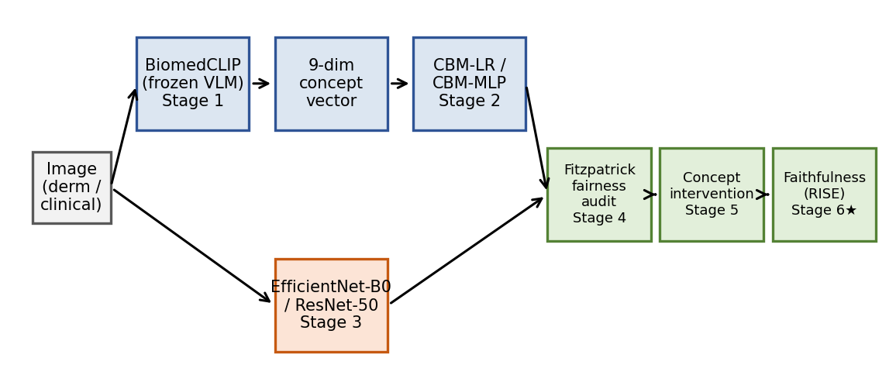
METHOD
End-to-end pipeline
1
Concept prediction
Frozen BiomedCLIP → 9 dermoscopic concepts via prompt pairs
2
CBM head
Sparse L₁ logistic regression on the concept probabilities
3
Baselines
EfficientNet-B0 & ResNet-50 on HAM10000 with Grad-CAM
4
Fairness audit
Per-concept & per-bucket AUROC, Spec, ECE, EOG, DPG
5
Concept intervention
Correct one concept at a time → measure rescue rate
6
Faithfulness ★
Insertion / deletion curves: concepts vs pixels
VLM-CBM Dermatology · Fitzpatrick Fairness Audit
Deepesh Khanna · UT Austin
3
Notes:
Now, Let’s walkthrough the pipeline.
Two prediction tracks share the same input: the CBM track (top, blue boxes) passes the image through a frozen BiomedCLIP in Stage 1, producing a 9-dimensional concept probability vector; one probability per ABCDE or 7-point-checklist concept.
Stage 2 is a sparse L1 logistic regression head that maps those 9 numbers to a melanoma-vs-benign decision.
In parallel (bottom, orange), Stage 3 is an EfficientNet-B0 and a ResNet-50 fine-tuned directly on HAM10000, with Grad-CAM for explanation.
Both tracks feed three evaluation stages on the right:
Stage 4 stratifies every metric by Fitzpatrick bucket;
Stage 5 simulates concept interventions replacing a single VLM concept with ground truth and measuring rescue;
Stage 6 is a bonus faithfulness analysis comparing concepts vs pixels on the insertion/deletion metric.

Slide 4
DATA
Four cohorts, four roles
Dataset | Size | Role in the audit | Fitzpatrick coverage
HAM10000 | 10,015 | Primary training for EfficientNet-B0 & ResNet-50 baselines | Unlabeled (assumed light-skin skew)
Derm7pt | 1,011 (294 pos) | CBM cross-validation + per-concept AUROC audit | No Fitzpatrick labels
DDI | 656 (171 pos) | Fairness audit, expert-Fitzpatrick gold standard | Light I-II · Medium III-IV · Dark V-VI
Fitzpatrick17k | 4,320 used | Pooled with DDI for the fairness audit (n = 4,976) | Self-reported + ITA-corrected Fitz I-VI
Why the pooled cohort matters. DDI alone gives a 100-sample dark-skin bucket; pooling Fitzpatrick17k lifts it to n = 618 and stabilises every per-bucket metric. Bucket counts (light / medium / dark): 2,518 / 1,840 / 618.
VLM-CBM Dermatology · Fitzpatrick Fairness Audit
Deepesh Khanna · UT Austin
4
Notes:
For datasets we have Four cohorts with four roles.
HAM10000 is the workhorse training set; that's where the EfficientNet and ResNet baselines live.
Derm7pt is the concept-supervised set, so that's where the CBM head is cross-validated with 5-fold stratified CV and where the per-concept AUROCs come from. DDI is the fairness gold standard with 656 images,
Fitzpatrick labels are assigned by expert dermatologists and Fitzpatrick17k contributes another 4,320 images to the fairness audit, pooled with DDI for a combined 4,976 cohort.
Pooling matters because DDI alone gave us a 100-sample dark-skin bucket and the bootstrap CIs swamped the point estimates; now we have 618 dark images, and the per-bucket numbers are stable.

Slide 5
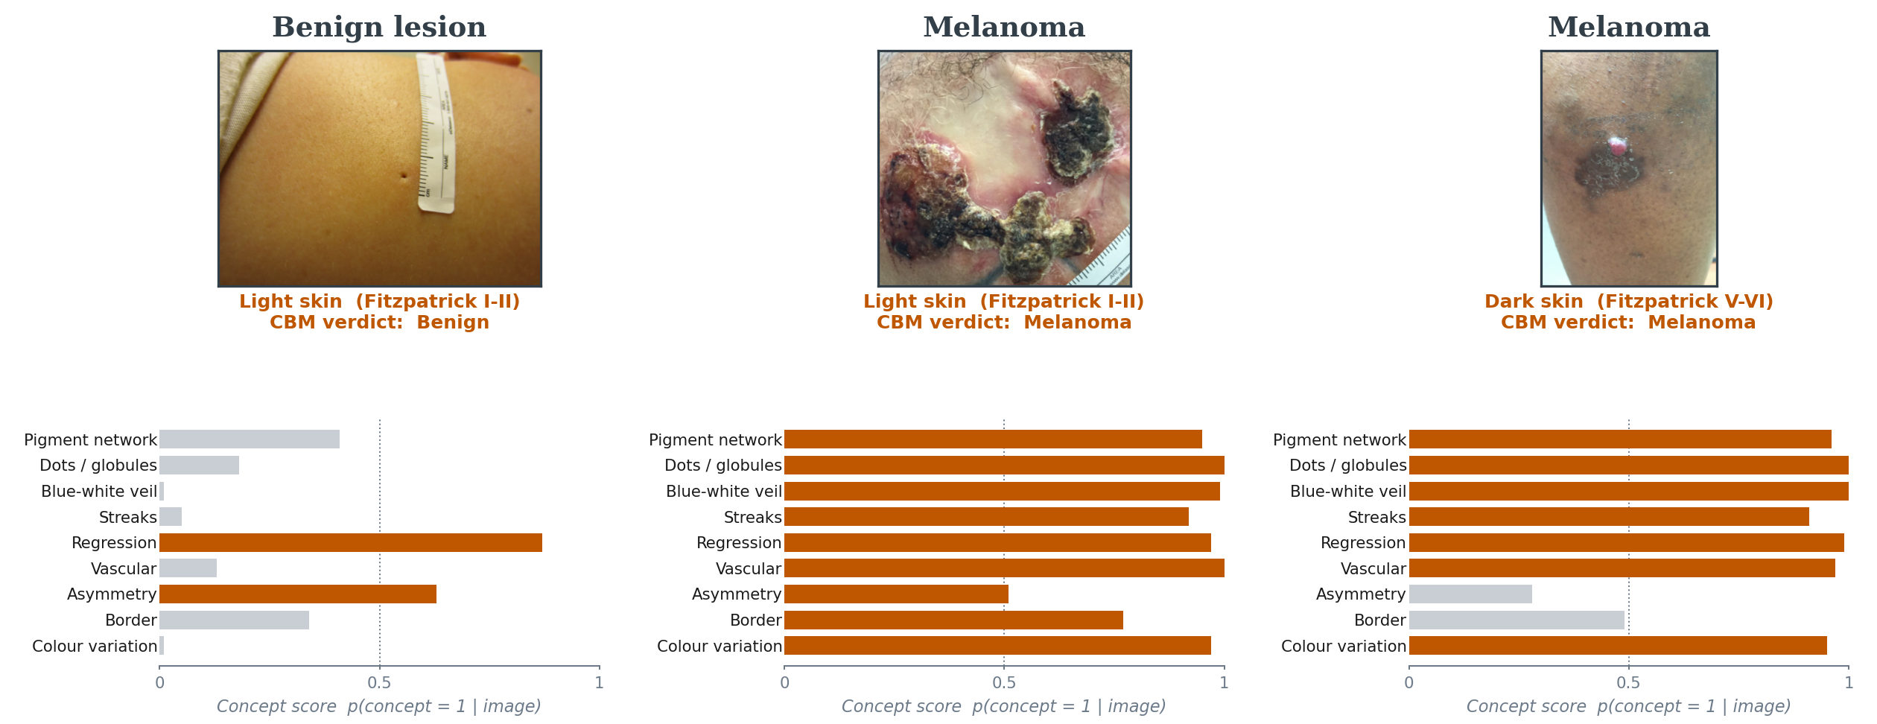
WORKED EXAMPLE
How the CBM reads a dermoscopy image
Read left-to-right. For every image, BiomedCLIP emits a probability per concept; the sparse head fires only when the right ones light up.
VLM-CBM Dermatology · Fitzpatrick Fairness Audit
Deepesh Khanna · UT Austin
5
Notes:
Now let’s look at the three real DDI images in the top row. Their nine-dimensional concept vector is plotted below each.
Left: a benign lesion on light skin; the CBM sees low blue-white veil, low colour variation, low streaks; only regression fires, which the head treats as protective, and it correctly calls it benign.
Middle: a melanoma on light skin which is almost every diagnostic concept lights up at 0.9+ and the head calls melanoma.
Right: a melanoma on dark skin in which the concept vector is essentially identical to the light-skin melanoma, which is reassuring on its own;
the fairness story on the next slide is NOT that the model stops seeing melanoma on dark skin, it's that its operating point shifts.

Slide 6
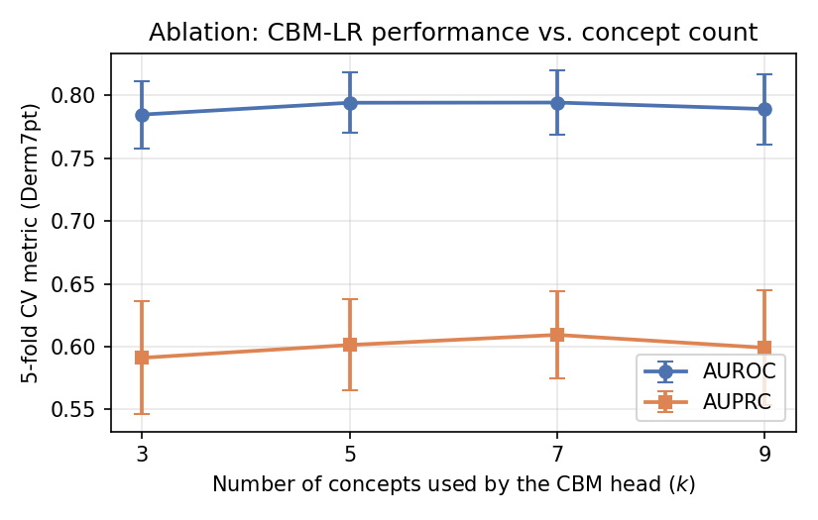
Q1 · ACCURACY
A 3-concept head matches a 9-concept model and a deep MLP
Concept-count ablation
0.79
AUROC
5-fold CV on Derm7pt · ± 0.03
CBM-MLP head 0.79 —> statistically indistinguishable
Top-3 concepts only 0.785 —> within 0.01 of the full 9
Takeaway. Three concepts saturate the head and this is the lever Q3 pulls on.
VLM-CBM Dermatology · Fitzpatrick Fairness Audit
Deepesh Khanna · UT Austin
6
Notes:
Our first questions was (Q1): can an interpretable concept-driven head match a deep baseline?
Yes. We achieved AUROC of 0.79, plus-or-minus 0.03, on 5-fold stratified Derm7pt CV.
The MLP head is statistically indistinguishable with 0.79 as well.
A more interesting finding on the right is the concept-count ablation.
I ranked concepts by absolute head-weight and retrained with only the top k.
Performance saturates at k = 3: colour variation, blue-white veil, pigment network together reach 0.785, within 0.01 of the full nine.
Beyond k = 5 the curve is flat.
This is not just trivia; it tells us the head is effectively 3-concept, which is why fixing one concept in Q3 rescues so many errors and Collapses the interpretability-vs-accuracy trade-off commonly claimed against CBMs.

Slide 7
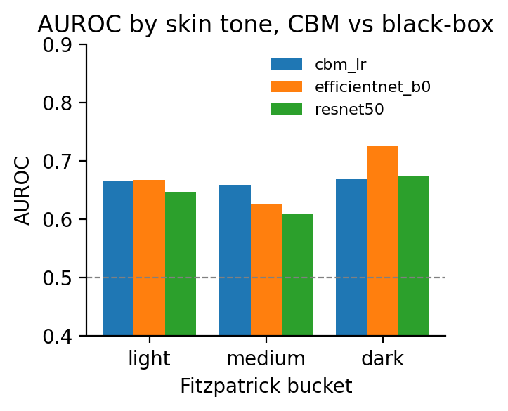
Q2 · THE FAIRNESS TWIST
AUROC parity is not fairness
AT FIRST GLANCE
BUT THEN
AUROC looks flat across skin tones
Specificity & calibration disagree
Bucket
AUROC
Spec.
ECE
Light I-II
0.67
0.58
0.080
Medium III-IV
0.66
0.56
0.103
Dark V-VI
0.67
0.45
0.178
Δ specificity light → dark: −0.13
Δ ECE light → dark: +0.098
Equalised-odds gap: CBM 0.133 > EffNet 0.098 > ResNet 0.051
CBM-LR 0.67 / 0.66 / 0.67 AUROC light / medium / dark
The head over-calls positives on dark skin rather than missing them and a clinically material fairness failure mode that AUROC alone hides.
VLM-CBM Dermatology · Fitzpatrick Fairness Audit
Deepesh Khanna · UT Austin
7
Notes:
Now comes The fairness twist.
On the LEFT is the 'good news' panel.
Per-bucket AUROC is 0.67, 0.66, 0.67 across light, medium, and dark which means it is essentially flat, and all three models (CBM, EfficientNet, ResNet) look comparable. If I stopped here we'd conclude we have a fair model.
Now look RIGHT. Same data, two other metrics the audit also tracks. Specificity drops 13 percentage points from 0.58 on light skin to 0.45 on dark skin and expected-calibration error more than doubles, from 0.08 to 0.18.
The dark-skin row is highlighted in orange.
The equalised-odds gap confirms the pattern: CBM-LR's gap of 0.133 is actually LARGER than the deep baselines; not because the CBM is less ranked-fair, but because the sparse linear head moves its operating point across buckets.
Looking at the clinical translation: the head over-calls positives on darker skin rather than missing them.
False positives mean unnecessary biopsies and that's a real cost.
This is what AUROC alone hides and what the concept layer is built to localise.

Slide 8
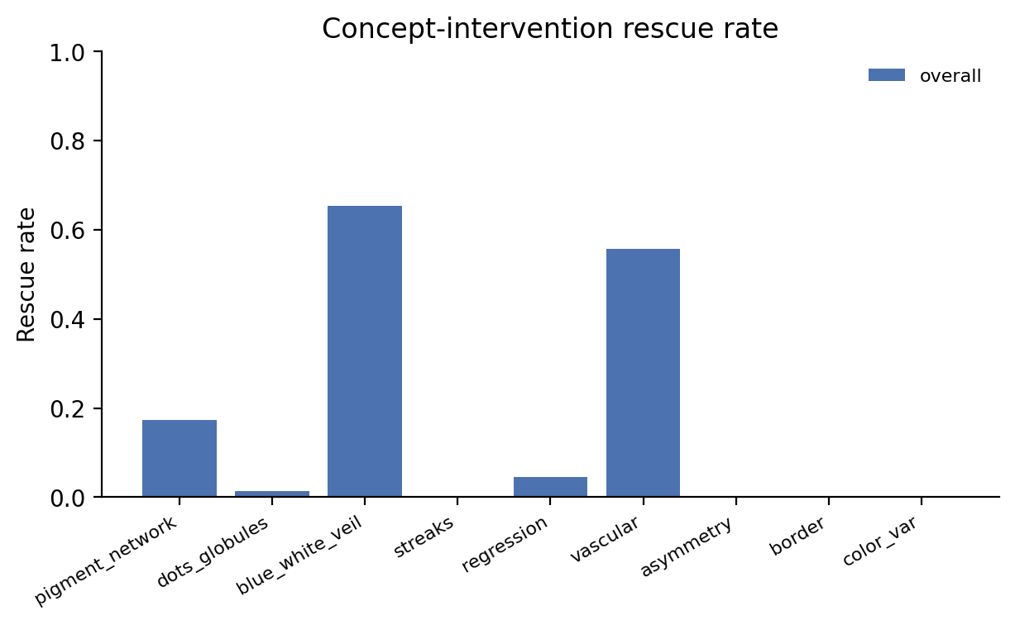
Q3 · INTERVENTION
One concept fix rescues 85.8 % of CBM errors
85.8%
of CBM errors rescued by correcting ONE concept
86.5 % with two concepts corrected
Error budget lives in the concepts, not in the head. Targeted concept retraining is the next highest-yield step.
65.4 %
55.7 %
17.3 %
Blue-white veil
Vascular
Pigment network
VLM-CBM Dermatology · Fitzpatrick Fairness Audit
Deepesh Khanna · UT Austin
8
Notes:
The next question is the concept-intervention oracle simulates what happens if a clinician corrects one of the 9 concepts on a misclassified image.
Out of 289 CBM misclassifications on held-out folds, 85.8% are fixed by correcting a single concept. 86.5% by correcting two.
The chart on the right breaks this down per concept.
One concept, blue-white veil, alone fixes 65.4% of errors which is two-thirds of the entire error budget.
Vessels fix another 56%.
Pigment network fixes 17%.
This is the ACTIONABLE part of the audit.
The clinical story is to collect more blue-white-veil labels on Fitzpatrick V-VI imagery, fine-tune the BiomedCLIP prompt or its text encoder on that targeted concept, and we expect to close the dominant part of the specificity and ECE gap from the previous slide without retraining the diagnosis head. That's a much smaller data-collection ask than rebuilding the whole classifier.

Slide 9
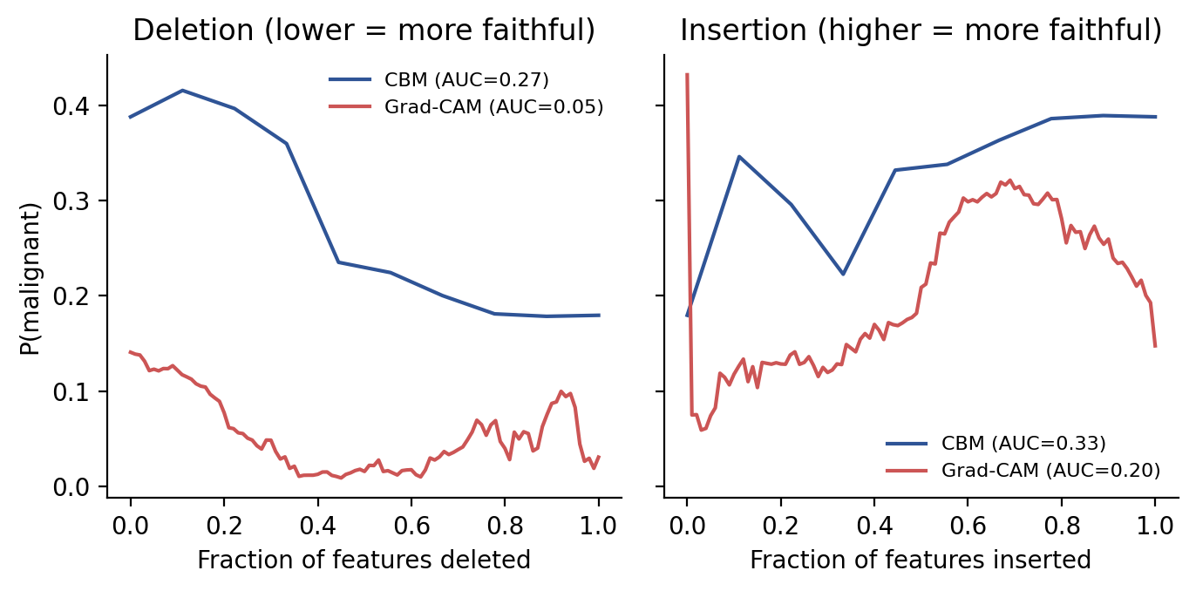
Q4 · FAITHFULNESS
Concepts beat Grad-CAM on insertion
CBM concepts
0.33
Insertion AUC (higher is more faithful)
dominant explanation
Grad-CAM
0.20
Insertion AUC (baseline saliency method)
insertion-AUC loss = 0.13
Deletion AUC is confounded by calibration differences and insertion is the decisive comparison.
VLM-CBM Dermatology · Fitzpatrick Fairness Audit
Deepesh Khanna · UT Austin
9
Notes:
For this next question, I reintroduce the top-ranked features one at a time (by head-weight for CBM, by Grad-CAM importance for pixels) and measure how fast the melanoma probability recovers.
Higher AUC on insertion is more faithful.
CBM concepts score 0.33, Grad-CAM 0.20 and the concepts win by a wide margin.
The insertion-AUC gap of 0.13 means the top-ranked concepts recover most of the model's decision when reintroduced, whereas saliency-only heatmaps do not.
Deletion is a worse comparison here because Grad-CAM has lower baseline probabilities which is a known confound against calibrated methods and so I rely on insertion as the decisive metric.

Slide 10
HONEST ACCOUNTING
Limitations and next steps
Limitations
Future directions
VLM zero-shot concepts are noisy
1
Targeted concept retraining
Prompt-pair softmax is a weak concept classifier
Re-label blue-white-veil + pigment on Fitzpatrick V-VI imagery
Concept-layer audit still DDI-only
Fitz17k has no dermoscopic concept GT and the concept heatmap is unchanged
2
Per-bucket head recalibration
Temperature / Platt scaling on dark-skin examples closes the ECE gap
Fitz17k labels are self-reported
Self-report + ITA correction, not expert-annotated like DDI
3
Learned linear probe on BiomedCLIP
Pooled bootstrap CIs not regenerated
Quantify prompt-design vs. representation error
Per-bucket CIs were DDI-only; pooled CIs are a clean next step
The CBM architecture turns a fairness gap into a concept-retraining task and not a dataset-collection moonshot.
VLM-CBM Dermatology · Fitzpatrick Fairness Audit
Deepesh Khanna · UT Austin
10
Notes:
Now let’s look at some of the limitations.
First: the VLM concepts are noisy; the two-class prompt-pair softmax is a weak classifier relative to a trained detector.
Second: the concept-layer audit is still DDI-only because Fitz17k ships no dermoscopic concept ground truth; adding Fitz17k strengthened the diagnosis-layer audit but not the concept heatmap.
Third: Fitz17k Fitzpatrick labels are self-reported plus ITA correction, not expert-annotated like DDI.
Fourth: pooled bootstrap CIs were not regenerated; that's a clean next step.
On the right, the three future directions that follow mechanically from the audit:
targeted concept retraining on blue-white veil;
per-bucket head recalibration to close the ECE gap without retraining the VLM;
and a learned linear probe on BiomedCLIP features to quantify how much of the concept-detection error is prompt-design vs representation.

Slide 11
CONTRIBUTIONS
Four takeaways from this audit
1
Interpretable accuracy
CBM-LR matches the MLP head (AUROC 0.79 on Derm7pt) and the top-3 concepts alone reach 0.785.
2
AUROC parity hides the real gap
On 4,976 pooled images AUROC is flat (0.67 / 0.66 / 0.67) but specificity drops 13 pts and ECE doubles on dark skin.
3
Concept intervention localises the error budget
85.8 % of errors fix on one concept; two-thirds via blue-white veil which is a directly actionable remediation target.
4
Faithful-by-construction explanations
Insertion fidelity 0.33 vs Grad-CAM 0.20 shows that the concept layer carries decision signal saliency cannot surface.
Thank you
Notes:
Finally, the Four takeaways are:
interpretable accuracy matches the deep baseline;
AUROC parity hides the real skin-tone gap;
concept intervention localises 85% of the error budget onto one or two concepts;
and the concept layer is more faithful than Grad-CAM on insertion.
Thank you.

