Slide 1




Better software. Better outcomes. Better healthcare.
MISSION: to ensure that all people, regardless of race, socioeconomic status or geographic location, have access to high-quality medical care through the donation of free, open source medical software and service relating to that software.
Siva Prasad Sahoo
Shruti Pareek
Nikhil P Naik
Deepesh Puthran

Slide 2
Objective
The objective of the system is to facilitate patients to schedule an appointment with a relevant healthcare provider for consultation with a doctor and for the healthcare providers to manage their daily activities for hassle free services such as managing appointments, payments, patients healthcare records online, etc

Slide 3
Requirement Analysis
Due to the increasing complexity and cost of providing health care, there is an ever increasing emphasis on managing the health care process.
The process extends from an individual presenting a health concern to a health care provider and continues through diagnosis, therapeutic selection, resource selection, treatment, and follow-up.
This process extends through booking an appointment, managing patients appointments, online payment process, etc.
So there is a need to develop a system that embodies the above functionality which takes care of the above requirements.

Slide 4
Processes involved here are:
Patient can check slots based on various illness types. If the patient is not able to make it after scheduling an appointment, he must have the option of rescheduling the appointment or cancelling it.
Once the appointment is made, healthcare provider would follow up with patient, prioritizing emergency cases.
Patient can pay online using credit card or health insurance account.
After the appointment is complete, patient can view his prescriptions and health records online.

Slide 5
Development Methodologies
For developing this system Agile methodology is implemented where the requirements are broken down based on functionalities in various releases.
Each release spans 4-5 iterations. Each iteration spans for 2 weeks.
A cross functional team consisting of developers, testers and business analysts is formed.
Once the development along with all the cycles of testing is completed a demo is scheduled with user for their feedback.
Based on the users feedback further enhancements are either made in the same release or will be pushed to the future releases.

Slide 6
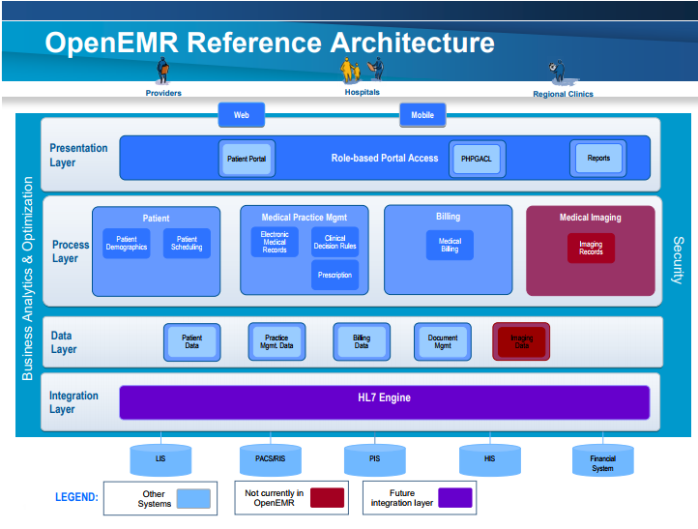
Architecture Overview
The OpenEMR consists of the three-tiered webpage design pattern-
Presentation Layer: On the basis of the role users such as patient and Healthcare providers can access the application( Web or Mobile)
Process Layer: This layer will process the functionality or the business logic of the application
Data Layer: This layer will persist the data and provide and API for Process layer to access, modify or update the data avoiding any dependency on storage mechanism.
*Integration Layer- This is the future layer suggestion for the system.

Slide 7
Security
Security for this system is implemented by providing role based access which protects data in the system from inappropriate access. Role-based access control allows access to certain data objects based on three aspects of security: the user requesting access, the object being requested, and the role of the user.

Slide 8
User Interface
The user interface is web-based, making it easier to secure and access for users, as well as being more familiar to them.

Slide 9
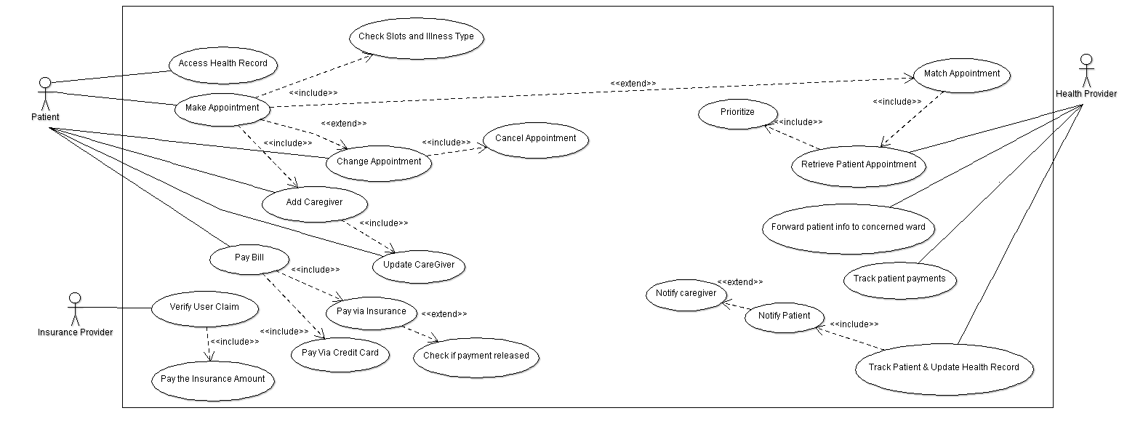
Use case diagram

Slide 10
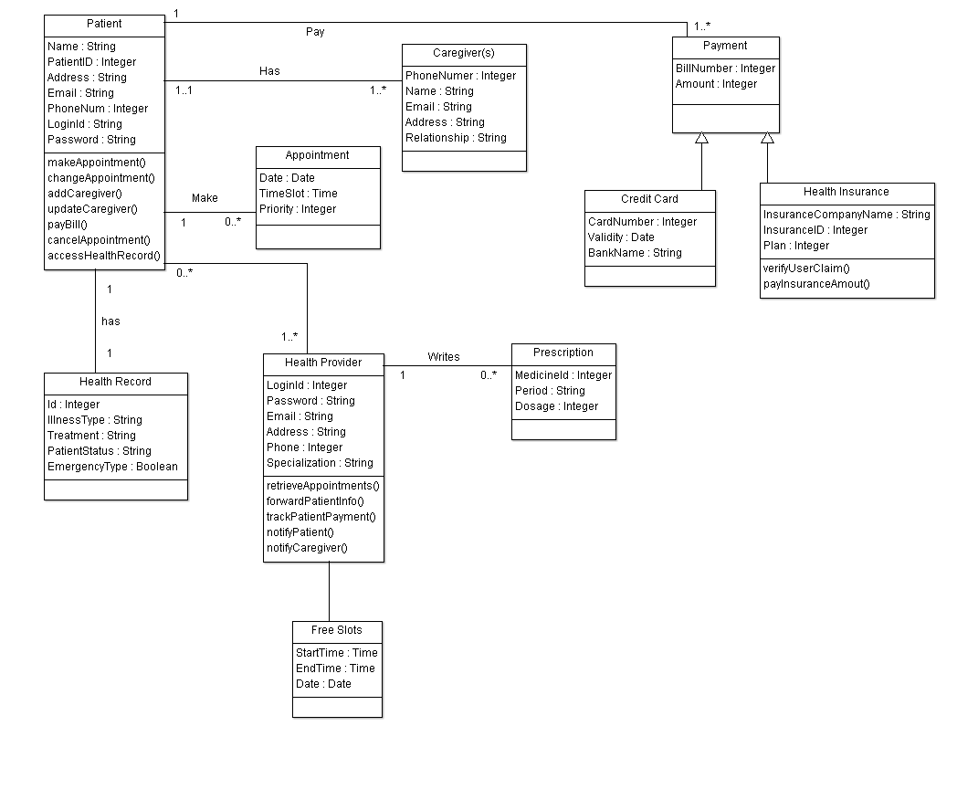
Class diagram

Slide 11
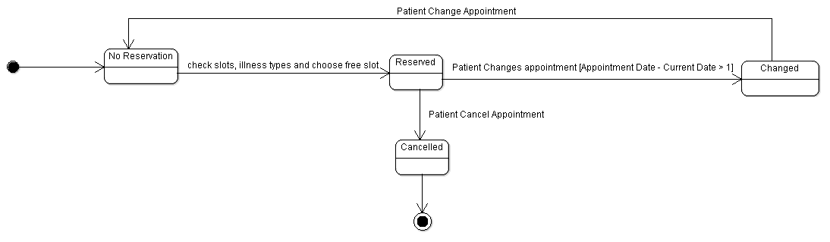
State Chart Diagram
For Booking Appointment

Slide 12
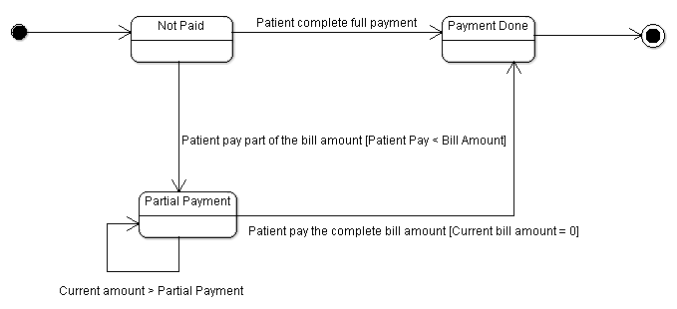
State Chart Diagram
For making payment

Slide 13
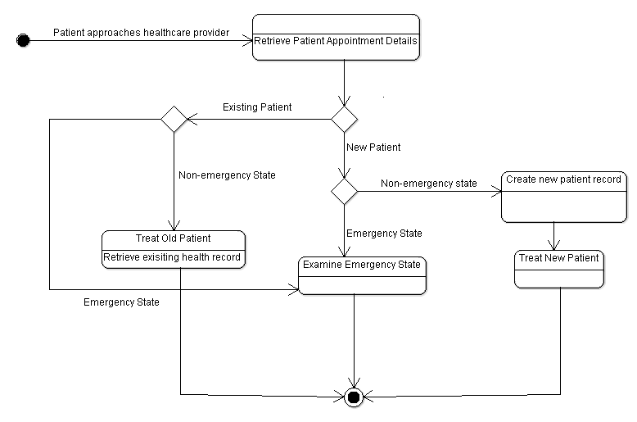
State Chart Diagram
Health Provider

Slide 14
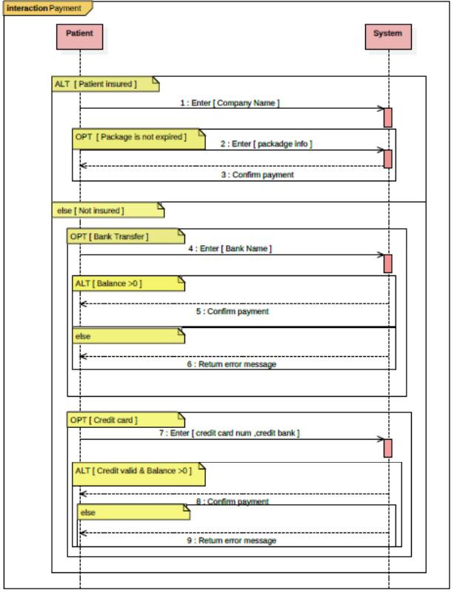
Sequence Diagram
Payments

Slide 15
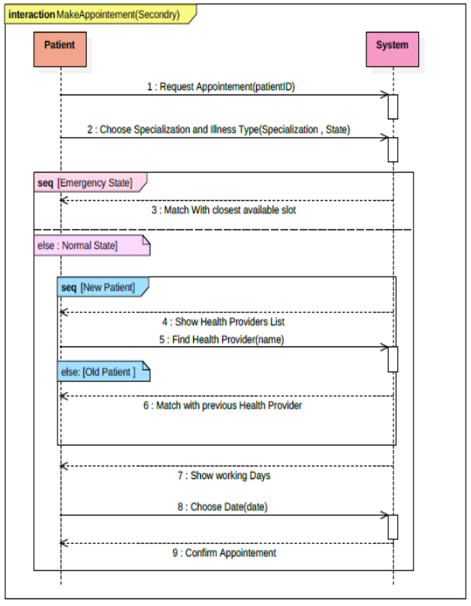
Sequence Diagram
Making
Appointment

Slide 16
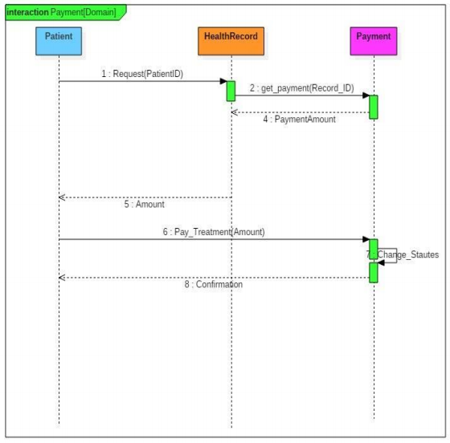
Domain Model Diagram
Payments

Slide 17
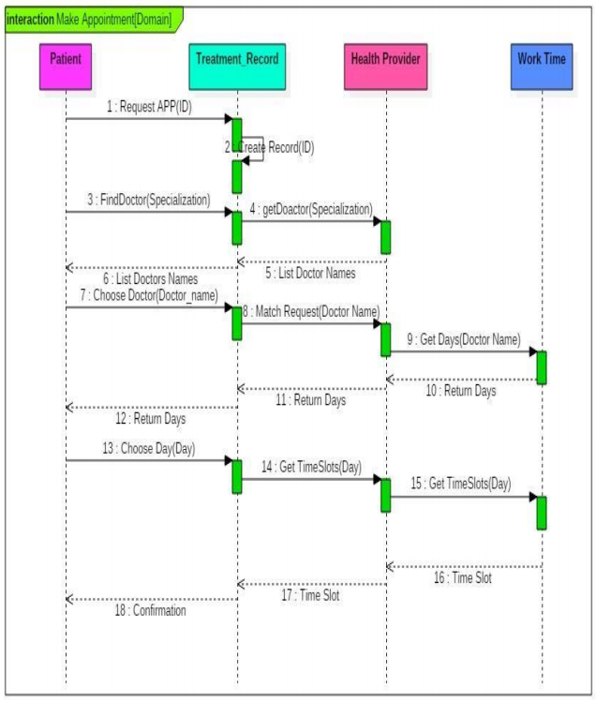
Domain Model Diagram
Scheduling Appointment

Slide 18
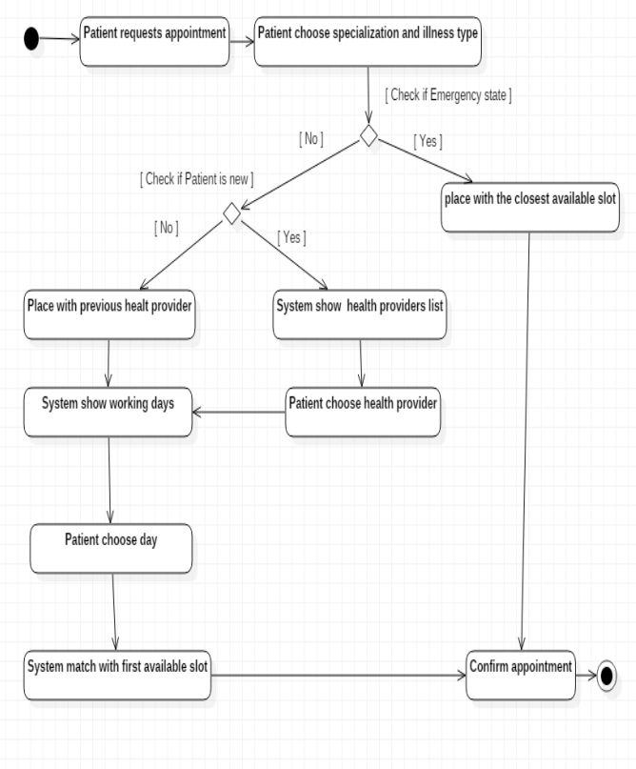
ACTIVITY DIAGRAMS
Create Appointment

Slide 19
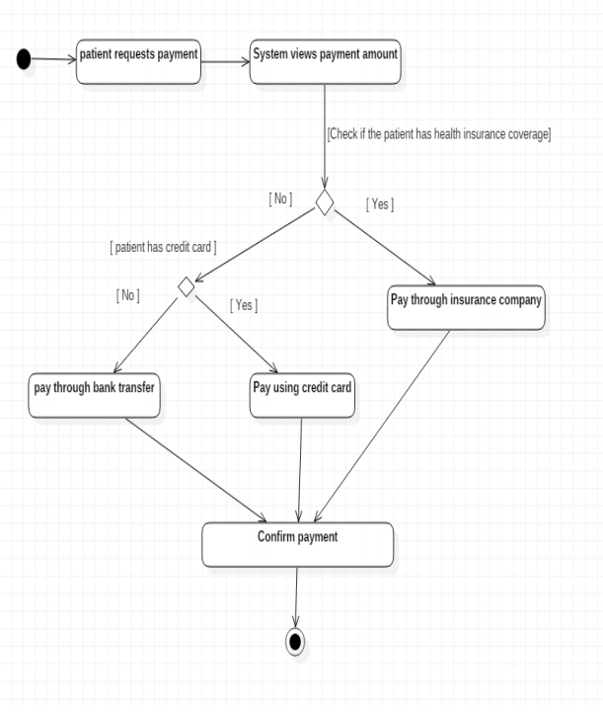
ACTIVITY DIAGRAMS
Make Payment

Slide 20
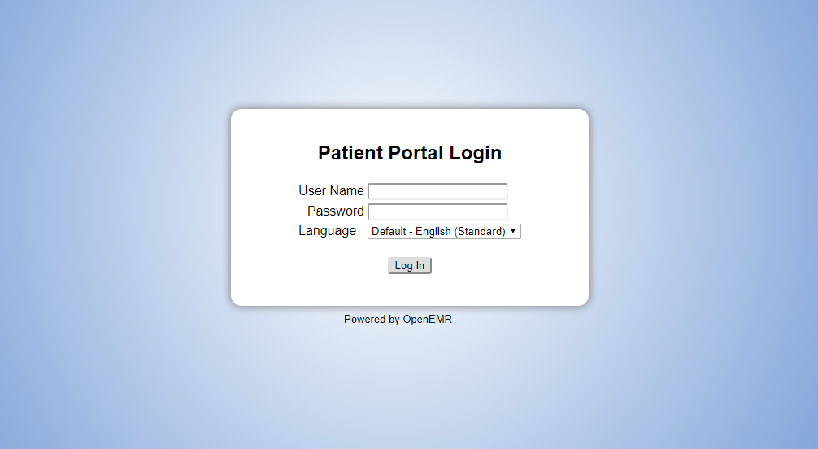
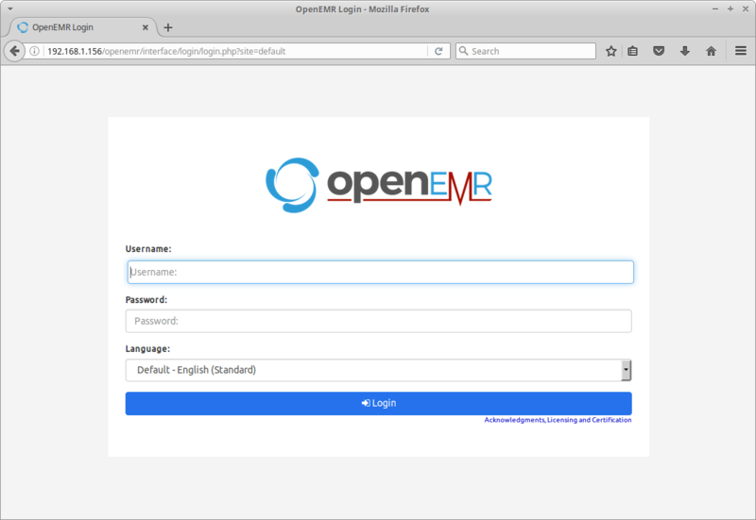
As you land on the website, Login!
Patient Login
Healthcare Provider Login

Slide 21
Automation Testing
To run the test suite, we can run the ‘phpunit’ command.
It will create and drop a database named "openemr_test_suite" that it uses for testing purposes
The test suite consists of a collection of PHP classes defined in the "Tests" directory of the distribution
Each time a new commit is made to the source code repository, a continuous integration server runs the test suite on the new code base

Slide 22
Recommendation/Suggestion
The OpenEMR is a bundled PHP script which needs to be manually installed on the system by the user. In absence of an in-house server administrator, it is cumbersome to deploy the application successfully even on the local machine.
A good cloud provider can distribute a cloud-based service solution to those who are really after it. A nominal monthly/yearly fee can be charged for providing a production grade solution, that comes packed with great backup, security and reliability features.
Another suggestion that can be made is that of creating intelligent chart summary.
Some key algorithms can be put together to summarize the most essential and crucial parts of a patient’s timeline including his health reports and other prescriptions.

Slide 23
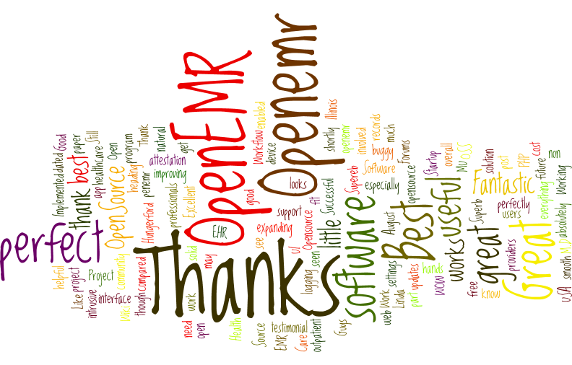
Time for Q&A

Slide 24
REFERENCES
http://www.open-emr.org
http://www.open-emr.org/wiki/index.php/OpenEMR_Wiki_Home_Page
https://www.uml-diagrams.org/examples/hospital-domain-diagram.html
http://www.open-emr.org/wiki/index.php/Database_Structure
https://www.lucidchart.com/pages/uml/activity-diagram
http://www.agilemodeling.com/artifacts/classDiagram.htm
https://www.slideshare.net/harshjegadeesan/lecture-domain-modeling-presentation
http://www.open-emr.org/wiki/index.php/OpenEMR_Features
http://www.open-emr.org/wiki/index.php/OpenEMR_5.0.0_XAMPP_Package_Installation
https://www.ibm.com/developerworks/rational/library/3101.html
https://www.lucidchart.com/pages/uml/sequence-diagram
https://www.youtube.com/watch?v=5zaJChAHF7A
http://www.open-emr.org/wiki/index.php/OpenEMR_Demo

