Slide 1

Data mining
BITCOIN Market analysis
Deepesh Puthran
Siva Prasad Sahoo
Shruti Pareek
Nikhil P Naik

Slide 2
Contents
Introduction
Data Set Evaluation
Data Field Description
Data Preprocessing
Bitcoin market analysis using tableau
Bitcoin price forecast using time series analysis with prophet using python
Bitcoin trend analysis using j48 and Multilayer perceptron algorithms
Summary

Slide 3
INTRODUCTION
BITCOIN is a web-based “Cryptocurrency" used to move money around quickly and anonymously with no need for a central authority.
There are two main approaches for doing market analysis of Bitcoin which are fundamental analysis and technical analysis.
While fundamental analysis examines the underlying forces of an economy, a company or a security, technical analysis attempts to forecast the direction of prices based on past market data, primarily historical prices and volumes found on price charts.
Here we are doing Bitcoin Market Analysis using the later approach.

Slide 4
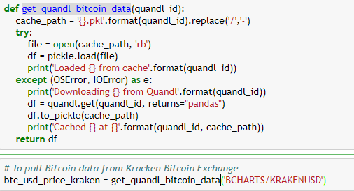
Data Set Evaluation
The Bitcoin pricing data is extracted using the Quandl’s free Bitcoin API using python

Slide 5
Data Field Description
Date: Date of observation
Open: Opening price on the given day
High: Highest price on the given day
Low: Lowest price on the given day
Close: Closing price on the given day
Volume(BTC): Volume of transactions on the given day in Bitcoins
Volume(Currency): Volume of transactions on the given day in US dollars
Weighted price: Weighted price of transaction on the given day.
Trend: Tread shows whether the price has increased or decreased on a given day with respect to its opening price.

Slide 6
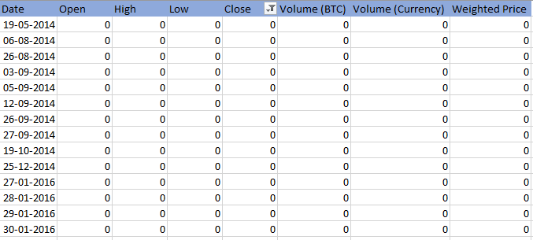
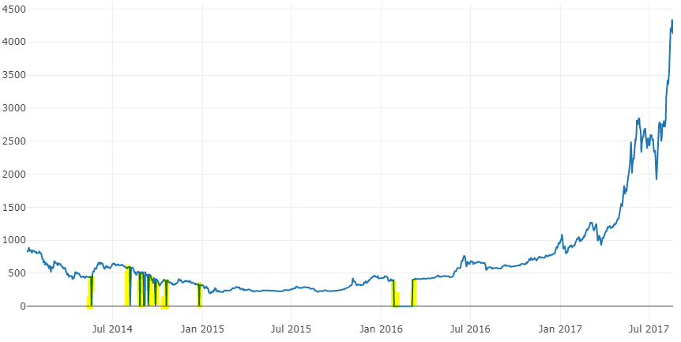
Pre-processed Data
Before we analyze, we need to identify areas of pre-processing needed.
In the extracted dataset there are various irregularities due to which there were few down spikes. These down spikes are due to zero values of price attribute in the dataframe.

Slide 7
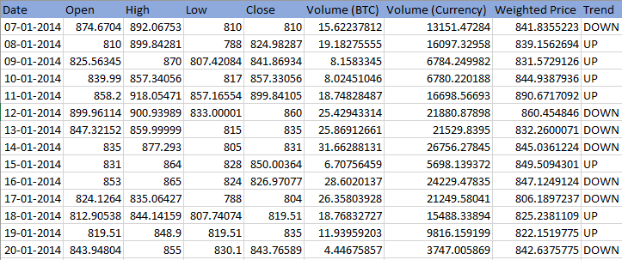
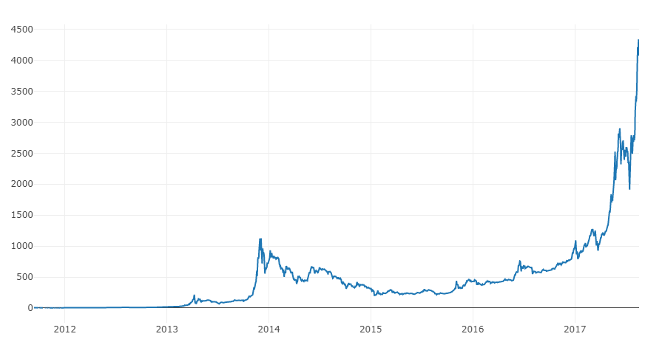
POST-processed Data
Since the price of Bitcoin has never been equal to zero the zero values has been removed to get the much cleaner chart without down-spikes.

Slide 8
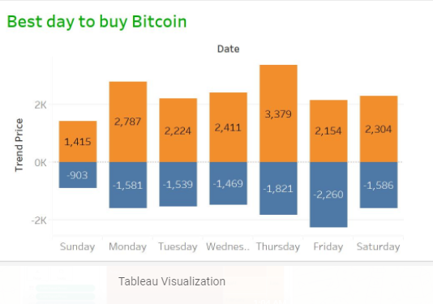
Bitcoin market analysis using tableau
Best day to buy the Bitcoin

Slide 9
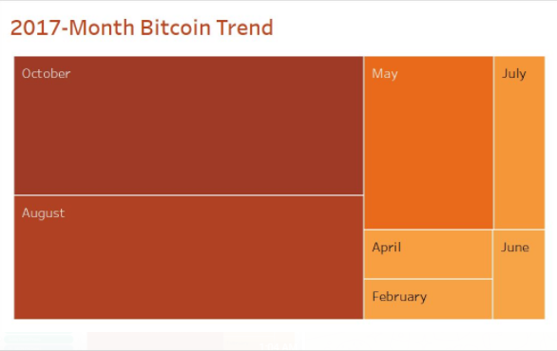
Bitcoin market analysis using tableau
Bitcoin Trend for the year 2017

Slide 10
Bitcoin price forecast using time series analysis with prophet using python
Prophet is library to built forecasting model for time series data. Here it uses additive regression model or curve fitting for forecasting. Internally the core part has been developed using Stan's probabilistic programming language.
According to the authors it gives us the option to estimate parameter uncertainty using the Hamiltonian Monte Carlo algorithm, and allows us to re-use the fitting procedure across multiple interface languages.”
The library is used to handle typical data challenges such as:
A reasonable number of missing observations or large outliers.
Historical trend changes, for instance due to product launches or logging changes.
Trends that are non-linear growth curves, where a trend hits a natural limit or saturates.

Slide 11
Bitcoin price forecast using time series analysis with prophet using python
The analysis for the same has been done in Juypter Notebook App which is a client-server application that allows editing and running notebook document via a web browser.
We have uploaded Jupyter Notebook along with the code to the GitHub link as follows:
https://github.com/deepesh240789/prophet_time_series_analysis/blob/master/Bitcoin%2BPrice%2BPrediction%2Band%2BAnalysis.ipynb

Slide 12
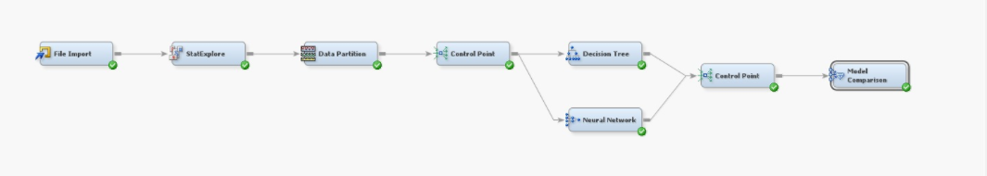
Bitcoin trend analysis using j48 and Multilayer perceptron Algorithms
Here we have created two classifiers such as Decision Tree and Neural Network in SAS Enterprise miner. Below are the model and their results:

Slide 13
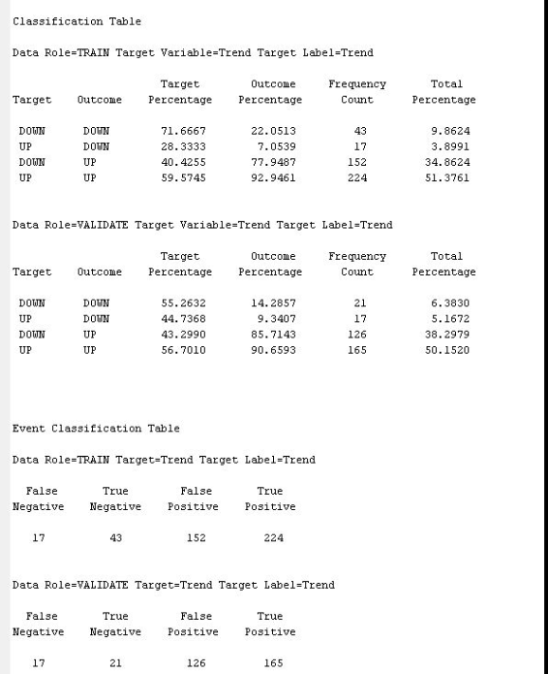
J48 classification table
Bitcoin trend analysis using j48 and Multilayer perceptron Algorithms

Slide 14
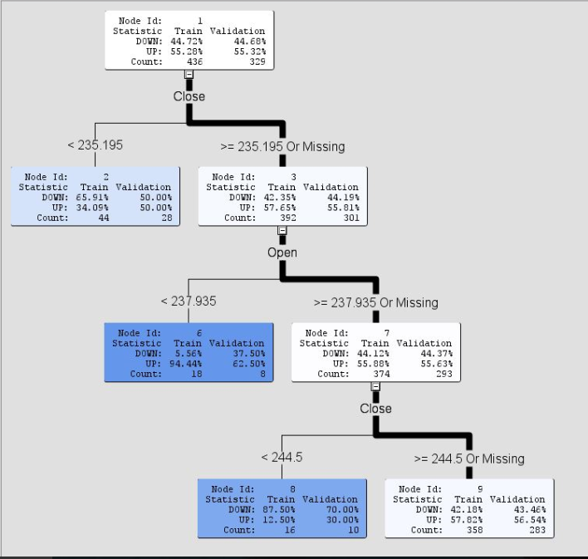
Bitcoin trend analysis using j48 and Multilayer perceptron Algorithms
J48 Decision tree

Slide 15

Bitcoin trend analysis using j48 and Multilayer perceptron Algorithms
J48 Fit Statistics

Slide 16
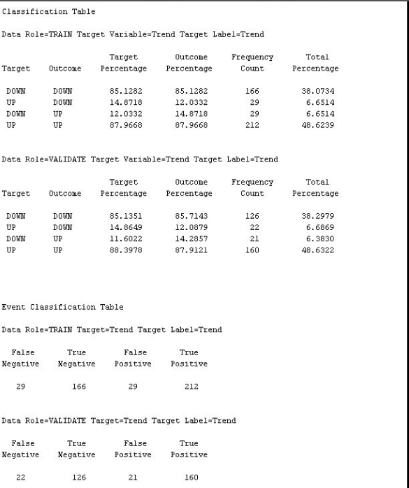
Bitcoin trend analysis using j48 and Multilayer perceptron Algorithms
MLP classification table

Slide 17
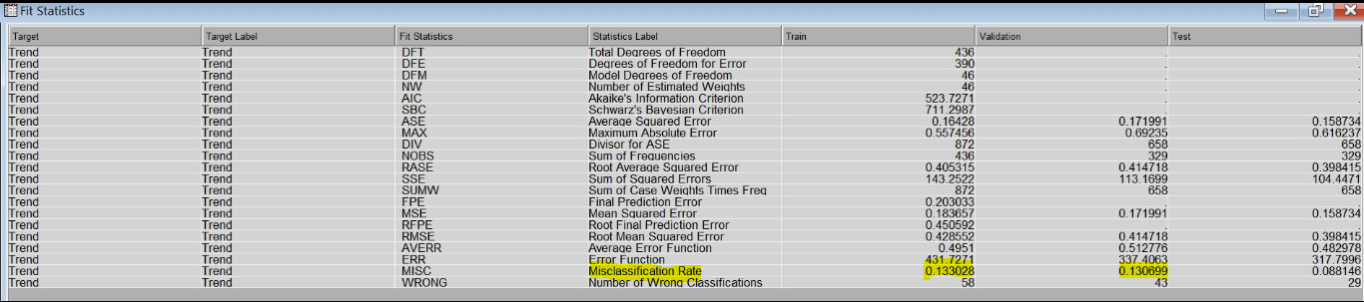
Bitcoin trend analysis using j48 and Multilayer perceptron Algorithms
MLP Fit Statistics

Slide 18
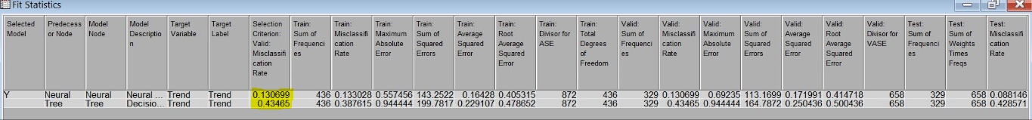
Bitcoin trend analysis using j48 and Multilayer perceptron Algorithms
Model Comparison

Slide 19
Summary
The results are speculative and it also depends on many factors. The list of factors are listed below:
News: New releases have an impact on the prices of Bitcoin. Whenever government releases statements about regulation of digital currencies, the prices of Bitcoin is affected.
Ecosystem Expansion: Bitcoin makes use of the blockchain technology. As ecosystem around digital currencies expands, the demand also increases. For example, the ability to buy goods on Amazon at a discount can drive the price of Bitcoin up.
Government policies: The operations of Bitcoin is independent of the governments of countries around the world. Prices of Bitcoin get affected if the IMF(International monetary fund) encouraging or discouraging governments to take a lenient view on digital currencies.

Slide 20
Summary
Government policies: The operations of Bitcoin is independent of the governments of countries around the world. Prices of Bitcoin get affected if the IMF(International monetary fund) encouraging or discouraging governments to take a lenient view on digital currencies.
Provenance: The value of Bitcoin also depends on their source. For instance, the value of bank notes that are received as proceeds in criminal activity will be less than that received otherwise. There are black Bitcoin and white Bitcoin. Therefore, there could be differences in their prices as well.
Competition: Competition does have a role to play in digital currencies. Altcoins that are competing with each other could bring about changes in supply and demand and thereby influence their prices.
Thus factors that affects price of Bitcoin are diverse. While some factors have a slow and steady impact while others have a more violent and sentimental influence on prices.

Slide 21
Summary
Provenance: The value of Bitcoin also depends on their source. For instance, the value of bank notes that are received as proceeds in criminal activity will be less than that received otherwise. There are black Bitcoin and white Bitcoin. Therefore, there could be differences in their prices as well.
Competition: Competition does have a role to play in digital currencies. Altcoins that are competing with each other could bring about changes in supply and demand and thereby influence their prices.
Thus factors that affects price of Bitcoin are diverse. While some factors have a slow and steady impact while others have a more violent and sentimental influence on prices.

Slide 22
Thank You

Slide 23
References
https://www.coindesk.com/information/understanding-bitcoin-price-charts/
https://fxdailyreport.com/major-factors-affect-price-bitcoin-ethereum/
https://www.quandl.com/data/BCHARTS/BITSTAMPUSD-Bitcoin-Markets-bitstampUSD
https://blog.exploratory.io/an-introduction-to-time-series-forecasting-with-prophet-package-in-exploratory-129ed0c12112
https://www.slideshare.net/RobertMcNally1/introduction-to-bitcoin-15161936

