Slide 1
EUREKA / PUBLIC SAFETY INTELLIGENCE
DrillLoop
D
Evidence-Linked Exercise Review and Action Closure
For hospital preparedness evaluators · synthetic demo
Review
WORKING MVP
Evidence
Improve
The claim stays connected to its source and its reviewer decision.
Fictional hospital prolonged power outage · 27 October 2026
Notes:
Open with the proposed first use case: hospital preparedness evaluators reviewing an exercise. DrillLoop makes a reviewable path from exercise records to a proposed finding and then to a corrective action whose closure needs evidence. The interface and hospital outage records are synthetic. This is a working local MVP, not a certified emergency management product.

Slide 2
THE PROBLEM
The exercise ends. The evidence work begins.
Evaluation is a reconciliation job across files, clocks, objectives, and people.
01
02
03
Evidence is scattered
Timelines disagree
Actions lose momentum
Evaluator notes, control-room logs, transcripts, and reports use different formats and detail.
Missing times, conflicting statements, and recognition errors can make event order look more certain than it is.
Findings become difficult to assign, review, and verify after the report is written.
What teams need
A review trail that shows what the evidence says, what the evaluator concludes, and who verifies the improvement.
The amount of time saved and the size of the gap vary by organization; neither has been measured yet.
Notes:
Explain this as workflow friction rather than a quantified market statistic. Evaluators reconcile multiple evidence sources, resolve timestamps and contradictory notes, map performance to objectives, then turn gaps into accountable actions. The MVP is aimed at this traceability and follow-through gap. We have not measured actual preparation time or correction workload with evaluators.

Slide 3
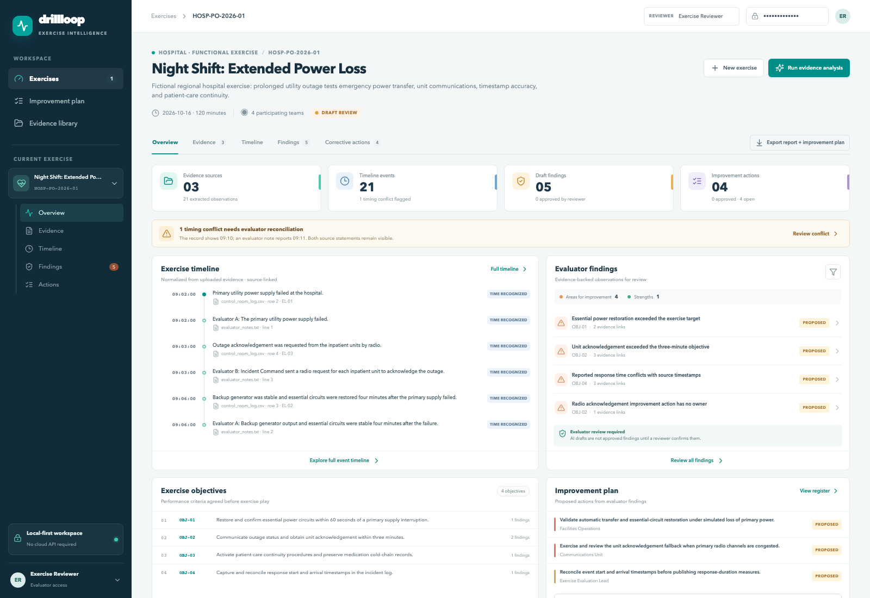
THE PRODUCT
One review workspace for the whole exercise
Follow evidence through to an after-action report and improvement plan (AAR/IP).
SYNTHETIC HOSPITAL EXERCISE
The screen keeps together:
Exercise plan
Objectives and milestones
Evidence
File and source locator
Timeline
Known, missing, and conflicting times
Review
Proposed vs approved status
Screenshot captured from the running app. All exercise content is fictional.
Notes:
Show that this is a live application rather than a slide-only concept. The overview page includes the selected exercise, its targets, source files, timeline, findings, actions, and report export. An after-action report and improvement plan (AAR/IP) is a report of what happened and a list of improvements to track. The captured interface uses fictional data only. The website is built with React and TypeScript; FastAPI is the server interface.

Slide 4
DEMO SCENARIO
A power outage with evidence that does not all agree
Hospital HOSP-PO-2026-01 · Night Shift: Extended Power Loss · fictional exercise.
09:02
09:06
09:18
Utility power lost
Backup stabilized
Procedure complete
Primary supply failure
4 min after outage · objective: 60 sec
Cold-chain relocation logged
09:03
09:10 / 09:11
Radio request
Acknowledgement recorded
ICU acknowledgement pending
Log and evaluator note conflict
Uncertainty stays visible
09:10 vs 09:11 is unresolved. “Generator lagged a bit” has no time or measure, so it is not ordered as a confirmed event.
Notes:
Walk through the fictional timeline. Power is lost at 09:02. The radio request begins at 09:03 and the log records acknowledgement at 09:10. The exercise target for unit acknowledgement is three minutes, so about seven minutes is late. Another evaluator says 09:11; the app shows both times and does not choose one. Backup circuits stabilize at 09:06, beyond the one-minute power objective. At 09:18 the ICU team completes the cold-chain procedure, which means moving temperature-sensitive medicines to safe storage and recording how they were handled. A vague debrief phrase has no timestamp or measure and is not promoted to a confirmed event.

Slide 5
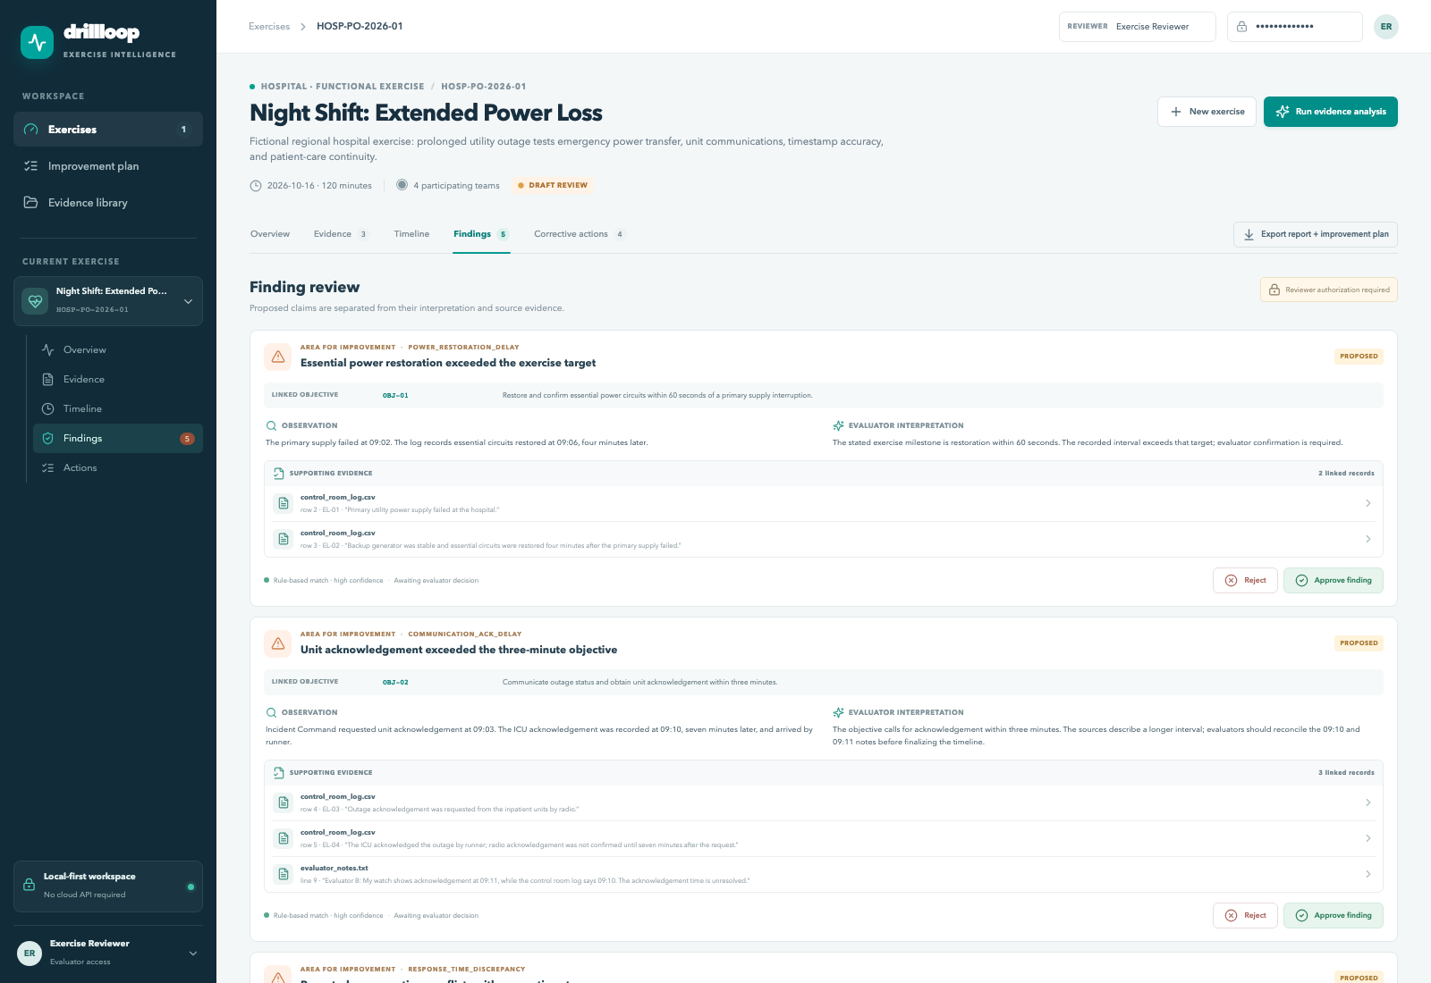
FROM EVIDENCE TO A FINDING
Open the source behind every draft
See what the record says, what it may mean, and where a reviewer can check it.
DRAFT FINDING
Delayed ICU acknowledgement
WHAT IT MAY MEAN
About 7 minutes observed; exercise target is 3 minutes.
SUPPORTING RECORDS
CSV rows 4–5
Note line 9
DRAFT / awaiting evaluator
The response-time discrepancy cites the independent event log; the low-confidence “too minutes” transcript phrase remains uncertain.
No finding is approved by the model. Reviewer decision remains explicit.
Notes:
A finding is an evaluator’s conclusion about performance against an exercise target. Here the target is acknowledgement within three minutes, while the records say it took about seven. The actual evidence sources are control_room_log.csv rows 4–5 and evaluator_notes.txt line 9, where the separate 09:11 report appears. The system should display those records separately; the discrepancy remains unresolved. Speech-to-text (also called automatic speech recognition or ASR) produced the fictional low-confidence “too minutes” error. The response-time finding instead relies on the independent event log. All findings begin as proposals and an authorized evaluator must approve or reject them.

Slide 6
AI WORKFLOW
A fixed pipeline keeps the evidence path inspectable
The MVP uses deterministic extraction for the demo fixture. Optional local models stay behind defined boundaries.
01
02
03
04
05
Collect files
Record details
Compare
Link evidence
Human review
Notes · spreadsheets
transcripts · readable PDFs
Keep exact file location
and known / unknown time
Compare recorded events
with exercise targets
Show the exact source
behind every proposal
A person decides
approve / reject
OPTIONAL LOCAL SPEECH-TO-TEXT
OPTIONAL LOCAL WRITING MODEL
faster-whisper can turn audio into draft text when installed. Demo transcript is pre-written; speakers are not identified.
Ollama may reword an action draft only. It cannot create a finding, change a source link, or make a reviewer decision.
Same evidence + same rules produce a repeatable draft. The evaluator still decides.
Notes:
This is a fixed workflow: the same evidence is processed by the same explicit rules, which makes the demo repeatable and easier to inspect. CSV means a spreadsheet-like file; JSON is a structured text file. A vector database is a separate search system for finding similar text; this tiny example does not need one. Speech-to-text (automatic speech recognition, or ASR) turns audio into a draft transcript; the demo transcript was typed in advance. A large language model (LLM) can draft or reword text, but the optional Ollama model can only rewrite an action after rules have created it. Neither optional path was used for the reported results.

Slide 7
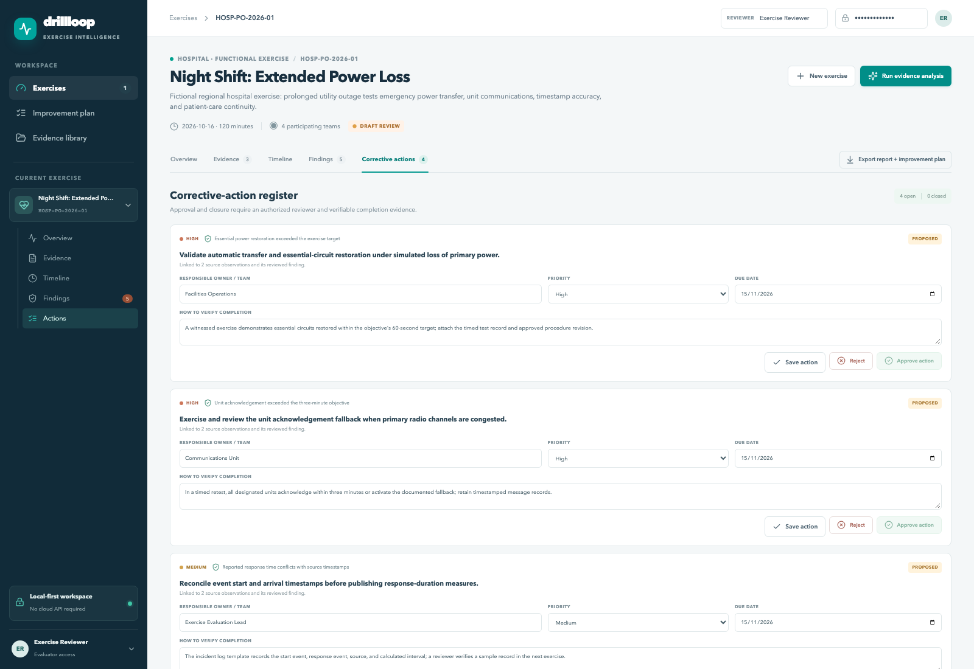
CORRECTIVE ACTION MANAGEMENT
A finding stays open until its improvement is checked
Every action needs an owner, a due date, a clear test for completion, and reviewer confirmation.
Proposed
Finding awaiting review
Assigned
Owner + due date
In progress
Acceptance criteria
Closure review
Attach completion proof
Closed
Reviewer confirms
Missing owner stays unassigned.
Notes:
A corrective action is a task intended to improve the next exercise. Its “acceptance criteria” are the test for deciding whether the task is done—for example, three timed drills where all units acknowledge within three minutes. The action is linked to its finding and source records. One sample action has no named owner; the app leaves it blank rather than inventing a person. A reviewer must approve the linked finding and later check completion evidence before closure.

Slide 8
MARKET CONTEXT
The category already has AAR and action-tracking tools
DrillLoop should validate a focused workflow advantage instead of claiming report generation is unique.
OPTION / CONTEXT
PUBLICLY VISIBLE SCOPE
IMPLICATION TO TEST
FEMA exercise guidance
Exercise planning and evaluation steps
Use familiar structure; no claim of certification.
Veoci
Publicly describes AAR reports, timestamps, transcripts, and corrective actions
Direct competitor; compare source-level review and closure in customer demos.
D4H
Emergency-team readiness, incident, personnel, and equipment workflows
Adjacent incumbent; confirm evaluation evidence workflow depth.
DrillLoop hypothesis
Exact source observation → human decision → closure evidence
Potential niche; uniqueness and willingness to pay remain unvalidated.
Sources: FEMA exercise guidance · Veoci after-action reporting · D4H team readiness. Public pages, not a scored teardown.
Notes:
HSEEP is FEMA’s Homeland Security Exercise and Evaluation Program. It provides a recognized way to plan and evaluate exercises; DrillLoop borrows some concepts but is not FEMA-certified. Veoci publicly markets after-action reporting, timestamps, transcripts, and corrective-action follow-up. D4H serves emergency response readiness and related workflows. Report writing by itself is not a unique claim. DrillLoop’s hypothesis is the source-to-review-to-closure trail, and that must be tested with buyers who already use these tools. Sources: https://www.fema.gov/sites/default/files/2020-04/Homeland-Security-Exercise-and-Evaluation-Program-Doctrine-2020-Revision-2-2-25.pdf ; https://veoci.com/emergency-management/after-action-reporting/ ; https://www.d4h.com/team-readiness-software

Slide 9
CUSTOMER WEDGE
Start with a hospital exercise review
This is a proposed first use case; no pilot partner or buyer has been confirmed.
Report preparer
Roles to validate
FIRST PILOT HYPOTHESIS
Exercise evaluator / preparedness staff (candidate user).
1
Who prepares the AAR/IP?
Hospital
tabletop review
Report approver
Preparedness lead or exercise sponsor (candidate).
2
Who approves findings?
Initial segment hypothesis. The included outage exercise is synthetic; no hospital partner is confirmed.
Budget owner
Not identified; role to validate in discovery.
3
Who controls the budget?
No interviews or purchasing-path validation are recorded yet.
Notes:
The hospital tabletop review is the proposed initial use case, not a confirmed customer or pilot. The candidate user is an exercise evaluator or preparedness staff member. A preparedness lead or exercise sponsor may approve the report; the actual buyer and budget owner are unknown. Discovery needs to identify who prepares the report, approves findings, owns the budget, and controls access to exercise data. No customer interviews or purchasing-path validation are recorded.

Slide 10
COMMERCIAL HYPOTHESIS
Start with a per-exercise pilot fee
This is the first model to validate; no price, buyer demand, or revenue has been established.
BUYER
Who owns the budget and approves an exercise-level purchase?
FIRST MODEL TO TEST
Per-exercise
pilot fee
VALUE
Does evidence lookup, review, or action follow-up improve on the current process?
Price to be set with the prospective buyer after delivery effort and procurement path are understood.
DELIVERY
What setup, security, support, and evidence-handling work does each exercise require?
Annual plans and private deployment remain later hypotheses.
Notes:
The proposed first commercial model is a per-exercise pilot fee. No price or willingness-to-pay evidence exists, so the pitch does not present an assumed quote as a selected price. Discovery should identify the user, approver, budget owner, procurement path, and actual delivery costs. Annual organizational plans, private deployment, templates, and support are possible later models if pilot evidence and buyers support them. The separate Business Case contains illustrative price and staffing assumptions; they are not market rates, a forecast, or revenue.

Slide 11
TECHNICAL FOUNDATION
Simple local app, with a person at the review gate
The demo can run without a cloud AI service; optional models stay on the computer.
Website screen
Application service
Saved records
Reports + optional local AI
Exercise setup
Evidence review
Action tracking
React + TypeScript
Checks uploaded files
Applies review rules
FastAPI + Pydantic
SQLite for the demo
PostgreSQL for deployment
SQLAlchemy database tools
PDF report: ReportLab
Speech-to-text: faster-whisper
Action wording: Ollama
TRACEABLE RECORD
DEMO SECURITY BOUNDARY
Original file + file-change checksum + extracted quote + location + reviewer decision + completion proof
Shared demo key; no named accounts, tenant separation, retention controls, or security assessment.
Exact library versions and licenses are listed in the Technical Design.
Notes:
The website is built with React and TypeScript. FastAPI is the web service, and Pydantic checks the data sent to it. SQLAlchemy is the database access library. SQLite stores the local demo; PostgreSQL is available through Docker Compose. Uploaded source bytes and extracted text are stored in the configured database. The demo has a shared reviewer key, but no named-user RBAC, tenant isolation, retention/deletion controls, or security assessment. The default workflow makes no cloud model call. faster-whisper runs locally with a staged model; optional Ollama is configured as a local/private service for action wording only. Neither optional path was benchmarked. The Technical Design lists versions and licenses.

Slide 12
TECHNICAL EVALUATION
The sample passed its checks; new exercises still need testing
Scores use one fictional exercise built for this demo. They do not measure evaluator agreement or general accuracy.
EVENT RECORDS
FINDING LABELS
SOURCE LINKS
RECORDED TIMES
8 / 8
5 / 5
9 / 9
8 / 8
All labeled rows found
All expected labels found
Expected record IDs linked
One disagreement shown
Measured
Not measured
Rule request latency p50 4.61 ms · p95 9.13 ms
Peak process RSS 78.2 MB · no model loaded
Unseen-exercise errors · reviewer edits · semantic citation quality
ASR WER/latency · local LLM quality and latency
Precision and recall were 100% because rules and labels used the same small scenario; they do not establish performance on an unfamiliar exercise.
31 / 32 action fields were filled; one owner is intentionally missing. No evaluator study was run.
12 local test calls · no AI model loaded · results apply to this synthetic fixture only.
Notes:
The benchmark used the one fictional exercise included with the project. Precision and recall were 100 percent on this closed sample, but the rules were written for these same labels. Nine of nine source-record IDs were present; that does not prove each source semantically supports the conclusion. The timeline matched eight explicit log times and displayed one disagreement. Action fields were 31 of 32 complete because an owner is intentionally missing. Request time and process memory exclude model inference. No real evaluator, unfamiliar-exercise test, speech-to-text accuracy test, or local LLM comparison was run. A next evaluation should use evaluator-labeled evidence from an exercise not used to write the rules and report both missed and incorrect findings.

Slide 13
THE NEXT PROOF POINT
Pilot the review trail.
Compare the current process and DrillLoop on the same permitted hospital exercise records, then test an unfamiliar exercise.
2–3 users
Paired review
Measure
Prospective hospital-preparedness interviews (proposed)
Same permitted records: existing process and DrillLoop
Time · misses · corrections · citations · action fields
Partner-defined success thresholds.
No pilot partner, interviews, baseline, or performance targets are confirmed.
DrillLoop · Fictional demo · Uses selected FEMA exercise guidance; not certified
Notes:
This is a proposed discovery and pilot sequence, not a confirmed project commitment. First interview two or three prospective hospital-preparedness users and observe one current review with permission. If a partner agrees, compare existing practice and DrillLoop on the same permitted records. Ask the partner to set thresholds before the trial for report time, reviewer corrections, citation accuracy, and action-field completeness. Then use evaluator-labeled evidence from an unfamiliar exercise and report missed and incorrect findings. Select one relevant alternative with the partner for a comparable source-location, reviewer-decision, and closure-evidence workflow. No pilot partner, access, schedule, or thresholds are currently confirmed.

