Slide 1
FUTURE OF WORK @ PRESIGHT
Human
API
Help answer work questions
when the expert is away
A cited answer when the evidence is clear. A person when it is not.
EUREKA INNOVATION HACKATHON · EARLY CONCEPT
LOCAL DEMO · FICTIONAL DATA
Notes:
Human API is an early concept for handling a work question when the colleague who knows is unavailable. The colleague chooses what questions may be handled and for how long. The person asking must still be allowed to open every source file. The local demo has fictional people and records, real question and approval flows, and a fixed answer template based on matching words. It does not use a large language model and is not connected to a Microsoft tenant. This is a concept-stage demonstration, not a deployed product.

Slide 2
01 / THE PROBLEM
Work can stop at the person who knows
A question needs context, but the right person or file is hard to find.
01
02
03
04
A decision is needed
The expert is away
Files are scattered
Work waits or interrupts
An engineer needs to understand a service change.
The person who remembers the reason is unavailable.
A decision note or operating guide may hold the answer.
Someone waits or interrupts another expert.
A problem to test—not a Presight measurement
Measure time spent searching. Do not count waiting time as saved work.
Background and research sources are in the speaker notes.
Notes:
The issue statement here is a product hypothesis rather than a Presight measurement. We are not presenting an external benchmark or claiming that colleagues' absence causes a particular number of lost hours. The chain is familiar to engineering and operations teams: a decision needs context, the subject expert is unavailable, the source may be distributed across repositories, and work either waits or another person is interrupted. The MVP helps by turning that dependency into a durable request with an explicit deadline, consent and evidence path. During a pilot, measure active time spent searching or reconstructing context. Do not count elapsed wait time as productive savings unless the employee can show the blocked time became useful work.

Slide 3
02 / A REALISTIC EXAMPLE
Why did the service setting change?
Alice asks Bob about a fictional Project Alpha change.
ASKED BY ALICE
SOFTWARE ANSWER · PARTIAL
Why did the timeout change from 90 to 120 seconds? Is 120 seconds still needed?
The decision note says the timeout rose because setup sometimes took longer than 90 seconds. The change was approved for release 5.2. The note does not say whether 120 seconds is still needed today.
Directed to Bob · DevOps / project owner
Synthetic out-of-office status
SOURCE ADR-024 · written decision · version 1.0
This is not a reply written by Bob.
Background and research sources are in the speaker notes.
Notes:
This synthetic Project Alpha example is implemented in the local demo. An ADR, or architecture decision record, is a written note explaining a technical decision. ADR-024 says startup setup sometimes took longer than 90 seconds and that the increase to 120 seconds was approved for release 5.2. It does not establish whether the setting is still needed. The answer is therefore partial and includes that limitation. The app's “AI-generated” label means software-produced and distinguishes the fixed-template text from a human reply; no language model generates it. A later operating guide records a different 180-second value, so a question about the current value is sent to a human instead of choosing one.

Slide 4
03 / BUSINESS IMPACT
What time might the idea save?
A planning example—not a measured Presight figure.
50,000
possible work questions each year
500 employees × 2 questions/week × 50 weeks
Count search time
Do not count waiting
Measure real use
Time people actually spend finding and checking the answer.
Time spent waiting is not automatically saved work.
Count answers people accept and time the pilot can verify.
EXAMPLE ASSUMPTIONS · NOT MEASURED BENEFIT
Background and research sources are in the speaker notes.
Notes:
The question volume is illustrative math: 500 employees multiplied by two knowledge-blocking questions per week and 50 working weeks gives 50,000 annual opportunities. It is not a measured count of Presight questions. An economic model should include only the share that can be safely handled, the share employees actually adopt, the share that resolves successfully, and active minutes that are demonstrably avoided. Waiting time should not be included by default. Also avoid counting a saved expert interruption separately when the same benefit is already part of the active minutes estimate. The business case later shows a base capacity value below illustrative annual operating costs, making measurement and a Microsoft configuration comparison important gates.

Slide 5
04 / THE SOLUTION
Owner consent does not give file access
Two separate checks protect the person asking and the person sharing knowledge.
The owner agrees
The asker has access
Answer or get help
Choose the dates, project, topic, coworkers, files and backup. Pause or stop at any time.
Use only files the signed-in requester is already allowed to open.
Show the source and limits. Deny restricted requests. Ask a human when evidence is weak.
Every answer shows
Who wrote it / which file supports it / what is unknown / who can help next
Background and research sources are in the speaker notes.
Notes:
Human API treats delegation consent as an explicit policy object: the knowledge owner chooses the active dates, project, topics, approved sources, audience, backup and response window. A manager can approve scoped policy changes. Authorization is a separate gate; an owner cannot make restricted source data available to a requester who lacks permission. The answer can be supported or partial, but source evidence and limitations are visible. When policy disallows access, the response is generic and reveals no hidden title or snippet. When evidence is missing or contradictory, the workflow escalates. The owner retains control and can revoke. Generated language is never attributed to the owner unless the owner actually answered.

Slide 6
05 / HOW IT WORKS
One question, five clear steps
The app records what happened and checks file access before searching.
01
02
03
04
05
Save the
question
Check owner's
limits
Check asker's
file access
Search
approved files
Answer or
ask a person
A source supports the answer
No proof, restricted or conflicting
Show the file, version and known limits
Give a safe denial or ask an approved person
Background and research sources are in the speaker notes.
Notes:
The workflow uses a deterministic state machine in a modular monolith, not a collection of independent LLM agents. Question creation persists the requester, owner, project, status and response deadline. When the deadline or approved absence condition applies, the policy engine checks consent, dates, topic, project, audience and manager approval. The authorization module filters approved content using the requester's current project membership and source ACL before ranking. The evidence step checks whether relevant support exists and whether sources conflict. A supported response is cited; otherwise the engine denies or escalates. Database-backed jobs survive process restarts. The local scanner is single-process and requires stronger locking, notification outbox and observability before multi-instance deployment.

Slide 7
06 / OWNER'S CHOICE
What Bob has agreed to
The owner can pause or stop the helper at any time.
DATES
PROJECT
OWNER CONTROL
20 Oct – 02 Nov
Project Alpha
Pause or stop
QUESTION TOPICS
WHO MAY ASK
Deployment · timeout
Approved project colleagues
A manager reviews changes. Being Busy or away never counts as permission.
FILES TO CHECK
BACKUP PERSON
Selected decision notes / guides
Carla Mendez
Every change is recorded.
Background and research sources are in the speaker notes.
Notes:
This is a fictional example of the limits Bob chooses: dates, one project, a short list of question topics, named coworkers, selected files and a backup. Bob can pause or revoke the policy. A manager reviews a scope change. The demo's out-of-office status is fictional and is only used after an owner-approved policy already exists; Busy status is not consent. “Delegation” here means limited permission for the software workflow to help. It never means the software pretends to be Bob or gives Alice access to Bob's files.

Slide 8
07 / POSSIBLE MICROSOFT CONNECTION
Where a Microsoft connection could fit
These connections are not part of the tested local demo.
Work sign-in
SharePoint files
Out-of-office status
Teams
Check who is signed in with a Microsoft work account. Early code only; needs tenant testing.
Search and open files as Alice, using Alice's existing access. Adapter not tenant-tested.
Possible future check of the owner's status and dates only. No inbox or message text.
No bot yet. A future app needs registration, a secure web address and tenant approval.
NOT CONNECTED
NOT TENANT TESTED
EARLY ADAPTER
FUTURE WORK
A future file search must use the requester's own Microsoft permissions.
Background and research sources are in the speaker notes.
Notes:
The local demo uses fictional identities and files; none of these Microsoft connections is active. Microsoft Entra ID is the work sign-in service. Microsoft Graph is the interface applications use to access files and settings. A future “on behalf of” (OBO) sign-in flow should make every SharePoint search as the signed-in requester, not as the knowledge owner. The adapter code exists but has not been tested in a tenant. The Outlook adapter is designed to read only an owner's automatic-reply status and dates, not message text or inbox. A Teams bot is future work and needs an app registration, a publicly reachable secure web address and tenant approval. Sources: Microsoft Graph Search API, Get mailbox settings, Graph permissions reference, and Teams SDK Register App quickstart.

Slide 9
08 / SAFETY
The requester keeps control of file access
The owner's permission never unlocks files for another person.
Who is asking?
What did owner allow?
Can asker open file?
Does source answer?
What happens next?
Work identity · project
question · deadline
Dates · topic
people · files
Project access
file permissions
Approved file
missing · conflict
Show source
deny · ask human
If access is denied
Give no file name, content or clue that it exists.
Audit trail
Record the owner's choice, file check, source and result.
Not built for production yet: encrypted storage, deletion controls, real file labels, multi-server safety or independent security review.
Background and research sources are in the speaker notes.
Notes:
The order matters: first verify who is asking, then check what the owner approved, then check whether the requester can open a file, and only then search. “ACL” means access control list, or the list of people allowed to open a file. Owner consent allows the workflow to operate; it never grants file access to another person. The app checks access again before showing a saved answer. A denial should not reveal a hidden file name or excerpt. The demo governance page shows counts and audit details, not private question content. Encryption, deletion controls, real file labels, multi-server coordination and independent security review still need to be built before a production pilot.

Slide 10
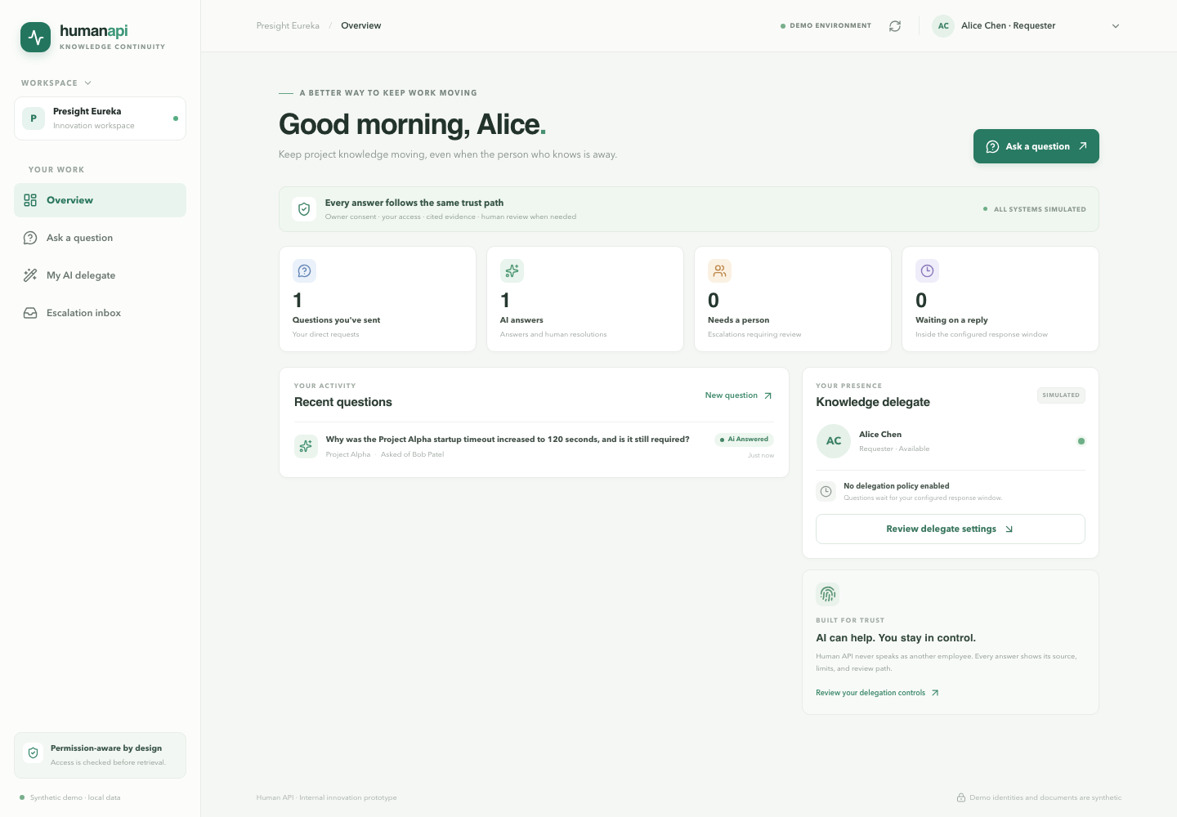
09 / WORKING DEMO
A real local app with fictional data
Question records and approval steps work; all people and files are examples.
The question is saved
See its status, response deadline and history.
The answer shows its source
The decision note explains the change, not whether it is still needed.
A person handles gaps
Unclear answers go to a human; reuse needs approval.
FICTIONAL DATA · NO LIVE MICROSOFT OR AI MODEL
Background and research sources are in the speaker notes.
Notes:
This screenshot is from the running local app after Alice submitted a Project Alpha question to Bob. The app shows real local question status and evidence, but all people and documents are fictional. The current answer path matches words in approved files and uses fixed text; it does not call an AI language model or Microsoft Graph. A presenter can use this page to show the question, the cited written decision and its limitation. Then ask for restricted budget data to show a safe denial, and ask about an undocumented change to show the human backup route.

Slide 11
10 / AI AND HUMAN ROLES
AI may explain evidence; people and rules keep control
The demo uses no language model. A future AI must never decide who may see a file.
SOFTWARE RULES
POSSIBLE FUTURE AI
PEOPLE DECIDE
Verify identity
Check owner approval
Check file access
Honor revocation
Summarize allowed files
Draft a cited answer
Say what is unknown
Resolve uncertainty
Approve corrections
Change or stop policy
The current demo follows a small set of steps. Add more AI only if a pilot shows it helps.
Background and research sources are in the speaker notes.
Notes:
The product uses agentic workflow in the sense of a routed, persistent work item with policy, evidence, feedback and human review. It does not need an LLM for each module. Identity, deadlines, permission decisions, revocation and approval remain deterministic. The current response composer is also deterministic, avoiding hallucinations while we validate the workflow. If a model is added, it should only receive requester-authorized evidence and produce a draft with citations. An objective evidence checker should validate citation IDs and coverage; no model confidence score should authorize disclosure. We did not add LangGraph because the workflow is a small state machine with one human interruption. Reconsider orchestration only when multiple tools/checkpoints show measurable value.

Slide 12
11 / WHAT ALREADY EXISTS
Search is common. The workflow is the question.
Microsoft and other tools already find files, show sources and respect file permissions.
Tools already do
Workflow to test
Open question
Search company files, summarize them, show sources and follow file permissions.
Owner opts in. A response time is set. The requester keeps existing file access. A person handles gaps.
Do teams need this extra handoff, or can they configure Copilot or another tool?
No public review proves this exact workflow is unique.
Sources: Microsoft Autopilot (25 Sep), SharePoint team knowledge base (14 Oct), Glean and Moveworks.
Notes:
The comparison is deliberately cautious. Microsoft 365 Copilot and SharePoint agents already ground on Microsoft sources and respect existing document permissions. Copilot Studio can build workflows and has a human assistance node. On 25 September 2026 Microsoft announced Autopilot, formerly Scout, as a persistent, proactive personal agent with tenant identity, governance and Microsoft IQ context; the announcement described private preview expansion at month end, not general availability. On 14 October Microsoft announced a SharePoint team knowledge base curated by Copilot and agents in Frontier Preview; Copilot in SharePoint began its general availability rollout on 30 September. Glean documents permission-filtered cross-app search, citations, people context and agents. Moveworks documents search, sources, action plugins and Smart Handoff. The exact combination of owner-specific consent, unanswered-question deadline and approved correction lifecycle was not proven in the public sources reviewed. That is a hypothesis, not a uniqueness claim. Vendor features and preview availability should be rechecked during a proof of concept. Sources: https://blogs.microsoft.com/blog/2026/09/25/introducing-the-new-copilot-with-home-code-and-autopilot/ ; https://techcommunity.microsoft.com/blog/spblog/introducing-a-team-knowledge-base-curated-by-copilot-and-agents/4564203 ; https://techcommunity.microsoft.com/blog/spblog/what%E2%80%99s-new-in-copilot-in-sharepoint-october-2026/4535423 ; https://docs.glean.com/user-guide/about/what-is-glean ; https://help.moveworks.com/ai-assistant/capabilities

Slide 13
12 / EXAMPLE ECONOMICS
Time value is not the same as cash saved
Compare estimated recovered work time with costs in AED (UAE dirhams).
AED 1,611k
BASE EXAMPLE · VALUE OF TIME
AED 700k
AED 700k
Example annual operating cost: AED 740k
8,400 answers people accept
× 20 minutes of search saved
× AED 250 per work hour
AED 125k
Time value is AED 40k below example cost
LOW
BASE
HIGH
Assumptions only. No work time or financial benefit has been measured.
Background and research sources are in the speaker notes.
Notes:
This is an example of possible employee work time made available, not a cash-savings claim. The base assumptions are 50,000 possible questions a year; 40% are suitable for the workflow, 60% of those are used, and 70% get an answer the requester accepts. That gives 8,400 accepted answers. At 20 active minutes saved each and an assumed AED 250 per work hour, the time is valued at AED 700,000. The example annual operating cost is AED 740,000 before Microsoft licensing, so the base estimate is AED 40,000 below cost. The cost assumes partial engineering and support roles plus infrastructure, security review and adoption. A pilot must measure actual active time, acceptance and cost. Waiting time is excluded.

Slide 14
13 / NEXT STEPS
A path from demo to a safe pilot
First review security and file access. Then connect Microsoft. Then measure value.
NOW
STEP 1
STEP 2
STEP 3
Local demo
Safety review
Connect Microsoft
Small pilot
Fictional people and files
Rules and file-access checks
Answer or human handoff
Review file labels
Check owner permission
Agree on data handling
Work sign-in
Requester file access
Teams app
One opt-in team
Low-risk files
Measure time and trust
Working
Needs review
Needs tenant setup
6–10 weeks
No live Microsoft connection has been tested. The demo uses no language model and is not security-certified.
Background and research sources are in the speaker notes.
Notes:
The local demo is working with fictional data. Before using real Microsoft files, a security and privacy review must decide what data can be processed, how long it is kept, and how access is removed. The Microsoft proof must test that work sign-in and every file search preserve the requester's own permissions. A future Teams app needs registration, tenant approval and a secure web endpoint. Only then should one opt-in team try low-risk files with a human fallback. Measure active search time, answer acceptance and trust. No live Microsoft connection has been exercised; no language model is bundled; this prototype is not security-certified.

Slide 15
PILOT PROPOSAL
Test the workflow
with one willing team.
01
One willing team
Use existing, low-risk files
The ask
02
6–10 weeks
Review security and connect Microsoft
Sponsor a security review, Microsoft setup and one pilot manager.
03
Safety first
Stop if anyone sees a file they should not
04
Measure value
Search time saved, accepted answers, cost
Human API · Evidence, boundaries, and a human path when the answer is not there.
Notes:
The ask is to test, not to fund a full product. Sponsor a security and privacy review, Microsoft tenant setup, and one manager-led pilot with a willing team. Use low-risk files and a human fallback. Stop immediately if anyone receives information they are not allowed to see. Measure active time spent searching, whether answers are accepted, how often questions go to a person, and the full cost including Microsoft licensing. Compare with what the organization can already configure in Microsoft tools. The goal is a clear decision based on evidence, not a claim that a benefit has already been achieved.

