Slide 1


AllenForum
|NOT JUST A DISCUSSION FORUM|
Ankit Prajapati | Deepesh Chaudhari | Sweety Singh | Shweta Gautam
| CSE Final Year |

Slide 2
What is AllenForum ?
AllenForum is a social networking site, where students can discuss their doubts, share their ideas, remove their communication gap and grow professionally….

Slide 3
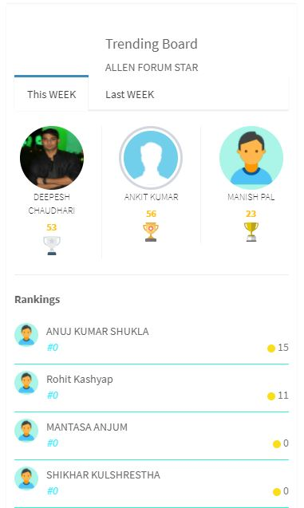
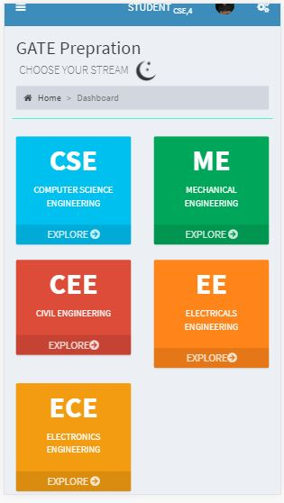
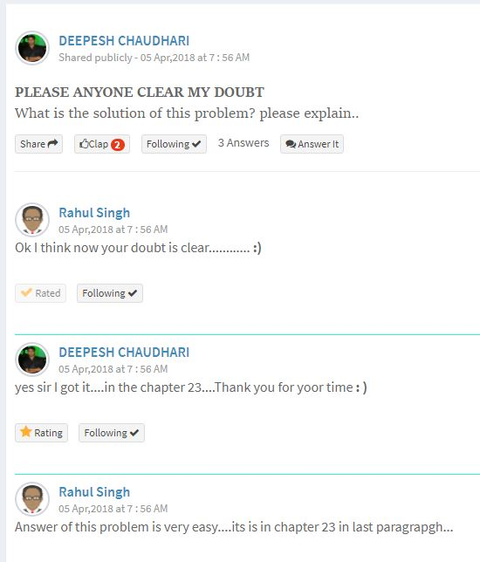
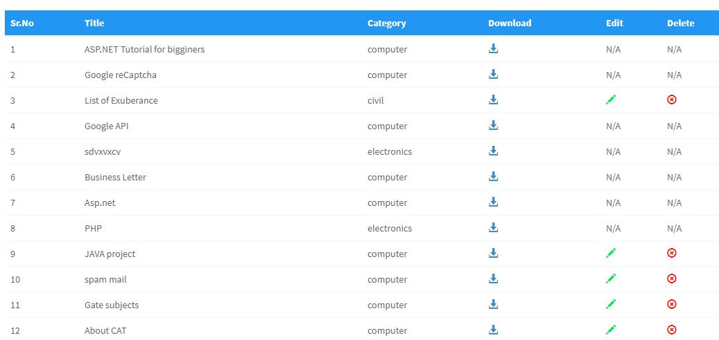
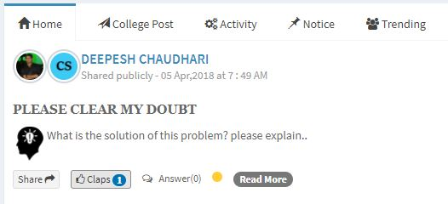
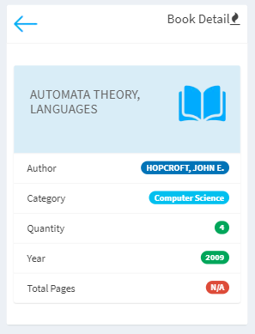

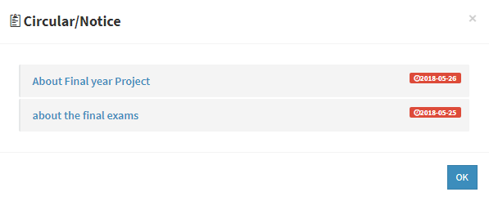
AllenForum | Uses and Functionality…
Students can clear their doubts anywhere, anytime via posts
Check book availability in library
Get updated with all the latest notifications of college
Collect useful information related to competitive exams
Faculties and students can get and share their notes
It help students to improve to their academic activities
Help students to get information related to companies
There is a competition between student via Trending Tab

Slide 4
AllenForum | Benefits and Why its needed…
Improve senior-junior interaction
College notifications on our finger tip
No need to communicate with students in any other application
Positive publicity of our College
Very few college have their own social networking site developed by their own students
Within few month we have our all courses online
All our college students will be connected at one place

Slide 5
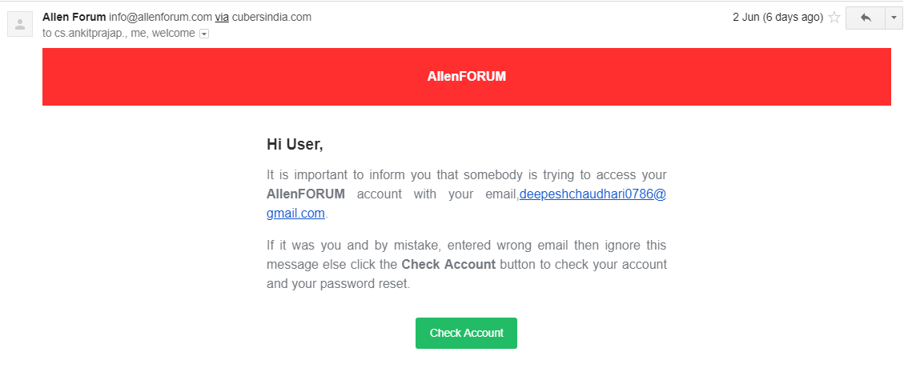
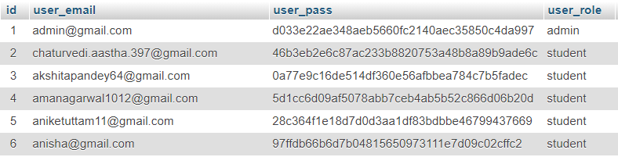
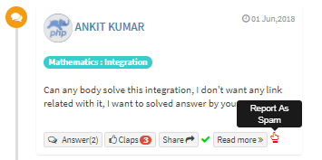
AllenForum | How much secure it is…
Only authenticated students can access AllenForum
If any unauthenticated user try to login, it will automatically send security alert to user with IP Address
Faculty can block any student for any inappropriate behavior
Blocked student will be unblock only by admin
If any post will get negative response, it will be deleted automatically
Password is encrypted by using SHA1 encryption Algorithm

Slide 6
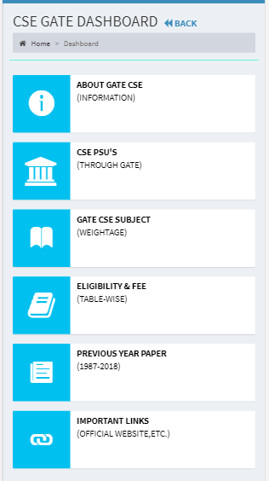
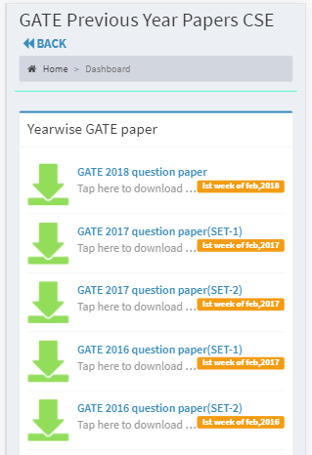
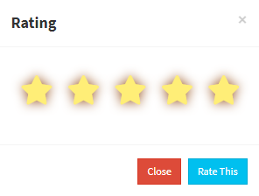
AllenForum | Improvements we did…
Student Faculty one to one communication
Enhanced the security of AllenForum
Complete GATE and CAT tab with authenticated data
Added JOB tab with full functionality
Connect AllenForum with ERP
Students give rating to answers
Library books functionality is tested with real data of library

Slide 7
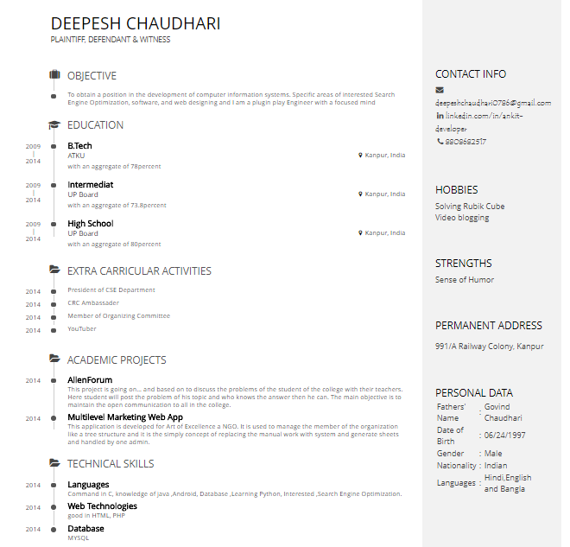
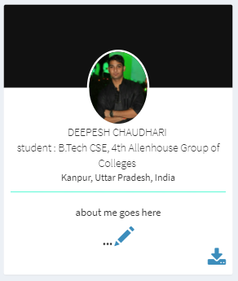
AllenForum | Some Special Points and Features
Students CV generator
Collect feedback from student
Trending tabs helps to find intellectual students
Database is normalized in structure
Code is written in proper structure wise
Files directory structure is properly maintained

Slide 8
AllenForum | Trending functionality Formula
Where the symbols meaning is defined as:
T_{c}= Total coins
T_{f}= Total followers
T_{l}= Total likes
T_{r}= Total ratings in given answers
T_{cp}= Total contribution post done by user

Slide 9
THANK YOU
Ankit Prajapati | Deepesh Chaudhari | Sweety Singh | Shweta Gautam
| CSE Final Year |

