Slide 1
LOAN
LOAN APPROVAL PREDICTION
using Machine Learning
Deepesh Tahlani
AI & ML Internship | Naviotech Solutions Pvt Ltd
Guide: Mr. Md. Ameen
Shri Mahavir College
Notes:
Introduce yourself, the company and the guide. The project predicts whether a loan application will be approved or rejected from the applicant's details.

Slide 2
Problem Statement
Given an applicant's details, predict whether the loan will be APPROVED or REJECTED.
1
2
3
Slow and subjective
Costly mistakes
Messy data
Manual review takes days and varies by officer
False approval = default; false rejection = lost customer
Missing values, skewed income, only 614 records
Binary classification on tabular data: output = Approved (1) or Rejected (0).
Notes:
Banks must decide quickly which loans to approve. A wrong approval means a defaulted loan; a wrong rejection loses a good customer. Manual checking is slow and inconsistent, so we let a model learn from past decisions.

Slide 3
Objectives
Understand the data and what drives approval
Handle missing and skewed data without data leakage
1
2
Engineer affordability features (total income, EMI)
Train, cross-validate and tune 6 models
3
4
Evaluate with accuracy, precision, recall, F1, ROC-AUC
Explain the model, analyse errors, predict new applicants
5
6
Notes:
Read each objective briefly. Stress that we choose the model by cross-validation and study the cost of different errors.

Slide 4
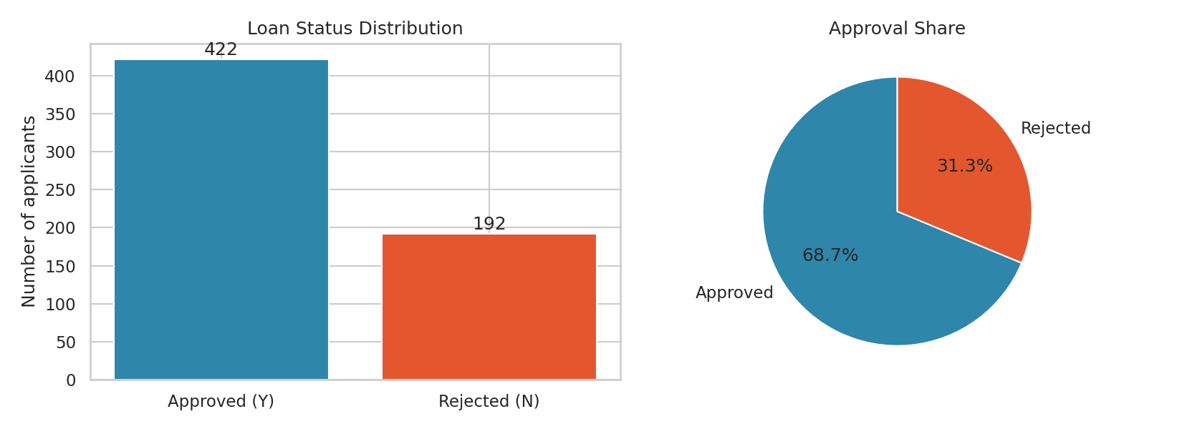
Dataset: Loan Prediction
614
12
applicants
input features
422
192
approved (68.7%)
rejected (31.3%)
Gender, marital status, dependents, education, employment, applicant and co-applicant income, loan amount and term, credit history, property area. 149 missing values in 7 columns.
Notes:
614 past applicants with 12 input columns and the outcome Loan_Status. About 69% were approved, so always predicting approved already gives 69% - that is our baseline.

Slide 5
Data Preparation and Features
Preprocessing pipeline
New features
Missing numbers: median
Missing categories: most frequent
Numbers: standard scaling
Categories: one-hot encoding
Fitted on training data only (no leakage)
TotalIncome
applicant + co-applicant
EMI
loan amount / term
BalanceIncome
income left after EMI
Log income, log loan
reduce skew
149 missing values across 7 columns are filled in, so all 614 records are kept.
Notes:
Missing values are filled inside the pipeline so the test set never influences training. Income is skewed so we use logs. EMI and balance income describe affordability.

Slide 6
Methodology
1
2
3
4
5
6
Load + EDA
Features
Pipeline
Split
Train + CV
Tune + Test
614 rows, charts
TotalIncome, EMI, logs
impute, scale, encode
80% train / 20% test
6 models, 5-fold
GridSearchCV, metrics
Tools: Python, pandas, scikit-learn, matplotlib, seaborn, Google Colab
Notes:
Walk through the pipeline left to right. The best model is chosen by cross-validated accuracy because a test set of 123 applicants is too small to trust on its own.

Slide 7
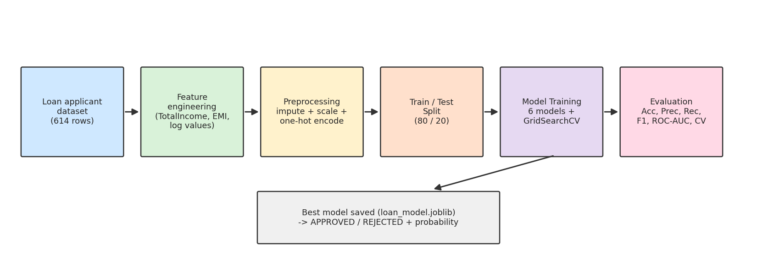
Model Architecture
Logistic Reg.
KNN
SVM (RBF)
Decision Tree
Random Forest
Gradient Boost.
linear, C tuned
k = 11
margin-based
depth 4
300 trees, tuned
100 shallow trees
Notes:
Every model sits in the same scikit-learn Pipeline, so preprocessing is identical and there is no data leakage. We compare six families of models and tune two of them.

Slide 8
Key Finding: Credit History Decides
79.6%
approved with good credit history
7.9%
approved without it
Gender: 67% vs 69%. Self-employed: 68% vs 69%. Almost no difference.
Notes:
Applicants with a good credit history were approved about 80% of the time; those without only 8%. Property area matters too. Gender and self-employment barely matter.

Slide 9
Results: Model Comparison
BEST MODEL
Logistic Regression (tuned, C = 0.1)
Test accuracy 86.18%
CV accuracy 79.83%
Precision 84.00%
Recall 98.82%
F1-score 90.81%
ROC-AUC 0.854
Notes:
All models beat the 69% baseline. Top models are within one point of each other in cross-validation, which is within noise for 614 rows. Tuned Logistic Regression ties with tuned Random Forest on CV, wins on F1 and AUC, and is easier to explain.

Slide 10
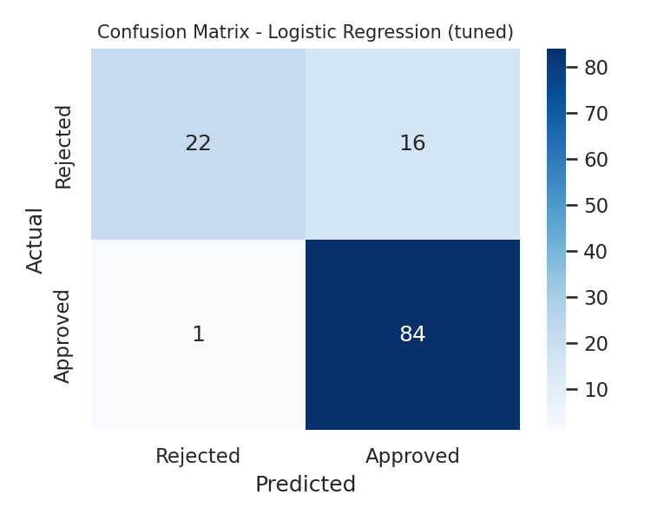
Results: Confusion Matrix
84 of 85
22 of 38
approved loans found
rejected loans caught
Rejected precision 95.7%: a rejection is almost always right
Rejected recall 57.9%: 16 risky loans slipped through
Test accuracy 86.18% vs baseline 69.11%
5-fold CV on all data: 80.30%
Notes:
The model almost never rejects a good applicant (1 of 85) but approves many risky ones (16 of 38 rejected loans). Cross-validation on all data gives 80.30%, the more cautious estimate.

Slide 11
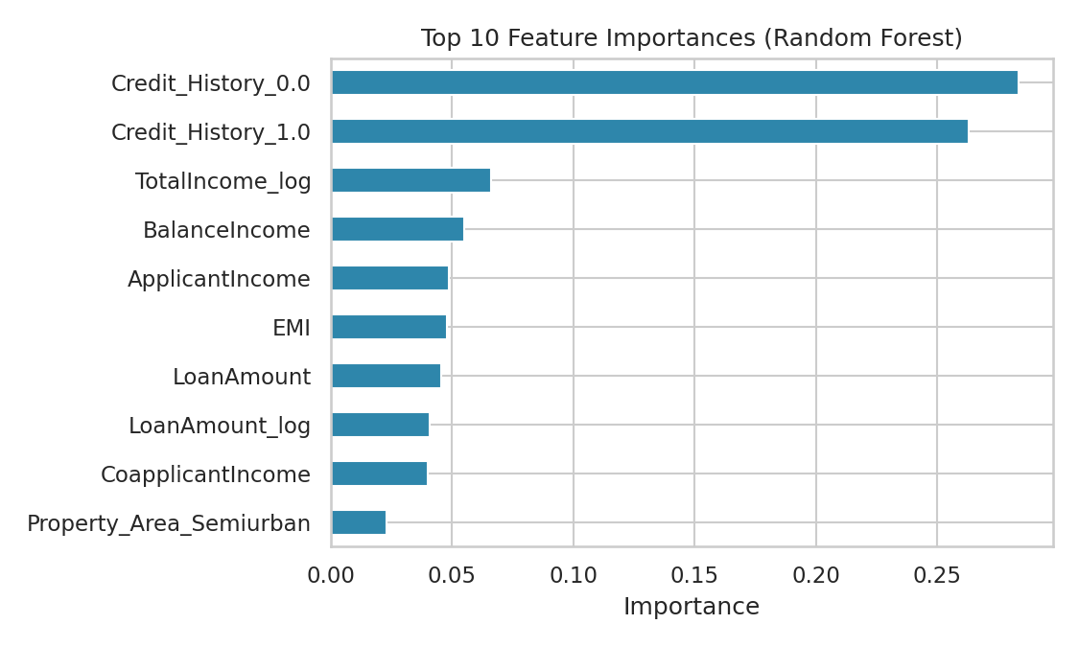
Which Features Matter?
Credit history: about 55% of importance
Then income, loan amount, EMI and balance income
Semiurban property, married and graduate: small positive effects
Engineered features appear in the top 5
Notes:
Credit history (both categories together) is about 55% of Random Forest importance. In Logistic Regression its coefficient is about three times bigger than any other. TotalIncome_log and BalanceIncome are engineered features, so the feature engineering helped.

Slide 12
Business Trade-off: Decision Threshold
57.9% to 71.1%
rejected recall at 0.5 vs 0.7
86.2% to 78.9%
accuracy at 0.5 vs 0.7
At 0.8 the model is too strict: only 33% of good loans approved.
Notes:
Raising the approval threshold from 0.5 to 0.7 catches 71% of the applications that should be rejected, but overall accuracy drops. The right threshold depends on the lender's cost of default, so it is a business decision.

Slide 13
Final Prediction Output
Graduate, married, good credit, income 6000
P(approve) = 0.84
APPROVED
Same profile but bad credit history
P(approve) = 0.38
REJECTED
Low income, large loan, no credit record
P(approve) = 0.12
REJECTED
High income, small loan, good credit
P(approve) = 0.78
APPROVED
Notes:
Same applicant, only the credit history changed: the decision flips from approved to rejected. These applicants are made up and are not in the dataset.

Slide 14
Conclusion and Future Scope
Conclusion
Future Scope
Tuned Logistic Regression: 86.18% test accuracy, 80.30% cross-validated
Baseline was 69.11%
Credit history is the key driver
Simple model matched complex ones on small data
Raise the threshold to reject more risky loans
More data and features (debts, credit score)
SMOTE / cost-sensitive learning
XGBoost, LightGBM, stacking
SHAP explanations and fairness audit
Streamlit web app and REST API
Notes:
Conclusion: about 80-86% accuracy against a 69% baseline; credit history dominates; the model is lenient, so raise the threshold. Future: more features, SMOTE, XGBoost, SHAP, fairness audit, Streamlit app.

Slide 15
Thank You
Questions?
Deepesh Tahlani| Naviotech Solutions Pvt Ltd | Guide: Mr. Md. Ameen

