Slide 1

Handwritten Digit Recognition Using Neural Networks
MNIST-based classification project
Deepesh Tahlani
Department of Artificial Intelligence
Naviotech Solution Pvt. Ltd.
Academic project presentation

Slide 2
Why automate handwritten digit reading?
Manual entry is slow and prone to human error.
Goal: classify a single grayscale digit image into one of ten classes, 0–9.
Project scope: supervised learning, single-digit 28×28 images, and a practical prediction demo.
2 / 10

Slide 3
MNIST turns handwriting into a learning problem
A fixed image format makes the task measurable.
70,000
28×28
0–9
grayscale images
pixels per image
one label from ten classes
60,000 images for training
10,000 images for testing
Pixel intensities begin in the 0–255 range before normalization.
3 / 10

Slide 4
Preprocessing makes every input consistent
The same transformation prepares both MNIST and custom images.
01
02
03
Load
Normalize
Prepare
Load MNIST arrays for training and testing.
Normalize each pixel by dividing by 255, mapping values to 0–1.
For custom images: grayscale → resize to 28×28 → normalize → reshape as a batch of one.
4 / 10

Slide 5
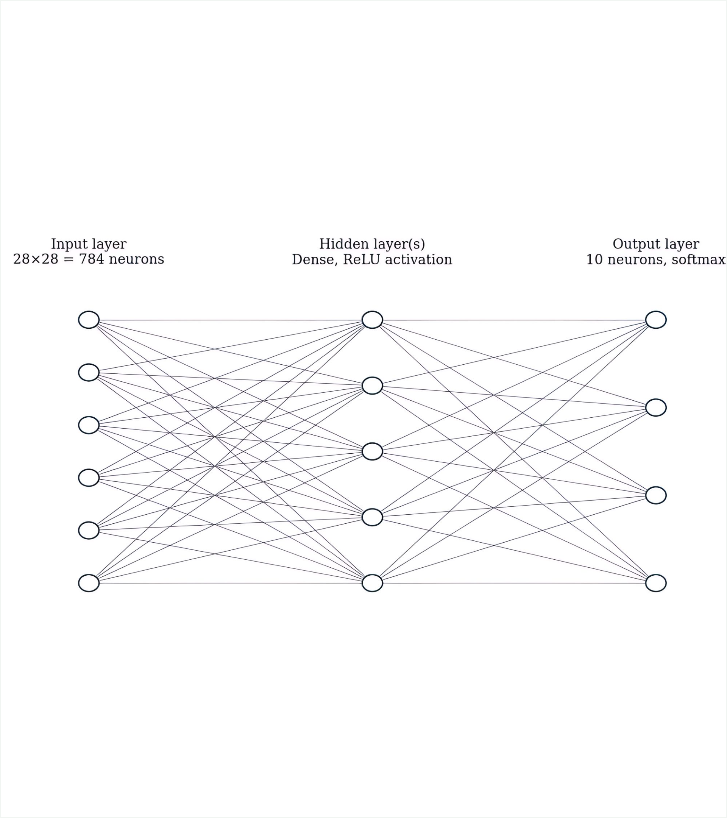
The model learns from pixels to probabilities
Input
28×28 grayscale image, flattened to 784 values.
Hidden dense layer(s)
ReLU activation learns non-linear stroke patterns.
Output
10 softmax neurons; argmax selects the predicted digit.
5 / 10

Slide 6
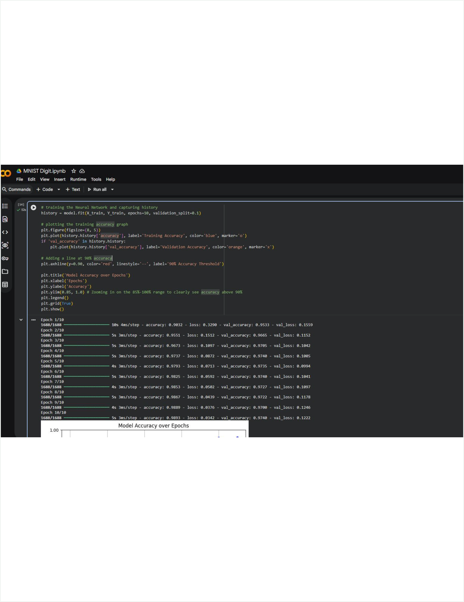
Training combines backpropagation with Adam
01
02
03
Loss
Gradients
Execution
Sparse categorical cross-entropy for integer labels.
Adam updates weights using gradients from backpropagation.
10 epochs with 10% of the training data held out for validation.
6 / 10

Slide 7
The implementation is a complete, reproducible pipeline
Each stage connects the experiment to the final prediction.
01
02
03
04
Load
Preprocess
Build
Compile
Python in Google Colab
MNIST arrays and image formatting
TensorFlow/Keras model
NumPy, OpenCV, Matplotlib
05
06
Train
Evaluate → predict
Backpropagation with Adam
Measure performance, then recognize a digit
7 / 10

Slide 8
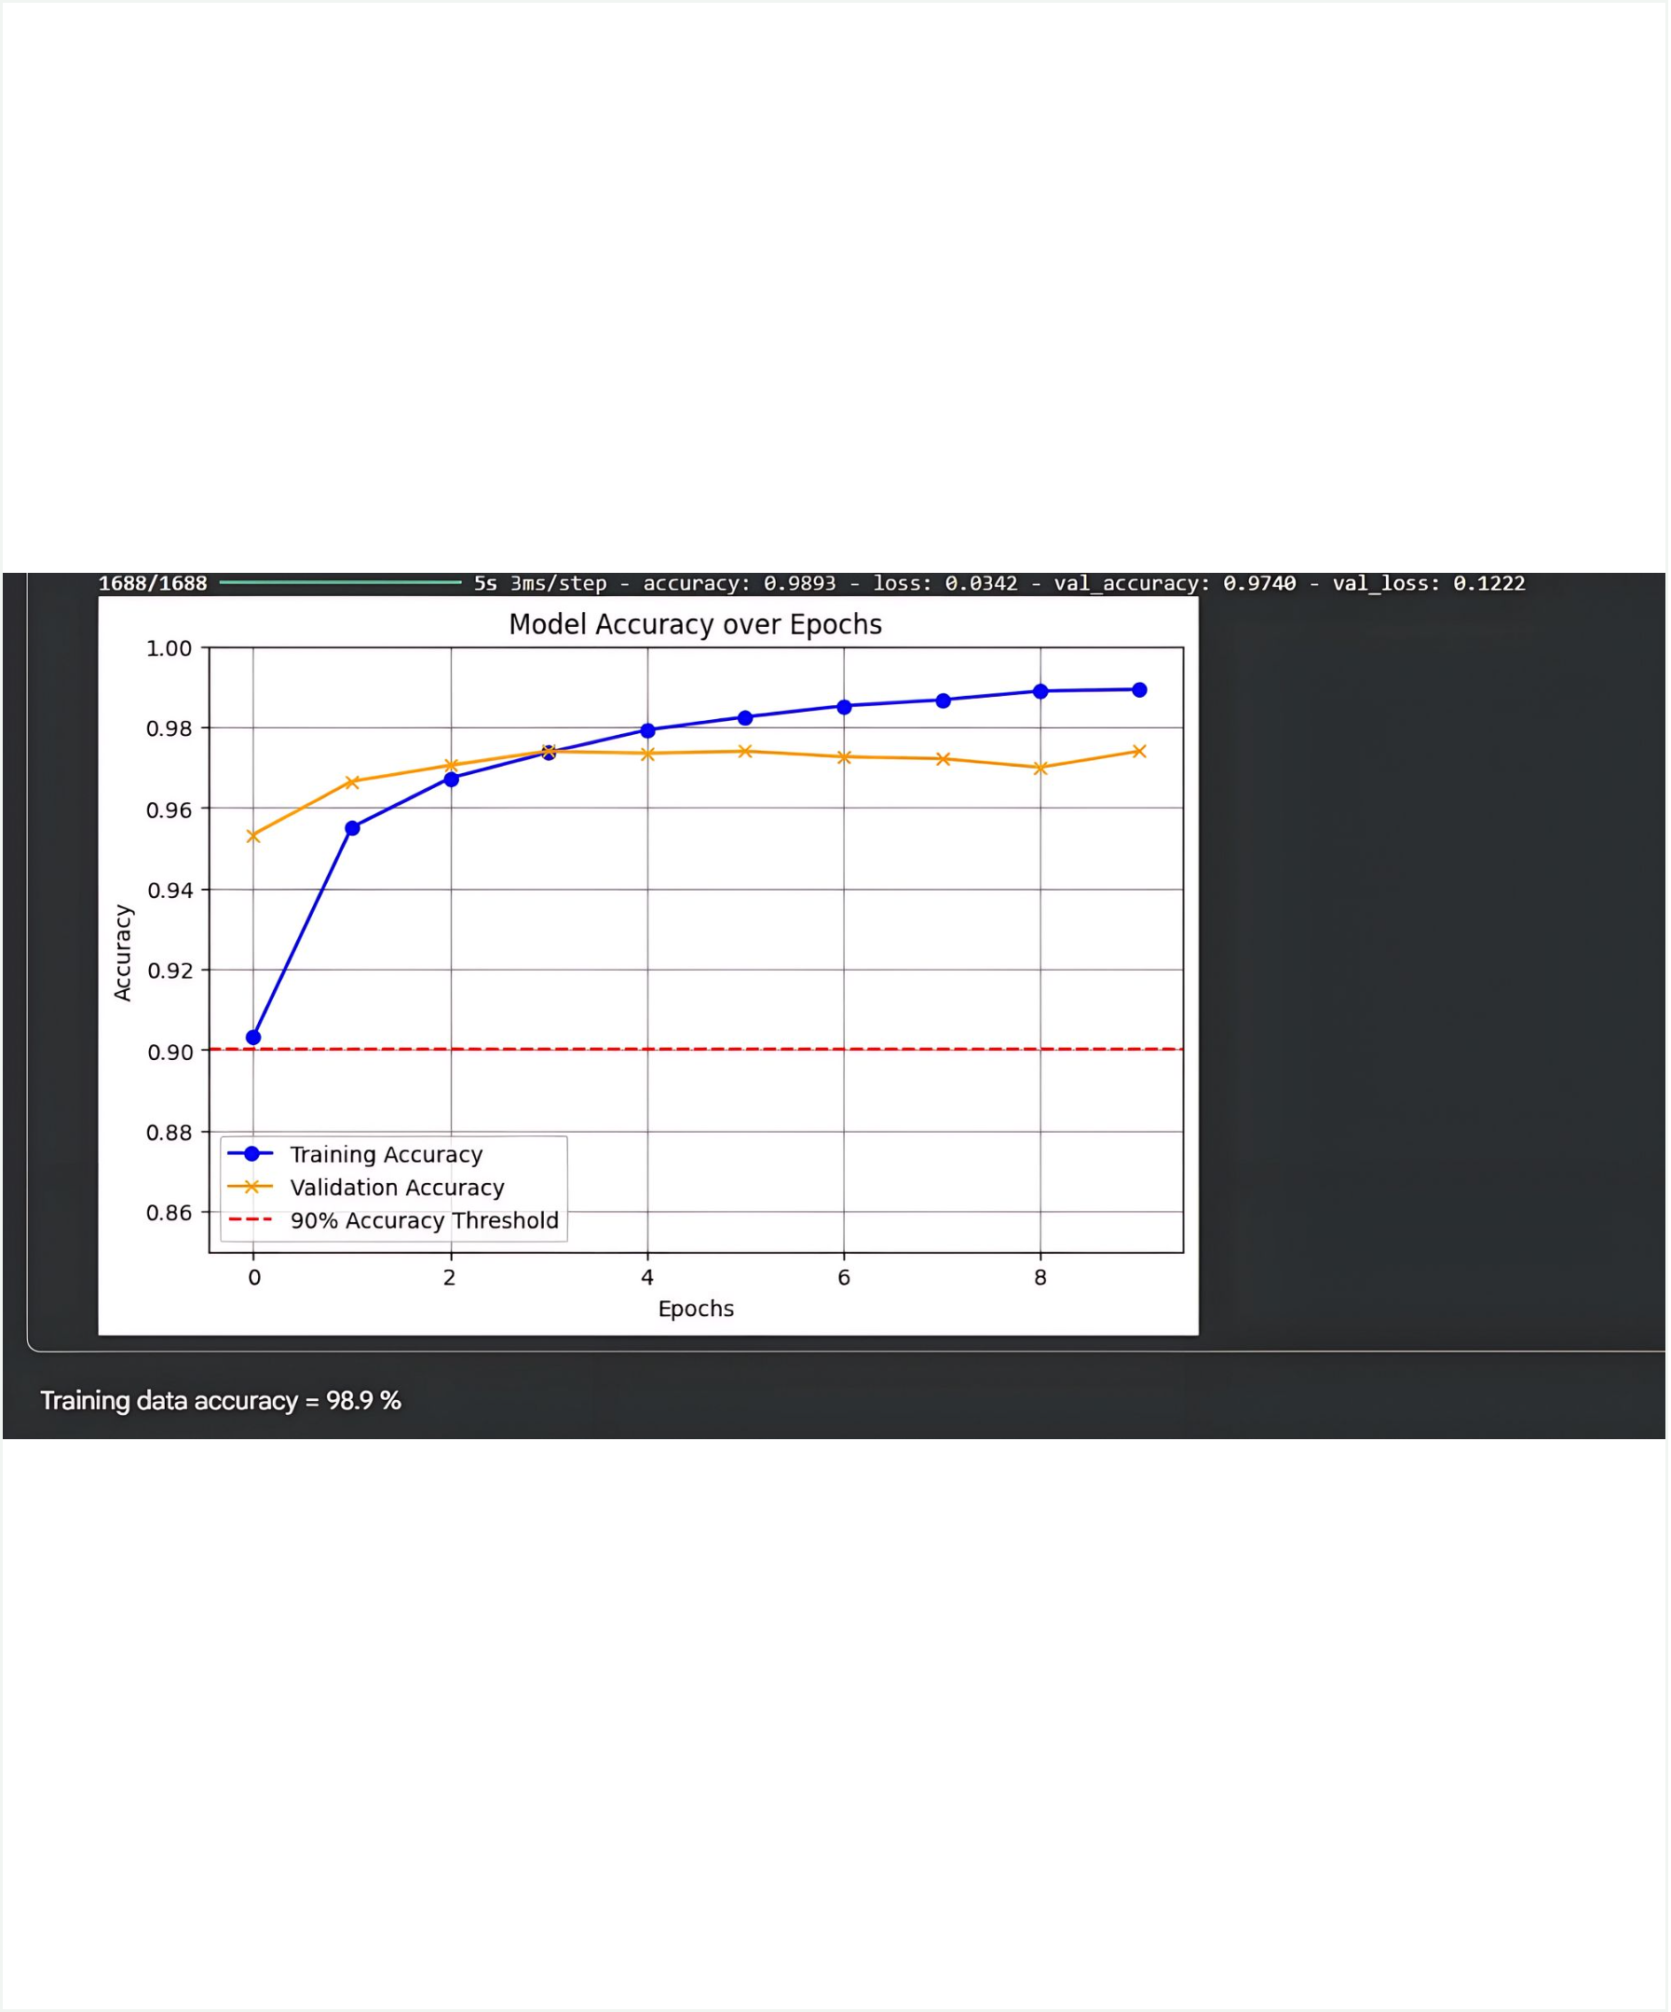
Accuracy crosses the target early and stays strong
Both curves remain above the 90% threshold.
98.93%
Final training accuracy
Training loss: 0.0342
97.40%
Final validation accuracy
Validation loss: 0.1222
The widening gap after the middle epochs suggests mild overfitting.
8 / 10

Slide 9
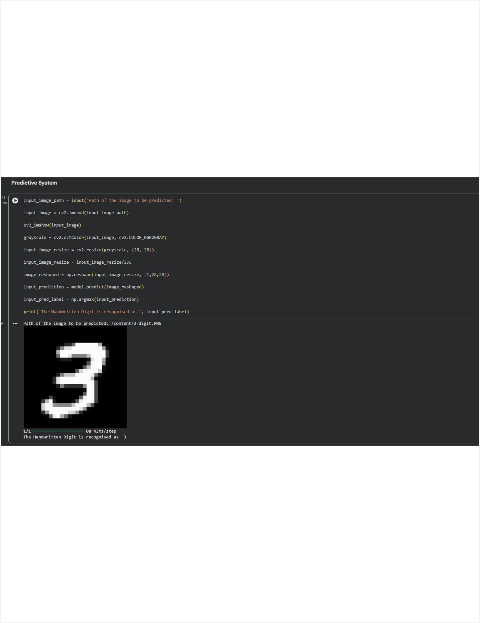
The predictive system recognizes a custom handwritten 3
OpenCV reads the image and converts it into the same normalized 28×28 format used during training.
The trained model returns the class with the highest softmax probability.
Demonstrated output: the handwritten digit is recognized as 3.
9 / 10

Slide 10
A simple MLP is a strong starting point
The project moves from dataset preparation to deployment in one reproducible workflow.
WHAT THE PROJECT PROVES
NEXT STEPS
TAKEAWAY
End-to-end workflow
Extend the system
High-accuracy recognition
The project proves an end-to-end workflow from dataset preparation to deployment.
Compare with a CNN, add augmentation, support multi-digit sequences, and test real-time camera input.
A compact neural network can deliver high-accuracy single-digit recognition on MNIST.
10 / 10

