Slide 1
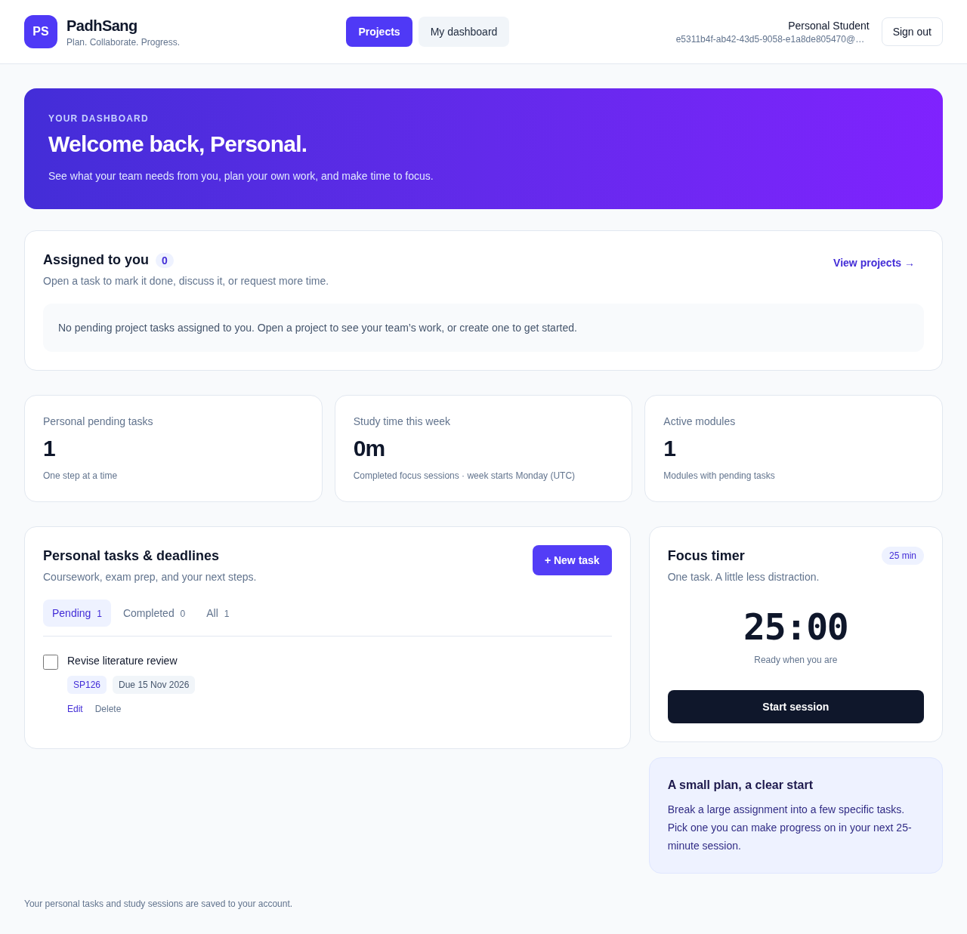
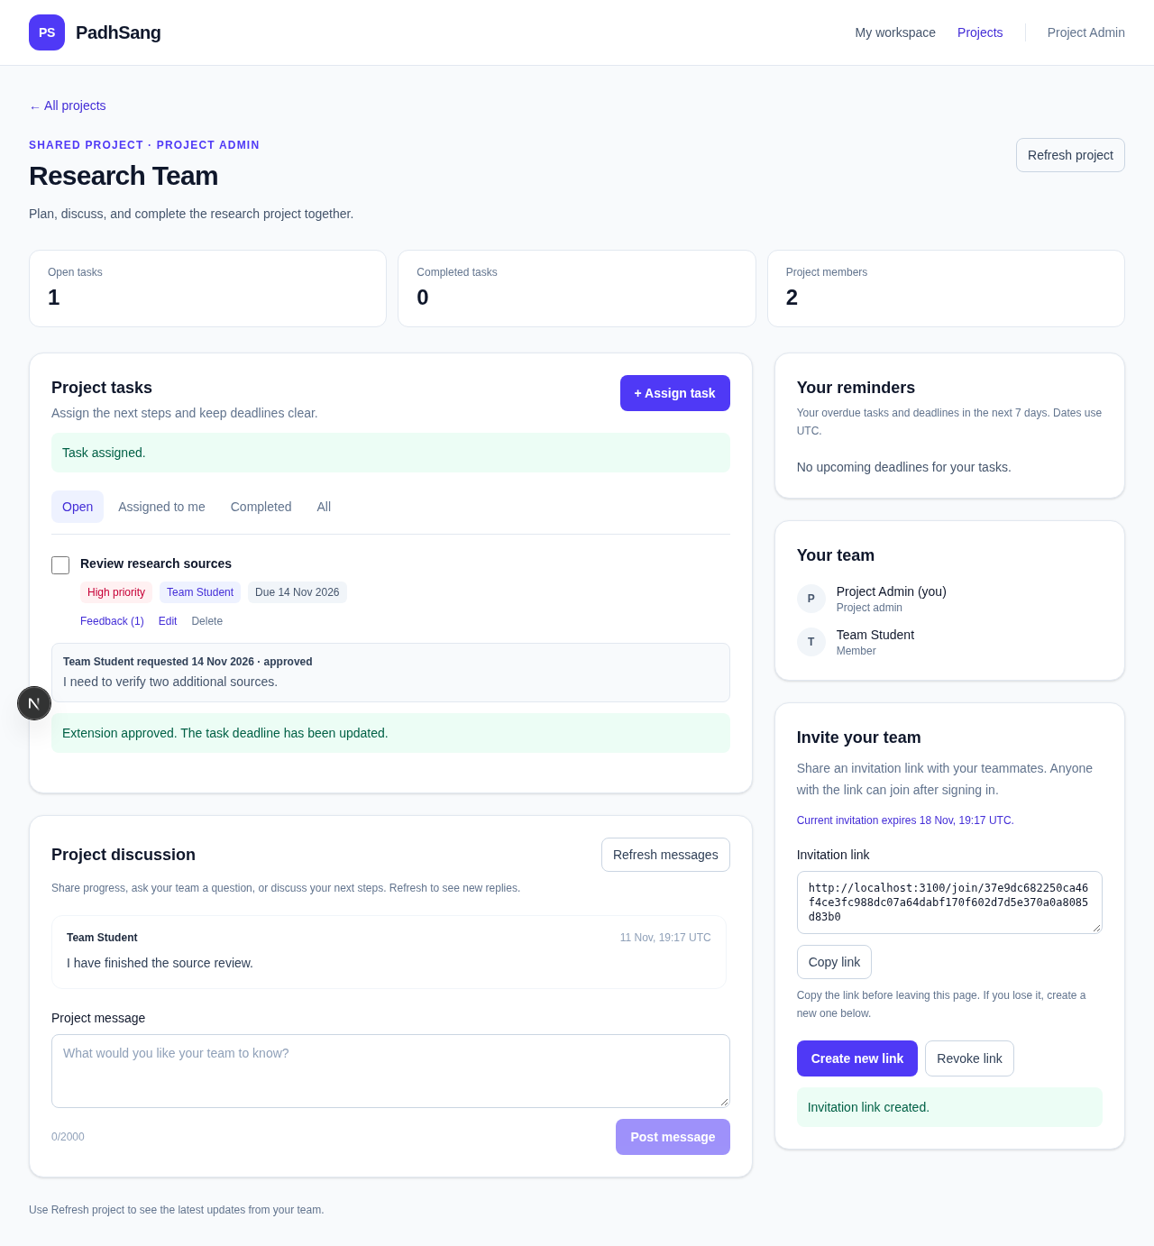
PS
PadhSang
PLAN. COLLABORATE. PROGRESS.
A secure collaborative workspace for student projects
Deepesh Kumar • SID 2327937 • Supervisor: Priyanka Sharma
I built, tested and investigated PadhSang to answer how third-party authentication and server-side authorisation can support secure student collaboration.
The tested system passed 25/25 automated checks and 5/5 complete browser workflows.
Problem & aim
Application evidence
What I found
Student teams often split discussions, deadlines and personal planning across different tools.
Aim: design and evaluate one secure workspace for project collaboration and focused study.
Research question: How can OAuth and server-side access control protect a practical student workspace?
Testing indicated that the implemented server-side checks separated personal and project data in the tested scenarios.
Members completed assigned workflows, while non-members were denied project access.
Security also depended on external OAuth, database and hosting configuration—not only application code.
What I built
Personal dashboard: assigned work, planner and focus timer
• Google and Microsoft OAuth support
• Project invitations and membership
• Assigned tasks, priorities and deadlines
• Extension requests and owner decisions
• Discussion and task feedback
• In-app reminders and private planner
• Persistent 25-minute focus timer
Security decisions
• Database-backed authenticated sessions
• Owner/member/assignee permission checks
• Hashed, expiring invitation tokens
• Transactional extension decisions
• Safe internal redirect validation
• No production test-login bypass
Project workspace: permissions, task workflow and discussion
Testing & results
Limitations
Secure architecture
25/25
5/5
12
• Microsoft live sign-in still needs provider credentials and real-account verification.
• Discussion refresh is manual; reminders are in-app only.
• Automated checks are not a formal penetration test or user study.
• Initial hosting was suspended pending provider review.
Student
→
Google / Microsoft
OAuth
→
Next.js + Auth.js
server checks
→
Prisma + PostgreSQL
SERVICE + SECURITY TESTS
BROWSER WORKFLOWS
DATABASE TABLES
Covered data isolation, task ownership, project membership, invitations, extension decisions, feedback, timer persistence and responsive layouts.
Membership and ownership are checked on every protected server operation. Invitation tokens are random, hashed and expire after seven days.
✓ Production build passed ✓ PostgreSQL migration passed
Conclusion
PadhSang demonstrates that secure authentication, role-based access and collaborative study tools can be combined in one practical student workspace.
Source: github.com/deepeshkumarbangrwa-sys/study-sync • Evidence uses isolated synthetic test accounts • References: OWASP Authentication Cheat Sheet; Auth.js; Next.js; Prisma

