Slide 1
Bro intrusion detection system (IDS): an overview
Nick Buraglio
Network Engineer, ESnet
Lawrence Berkeley National Laboratory
Enhancing CyberInfrastructure by Training and Education
Webinar
05/22/2015

Slide 2
What is the Bro IDS?
An actively developed intrusion detection system originally developed and published by Vern Paxson in 1998, with work starting as early as 1995 currently funded by the NSF and supported by joint efforts at the International Computer Science Institute (ICSI) and National Center for Supercomputing Applications (NCSA)
Open Source Software, licensed under the BSD license.
http://www.bro.org/
Notes:
Unlike a typical signature based IDS that will perform actions when a specific signature is identified, Bro profiles network traffic and tells you what your network is doing. It is is up to the manager of bro to determine what is and is not acceptable and alert worthy. It’s a programming language for looking at traffic. It operates on streams.

Slide 3
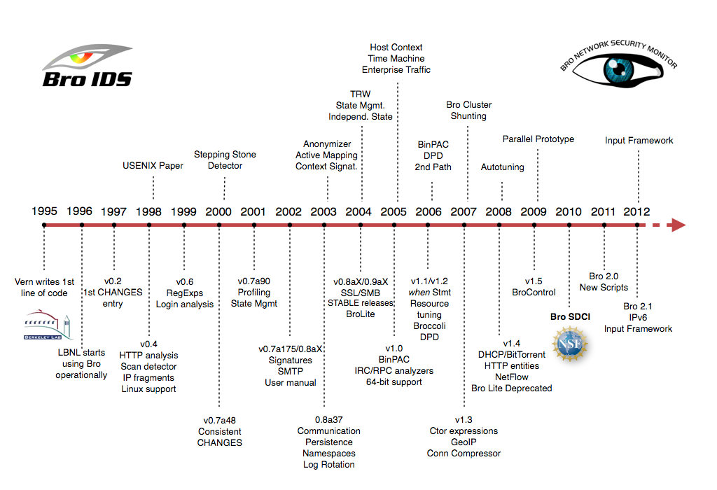
Image source: http://www.bro.org
Notes:
Here is a brief timeline detailing the progress and development of bro

Slide 4
What is the Bro IDS?
A network Monitoring Platform
Commonly used as a power anomaly and intrusion detection system (IDS)
A modular software stack: three components
Packet processing layer
Event Engine
A policy script interpreter

Slide 5
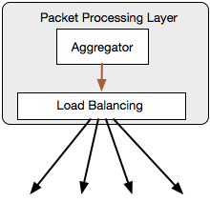
What is the Bro IDS?
Packet processing layer
Has knowledge of what the higher layers need
Can exist as hardware or software
Pass data to higher layers according to configuration / policy
In most cases this layer is an external device or software stack
Notes:
In most cases the packet processing layer is handled by an external process or device. This would be the gigamon, cpacket, arista types of devices.

Slide 6
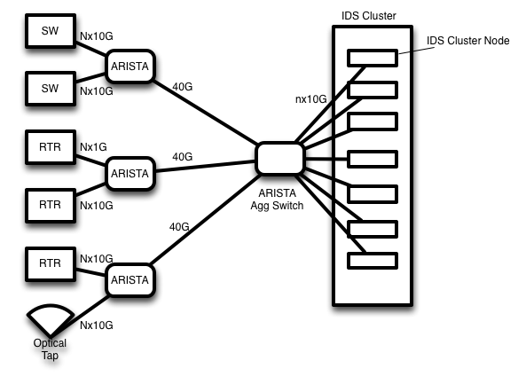
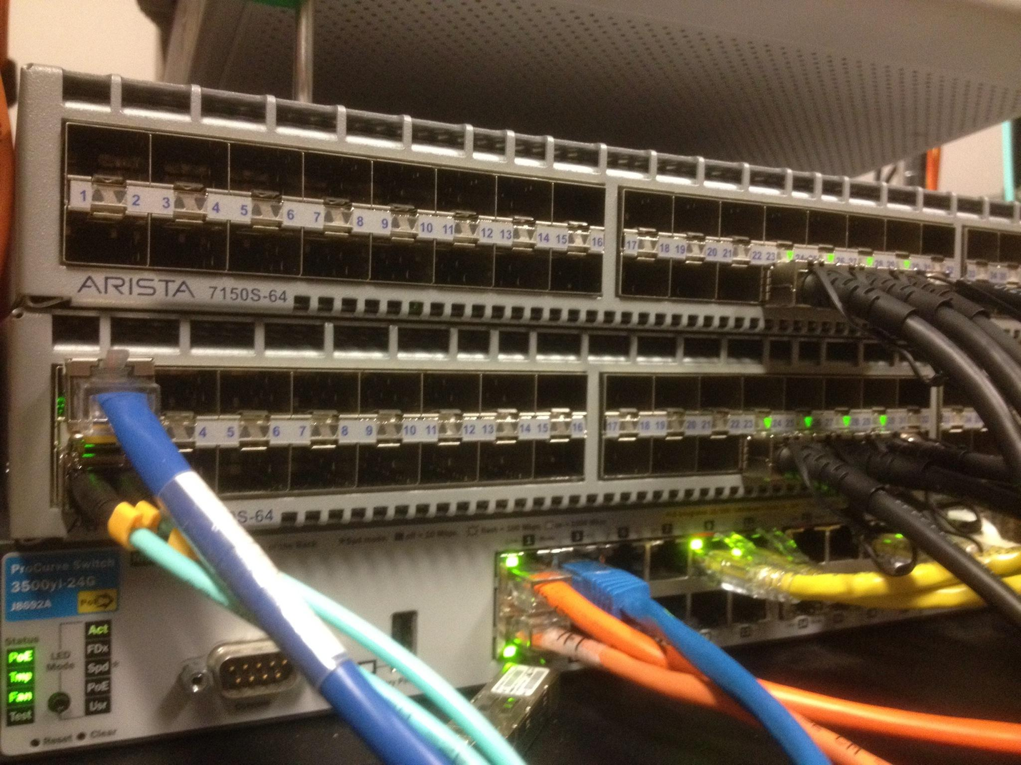
What is the Bro IDS? Packet Processing Layer
Packet processing layer example
External hardware consuming and breaking out data streams to each bro node
Notes:
This was an architecture and proof of concept that I did a few years ago utilizing Arista devices for this task. It can also be accomplished by using openflow and things such as scipass or with other commercial devices like gigamon and cpacket. I did a brief write up which is a little dated at this point but the concept pieces are there.

Slide 7

What is the Bro IDS?
Event Engine or “Bro Core”
Dynamic Protocol Detection (DPD)
Generates “Events” to be processed

Slide 8

What is the Bro IDS?
A policy script interpreter
Acts on Events.
Bro Programming Language
Pre-built frameworks and protocol analyzers
Ships with basic policies that primarily provide logging

Slide 9
An example

Slide 10
What does the Bro IDS do?
Bro provides the following capabilities including (but not limited to):
Deep packet inspection
Attack and anomaly detection
Event correlation
Alert generation
Full IPv6 and IPv4 support
A powerful, flexible policy scripting language
Scalable, clustering architecture
Accolades
Born from research and education networking
Used and tested in the fastest networks on the planet

Slide 11
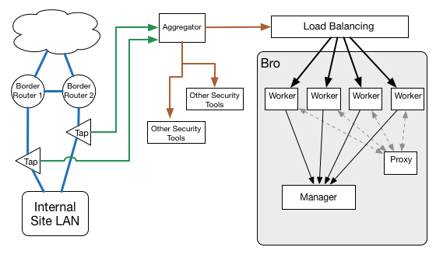
Science Data and large flows
Image courtesy of Mike Dopheide dopheide@es.net

Slide 12
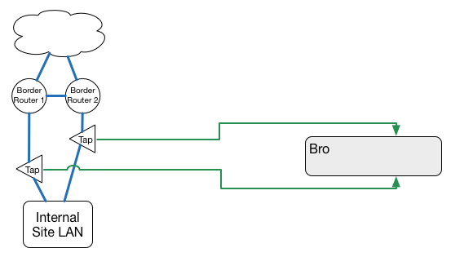
Science Data and large flows

Slide 13
Integration
Integrates into existing tools
Utilize resources already in place
SIEM (Log aggregation)
Log hosts (Log aggregation)
Splunk (Log aggregation)
Flow data collectors (As an analog or verification tool)
Pagerduty (Alerting and notification)
custom middleware (Other proprietary services for internal process)
Built for flexibility.
Scalable
IPv4 and IPv6 aware
Notes:
These are part of the defense in depth strategy. You may or may not have them but their functions often exist as part of a larger security architecture. Bro can either integrate into or augment these types of services.

Slide 14
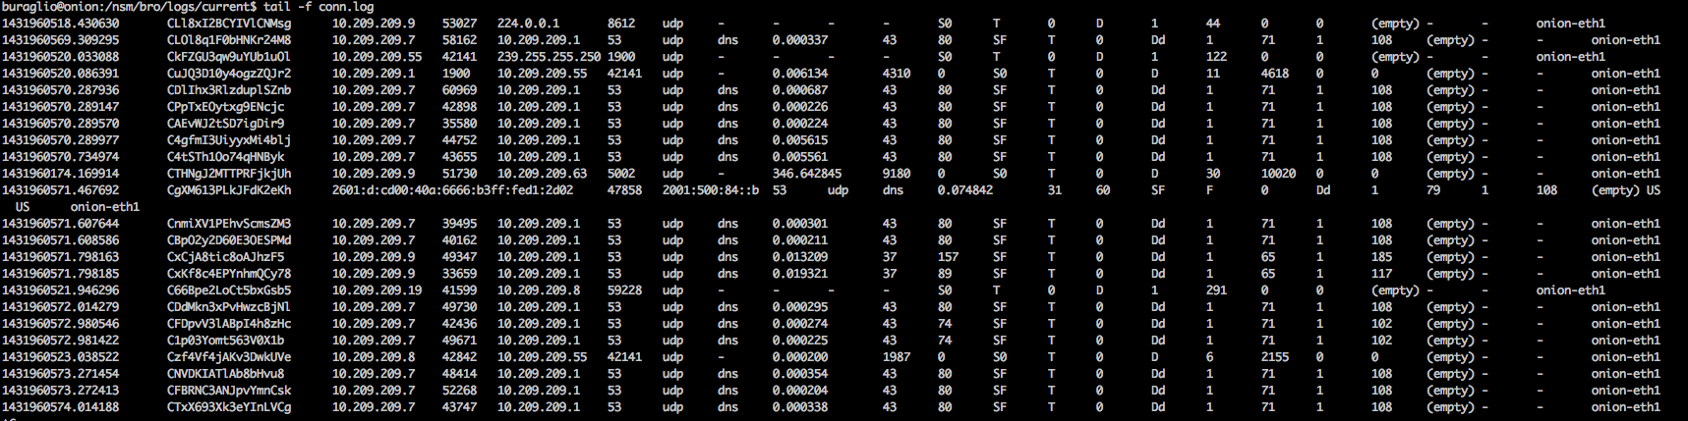
Actions: Logging

Slide 15

Actions: Alerting
Customizable Notification framework
Large number of variables:
$note
$msg
$sub
$conn
$id
$src
$n
$identifier
$suppress_for
Notes:
This can be tailored to whatever your site needs. It is very flexible. There is a global policy and then each alert can be customised based on needs and requirements.

Slide 16
Out of the box….
Connection Log
Similar to netflow information
Protocol specific logs:
HTTP, FTP, SMTP, IRC, SSH, SSL, DNS, …
Observational logs:
known_certs, known_services, known_devices, software, files
Detection:
Intel, notice, notice_alarm, signatures, traceroute
Diagnostics
capture_loss, packet_filter, communication, reporter
Notes:
Bro provides a really nice set of logs to start with right out of the box; You can coorelate things like netflow with connection logs, see anomalies with protocols like http. ftp, ssh, irc, etc. It also allows for some good observational data for things like known certs, services and will even produce some notices and alarms. It is also useful for simple diagnostics like detecting capture loss.

Slide 17
Out of the box: Notices
CaptureLoss::Too_Much_Loss
Conn::Retransmission_Inconsistency
Conn::Ack_Above_Hole
Conn::Content_Gap
DNS::External_Name
FTP::Bruteforcing
FTP::Site_Exec_Success
HTTP::SQL_Injection_Attacker
HTTP::SQL_Injection_Victim
Heartbleed::SSL_Heartbeat_Attack
Heartbleed::SSL_Heartbeat_Attack_Success
Heartbleed::SSL_Heartbeat_Odd_Length
Heartbleed::SSL_Heartbeat_Many_Requests
Intel::Notice
PacketFilter::Compile_Failure
PacketFilter::Install_Failure
PacketFilter::Too_Long_To_Compile_Filter
PacketFilter::Dropped_Packets
PacketFilter::Cannot_BPF_Shunt_Conn
ProtocolDetector::Protocol_Found
ProtocolDetector::Server_Found
SMTP::Blocklist_Error_Message
SMTP::Blocklist_Blocked_Host
SMTP::Suspicious_Origination
SSH::Password_Guessing
SSH::Login_By_Password_Guesser
SSH::Watched_Country_Login
SSH::Interesting_Hostname_Login
SSL::Certificate_Expired
SSL::Certificate_Expires_Soon
SSL::Certificate_Not_Valid_Yet
SSL::Invalid_Server_Cert
SSL::Invalid_Ocsp_Response
SSL::Weak_Key
SSL::Old_Version
SSL::Weak_Cipher
Scan::Address_Scan
Scan::Port_Scan
Signatures::Sensitive_Signature
Signatures::Multiple_Signatures
Signatures::Multiple_Sig_Responders
Signatures::Count_Signature
Signatures::Signature_Summary
Software::Software_Version_Change
Software::Vulnerable_Version
Traceroute::Detected
Weird::Activity
Notes:
Bro is able to consume and utilize any number of community intelligence feeds. There are free, open and private feeds. Much like any good security deployment, this is not set and forget. It needs care and feeding over time with an initial ramp up of tuning to allow for squelching and minimizing false positives.

Slide 18
Care and feeding
Consume community intelligence feeds
Alert based on a combination of criteria from different feeds
Tuning, tuning, tuning.
Not “set and forget”**
** Out of the box, untuned Bro IDS will still provide huge amounts of useful information.
Example to follow.
Notes:
Bro is able to consume and utilize any number of community intelligence feeds. There are free, open and private feeds. Much like any good security deployment, this is not set and forget. It needs care and feeding over time with an initial ramp up of tuning to allow for squelching and minimizing false positives.

Slide 19
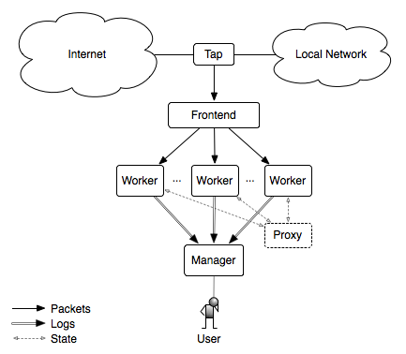
Clustering
Bro provides a very powerful clustering environment
Image via https://www.bro.org
Notes:
This is how bro is able to consume data from very large network feeds. Distribution of the data via the packet processing layer helps distribute the load to worker nodes allowing the data to be consumed in smaller streams.

Slide 20
Actions
Execute external scripts for operational response
Black hole routing
https://github.com/buraglio/singularity
https://github.com/JustinAzoff/bhr-site
Apply ACLs
Quarantine hosts
...basically anything that you can write a script to do
Notes:
A good example of this is the black hole routing, and this can also tie back into an existing infrastructure as well. Given an existing or new black hole router, Bro is able to, based on user defined criteria, execute a script that can insert routes into a black hole router. There are projects on github that provide this functionality.

Slide 21
15’ view.
A quick view of a single bro instance running on a small network.
Notes:
Bro is able to consume and utilize any number of community intelligence feeds. There are free, open and private feeds. Much like any good security deployment, this is not set and forget. It needs care and feeding over time with an initial ramp up of tuning to allow for squelching and minimizing false positives.

