Slide 1
Deep-Learning and HPC to Boost Biomedical Applications for Health
HPC-Lab
Eduardo Quiñones, Sergi Albiach
{eduardo.quinones, sergi.albiach}@bsc.es
BSC
Iacopo Colonnelli, Barbara Cantalupo
{iacopo.colonnelli, barbara.cantalupo}@unito.it
UNITO
DeepHealth Winter School – 24 January 2022

Slide 2
Objectives of the HPC-Lab
Extract the parallelism exposed by a set of simple benchmarks and parallelised them with COMPSs
Identify the parallelism exposed by three data-parallelism training strategies: Synchronous, Relaxed Synchronous, Removed Synchronous
Execute performance experiments on a parallel environment composed of 2, 4, 8 and 16 GPUs

Slide 3
Agenda
Kubernetes Environment Setup
Parallel exercises with simple benchmarks
Identify the parallelism exposed by training operations
Execute performance experiments

Slide 4
Kubernetes Environment Setup

Slide 5

Environment
Execution Environment Setup
Readme.md → Instructions to deploy the pods and start a run
datasets → folder with the datasets that are used in the docker image
docker → folder with code (pyeddl), configuration scripts (compss), Dockerfile and Makefile to create the image
kubernetes → folder with yaml file to configure the cluster
*From https://gitlab.bsc.es/ppc-bsc/software/deep-health-compss
Readme.md
datasets
docker
kubernetes

Slide 6
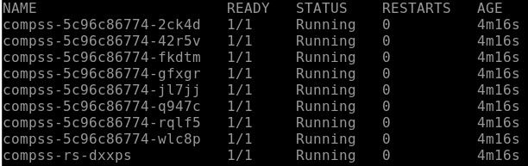
Deployment
Execution Environment Setup
Go to the “kubernetes” folder
Execute the command: “kubectl create –f compss_deephealth.yaml” *
Wait until the pods are correctly initialized (Running)
You can see the state of the pods with the command: “kubectl get pods”
* you’ll see the number of worker replicas set to 16 but less workers will be created to fit the maximum number of available pods

Slide 7
Deployment
Execution Environment Setup
The resultant computing infrastructure for the example shown belong are 1 master node and 8 worker nodes (9 kubernetes pods)
Each pod is composed of an Intel 12-core and a NVIDIA A40 GPU
Workers are named like: compss-**********-*****
Master is named like: compss-rs-*****
master
worker1
worker2
worker3
worker4
worker5
worker6
worker7
worker8

Slide 8
Initial Configuration
Execution Environment Setup
Space 1
Space 2
Space 3
Space 4
Space 5
Space 6
Group1
Group2
Group3
Group4
Group5
Group6

Slide 9
Deployment
Execution Environment Setup
Every pod, master or worker, has the same deployed image containing, among other files:
The configuration script (configure_compss.sh),
The folder containing the code that will be executed (pyeddl, pyeddl/simple)
A run script (runcompss.sh)
The image starts in a conda environment that has been created with the following main packages:
Python 3.6
PYCOMPSs 2.8
PYEDDL 1.1

Slide 10
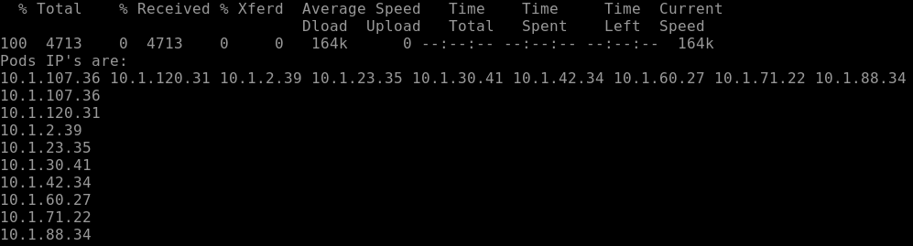
Execution: Master Initialization
Execution Environment Setup
In order to enter the master pod, the following command should be executed (replace * with master’s name): “kubectl exec –it compss-rs-***** -- /bin/bash”
Now, you are inside the master. The worker’s IPs must be added to a “project.xml” and “resources.xml” files so that COMPSs is able to locate the pods and distribute the tasks. This is done with the command: “bash configure_compss.sh”
IPs of the distributed computing infrastructure (pods)

Slide 11
COMPSs execution
Execution Environment Setup
The run will be handled by the “runcompss.sh” script. It can be modified, if desired, to change the dataset, the network, the number of epochs and the number of workers *. The following options are accepted:
--dataset= “mnist” – “cifar10”
--network= “simple-mnist” – “lenet” – ”vgg16”
--num_epochs= any integer
--num_workers= 1 – 2 – 4 – 8
--sync_type= 0 – 1 – 2 (sync, asyncm, full-async)
Once the parameters are correctly defined, execute the following command to run the code: “bash runcompss.sh”
* to modify the file in the master you can use vi like: “vi runcompss.sh” Press Insert to enable modifications, make your changes and press the sequence Esc - :wq to save and close the edit view.

Slide 12
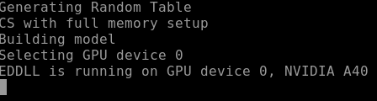

COMPSs execution
Execution Environment Setup
Once the parameters are correctly defined, execute the following command to run the code: “bash runcompss.sh”
The first time the code is executed it is usual to face a wait of 5 minutes. This is because the model is being built first in the master and then in parallel in the workers.

Slide 13
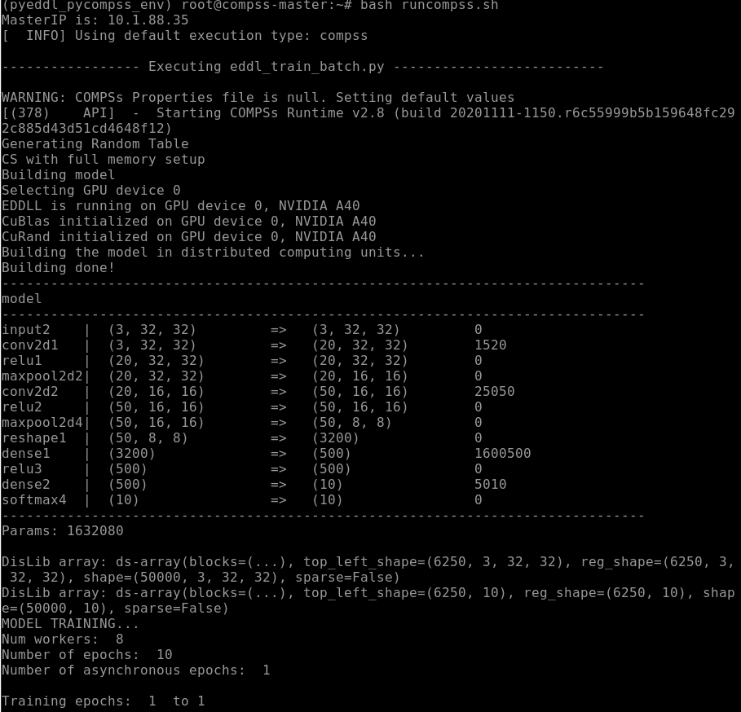
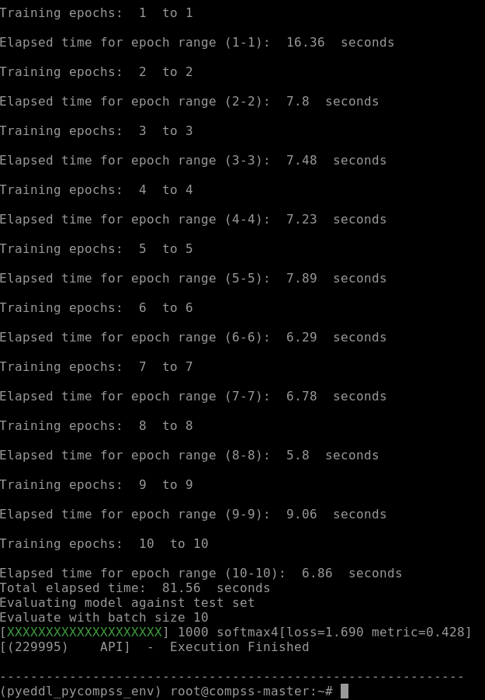
COMPSs execution
Execution Environment Setup
After the building, the model is trained and tested against the test set

Slide 14
Termination
The execution of a run can be stopped by pressing Ctrl+C. Make sure that after this kind of abrut stopping you execute the command “compss_clean_procs”, just in case any compss process did not end correctly.
To exit the pod just type “exit”
To end the deployment, exit the pod and in the “kubernetes” folder execute the command: “kubectl delete –f compss_deephealth.yaml”.
Take into account that this process may take several seconds, so it is recommended to wait until no pods are deployed before starting a new deployment. Remember that you can see the state of the pods with the command: “kubectl get pods”

Slide 15
Parallel exercises with simple benchmarks

Slide 16
Memory Model and Parallel distribution
COMPSs Task Model
The master maintains the memory consistency and distributes the asynchronous tasks across the workers
Workers
(resource.xml)
Master
i
@task(x=OUT)
def f1(i):
…
return x
@task(x=IN)
def f2(x):
…
def main():
x=f1(i)
f2(x)
Resource 2
Native Linux
main
f1
main
f1
Resource 1
4. Data Transfer
f1
x
1. Data renaming of WaR and WaW
2. TDG generation
f2
3. Task Scheduling
f2
Resource 3
cloud
f2

Slide 17
Memory Model and Parallel distribution
COMPSs Task Model
@task(x=OUT)
def f1(i):
return i*2
@task(x=IN)
def f2(x):
return x+2
def main():
for i in [1..2]
x=f1(i)
y=f2(x)
compss_wait_on(y)
@task (python decorator) to describe parallel units
compss_wait_on (COMPSs runtime call) for coarse-grain synchronization
IN,OUT,INOUT data dependencies (python decorator) for fine-grain synchronization
worker
f2
f2
x=2
y=4
x=4
y=6
worker
f1
f1
i=1
i=2
compss_wait_on
compss_wait_on
master
main
main
main

Slide 18
Exercise 1
Parallel exercises with simple benchmarks
Identify the parallelism exposed by the simple1.py (available in pyeddl/simple folder) by:
Identifying the parallel units
Identifying the synchronization dependencies
Parallelised the program using 4 COMPSs tasks
Edit the “runcompss.sh” script to invoke simple1.py and run the script as follows:
“bash runcompss.sh”
def f1(val):
return val + 1
​
def f2(val):
return val + 2
​
def f3(val):
return val + 3
​
def f4(val1, val2, val3):
return val1 + val2 + val3
​
if __name__ == "__main__":
val1 = f1(1)
val2 = f2(2)
val3 = f3(3)
​
sum = f4(val1, val2, val3)
print(sum)

Slide 19
Exercise 1: Solution
Parallel exercises with simple benchmarks
@task(val=IN)
def f1(val):
return val + 1
​
@task(val=IN)
def f2(val):
return val + 2
​
@task(val=IN)
def f3(val):
return val + 3
​
@task(val1=IN, val2=IN, val3=IN)
def f4(val1, val2, val3):
return val1 + val2 + val3
​
if __name__ == "__main__":
val1 = f1(1)
val2 = f2(2)
val3 = f3(3)
​
sum = f4(val1, val2, val3)
sum = compss_wait_on(sum)
print(sum)
master
workers
main
val=1,2,3
f1
f2
f3
val2=3
val1=2
val3=4
f4
sum=9
wait
print(9)

Slide 20
Exercise 2
Parallel exercises with simple benchmarks
Identify the parallelism exposed by the simple2.py (available in pyeddl/simple folder) by:
Identifying the parallel units
Identifying the synchronization dependencies
Parallelised the program using 3 COMPSs tasks
Edit the “runcompss.sh” script to invoke simple2.py and run the script as follows:
“bash runcompss.sh”
def f1(val):
return val + 1
​
def f2(val):
return val + 2
​
def f3(val):
return val + 3
​
def f4(val1, val2, val3):
return val1 + val2 + val3
​
if __name__ == "__main__":
val1 = f1(1)
val2 = f2(2)
val3 = f3(3)
​
sum = f4(val1, val2, val3)
print(sum)

Slide 21
Exercise 2: Solution
Parallel exercises with simple benchmarks
@task(val=IN)
def f1(val):
return val + 1
​
@task(val=IN)
def f2(val):
return val + 2
​
@task(val=IN)
def f3(val):
return val + 3
​
def f4(val1, val2, val3):
return val1 + val2 + val3
​
if __name__ == "__main__":
val1 = f1(1)
val2 = f2(2)
val3 = f3(3)
​
val1=compss_wait_on(val1)
val2=compss_wait_on(val2)
val3=compss_wait_on(val3)
​
sum = f4(val1, val2, val3)
print(sum)
master
workers
main
val=1,2,3
val1=2
f1
f2
f3
val2=3
val3=4
wait
f4
print(9)

Slide 22
Exercise 3
Parallel exercises with simple benchmarks
Identify the parallelism exposed by the simple3.py (available in pyeddl/simple folder) by:
Identifying the parallel units
Identifying the synchronization dependencies
Parallelised the program
Edit the “runcompss.sh” script to invoke simple3.py and run the script as follows:
“bash runcompss.sh”
def increment(val):
return val + 1
​
​
if __name__ == "__main__":
arr = [1,2,3,4,5]
​
for i in range(len(arr)):
arr[i] = increment(arr[i])
​
print(arr)

Slide 23
Exercise 3 - Solution
Parallel exercises with simple benchmarks
master
workers
@task(val=IN)
def increment(val):
return val + 1
​
if __name__ == "__main__":
arr = [1,2,3,4,5]
​
for i in range(len(arr)):
arr[i] = increment(arr[i])
arr = compss_wait_on(arr)
​ print(arr)
main
val=1,2,3,4,5
incr
incr
incr
incr
incr
arr
wait
print()
[2,3,4,5,6]

Slide 24
Exercise 4
def initialize_variables():
…
def multiply(a, b, c):
import numpy as np
c += a*b
​
if __name__ == "__main__":​
…
​
initialize_variables()
​
for i in range(MSIZE):
for j in range(MSIZE):
for k in range(MSIZE):
multiply(A[i][k], B[k][j], C[i][j])
​
​
for i in range(MSIZE):
for j in range(MSIZE):
print ("C" + str(i) + str(j) + "=" +
str(C[i][j]))
Parallel exercises with simple benchmarks
Identify the parallelism exposed by the simple4.py (available in pyeddl/simple folder) by:
Identifying the parallel units
Identifying the synchronization dependencies
Parallelised the program
Edit the “runcompss.sh” script to invoke simple4.py and run the script as follows:
“bash runcompss.sh”

Slide 25
Exercise 4
Parallel exercises with simple benchmarks
def initialize_variables():
…
@task(c=INOUT)
def multiply(a, b, c):
import numpy as np
c += a*b
​
if __name__ == "__main__":​
…
​
initialize_variables()
​
for i in range(MSIZE):
for j in range(MSIZE):
for k in range(MSIZE):
multiply(A[i][k], B[k][j], C[i][j])
​
​
for i in range(MSIZE):
for j in range(MSIZE):
print ("C" + str(i) + str(j) + "=" +
str(compss_wait_on(C[i][j])))
master
workers
main
A[i][j],B[i][j],C[i][j]
mult
mult
…
mult
C[i][j]
MSIZE*MSIZE*MSIZE
wait
print(C[0][0])
wait
print(C[0][1])
wait
print(C[MSIZE][MSIZE])

Slide 26
Identify the parallelism exposed by training operations

Slide 27
Code Structure
Identify the parallelism exposed by training operations
eddl_master_train_batch.py, loads the dataset, builds the model and invokes the fit processes:
fit_sync, corresponding to Synchronous Parameter Averaging
fit_async, corresponding to Relaxing Synchronzation
fit_full_async, corresponding to Removing Synchronzation
eddl_master_distributed_api.py, implements the fit processes by iterating over a number of predefined epochs and workers, and invoking train_batch and aggregation_paramaters processes
eddl_worker_sequential.py, invokes the eddl functions build and train_batch
eddl_master_train_batch.py
eddl_master_distributed_api.py
eddl_worker_sequential.py

Slide 28
Exercise 5
Identify the parallelism exposed by training operations
Identify the parallelism exposed by the fit_sync, fit_async, fit_full_async functions (available in pyeddl/eddl_master_distributed_api.py and invoking pyeddl/eddl_worker_sequential.py ) by:
Identifying the parallel units
Identifying the synchronization dependencies
Determine which functions should be executed by the master node and which by the worker node
fit_sync
(Synchronous
Parameter
Averaging)
fit_async
(Relaxing Synchronzation)
fit_full_async
Removing Synchronzation

Slide 29
Exercise 5 solution
Identify the parallelism exposed by training operations
eddl_master_train_batch.py, loads the dataset, builds the model and invokes the fit processes:
fit_sync, corresponding to Synchronous Parameter Averaging
fit_async, corresponding to Relaxing Synchronzation
fit_full_async, corresponding to Removing Synchronzation
eddl_master_distributed_api.py, implements the fit processes by iterating over a number of predefined epochs and workers, and invoking train_batch and aggregation_paramaters processes
eddl_worker_distributed.py, invokes the eddl functions build and train_batch
eddl_master_train_batch.py
eddl_master_distributed_api.py
eddl_worker_distributed.py

Slide 30
Exercise 5 - Solution
Identify the parallelism exposed by training operations
Synchronous Parameter Averaging
@task(INOUT = weights)
def train_batch(model, dataset):
# A train operation is executed at each worker
# on the model and the dataset passed
[…]
def main():
# A new model is created
net = eddl.model([…])
build(net)
for i in range(num_epochs):
shuffled_data=global_shuffling(dataset)
for j in range(num_batches):
param[j] = train_batch(net,shuffled_data[j])
# Synchronize all parameters from workers
compss_wait_on(param)
parameter_averaging(net,param)
Worker Node
1
2
3
Master Node
3
2
1
2
3
1

Slide 31
Exercise 5 - Solution
Identify the parallelism exposed by training operations
Relaxing Synchronzation
@task(INOUT = weights)
def train_batch(model, dataset):
@task(partial_global_param=COMMUTATIVE, local_params=IN)
def aggreg_params_async(partial_global_params, local_params):
def main():
net = eddl.model([…])
build(net)
for i in range(0, num_async_epochs):
for j in range(0, num_workers):
shuffled_data[j]=selective_shuffle(dataset)
worker_parms[j]=train_batch(net, shuffled_data[j])
partial_parms[j]=aggreg_params_async(partial_gparams,workers_parms[j])
Worker Node
1
2
3
4
5
6
Master Node

Slide 32
Exercise 5 - Solution
Identify the parallelism exposed by training operations
@task(INOUT = weights)
def train_batch(model, dataset):
# A train operation is executed at each worker
# on the model and the dataset passed
[…]
def main():
# A new model is created
net = eddl.model([…])
build(net)
for i in range(num_epochs):
for j in range(num_batches):
shuffled_data=local_shuffling(dataset[j])
param[j]=train_batch(net,shuffled_data [j])
# Synchronize all parameters from workers
compss_wait_on(param)
parameter_averaging(net,param)
Worker Node
Removing Synchronzation
1
2
3
Master Node

Slide 33
Performance experiments on a parallel environment

Slide 34
Setup 1 (Initial Configuration)
Performance experiments on a parallel environment
Space 1
Space 2
Space 3
Space 4
Space 5
Space 6
Group1
Group2
Group3
Group4
Group5
Group6

Slide 35
Setup 2
Performance experiments on a parallel environment
Space 1
Space 4
Empty Space
Group1
Group2
Group3
Group4
Group5
Group6
Master
Master
(At every new setup configuration, the environment needs to be configured again; see slides 6 to 10)

Slide 36
Setup 3
Performance experiments on a parallel environment
Space 2
Empty Space
Group1
Group2
Group3
Group4
Group5
Group6
Master
(At every new setup configuration, the environment needs to be configured again; see slides 6 to 10)

Slide 37
Experiments to be conducted
 | Setup 1 | Setup 2 | Setup 3
Group 1 | --num_workers=1/2 --sync_type= 0 | --num_workers=8 --sync_type= 0/1
Group 2 | --num_workers=1/2 --sync_type= 1 |  | --num_workers=16 --sync_type= 0/1/2
Group 3 | --num_workers=1/2 --sync_type= 2
Group 4 | --num_workers=1/4 --sync_type= 0 | --num_workers=8 --sync_type= 2
Group 5 | --num_workers=1/4 --sync_type=1
Group 6 | --num_workers=1/4 --sync_type=1

Slide 38
Experiments to be conducted
Conduct two executions per experiment collecting:
Model accuracy
Total elapsed time
Report the experiments here:
https://docs.google.com/spreadsheets/d/10CZWpdG9ZnYGkuVOiDofHfAsLgPLNvilAFNDoUIxgl4/edit?usp=sharing

Slide 39
COMPSs execution
Execution Environment Setup
Configure “runcompss.sh” script with the following options:
--dataset= “cifar10”
--network= “lenet”
--num_epochs= 10
--num_workers= 1 – 2 – 4 – 8 – 16
--sync_type= 0 – 1 – 2 (sync, asyncm, full-async)
Execute the train: “bash runcompss.sh”
* to modify the file in the master you can use vi like: “vi runcompss.sh” Press Insert to enable modifications, make your changes and press the sequence Esc - :wq to save and close the edit view.

Slide 40
Evaluation
Let’s comment the experiments!
for sure there will be many surprises… ;)

Slide 41
Thank you!
Eduardo Quiñones
eduardo.quinones@bsc.es

