Slide 1
Department of Data Science & Cyber Security
III B.Tech I Semester MiniProject-2023
Submitted by
Batch -07
Decentralized Image Upload and Sharing
Names: RollNo:
S. Deepika 21R21A6255
P. Varshitha 21R21A6244
S. Swathi 21R21A6254
Shaik Rehana 21R21A6251
R. Varsha 21R21A6245
P. Jitendra 21R21A6243
Supervisor:
Mr. A. Kiran Kumar Reddy,
Assistant Professor, Department of Cyber Security.

Slide 2
Contents
Abstract
Introduction
Features
Existing System
Advantages
Disadvantages
Proposed Systems
System Design
Literature Survey
Requirements
Output Analysis
Conclusion

Slide 3
Abstract
This project facilitates decentralized image upload and sharing on the blockchain using Solidity for the smart contract and React for the front-end interface.
It enables users to securely upload images to IPFS (InterPlanetary File System) and share access with specified users through smart contract functionality.
This decentralized approach eliminates the need for a central authority, enhancing privacy and reducing the risk of data manipulation. Additionally, the system incorporates a peer-to-peer (P2P) content delivery mechanism, optimizing speed and efficiency in image retrieval.
This innovative solution addresses concerns related to centralized platforms, offering a decentralized alternative that prioritizes user autonomy, security, and resilience.

Slide 4
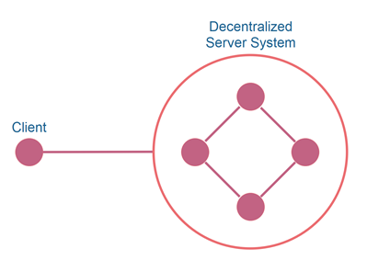
Introduction
Decentralized Google Drive systems offer an innovative approach to file storage and sharing, steering away from traditional centralized models. Unlike the typical Google Drive, which relies on centralized servers owned by a single entity (Google), a decentralized system operates through a network of interconnected devices, distributing data across multiple nodes.
These systems often utilize blockchain or peer-to-peer technology, allowing users to store, manage, and share files without relying on a central authority.

Slide 5
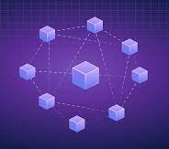


Features
Decentralized Storage: Images are uploaded to IPFS, ensuring decentralized and immutable storage.
Smart Contract: Utilizes Solidity smart contracts on the Ethereum blockchain for access control and ownership management.
Access Control: Users can grant or revoke access to their uploaded images to specific individuals through the smart contract.

Slide 6
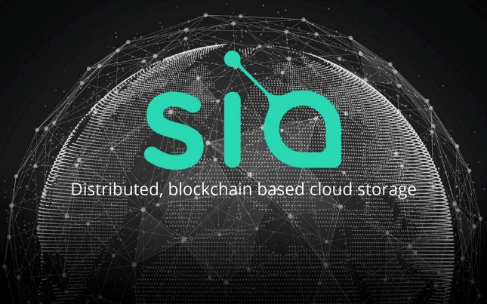
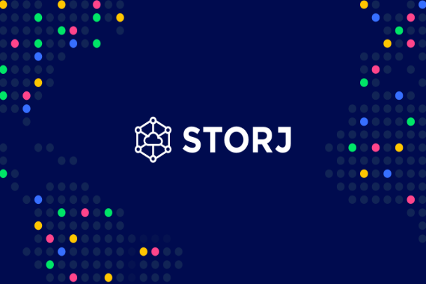
Existing System
Users can update the file by replacing the same file name
Users can share files and folders with others by addressing their email link
The system can support file and folder Sync across the devices
The system can allow each user to upload up to 10 GB for free.

Slide 7
Advantages
Censorship Resistance.
Data Privacy and Ownership
Data Integrity
Decentralized Storage

Slide 8
Disadvantages
User Experience
Dependency on Network
Security Concerns
Energy Consumption

Slide 9
Proposed System
Decentralized image upload and sharing platforms leverage blockchain technology and decentralized storage systems to provide a secure, censorship-resistant, and transparent way of sharing images without relying on a central authority.
These platforms focus on ensuring data integrity, privacy, and control for users.
The decentralized nature of blockchain technology enhances security, trust, and transparency, making it a powerful tool for various applications beyond cryptocurrencies, including supply chain management, voting systems, and decentralized finance (DeFi).
Community governance, open-source development, and interoperability with other blockchains are integral aspects of decentralized blockchains, fostering collaboration and innovation within the broader blockchain ecosystem.

Slide 10
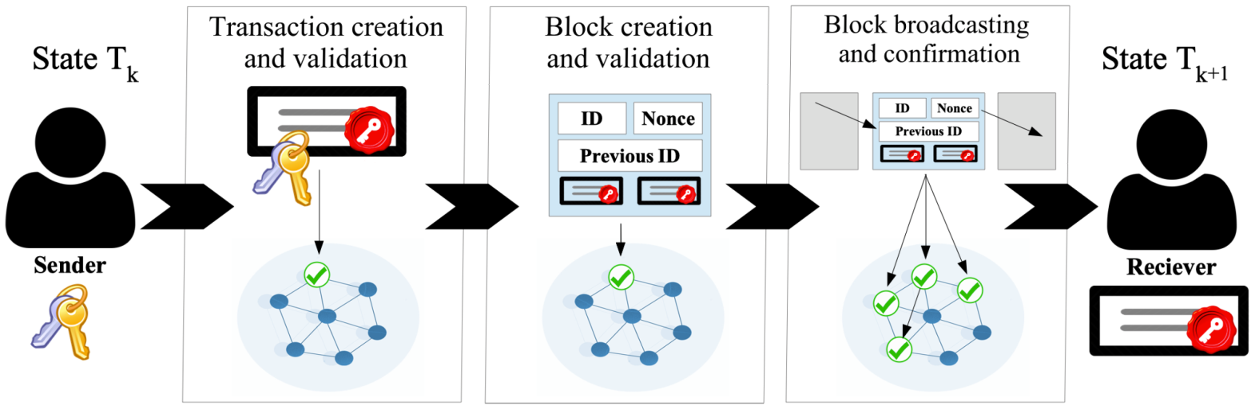
System Design

Slide 11
Literature Survey
TITLE | AUTHOR | OBJECTIVE | METHODOLOGY | FEATURES
Maidsafe | David Irvine, Viv Rajkumar | The Maidsafe project aims to create a decentralized and autonomous data network. This paper provides security, privacy, and decentralization. | MaidSafe uses a self-authentication mechanism, where users generate a unique cryptographic key pair. | provides a secure, private, and decentralized internet experience for users worldwide.
Filecoin | Juan Benet, Jesse Clayburgh, et al. | Filecoin aims to create a decentralized, incentivized, and secure storage network and the way data is stored and accessed. | Filecoin is a decentralized storage network that incentivizes users to share their storage space in exchange for cryptocurrency. | It offers an alternative to traditional centralized storage systems, providing users with greater control over their data

Slide 12
Requirements
Software Requirements:
Solidity
React
IPFS
Hardware Requirements:
Reliable internet connection
Smart Contract

Slide 13
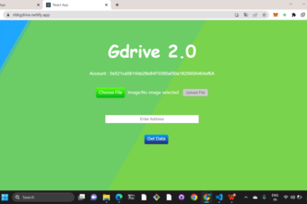
Output Analysis
Uploading file on pinata cloud

Slide 14
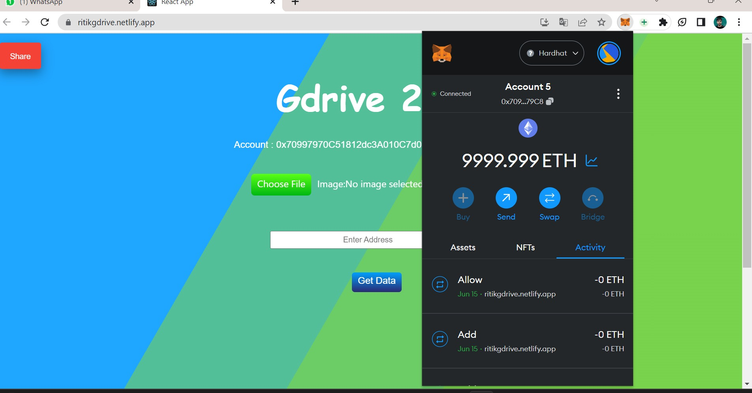
Data exiting:
Output Analysis

Slide 15
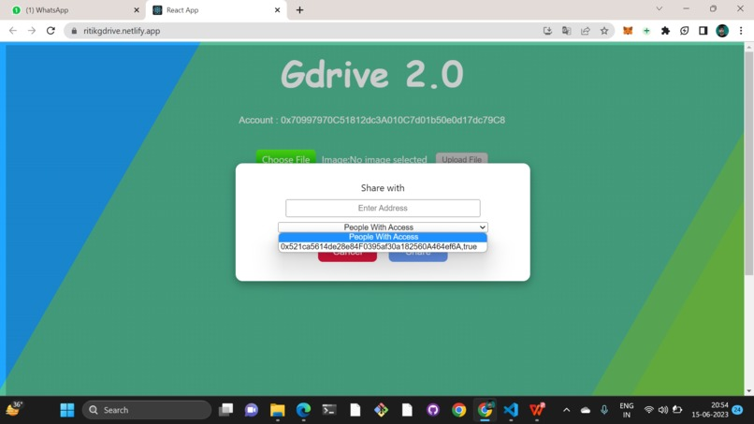
Share the data of account five to account one
Output Analysis

Slide 16
Conclusion
Creating a decentralized Google Drive alternative offers promising solutions through systems like IPFS, Filecoin, Storj, Sia, and Swarm. While these platforms offer decentralized storage and enhanced security, replicating the full suite of Google Drive's features—such as real-time collaboration, seamless integration, and high-performance—remains a challenge in the decentralized landscape. However, these systems represent substantial strides towards decentralized, secure file storage, emphasizing data ownership and privacy. As these technologies evolve, they may eventually offer a more comprehensive decentralized alternative to Google Drive.

Slide 17


