Slide 1

DEPARTMENT OF ARTIFICIAL INTELLIGENCE
DESIGN PROJECT–II – 20AM6203
BATCH NO : 03
BATCH MEMBERS :
INDUJA N 811722001015
DEEPIKA P 811722001007
MACTHALIN SWEETY S 811722001029
GUIDED BY
Mrs. D. Deena Rose, M.E., (Ph.D),

Slide 2
PERSONALIZED TUTOR BOT

Slide 3
The bot tailors personalized learning paths based on individual career goals through capacity tests and adaptive final assessments with real‑time progress tracking, delivering targeted recommendations and actionable feedback for exam readiness.
OBJECTIVE

Slide 4
EXISTING SYSTEM
AI-powered learning assistant that adapts to users goals, analyzes learning capacity, and provides customized study paths for efficient progress.
DEMERITS
Traditional Methods: Unlike AI-driven platforms, conventional tutoring lacks adaptive learning strategies and personalized recommendations.
No Capacity Analysis: Standard teaching methods don’t assess learning speed, comprehension, or reasoning skills, limiting effective guidance.
Limited Integration: Existing systems often lack seamless connection between different learning tools, making progress tracking difficult.
Delayed Feedback: Manual grading and teaching methods can slow down learning, reducing real-time insights into strengths and weaknesses.

Slide 5
PROPOSED SYSTEM
An intelligent learning assistant that customizes study plans based on user goals and cognitive capacity, ensuring an optimized and adaptive learning experience.
BENEFITS
Personalized Learning Analysis: AI evaluates IQ, knowledge, typing speed, and comprehension to tailor study plans effectively.
Goal-Oriented Approach: Users define their learning objective—whether competitive exams or skill development—ensuring focused preparation.
Smart Curriculum Recommendations: The bot designs structured learning paths based on assessments, adapting the pace and depth to individual needs.
Final Knowledge Assessment: A comprehensive test at the end of the course offers readiness insights, helping users gauge their progress.

Slide 6
LITERATURE SURVEY
S.NO | TITLE | YEAR | AUTHOR | TECHNIQUES AND TOOLS USED | MERITS | DEMERITS
1 | AI-Assisted Assessment and Feedback Systems | 2019 | M. Williams, T. Lee | NLP algorithms for automated grading, AI-based feedback mechanisms enhance evaluation accuracy and efficiency. | Provides instant assessment, improving learning effectiveness and reducing human bias in grading. | Subjective evaluations (such as essays) may produce inconsistent or inaccurate results.
2 | AI-Based Personalized Education | 2021 | J. Smith, R. Brown | Machine learning models analyze user behavior and recommend adaptive content, optimizing learning efficiency. | Customizes learning paths for individuals, improving engagement and retention rates. | Requires large datasets for effective personalization, raising data privacy concerns.
3 | Gamification in Learning Platforms | 2021 | A. Kumar, L. Johnson | AI-driven scoring systems, game mechanics incentivize engagement and encourage retention through interactive learning. | Makes learning fun and interactive, increasing motivation and participation. | Can distract learners from academic goals if gamification is not properly balanced.

Slide 7
S.NO | TITLE | YEAR | AUTHOR | TECHNIQUES AND TOOLS USED | MERITS | DEMERITS
4 | Deep Learning for Skill-Based Education | 2022 | S. Patel, D. Robinson | Neural networks, reinforcement learning algorithms adapt to user progress for optimized skill-building. | Dynamically adjusts to learning patterns, helping individuals strengthen specific skills. | Requires high computational power, making it less accessible for lower-resource environments.
5 | EdTech Growth and AI-Driven Learning Strategies | 2023 | P. Singh, G. Garcia | Predictive analytics, AI-powered tutors provide personalized learning recommendations based on user activity. | Enhances learning efficiency by tailoring educational content to individual needs. | Raises ethical concerns surrounding data collection, privacy, and algorithmic bias.
6 | Adaptive AI in Competitive Exam Preparation | 2024 | B. White, C. Thompson | Bayesian models, AI-driven question banks adjust difficulty levels based on user performance analytics. | Tailors learning experiences by focusing on users' strengths and weaknesses for optimized exam readiness. | Requires frequent updates to stay relevant to changing exam formats and syllabus requirements.

Slide 8
DATA FLOW DIAGRAM
USER LOGIN
CAPACITY ANALYSIS
GOAL SELECTION
FEEDBACK
FINAL ASSESSMENT
RECOMMENDATION PATH

Slide 9
SYSTEM & SOFTWARE SPECIFICATION
HARDWARE SPECIFICATIONS
Processor: Intel Core i5/i7 (or AMD Ryzen 5/7) – Supports efficient AI processing.
RAM: Minimum 8GB (Recommended 16GB+ for faster data handling).
Storage: SSD (256GB+, recommended 512GB for smooth performance).
Graphics: Integrated GPU (or NVIDIA GTX/RTX for AI-based media processing).
Network: Stable Wi-Fi / Ethernet (minimum 50Mbps for web-based operations).
Input/Output: USB ports, HDMI, high-resolution monitor support.

Slide 10
SYSTEM & SOFTWARE SPECIFICATION
SOFTWARE SPECIFICATIONS
Operating System: Windows 10/11, macOS, or Linux-based environments.
Programming Language: Python, JavaScript, and Flask for AI backend development.
Database: MySQL for storing user data and learning progress.
Frameworks & Libraries: TensorFlow, PyTorch, Flask.
WEB FRAMEWORK:
Frontend: ReactJS, Angular, or Vue.js for creating interactive learning interfaces.
Backend: Node.js with Express or Django/Flask for handling API requests.
AI API Integration: OpenRouter with custom models for adaptive learning recommendations.

Slide 11
MODULES
Learning Capacity Analysis
Goal Selection & Recommendation
Final Assessment & Performance Feedback

Slide 12
LEARNING CAPACITY ANALYSIS
Purpose:
The Learning Capacity Analysis module assesses a user’s strengths and weaknesses through a dynamic quiz system. It customizes question difficulty based on real-time responses, identifying core learning gaps.
Key Features:
AI-powered adaptive assessments
Automated difficulty scaling using response patterns
Personalized quiz generation based on user profiles

Slide 13
Algorithms in Learning Capacity Analysis
1. Adaptive Question Selection - Bayesian Adaptive Testing:
The system uses probability models to determine the best next question for the user based on their previous answers, ensuring questions neither feel too easy nor too hard.
2. Pattern Recognition for Weak Areas - Algorithm K-Means Clustering:
Analyzes responses to group users into different learning categories. Identifies weak concepts based on common incorrect responses.
3. Performance Evaluation - Reinforcement Learning Model:
Adjusts quiz difficulty dynamically using a reward-based learning system. If a user consistently answers questions correctly, the system increases complexity. If the user struggles, easier foundational concepts are reinforced.

Slide 14
GOAL SELECTION & RECOMMENDATION
Purpose:
This module helps users define career goals and recommends a personalized learning pathway.It aligns learning strategies with career aspirations through AI-powered analysis.
Key Features:
AI-driven career recommendations
Learning path generation based on quiz results
Tailored study plan using intelligent ranking

Slide 15
Algorithms in Goal Selection
1. User Profile Matching - Decision Tree Classification:
Maps user strengths to relevant career paths. Based on initial quiz results and study preferences, the system decides which career paths best suit the user’s capabilities.
2. AI-powered Study Plan Generation - Collaborative Filtering (Recommendation System):
Learns from similar user profiles and suggests study materials, tutorials, and learning activities based on patterns found in successful learners.
3. Adaptive Learning Path Optimization - Neural Networks & Reinforcement Learning:
Continuously improves learning recommendations by tracking user engagement and adjusting the curriculum accordingly.

Slide 16
FINAL ASSESSMENT & PERFORMANCE FEEDBACK
Purpose:
The final exam module measures mastery over learned concepts, evaluates progress trends, and suggests improvement areas.
Key Features:
AI-generated final exam tailored to the user’s learning path
Real-time performance scoring and feedback
Personalized study reinforcement recommendations

Slide 17
Algorithms in Final Assessment
1. Exam Question Optimization - Markov Decision Process (MDP): The system selects exam questions dynamically based on the user’s skill level. If previous responses indicate strong understanding, more complex questions appear.
2. Performance Analysis & Scoring - Linear Regression Model: Compares a user’s final test performance against their initial capacity test, predicting learning improvement trends over time.
3. AI-generated Feedback & Study Recommendations - Natural Language Processing (NLP) Model: The system automatically generates feedback using AI-driven text processing to provide personalized study suggestions for weak areas.

Slide 18
ADVANTAGES
Personalized Learning
Efficiency & Optimization
Continuous Progress Tracking
Adaptive Learning Pace
Enhanced Assessment
Secure & Accessible
Multi-domain Applicability
Interactivity

Slide 19
APPLICATIONS
Education Technology Platforms
Competitive Exam Preparation
Corporate Training & Upskilling
Personalized Coaching Systems
Knowledge Assessment & Certification Platforms
Interactive E-learning Solutions
Gamified Skill-Based Learning

Slide 20
CONCLUSION
In conclusion, AI-powered personalized learning enhances efficiency, engagement, and adaptability. By tailoring curricula, providing interactive content, and offering real-time progress tracking, AI optimizes the learning experience. Iterative feedback ensures continuous improvement, making AI-driven education a transformative advancement.

Slide 21
REFERENCES:
Microsoft Research (2025) – Next-Gen AI for Adaptive Learning Systems, Microsoft AI & Education Journal.
OpenAI Team (2023) – GPT-4 Technical Report, OpenAI Research Publications.
Zhou, Y., Xu, T., & Liu, J. (2021) – AI-Powered Adaptive Learning Systems: A Comparative Analysis, International Journal of Artificial Intelligence in Education.
Radford, A., et al. (2021) – Learning Transferable Visual Models From Natural Language Supervision, ICML.
Brown, T., et al. (2020) – Language Models Are Few-Shot Learners, NeurIPS.

Slide 22
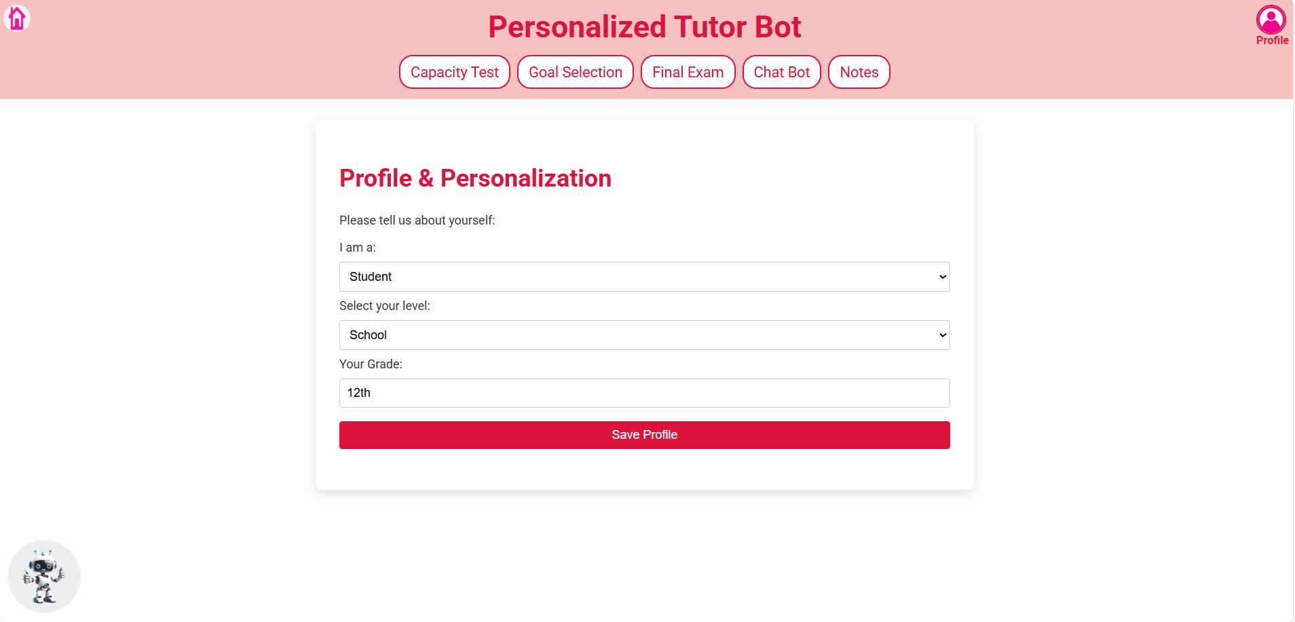
SCREENSHOTS:
Personalization

Slide 23
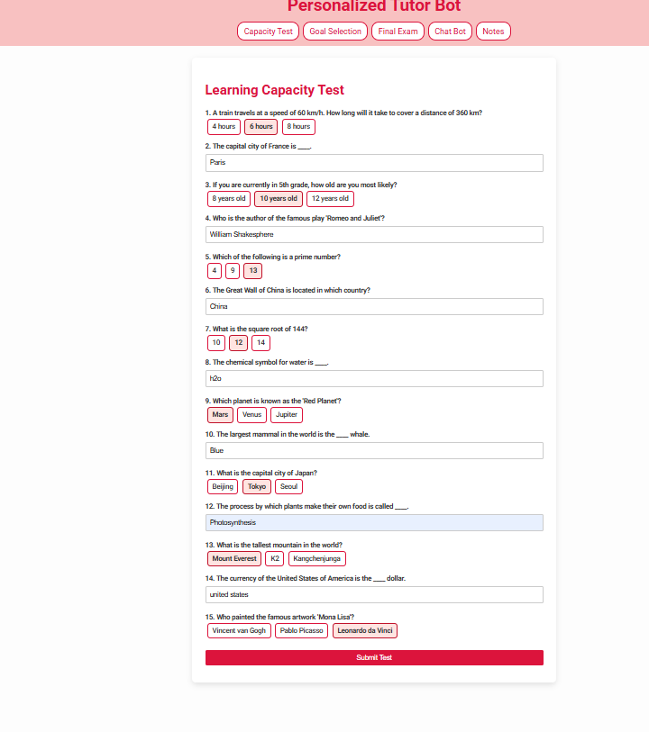
Learning Capacity Test

Slide 24
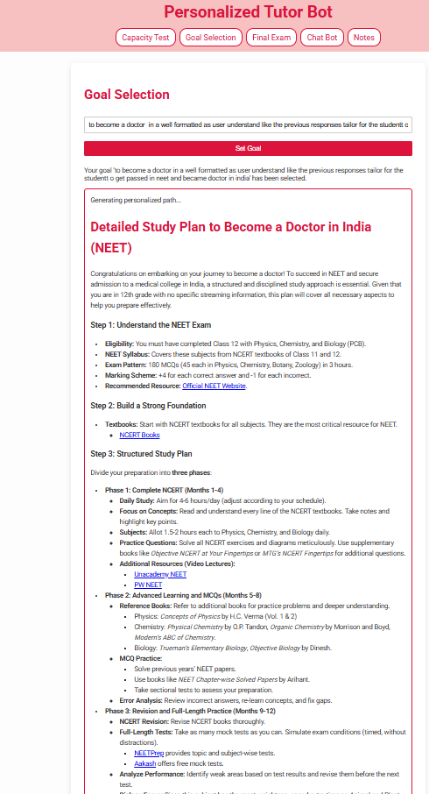
Goal Selection & Recommendation

Slide 25
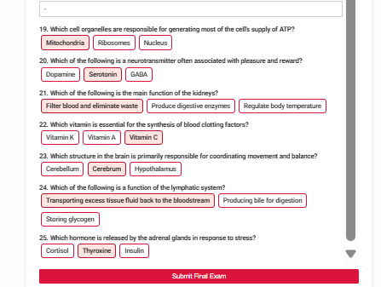
Final Exam & Feedback

Slide 26
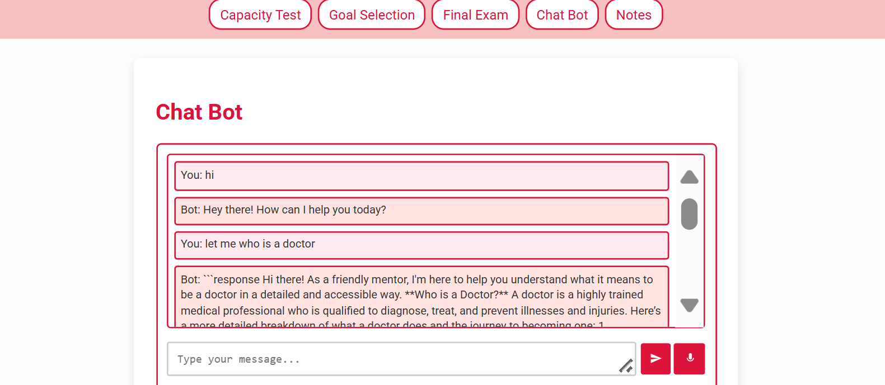
Chatbot

