Slide 1
How to Create/Add Users in Jenkins & Manage Permissions:
Login to Jenkins as an administrator.
First we install “Rolebased authorization strategy”
Go to "Manage Jenkins" and then "Manage Users."
Click on "Create User.“
Enter Jenkins add user details like password ,name .
Click create user
To manage permissions for the user, go to "Manage Jenkins" and then "Configure Global Security."
Here give it “Rolebased authorization strategy” add plugins
. Go to Manage Jenkins - Select Manage and Assign Roles

Slide 2
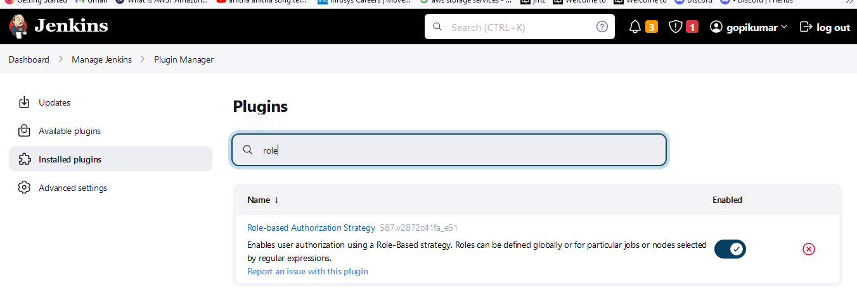

Slide 3
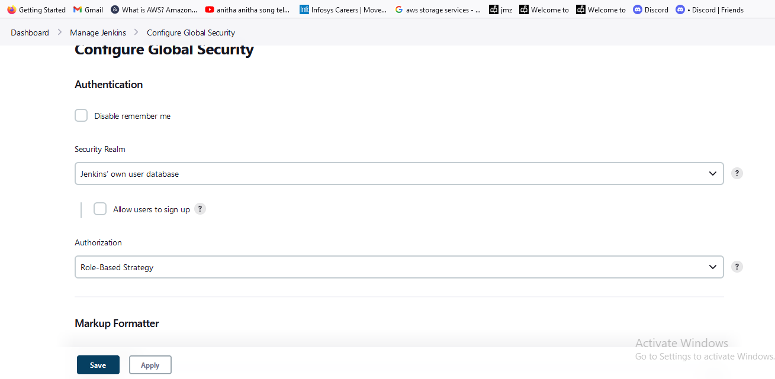

Slide 4
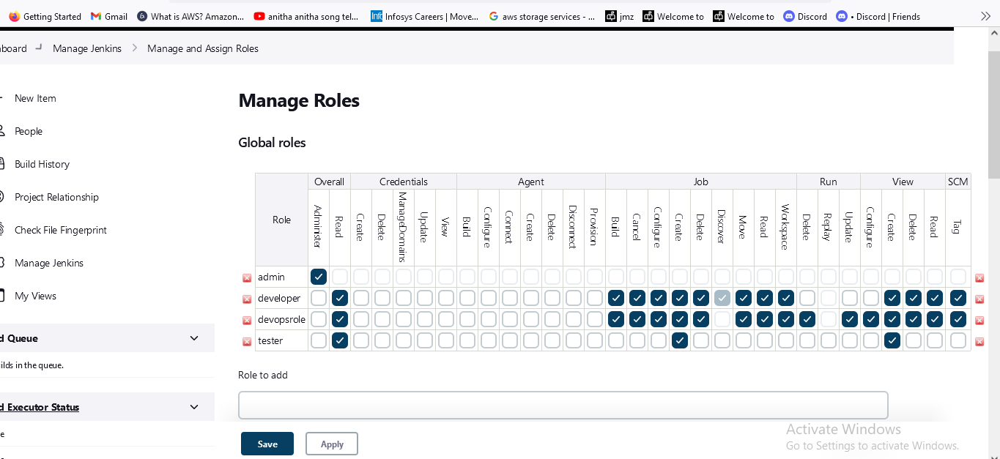

Slide 5
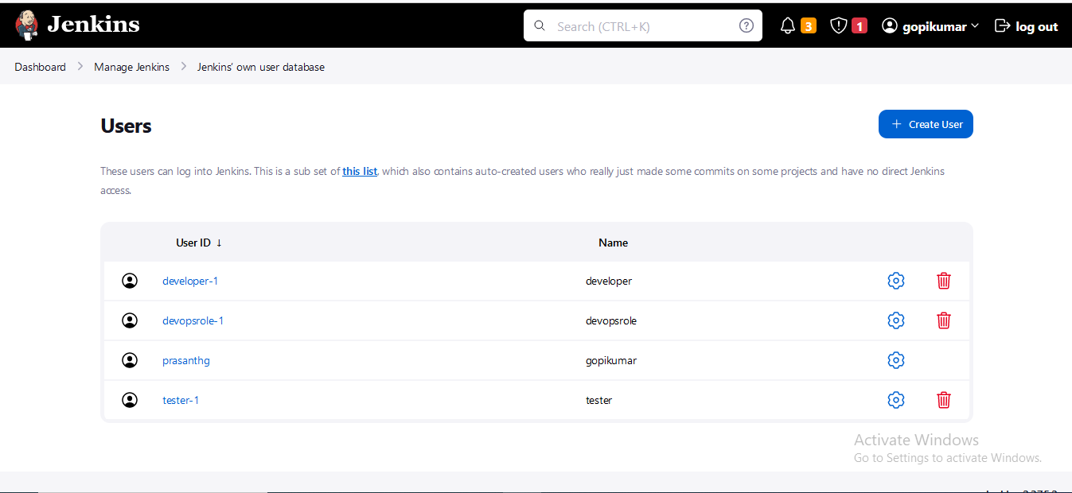

Slide 6
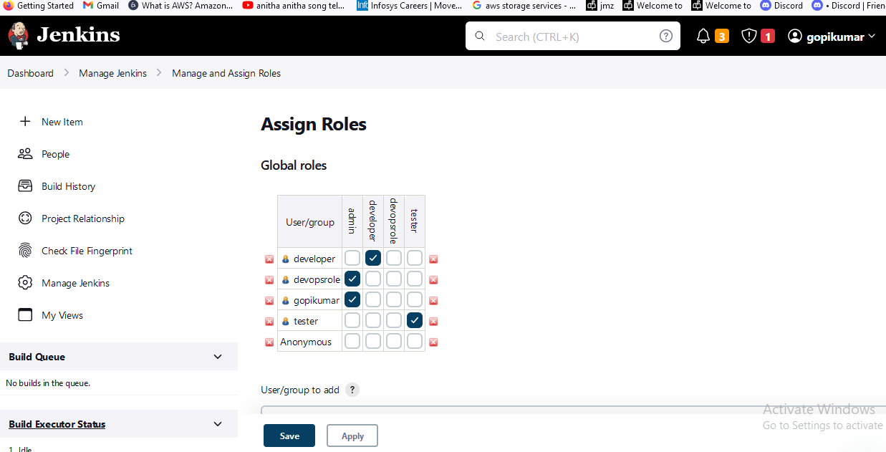

Slide 7
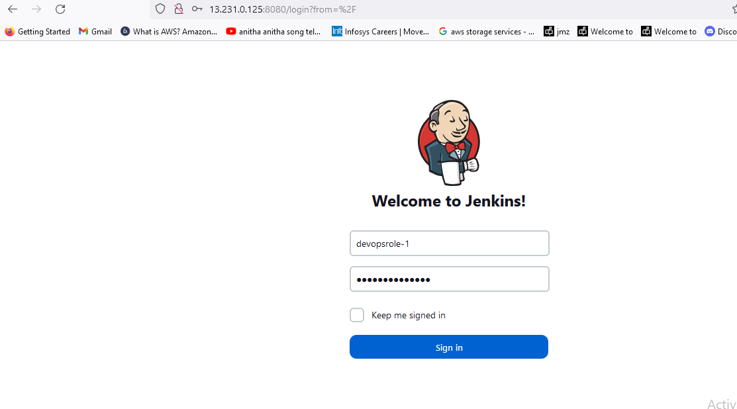
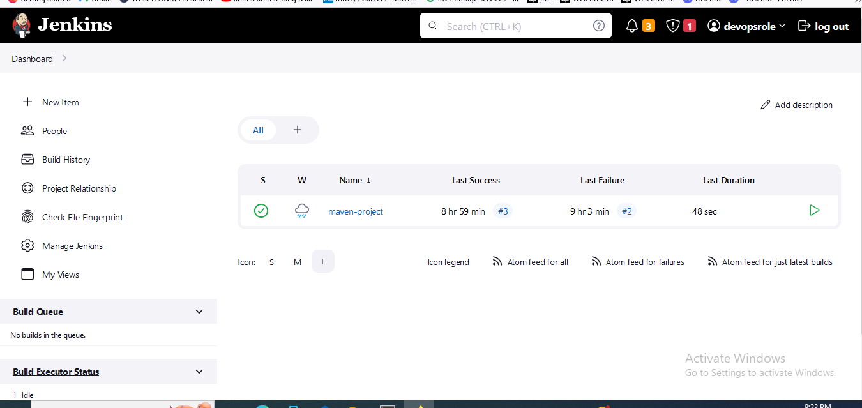

Slide 8
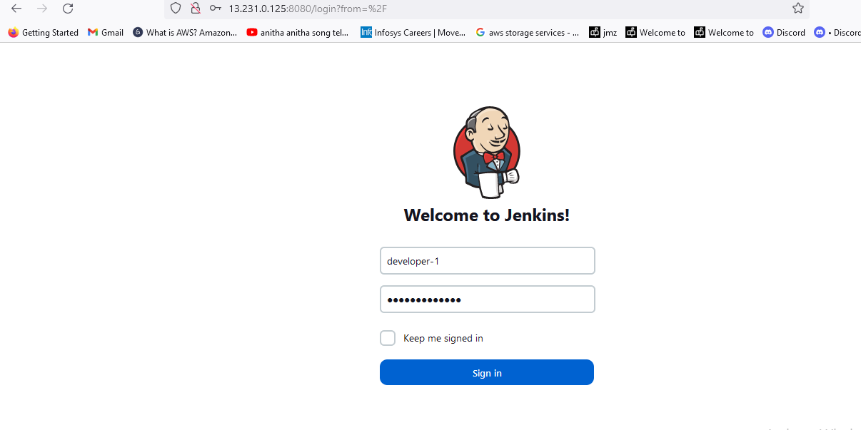
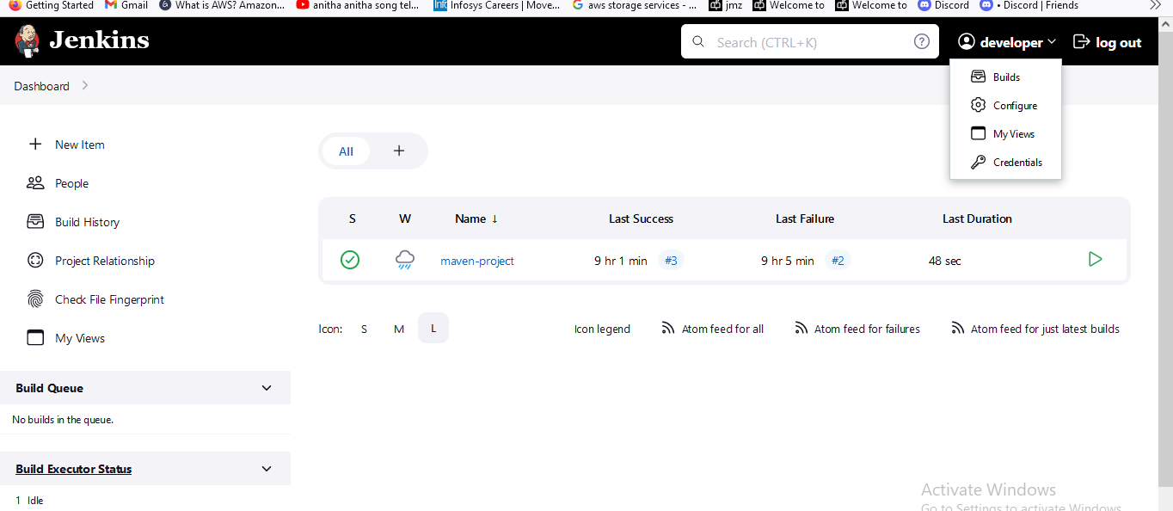

Slide 9
