Slide 1
Trump Vs No Trump
<can change :P>

Slide 2
Scope of the Project

Slide 3


Our approach
Data Extraction
Data Cleaning

Slide 4



Slide 5
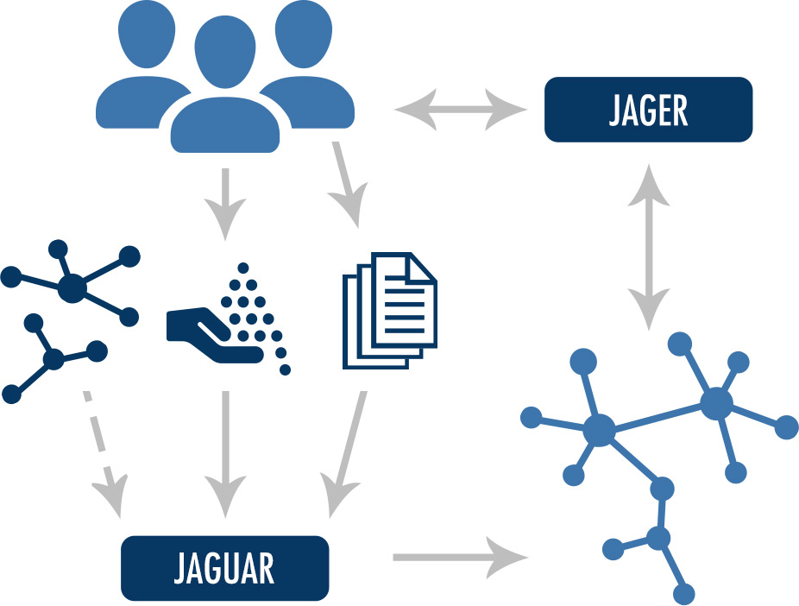
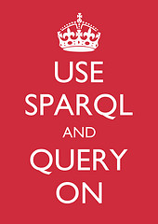

Slide 6
Data Source

Slide 7
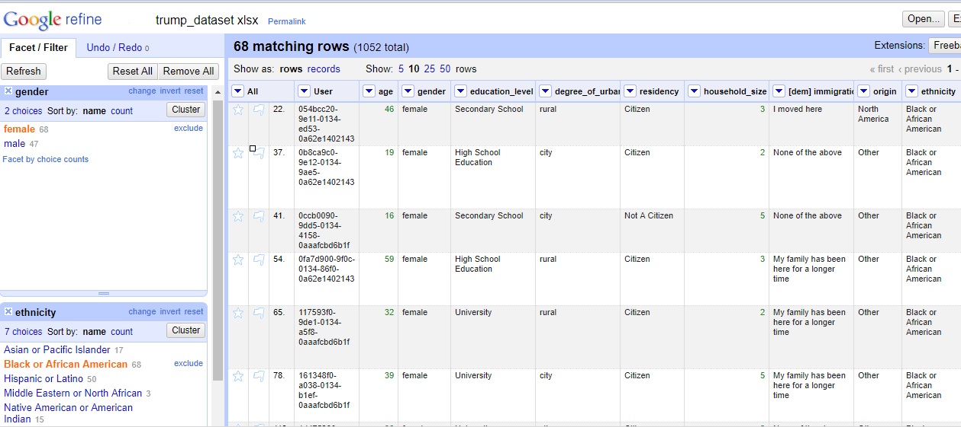
Data Cleaning
Some of the data was in the form of Questions and some data was missing/inconsistent
Used Google refine to clean up
Python Script to extract clean answers

Slide 8
Ontology

Slide 9
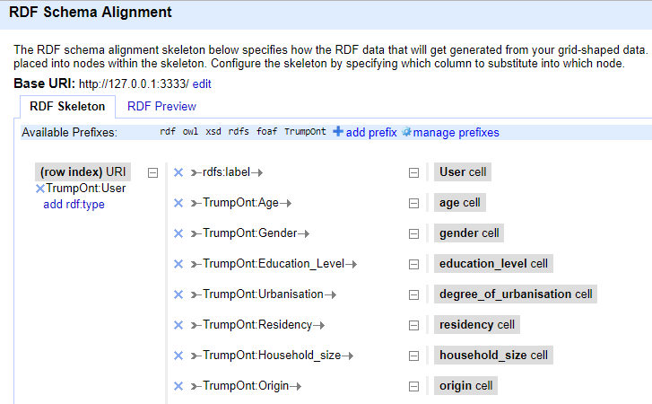
CSV to RDF
Created .turtle file from Google Refine

Slide 10
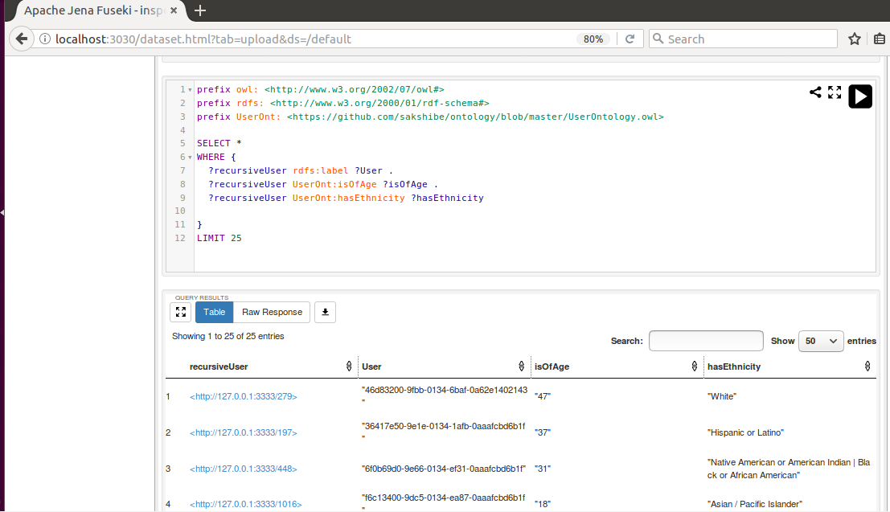
SPARQL

Slide 11
Interface

Slide 12
Thank you

