Slide 1
ANALYSIS OF
2016 UNITED STATES
PRESIDENTIAL ELECTIONS
Presented By :
Group 2 : Deepika Anand
Roopa Thuravi Prakash
Sakshi Kochhar
Srividya Ramaswamy

Slide 2

AGENDA
Motivation
Problem Description
Integration Of Datasets
Technical Architecture
Results And Insights
Challenges Faced
Conclusion
Future Work

Slide 3
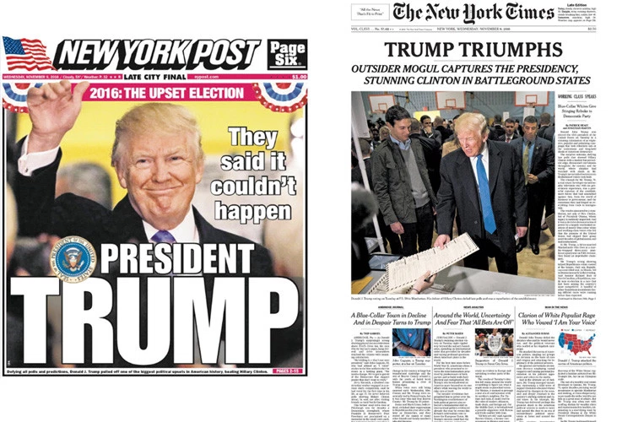

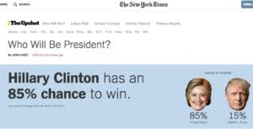
MOTIVATION

Slide 4
PROBLEM DESCRIPTION
Use Federated Ontologies to understand and assess the factors that impacted US Presidential Elections 2016

Slide 5

DATA SOURCE
Data collected by Dalia Research
Post Election Survey Data
Seven Internal Diverse Datasets :-
People Information
Ethnicity
Origin
Social Media
Organization
Political Leader
Voting Issues

Slide 6

DATA CLEANING
Powerful Tool for working with Messy Data
Desktop application running on Port 3333
Steps for Processing of Individual Datasets :-
Importing Data Source
Filtering / Faceting
Clustering
Usage Of Regular Expressions for manipulating data fields

Slide 7
ONTOLOGICAL REPRESENTATION OF DATASETS

Slide 8
TECHNICAL ARCHITECTURE

Slide 9
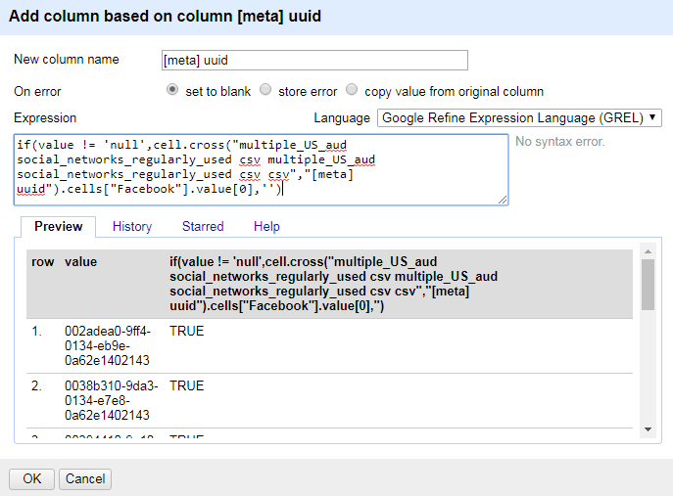

DATASET INTEGRATION

Slide 10
TTL REPRESENTAION OF DATASET

Slide 11
QUERYING THE RDF REPOSITORY

Slide 12
FEDERATED ONTOLOGY

Slide 13
DEMO…

Slide 14
WHERE WE STARTED FROM ?

Slide 15
INSIGHTS

Slide 16

CHALLENGES FACED
Data Filtering And Feature Selection
Combining Various Data Sources
Trial And Test using various technologies
Derivation of insights from the federated ontology

Slide 17

CONCLUSION
Used Federated Ontologies to understand and assess the factors that impacted US Presidential Elections 2016
For this we Collected various Data Sources from Kaggle
Data Cleaning using Google Refine
Integration of Data using Google Refine Expression Language
RDF Representation of the Integrated Data Sources using Protege
SPARQL to query the RDF Triple Stores hosted on Apache Jena Fuseki
User Interface for querying the SPARQL End point and Analysis of the 2016 US Election Results

Slide 18

FUTURE WORK
Integration with data sources such as Twitter for Language Processing
Extension of the idea to the population of Europe
Generalizing usage of various data feature selection

Slide 19



