Slide 1
ANALYSIS OF
2016 UNITED STATES
PRESIDENTIAL ELECTIONS
Presented By :
Group 2 : Deepika Anand
Roopa Thuravi Prakash
Sakshi Kochhar
Srividya Ramaswamy

Slide 2

CONTENTS
Motivation
Problem Description
Datasets
Integration Of Datasets
Results
Challenges Faced
Conclusion
Future Work

Slide 3
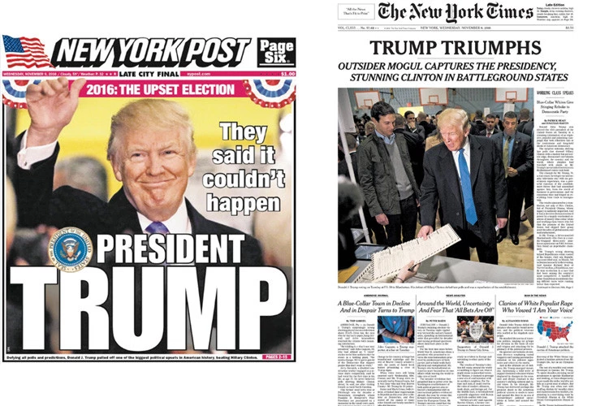

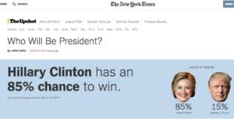
MOTIVATION

Slide 4
PROBLEM DESCRIPTION

Slide 5

DATASOURCE
Data collected by Dalia Research
Post Election Survey Data
Seven Internal Diverse Datasets :-
People Information
Ethnicity
Origin
Social Media
Organization
Political Leader
Voting Issues

Slide 6
ONTOLOGICAL REPRESENTATION OF DATASETS

Slide 7

DATA CLEANING
Powerful Tool for working with Messy Data
Desktop application running on Port 3333
Steps for Processing of Individual Datasets :-
Importing Data Source
Filtering / Faceting
Clustering
Usage Of Regular Expressions for manipulating data fields

Slide 8
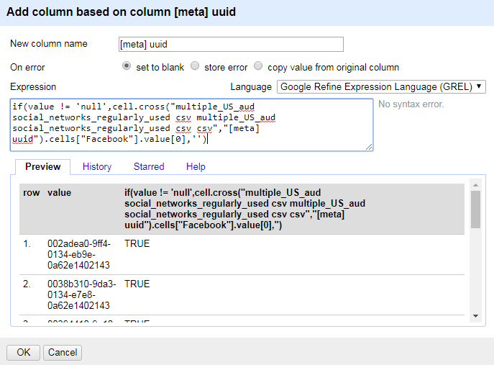

DATASET INTEGRATION

Slide 9
DEFINING OBJECTS, PROPERTIES AND RELATIONS

Slide 10
RDF REPRESENTAION OF DATASET

Slide 11
QUERYING THE RDF REPOSITORY

Slide 12
ANALYSIS OF RESULTS
DEMO…

Slide 13

CHALLENGES FACED
Choosing the right dataset
Finalizing and usage of new technologies
Analysis of data sources
Derivation of Interesting stats from the federated ontology

Slide 14

CONCLUSION
Analysis of the Surprising Results of the US Elections 2016
Collection of Data Sources from Kaggle
Data Cleaning using Google Refine
Integration of Data using Google Refine Expression Language
RDF Representation of the Integrated Data Sources using Protege
SPARQL to query the RDF Triple Stores hosted on Apache Jena Fuseki
User Interface for querying the SPARQL End point and Analysis of the 2016 US Election Results

Slide 15

FUTURE WORK
Integration of more relevant data sources
Extension of the idea to the population of Europe
More generic analysis of elections

Slide 16



