Slide 1
ScratchPad
Submitted By : Deepika Anand
Team Name : TeamME

Slide 2
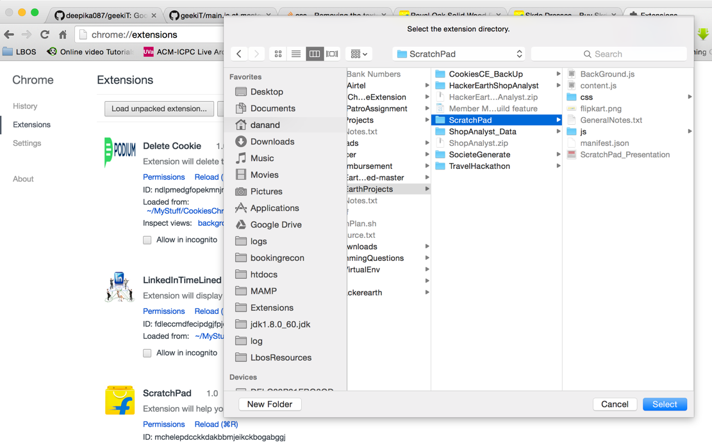
How to Install a Chrome Extension :-
1.) Directly via the source code.(chrome://extensions -> Load unpacked Extension)

Slide 3
2.) Directly via the CRX file. Just drag and drop .CRX file on chrome://extension.
You might get a warning that chrome extension is not from the chrome web store
just ignore it.
Note : Don’t try it on incognito mode.

Slide 4
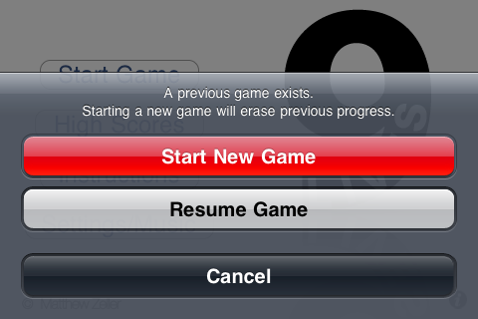
Why ScratchPad ?
We all like to explore options available.
Often forget what analysis we did last time we were looking for a product.

Slide 5
Demo
1.) Write your notes.
2.) View your custom notes.
3.) View all personal notes.
4.) Search your notes.
5.) Ready to purchase ? Clear all notes

Slide 6
Technical Points :-
1.) Minimum required chrome version 37+.
2.) Languages used : HTML, Javascript, CSS.
3.) Libraries used : Jquery, tipped.js, hint.css
Thank You ! !

