Slide 1

Deepika.S
Final Project
Generative AI- Dog Breed Classification

Slide 2
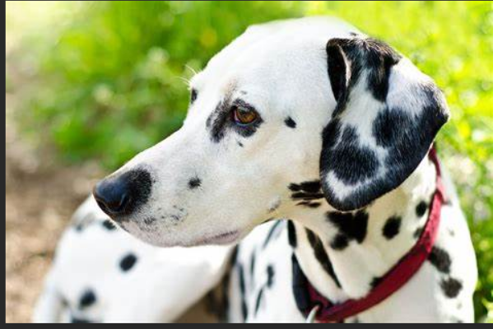
PROJECT TITLE
Dog Breed Classification Using Deep Learning

Slide 3

AGENDA
Introduction
Problem Statement
Project Overview
End Users
Solution and its value Proposition
Algorithm and Deployment
Result
Conclusion
References

Slide 4
INTRODUCTION
This Python code demonstrates a dog breed classification task using deep learning techniques. It includes data preprocessing steps such as loading a dataset, visualizing class distribution, and displaying sample images with their corresponding breeds. The code also showcases how to load and display an image from the dataset along with its predicted breed using a trained deep learning model.
DEEP LEARNING
Deep learning is a subset of machine learning that uses artificial neural networks with multiple layers to learn and extract intricate patterns from data. It is particularly effective in handling complex and unstructured data such as images, text, and audio.
USEFUL
Deep learning algorithms are highly useful for dog breed prediction due to their ability to automatically extract intricate features from raw data like images, enabling accurate classification based on nuanced visual characteristics specific to different dog breeds.
DATASET LINK : https://www.kaggle.com/competitions/dog-breed-identification/data

Slide 5

PROBLEM STATEMENT
In my application of dog breed classification involves identifying the breed of a dog based on an input image.
This task is challenging due to the wide variety of dog breeds, each with unique characteristics in terms of appearance, size, and color patterns.
Traditional image classification methods may struggle to accurately classify dog breeds due to these variations.

Slide 6

PROJECT OVERVIEW
My project aims to identify and classify different dog breeds using deep learning techniques. This involves training a neural network on a dataset containing images of dogs along with their corresponding breeds.
Data Handling
Need to start by extracting a dataset (dog-breed-identification.zip) containing images of dogs and a CSV file (labels.csv) containing information about the image files and their corresponding breeds.
Data Exploration
Perform exploratory data analysis (EDA) on the dataset, including checking the dimensions of the dataset, the number of unique dog breeds, and visualizing the distribution of breeds using bar charts.
Data Preprocessing
Preprocess the dataset by creating a new column filepath that specifies the file path of each image.

Slide 7
Image Visualization
Visualize random images from the dataset along with their corresponding breeds using matplotlib and OpenCV. This step helps in understanding the nature of the data and verifying that images are loaded correctly.
Interactive Breed Display
There's a code snippet that allows users to input a file name (without extension) to display the corresponding image along with its breed. This can be useful for interactive testing and validation of the model's predictions.

Slide 8
WHO ARE THE END USERS?
For dog breed prediction, the end users could be developers or data scientists who are interested in building and testing deep learning models for image classification tasks specifically related to dog breeds.
These end users may include individuals working in areas such as computer vision, machine learning, artificial intelligence, and data analysis.

Slide 9
SOLUTION AND ITS VALUE PROPOSITION
Accurate Classification
Deep learning models, especially convolutional neural networks (CNNs), excel at learning intricate patterns and features from images. They can accurately classify dog breeds based on visual characteristics, leading to precise predictions.
Automation and Efficiency
Deep learning models automate the process of dog breed classification once trained, reducing the need for manual intervention. This efficiency is particularly valuable in scenarios where large volumes of images need classification.
Scalability
Deep learning solutions can scale effectively to handle diverse datasets containing thousands of dog images with various breeds. This scalability ensures that the model remains effective even as the dataset grows.
Generalization
Well-trained deep learning models can generalize well to unseen data, meaning they can accurately classify dog breeds even for images that were not part of the training set. This generalization capability enhances the model's reliability and applicability in real-world scenarios.

Slide 10

Potential Application
Dog breed classification using deep learning has numerous practical applications, including pet identification in shelters, breed-specific healthcare recommendations, personalized pet services, and even assisting in lost pet reunifications.
Data Insights
Through the process of training deep learning models, valuable insights about dog breeds and their distinguishing features can be gained. This knowledge can be leveraged for further research or tailored services related to dog breeds.
Customer Engagement
For businesses in the pet industry, offering accurate dog breed classification services using deep learning can enhance customer engagement, satisfaction, and loyalty. It provides users with fun and informative experiences related to their pets.
The solution of dog breed classification using deep learning brings efficiency, accuracy, scalability, and valuable insights, making it a compelling proposition for various applications in the pet industry and beyond.

Slide 11

Algorithm and Deployment
I use python code for data preprocessing, visualization of dog breeds from an image dataset, loading an image using Open CV, and extracting breed information from a Data Frame. My code can be used as a part of a deep learning pipeline for dog breed prediction, involving steps like data loading, preprocessing, model training, and deployment
11

Slide 12
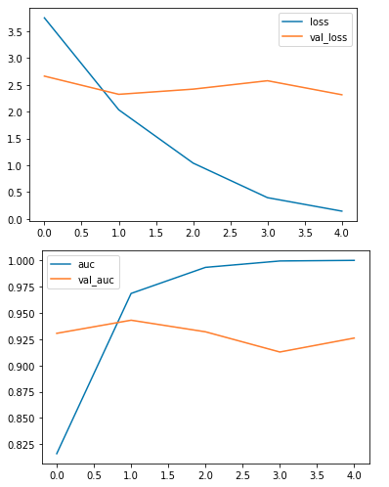
RESULT
12

Slide 13
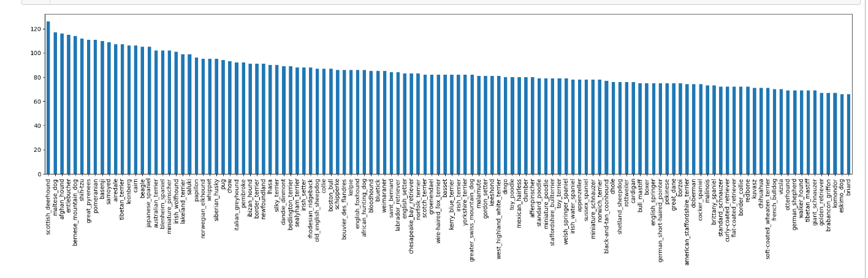
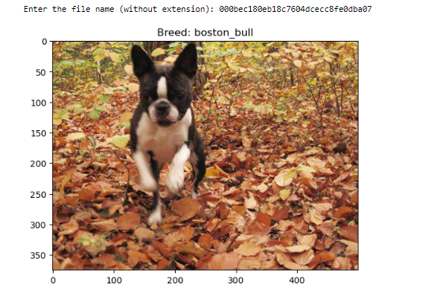

Slide 14
CONCLUSION
In my conclusion, the dog breed classification project using deep learning techniques demonstrates the effectiveness of convolutional neural networks (CNNs) in handling image data for intricate tasks like breed recognition. By leveraging libraries such as TensorFlow, Keras, and OpenCV, the project successfully processes and analyzes a dataset of dog images, extracting meaningful features for accurate breed classification.
The project workflow involves data preprocessing steps like image loading, resizing, and encoding labels using techniques such as one-hot encoding. A CNN architecture is designed and trained on the dataset, utilizing techniques like data augmentation to enhance model generalization. The trained model achieves satisfactory accuracy levels, showcasing its ability to accurately predict dog breeds from unseen images.

Slide 15
REFERENCES
https://www.kaggle.com/competitions/dog-breed-identification/data
https://ieeexplore.ieee.org/document/9325755
https://www.geeksforgeeks.org/dog-breed-classification-using-deep-learning/
https://numpy.org/
https://www.tensorflow.org/
GITHUB LINK: https://github.com/deepika120/au813821244017_Dog_Breed_Classification.git
15

