Slide 1
Automation Exercise
Deepika Nagaraja

Slide 2
Problem Statement
Scenario: A trip request can be executed and results returned Given Phileas is planning a trip When he executes a trip plan from "North Sydney Station" to "Town Hall Station" Then a list of trips should be provided
Task Create an automated test for the scenario below using open-source tooling (e.g. Selenium) in the language (C#, Java etc) and framework (xUnit, BDD etc) of your choice. Note that although the scenario is defined in Gherkin, a BDD implementation is not mandatory.

Slide 3
Solution
Framework used – TESTNG
TestNG is an open source testing framework inspired by Junit. It stands for Test Next Generation
Advantages –
HTML reports can be generated
Annotations make testers life easy
Test cases can be grouped and prioritized
Data Parameterization is possible

Slide 4
Solution
Annotations -@beforetest -Method will run before any test of the class is run. So browser is invoked in this method just once ,so that all tests are run within same instance.
@test- Since in this case, there is only one scenario is asked, there is only one test method . Element locator used is ID to find send the parameters and hit Go .
@parameter – used to send the parameters –From and To destination from the config.xml. If more inputs are needed, it can be added in xml, or @DataProvider can be used or Excel sheet can be read
@Aftertest- Method will run after all the tests of the class have run. So quit browser is declared in this so that after all the scenarios ,browser is closed.

Slide 5
Assumptions
Browser used –Chrome
This is the only scenario , Additional cases can be added easily as parameters within the framework, or if huge data is to be used, it can be data driven using Excel .

Slide 6
Installation and steps to follow
Eclipse with Java has to be installed in the users system in order to run this project
Selenium Jars have to be added.
Assuming Chrome is widely used browser, this program is coded to run only for Chrome browser.
Add TestNG Framework—
Go to Eclipse->Help->Eclipse marketplace->search for TestNG and hit confirm
Now once you import the project to eclipse, you have to add TestNG jar files manually if it shows error on the code, by clicking on error and selecting Add TESTNG reference.

Slide 7
Import the project to your Local
Download the zip file
After installing eclipse, Go to files->Import->General->Existing projects into workspace->select archive file->browse->choose your zip file->finish
Now you can see the project in your workspace
Under the config folder , right click on the nswparameter.xml → select run as→ testNG suite
If all above configurations are done, Chrome browser instance should open with NSW url

Slide 8
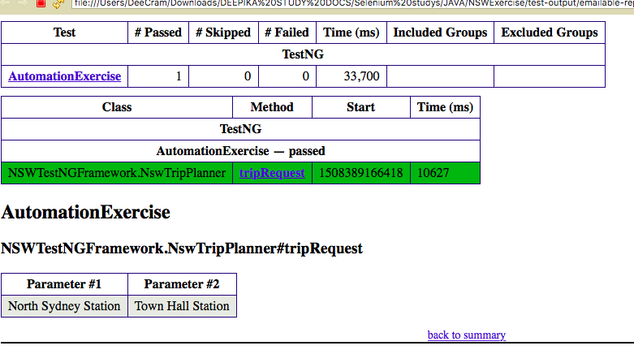
Output

Slide 9
Recommended Next steps
To build a complete automation framework, we can adopt Hybrid Framework(data driven + Keyword driven )where we can read different station names from the excel file and ensure if the result is retrieved .
More factors like all browser types, OS have to be considered .

Slide 10
Thank you !!

