Slide 1

Uber Demand and Supply Analysis using Azure
Deepika Ketavarapu 2320030328 Keerthi Laxmi Vinay 2320030188 kolasani Sreya Tulasi 2320090037

Slide 2
ABSTRACT
This project presents a cloud-native data analytics framework for Uber demand–supply analysis using Azure Databricks and Power BI. The raw ride request dataset is ingested into the Databricks environment, where distributed ETL operations are performed using Apache Spark, including data cleansing, timestamp normalization, and feature engineering for time-based analysis. Spark SQL is utilized for structured data modeling and validation, and the transformed dataset is persisted as a managed table within the Hive Metastore to ensure centralized storage and optimized query performance.
Power BI is integrated with the Databricks compute layer to develop interactive, multi-dimensional dashboards that visualize ride outcomes, peak demand intervals, and supply shortages. The architecture follows a layered separation of data engineering and business intelligence, enabling scalable computation, efficient data processing, and insight-driven operational decision-making.

Slide 3
EXISTING SOLUTIONS
Direct Power BI with Local / Cloud CSV
Data is directly imported into Power BI for transformation and visualization.
Uses Power Query and DAX for basic data cleaning and reporting.
Relational Database + BI Tool (SQL Server / MySQL)
Ride data stored in structured relational databases.
SQL queries used for aggregation and periodic reporting.
Cloud Storage + Direct BI Connection
Raw data uploaded to cloud storage (Azure Blob / S3).
BI tools connected directly to cloud files for visualization.
Data Warehouse-Based Reporting
Data stored in centralized data warehouse systems.
Pre-aggregated reports generated for business users.

Slide 4
DRAWBACKS
Direct Power BI with Local / Cloud CSV
Heavy data transformations inside Power BI reduce performance and scalability.
No distributed processing layer, making it inefficient for large datasets.
Relational Database + BI Tool
Limited horizontal scalability for big data workloads.
Complex transformations require manual SQL scripting and maintenance.
Cloud Storage + Direct BI Connection
Raw data is not structured or optimized before visualization.
Poor performance when handling large or semi-structured datasets.
Data Warehouse-Based Reporting
High infrastructure and maintenance cost.
Less flexible for dynamic feature engineering and advanced analytics

Slide 5
PROPOSED SOLUTION
The solution implements a cloud-native analytics architecture using Azure Databricks (Apache Spark) for distributed ETL processing and Spark SQL for structured data modeling. The Uber dataset undergoes cleansing, transformation, and feature engineering before being stored as a managed cloud table in the Hive Metastore.
Power BI integrates with the Databricks environment to deliver interactive, multi-dimensional dashboards. This layered architecture decouples data engineering from visualization, ensuring scalability, performance optimization, and efficient demand–supply analysis.

Slide 6
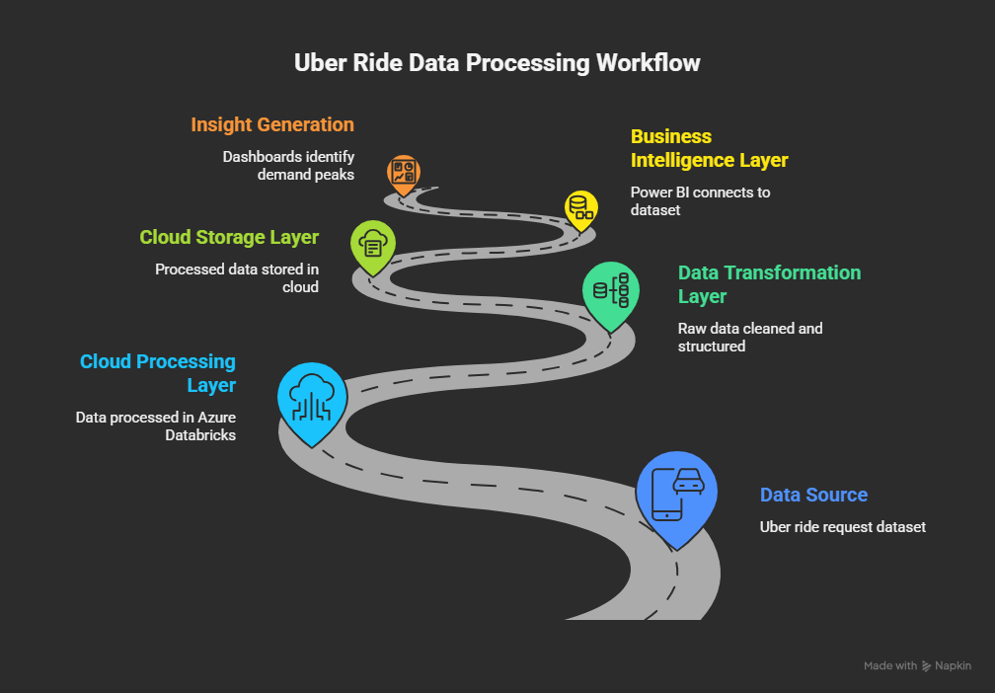

Slide 7
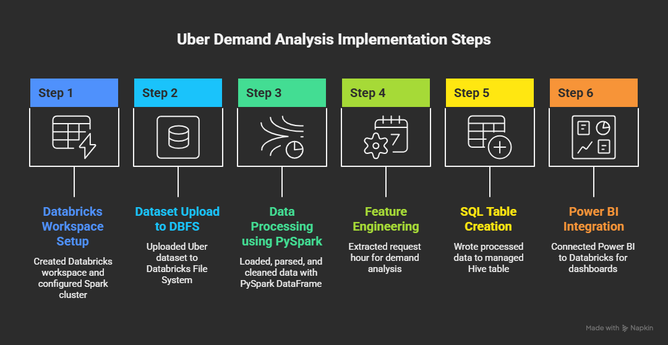

Slide 8
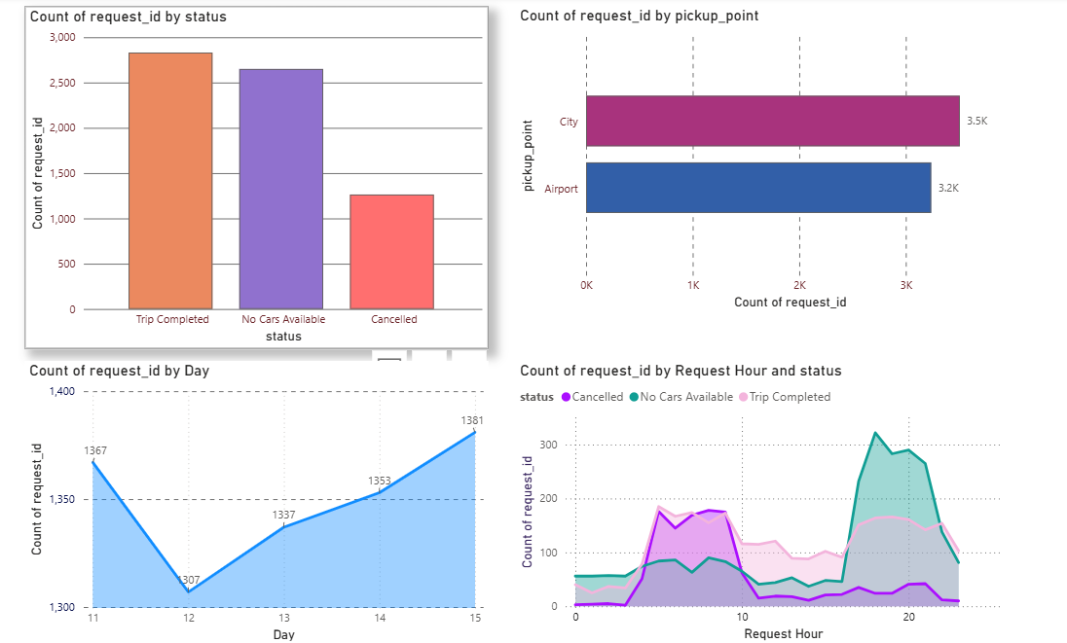
EXPECTED RESULTS

