Slide 1
IBM University Engagement Project Submission
“Exploring the Power of Agentic AI with IBM Granite and LangFlow”

Slide 2
Project Tile – AI STUDYMENTOR: AN AI-POWERED PERSONALIZED LEARNING GUIDANCE SYSTEM
Domain of Project – Education
Student Name | Recent Passport Photo | Email ID | Mobile number [WhatsApp]
Deepika B |  | deepikabalaji006@gmail.com | 7092723388

Slide 3
Problem Statement -
Many students and self-learners struggle to choose an effective and structured learning path due to the absence of personalized academic guidance. With the abundance of online courses and resources, learners often feel confused, overwhelmed, and uncertain about what to study next based on their current skill level and career goals. This lack of direction leads to inefficient learning, wasted time, and reduced motivation, especially among beginners and first-generation learners.
There is a need for an intelligent, accessible, and ethical AI-based system that can analyze a learner’s skill level and learning objectives to provide clear, personalized, and goal-oriented study guidance. Such a solution should support inclusive education, improve learning clarity, and help learners make informed decisions—contributing directly to SDG 4: Quality Education.

Slide 4
Technology Used
LangFlow – Used to design and manage AI workflows through a visual interface, enabling seamless integration of AI components.
IBM watsonx.ai – Provides the platform for developing, testing, and deploying AI-powered educational assistance and recommendation services.
IBM Granite-4.0-8B-Instruct Model – Generates personalized study plans, learning recommendations, and academic guidance based on student inputs.
Streamlit – Used to build an interactive and user-friendly web interface for student interaction.
Python – Implements the core application logic, recommendation engine, and data processing functionalities.
File Component – Stores and retrieves student profiles, learning progress, and recommendation history.
Prompt Template – Structures student queries to improve the accuracy and relevance of AI-generated responses.
Memory Component – Maintains conversation context and learning preferences for personalized assistance.
IBM Cloud - Enables scalable deployment, secure data management, and remote accessibility of the application.

Slide 5
Proposed Solution -
Proposed Solution: AI-Powered Nutrition Agent
The proposed solution is a multi-agent AI-powered Nutrition Agent built using LangFlow, IBM watsonx.ai, and Granite Models to provide personalized, real-time dietary guidance. The system addresses challenges in diet planning, nutrition tracking, and preventive healthcare through an intelligent, modular architecture.
At its core, the solution uses a Retrieval-Augmented Generation (RAG) pipeline to fetch accurate nutritional data from trusted sources such as USDA and WHO datasets. This data is embedded and stored in a vector database, enabling the system to retrieve and summarize food nutrition details (calories, macros, vitamins) using Granite models.
The system consists of four key agents:
Nutrition Knowledge Agent retrieves and summarizes nutritional information using RAG.
Diet Recommendation Agent generates personalized meal plans based on user inputs such as age, health conditions, dietary preferences, and fitness goals.
Health Advisory Agent provides preventive health suggestions, including disease-specific diets (e.g., diabetes-friendly or heart-healthy plans).
Food Log & Feedback Agent allows users to log meals via text, voice, or images and delivers instant nutritional analysis with actionable feedback.
The solution includes a user-friendly dashboard (built with Streamlit or React) that visualizes daily and weekly nutrient intake, highlights deficiencies, and tracks progress toward health goals.
LangFlow is used to orchestrate agent workflows, while watsonx.ai ensures scalable model deployment, embeddings, and AI governance. Granite models power reasoning, summarization, and personalization.
Overall, this solution delivers an end-to-end intelligent nutrition assistant that promotes healthier lifestyles through personalized insights, real-time feedback, and preventive healthcare recommendations.

Slide 6
Langflow component Used -
1) Chat Input Interface where students enter their academic details, learning goals, preferred subjects, skill levels, and study-related queries.
2) IBM watsonx AI Agent Processes student inputs using IBM Granite models and analyzes learning requirements to provide personalized study guidance and recommendations.
3) IBM Granite Model Granite-4.0-8B-Instruct → Efficient large language model used for generating personalized learning paths, study schedules, resource recommendations, and answering academic queries.
4) Chat Output Displays AI-generated responses such as study plans, learning recommendations, subject-wise guidance, career suggestions, and progress improvement tips.
5) File Component Stores and retrieves student profiles, learning progress, study resources, performance reports, and recommendation history for future analysis.
6) Prompt Template Component Structures and formats user inputs before sending them to the Granite model, ensuring accurate and context-aware responses.
7) Python Function Component Implements custom recommendation logic, progress analysis, and personalized study plan generation based on student performance data.
8) Memory Component Maintains conversation history and previous learning preferences to provide more personalized and continuous guidance.
9) Streamlit Interface Provides an interactive web application where students can access recommendations, view progress reports, and interact with the AI StudyMentor system.
10) IBM Cloud Deployment Component Hosts the application and enables secure access, scalability, and cloud-based storage for student data and AI services.

Slide 7
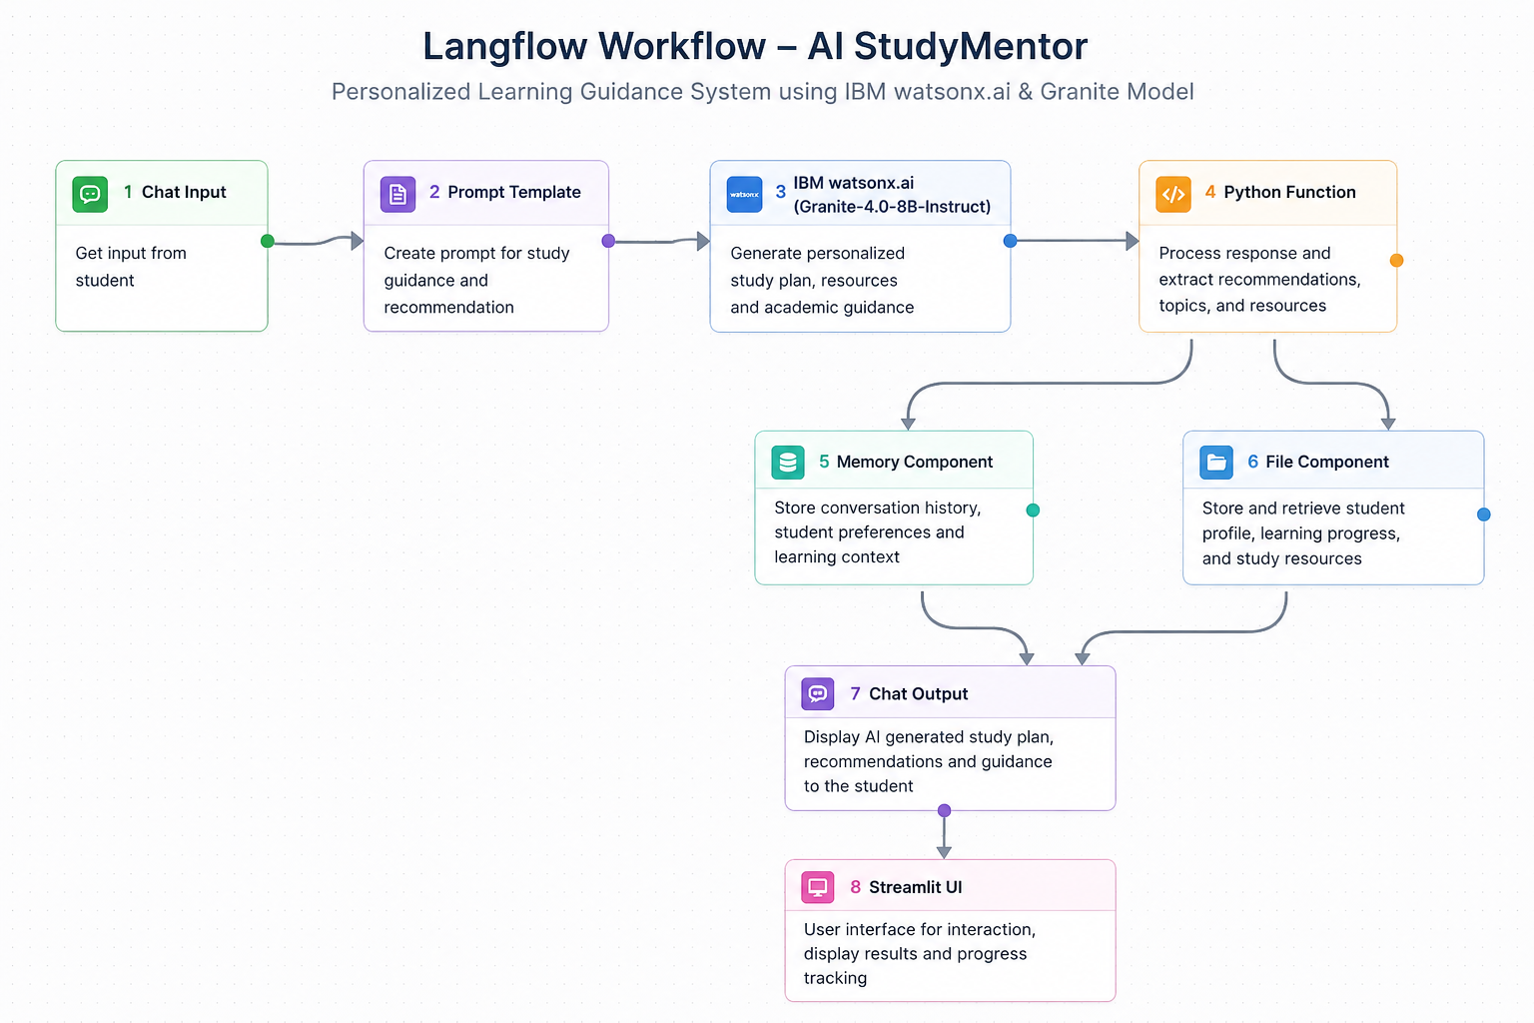
Langflow workflow -

Slide 8
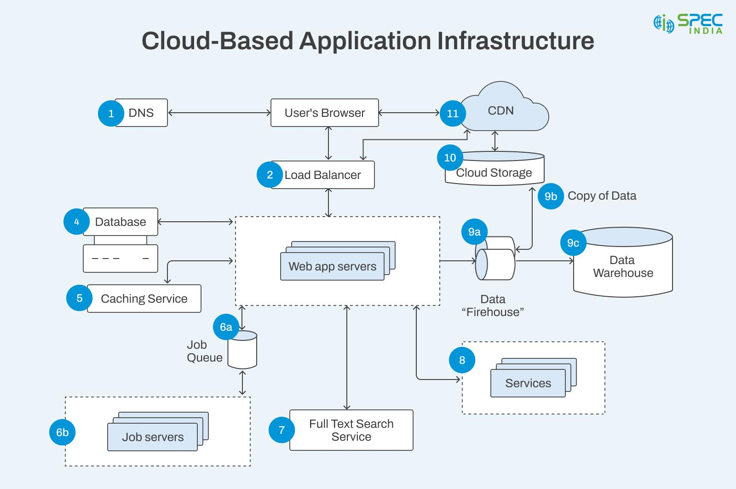
Architecture blueprint

Slide 9
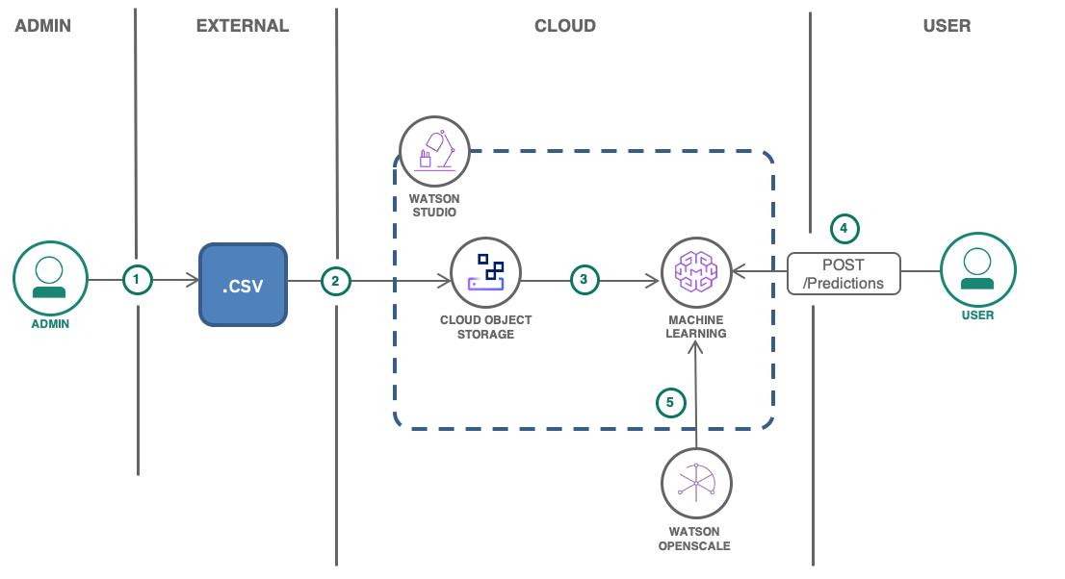
Architecture blueprint

Slide 10

Role of Agentic AI in the solution
Agentic AI acts as an intelligent academic assistant that can understand student needs, make decisions, and provide personalized learning guidance without constant human intervention.
The Agentic AI in AI StudyMentor performs the following functions:
Analyzes Student Requirements: Understands students' learning goals, strengths, weaknesses, and subject preferences.
Generates Personalized Study Plans: Creates customized study schedules and learning paths based on individual needs.
Recommends Learning Resources: Suggests relevant courses, tutorials, books, and practice materials.
Tracks Learning Progress: Monitors student performance and adapts recommendations accordingly.
Provides Real-Time Assistance: Answers academic questions and offers instant guidance through a conversational interface.
Improves Decision-Making: Continuously evaluates student progress and adjusts study strategies for better outcomes.
Enhances Learning Experience: Delivers tailored recommendations that help students learn more effectively and efficiently.
Impact of Agentic AI
By leveraging IBM watsonx AI and Granite models, the Agentic AI system transforms traditional learning guidance into an intelligent, adaptive, and personalized educational experience. It acts as a virtual mentor, helping students achieve their academic goals through data-driven recommendations and continuous support.

Slide 11
Novelty and Uniqueness
Uses IBM Granite AI models to provide personalized learning recommendations.
Generates custom study plans based on student goals and performance.
Employs Agentic AI for intelligent decision-making and adaptive guidance.
Integrates Langflow for efficient AI workflow orchestration.
Cloud-based solution enabling anytime, anywhere access.
Acts as a virtual mentor, offering real-time academic support and progress tracking.
Provides personalized resource recommendations such as courses, tutorials, and study materials.
Continuously analyzes learning progress and updates recommendations to improve academic outcomes.

Slide 12
Git Hub Link
·–
Please test and Paste the working Github URL – https://github.com/deepikabalaji006/AI-StudyMentor
·
·
·

Slide 13
Future Scope
Advanced AI Personalization: Future versions can leverage more powerful IBM Granite models to analyze student learning patterns and generate highly personalized study plans, recommendations, and assessments.
Mobile Application Development: A dedicated mobile app can be developed to provide seamless access to learning resources, progress tracking, and AI-powered guidance anytime and anywhere.
Career Guidance Integration: The system can be expanded to recommend career paths, certifications, internships, and skill-development opportunities based on students' interests and academic performance.
Multilingual and Voice Support: Adding support for multiple languages and voice-based interaction will make the platform accessible to a wider range of students from diverse backgrounds.
Learning Analytics Dashboard: Advanced analytics can be integrated to provide detailed insights into student performance, learning behavior, strengths, and areas requiring improvement.
Integration with E-Learning Platforms: The solution can be connected with platforms such as Coursera, Udemy, NPTEL, and LMS systems to automatically recommend relevant courses and learning materials.
Collaborative Learning Features: Future enhancements may include peer-to-peer learning, group discussions, mentoring programs, and collaborative project recommendations.
·
·
·

Slide 14


