Slide 1

Predicting Antibiotic Resistance in Bacterial Strains Using Machine Learning
Subtitle: A Data Science Approach to Antimicrobial Resistance (AMR) Prediction
Presented by: Mary Deepika Basani Mentor: Hayden Sansum Date: 05/02/25

Slide 2
Problem Statement
Antimicrobial Resistance (AMR) is a global health crisis.
Objective: Predict bacterial resistance to antibiotics using genomic data.
Challenges:
Understanding genetic mutations that contribute to resistance.
Predicting resistance accurately using available data.
Data: Genomic features and MIC (Minimum Inhibitory Concentration) values.

Slide 3
Data Overview
Dataset: Genomic data of bacterial strains, including resistance levels.
Features: Resistance genes, MIC values for various antibiotics (e.g., azm_sr, cip_sr).
Target: Resistance levels (e.g., resistant or susceptible).
Handling Missing Data:
Numeric features imputed with mean.
Categorical data imputed with mode.

Slide 4
Preprocessing & Feature Engineering
Preprocessing: Imputed missing values, scaled features.
Normalization: Applied StandardScaler to scale numerical features.
Features: MIC values, genetic resistance markers.
Gene Presence/Absence: Extracted features indicating the presence or absence of resistance genes.
MIC Values: Used to determine resistance (e.g., azm_sr, cip_sr).

Slide 5
Model Choice and Evaluation
Model Used: Random Forest (ensemble learning method for classification).
Evaluation Metrics: Accuracy, Confusion Matrix, Sensitivity, Specificity.
Cross-Validation: Applied 5-fold cross-validation for model evaluation.

Slide 6
Model Performance
Confusion Matrix: Shows True Positives (TP), False Positives (FP), True Negatives (TN), False Negatives (FN).
Key Metrics:
Accuracy: Percentage of correct predictions.
Precision and Recall: Measure the balance between false positives and false negatives.
F1 Score: Harmonic mean of precision and recall.
Classification Report: Provides precision, recall, and F1-score for each class.

Slide 7
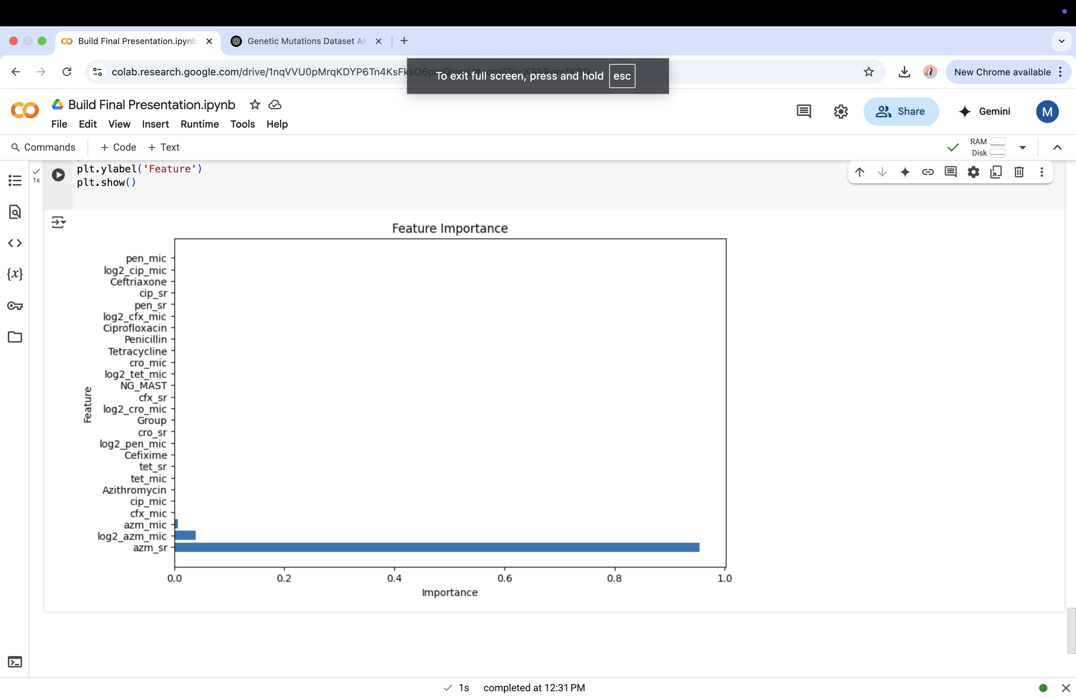
Feature Importance
Random Forest Feature Importance: Identifies which features are most influential in making predictions.
Top Features:
Azithromycin resistance gene.
Ciprofloxacin resistance gene.

Slide 8
Next Steps & Model Improvement
Hyperparameter Tuning: Use Grid Search or Random Search to optimize model performance.
Feature Engineering: Explore k-mer analysis to capture more detailed genetic patterns.
Test Other Models: Compare Logistic Regression and Gradient Boosting for further improvement.

Slide 9
Conclusion
Summary: The project predicts antibiotic resistance using genomic data and Random Forest.
Results: Promising results with solid classification performance.
Impact: Helps improve AMR prediction for better healthcare management.
Future Work: Implement hyperparameter tuning, explore k-mer features, and test additional models.

Slide 10
THANK YOU

