Slide 1

ADTA 5240 – Final Project
GROUP 19

Slide 2
INTRODUCTION
Importance of Deploying Big Data Using GCP
Data Preprocessing using OpenRefine
Data Transformation / Wrangling using OpenRefine
Using Big Query to find information from a Dataset

Slide 3
PART 1 – Importance of DEPLOYING Big Data using Gcp
GCP can be used to add more value to an organization.
Some Use Cases where GCP can be used are:
Customer Churn Prediction
Inventory Management
Real time tracking of Shipments
GCP Services:
Big Query
AI Interface
Cloud Storage

Slide 4
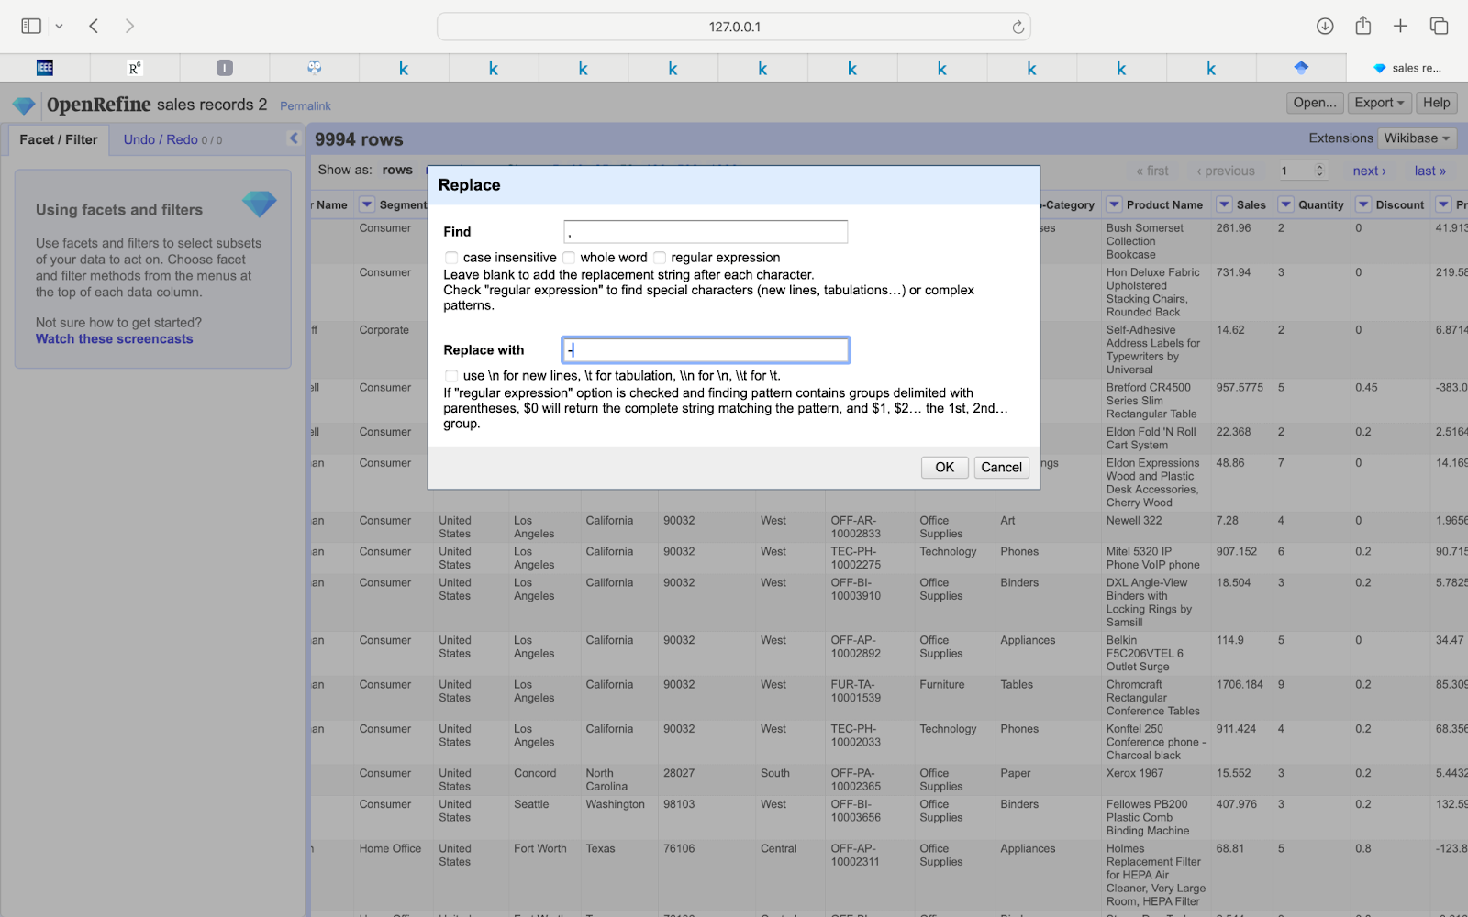
PART II - Data preprocessing using openrefine
Import data to openRefine
Replace , with -
Export to a new csv file

Slide 5
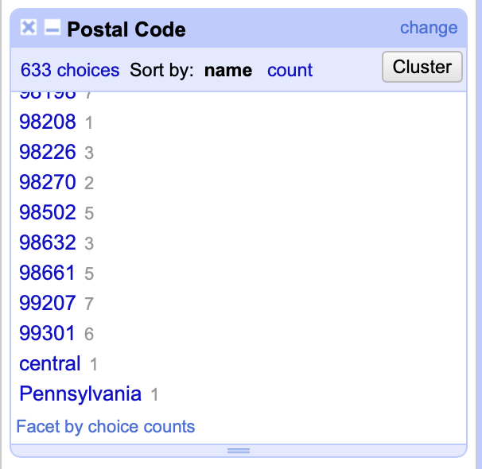
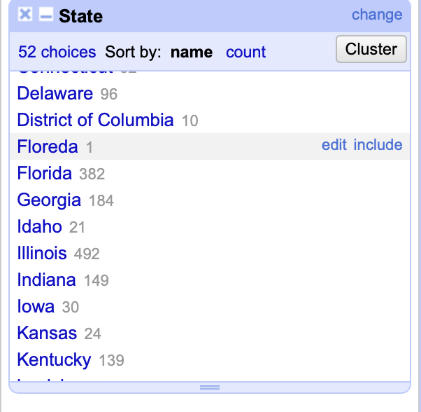
PART III - Data transformation / wrangling using openrefine
Zip codes contain non-numeric values.
State names are misspelt.

Slide 6
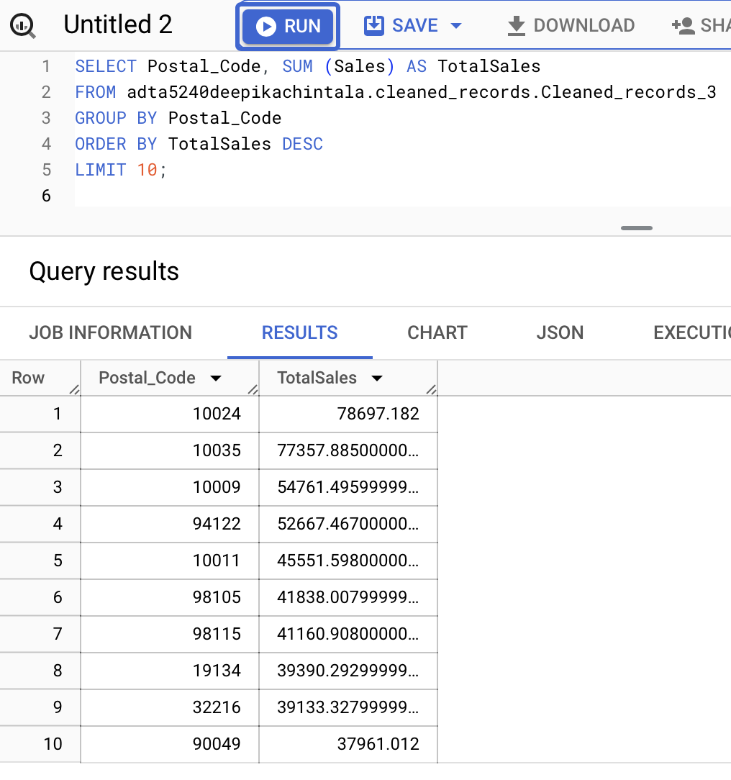
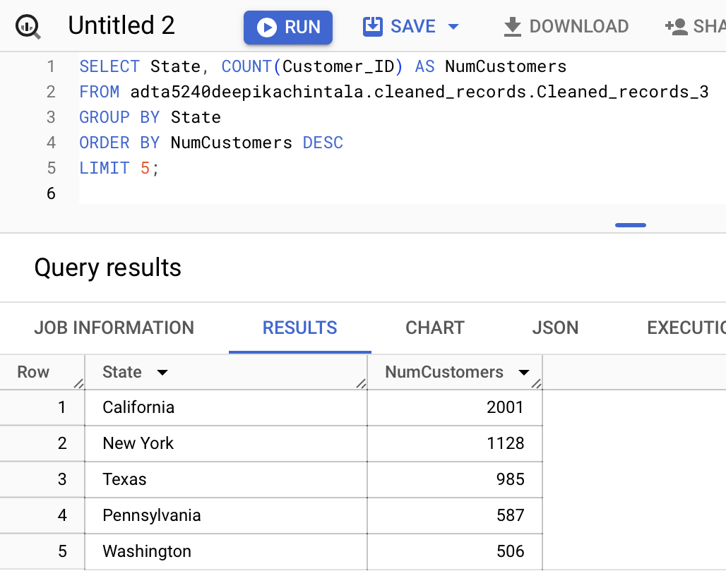
PART IV - Using big query to find information from a dataset
Top 5 States where the company has the most number of customers.
Top 10 zip code areas with the highest sales amount.

Slide 7
CONCLUSION
We saw how GCP can be used to cater to deploy Big Data solutions.
We saw how we can preprocess data using OpenRefine.
We saw how we can perform various Data Transformations and Data Wrangling using OpenRefine.
We saw how we can use BigQuery to query information from a dataset.

Slide 8

Thank You

