Slide 1
Deepfake detection using Deep Learning
Project by: GROUP 4
Gyana Deepika Dasara (gd452)
Pranathi Vaddela (pv250)
Tejaswini Velicheti (tv186)
Aditya Sehgal (as4099)
Aditya Kaushik Jonnavittula (aj918)
Prateek Mishra (pm883)

Slide 2
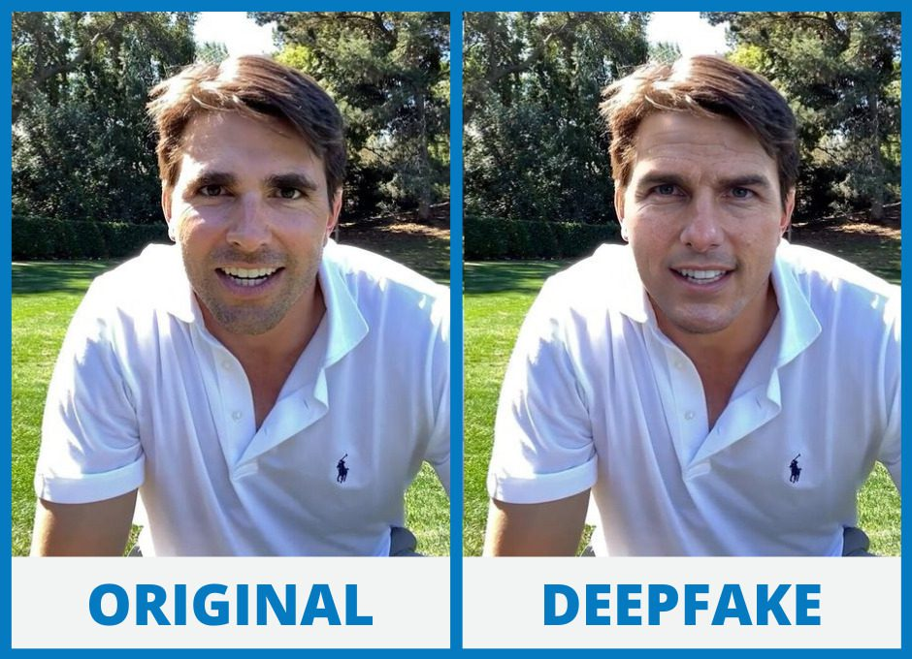
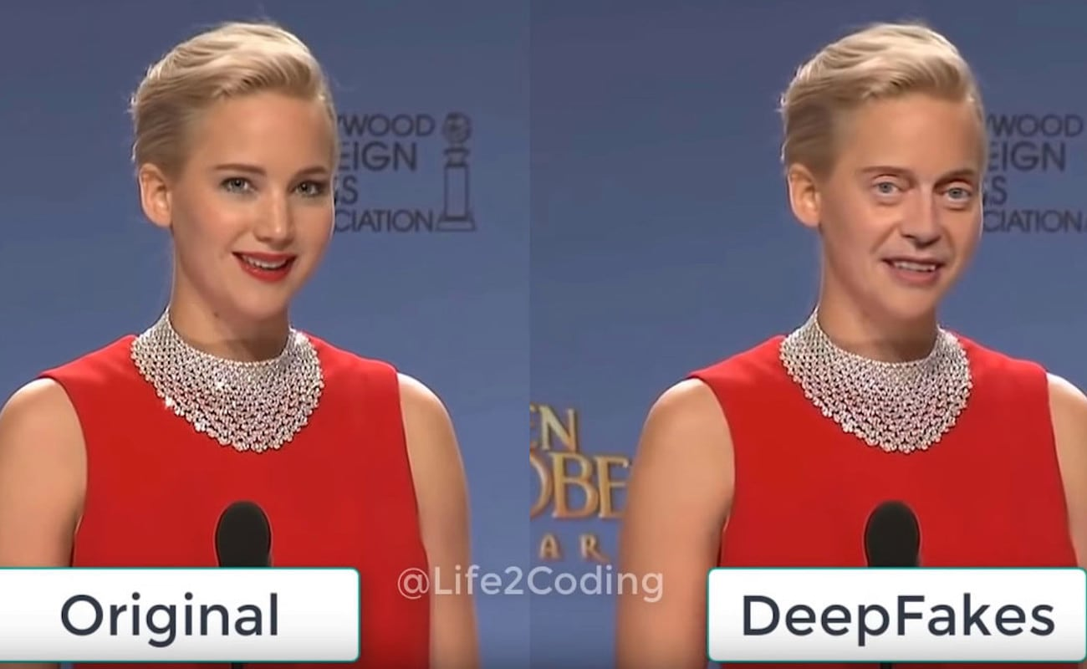
Introduction
Problem Statement: To Design and Develop a Deep Learning algorithm to classify the video as deepfake or real. A deep fake refers to a method of generating human-like images through artificial intelligence.

Slide 3
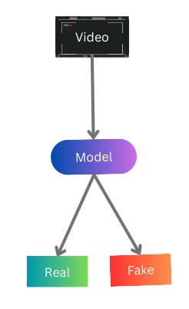
Introduction
Deepfakes are generated using two algorithms, a generator, and a discriminator, to create and refine fake content by analyzing its realism and continuously improving the fake digital content
Deepfakes should be detected because they can be used to spread misinformation, incite political unrest, and engage in malicious activities, posing threats to digital and information security

Slide 4
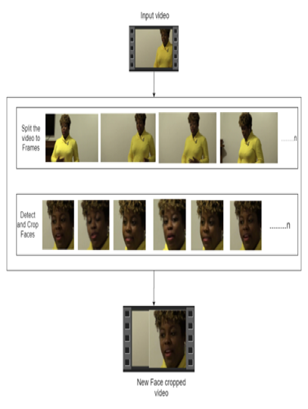
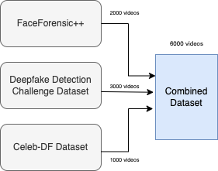
Datasets & Preprocessing

Slide 5
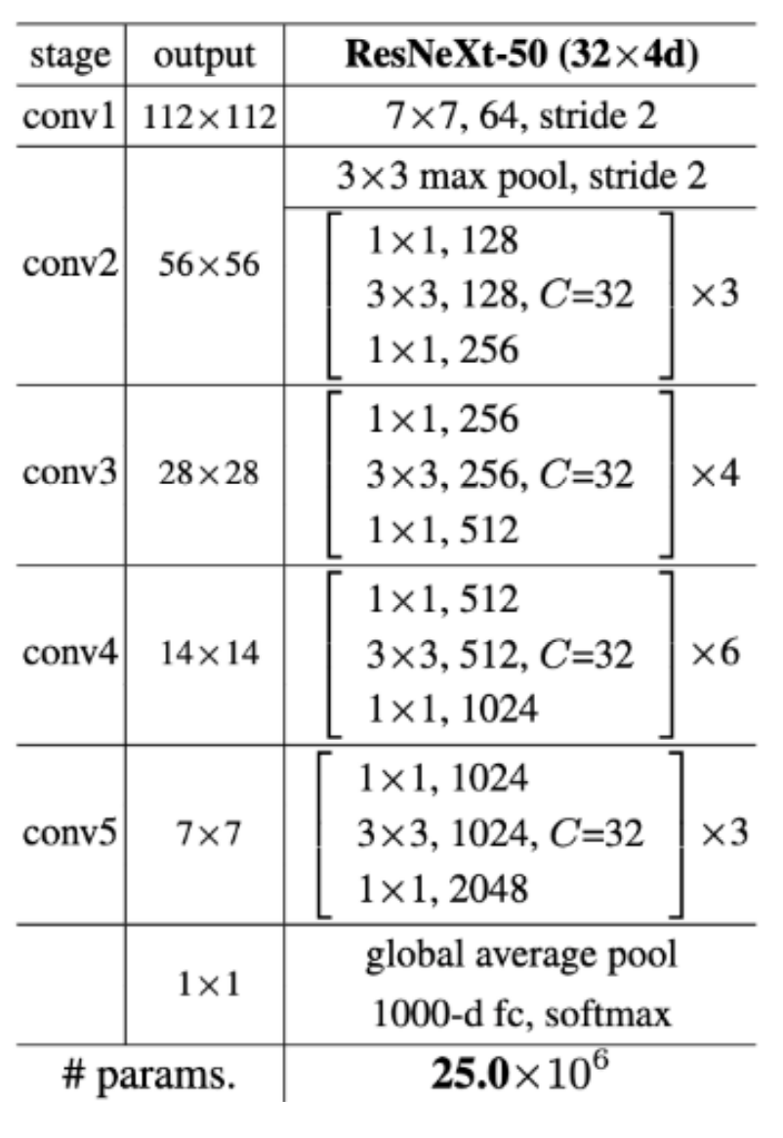
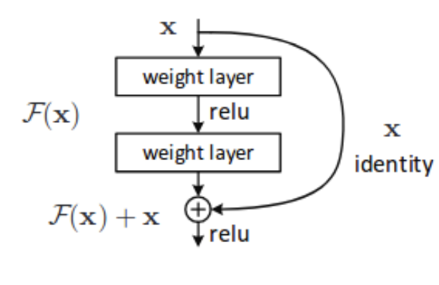
Methods
ResNext
Used the pre-trained model of ResNext for feature extraction.
ResNext is a Residual CNN network optimized for high performance on deeper neural networks.
We have used a ResNext of 50 layers and 32 x 4 dimensions.
The model also consists of Leaky Relu activation function.
ResNext Architecture

Slide 6
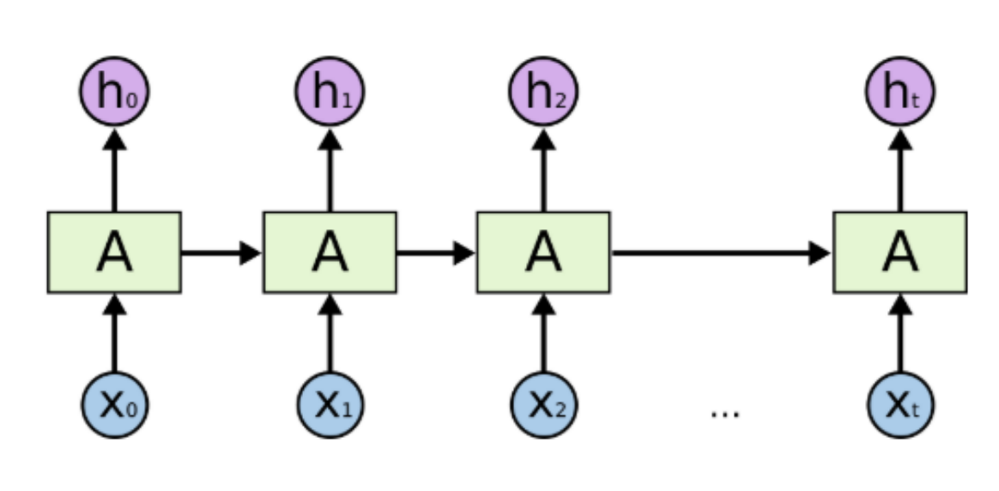
Methods
LSTM
We are using 1 LSTM layer with 2048 latent dimensions and 2048 hidden layers along with 0.4 chance of dropout.
LSTM is used for sequence processing and spot the temporal change between the frames.
LSTM Architecture

Slide 7
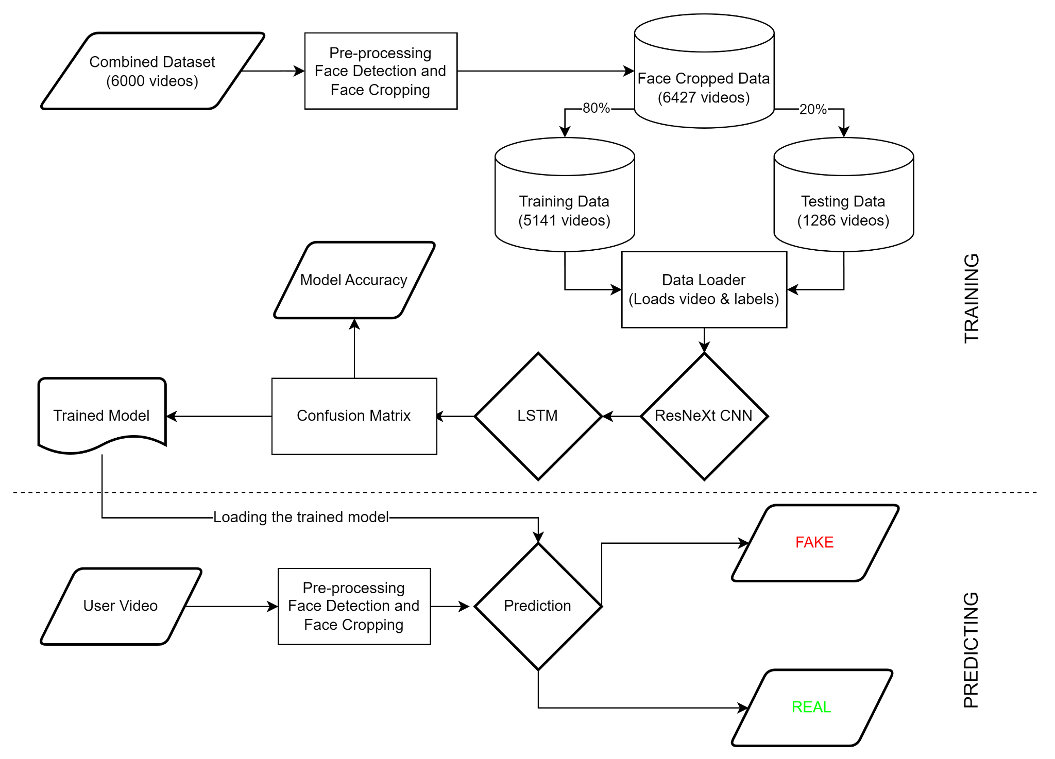
Project Workflow

Slide 8
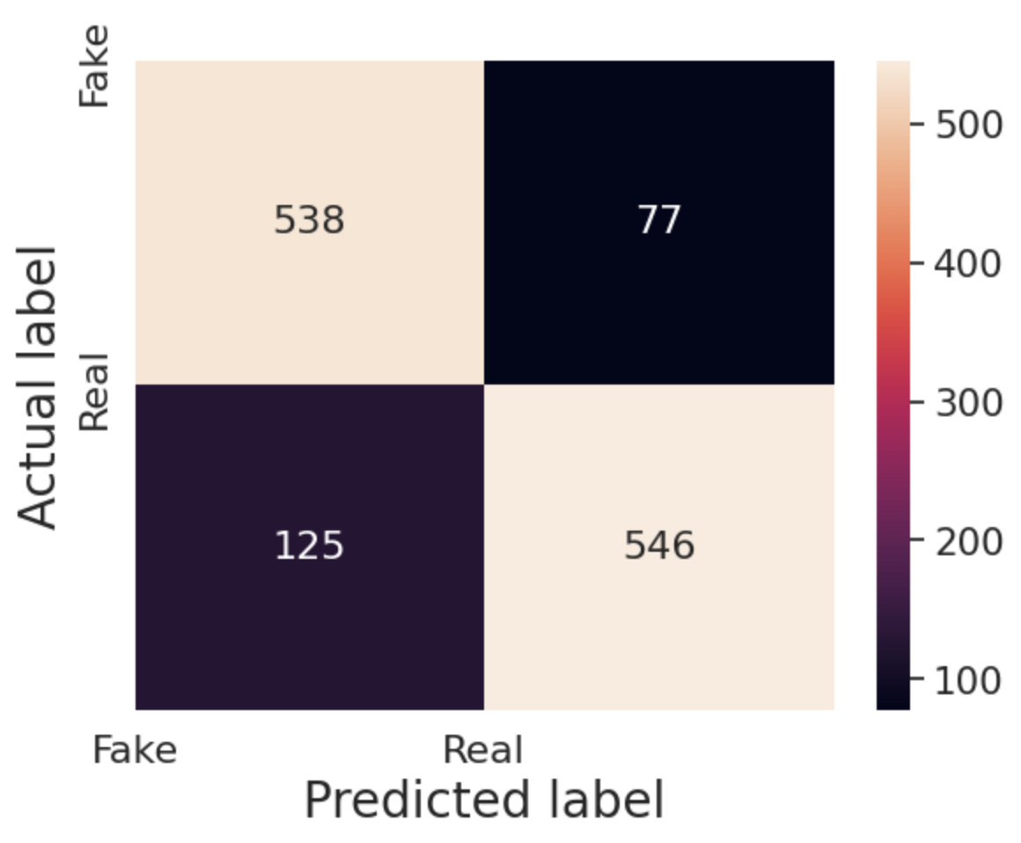
Results
Confusion Matrix:
Performance Metric | Score achieved
Testing Accuracy | 84.29
Precision | 87.64
Recall | 81.37
F1-Score | 84.39

Slide 9
Conclusion
We proposed a neural network-based method for classifying videos as deep fake or real, in addition to the model's confidence.
With a significant level of accuracy, our system is capable of predicting the output by processing 1 second of video, which is equivalent to processing 10 frames per second.
We used a pre-trained ResNext CNN model to extract frame-level features and an LSTM for temporal sequence processing to detect differences between the t and t-1 frames.

Slide 10
Future scope
There is always scope for enhancements in any developed system, especially one that is so relevant in today's time.
In the future, the algorithm can be enhanced to detect full body deep fakes also, though right now only faces are supported.
Web based platforms could be converted into mobile apps for the ease of use, as well as for the automatic detection and prevention of deepfake videos while uploading content on social media.

Slide 11
Thank you!!

