Slide 1

RETAIL SALES ANALYSIS
Data Analytics Project
Tools Used: Excel | SQL | Python | Power BI
Presented by: Deepika M

Slide 2






Project Overview
INTRODUCTION
Retail Sales Analysis
• An end-to-end analytics project to transform retail transaction data into meaningful business insights.
• Analyses sales, customer behaviour, product performance, inventory, and staff performance across multiple stores.
• Uses RFM analysis to segment customers based on purchasing behaviour and spending patterns.
• Combines data analysis and interactive visualization to support data-driven business decisions.
Inspect
Excel
Query
SQL
Analyses
Python &
Visualize
Power BI
PROJECT SCOPE
1,445 Customers • 1,615 Orders • 321 Products • 3 Stores • 10 Staff

Slide 3

















TOOLS AND TECHNIQUES
4
Power bi
1
excel
2
SQL
3
python
Data Cleaning & Preparation
Data Validation and Duplicate Removal
Lookup Functions and Pivot Tables
Database Creation and Management
Joins, Aggregations and Subqueries
Sales and Customer Analysis
Pandas and NumPy for Data Processing
Exploratory Data Analysis (EDA)
RFM Analysis for Customer Segmentation
Matplotlib for Data Visualization
Interactive Dashboard Development
KPI Cards and Data Visualizations
DAX Measures and Data Modelling
Customer Segment Analysis and Slicers

Slide 4

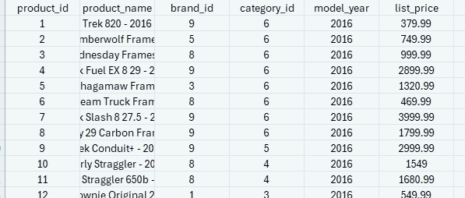
Excel Analysis - Data Cleaning
STAGE 1
Data Cleaning: Identified missing values and duplicate records in the dataset.
Data Standardization: Standardized column names and text formats for consistency.
Data Type Conversion: Verified date and numeric column formats.
Data Validation: Checked data consistency and accuracy.
Lookup Functions: Used lookup functions to retrieve product details using product IDs.
Calculated Columns: Calculated total price using quantity, list price, and discount.
Pivot Table Analysis: Summarized sales performance by product category.
Data Export: Prepared cleaned datasets in CSV format for SQL import.

Slide 5

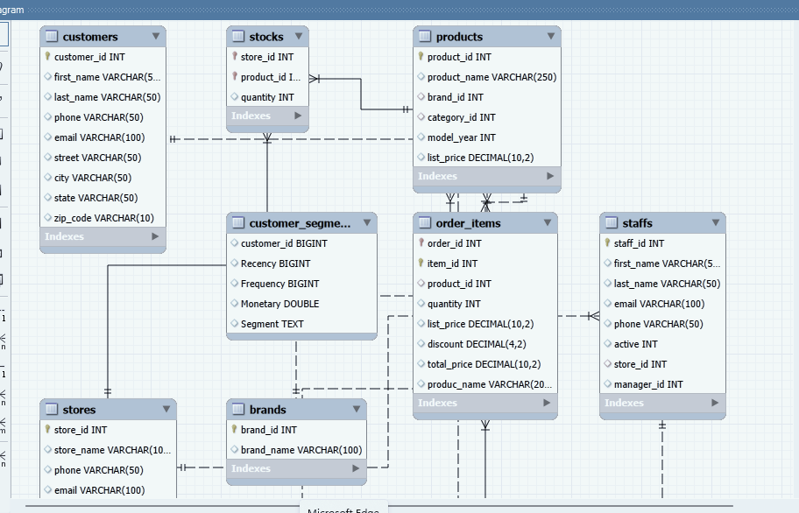
SQL ANALYSIS
STAGE 2
Order Details: Joined orders, order items, and products tables to create a detailed view of order transactions.
Store-Wise Sales: Used GROUP BY and SUM() to analyses sales revenue across three store locations.
Top-Selling Products: Analysed product quantities and revenue to identify the best-performing products.
Customer Purchase Analysis: Summarized customer order counts and spending patterns using aggregate functions.
Staff Performance: Examined orders and revenue associated with staff members across stores.
Stock Alerts: Used conditional logic to identify products with stock quantities below 10.

Slide 6








PYTHON ANALYSIS WORKFLOW
STAGE 3
01 | Data Loading
Loaded customer and order data from MySQL using Pandas.
RFM MODEL
How recently a customer placed an order.
02 | Data Exploration
Checked data details, summary statistics, and customer
purchase patterns.
R
F
M
03 | RFM Calculation
Calculated Recency, Frequency, and Monetary values for
each customer.
Recency
Frequency
Monetary
How often a customer places orders.
How much a customer spends on purchases.
04 | Customer Segmentation
Used RFM scores to group customers based on them
purchasing behaviour.
05 | Result Export
Saved the customer segment results in SQL for
Power BI dashboard.

Slide 7
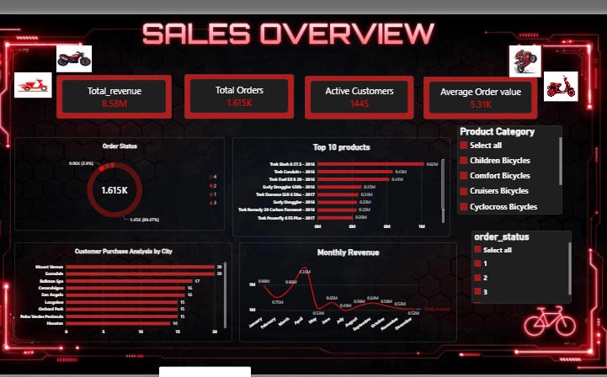



POWER BI ANALYSIS
STAGE 4
01| Data Connection – Connected retail data to Power BI.
02 | Data Modelling – Created relationships between tables.
03 | KPI Analysis – Analysed revenue, orders, and customers.
04 | Dashboard Creation – Used charts, slicers, and filters to present business insights.

Slide 8








Key Findings from the Dashboard Data
RESULTS
8.58M
Total Revenue
1,615
Total Orders
1,445 K
Active Customer
5,31K
Average Orders value
323
Low Stock Records
13,511
Total Stock Units
Key Findings from the Dashboard Data
Highest Store Revenue: Baldwin Bikes generated ₹88,25,902.
Top Revenue Product: Trek Slash 9.7 5 - 2016 generated ₹6,75,988.
Highest Staff Revenue: Marcelene Boyer achieved ₹29,38,714 in sales.

Slide 9







CONCLUSION
Built an end-to-end analytics workflow using Excel, SQL, Python and Power BI.
Analysed 1,615 orders and 1,445 customers to understand sales performance and customer behaviour .
Used SQL to extract insights and Python to perform RFM customer segmentation.
Created an interactive Power BI dashboard to visualize sales, customer segments and inventory performance.
Identified key business insights to support data-driven decision-making.

Slide 10


