Slide 1

HEALTHCARE ANALYTICS FOR DOCTOR VISITS - TIRTC
Deepika E
AICTE ID: STU6a53a459d65121783866457

Slide 2

PROBLEM STATEMENT
Healthcare datasets record a lot of information about patients — their illness, health condition, and doctor visits. But just looking at raw data does not tell us which factors actually affect how often a person visits the doctor.
This project analyzes a doctor-visits survey dataset to find patterns and relationships between doctor visits and factors like gender, age, income, illness, and chronic conditions.

Slide 3
Project Description
This is a student data analytics project that studies a healthcare survey dataset of 5,190 patients to understand what factors are linked to how often people visit the doctor.
The dataset has 13 columns covering gender, age, income, illness, reduced-activity days, self-rated health, chronic conditions, and insurance type.
The project follows a step-by-step process: loading and cleaning the data, exploring it with descriptive statistics, visualizing patterns with charts, and summarizing what the data shows about doctor visits.

Slide 4

WHO ARE THE END USERS?
Doctors and clinics — to understand which patients may need more attention or follow-up
Hospital administrators — to plan resources based on which patient groups visit most often
Health insurance providers — to understand usage patterns across income and chronic-condition groups
Public health policy makers — to see how age, income and insurance type relate to healthcare access
Students and researchers — as a beginner-friendly example of healthcare data analysis

Slide 5

Technology Used
Programming Language: Python
Libraries:
      Pandas,
      NumPy,
      Matplotlib,
      Seaborn
Development Environment: Jupyter Notebook (Google Colab)

Slide 6
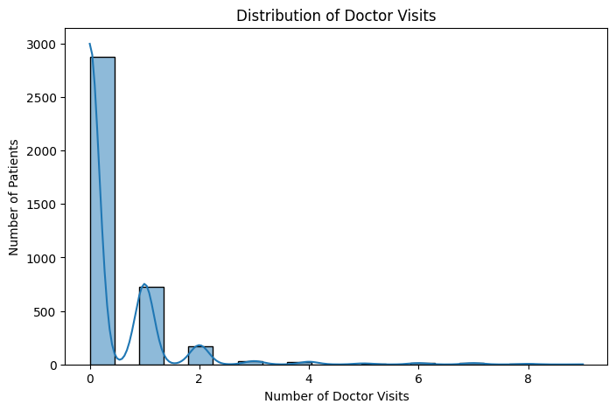
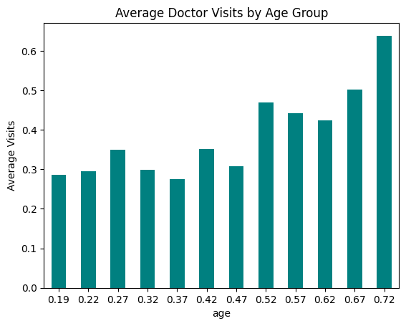
RESULTS
https://github.com/deepikae1504/Healthcare_analysis.git

Slide 7
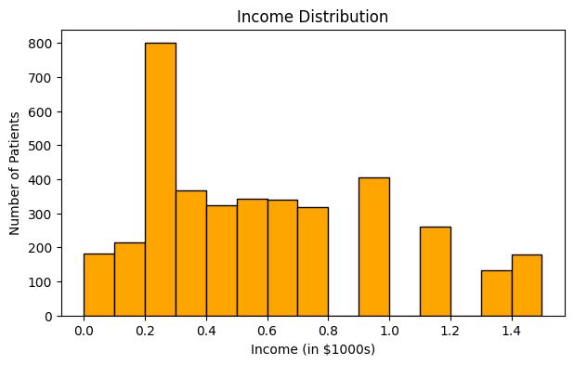
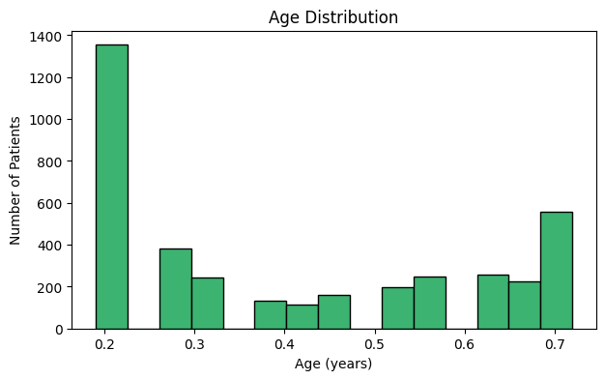
RESULTS
https://github.com/deepikae1504/Healthcare_analysis.git

Slide 8
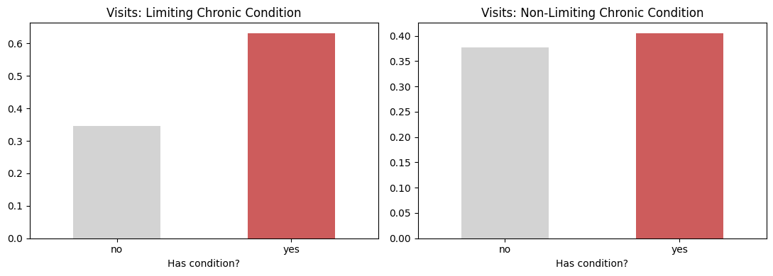
RESULTS
https://github.com/deepikae1504/Healthcare_analysis.git

Slide 9
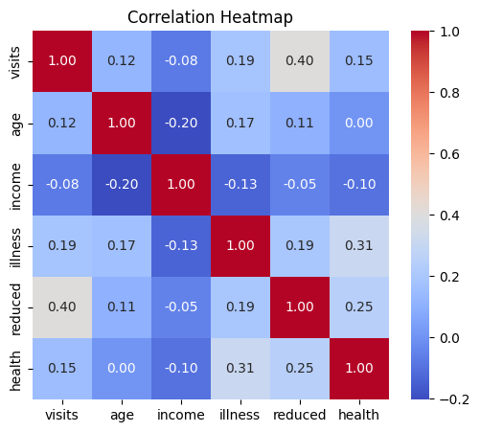
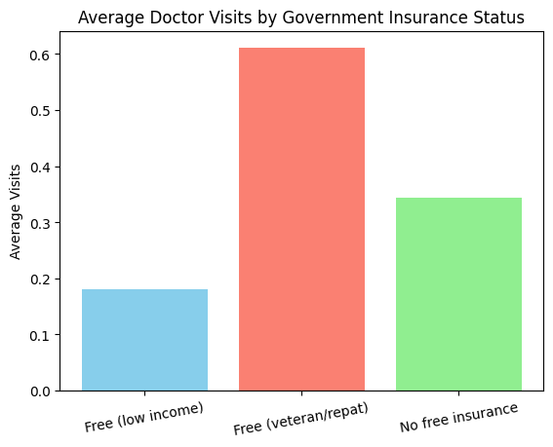
RESULTS
https://github.com/deepikae1504/Healthcare_analysis.git

Slide 10
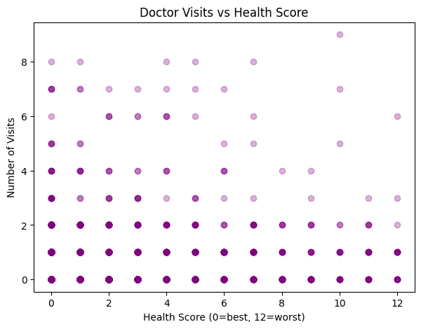
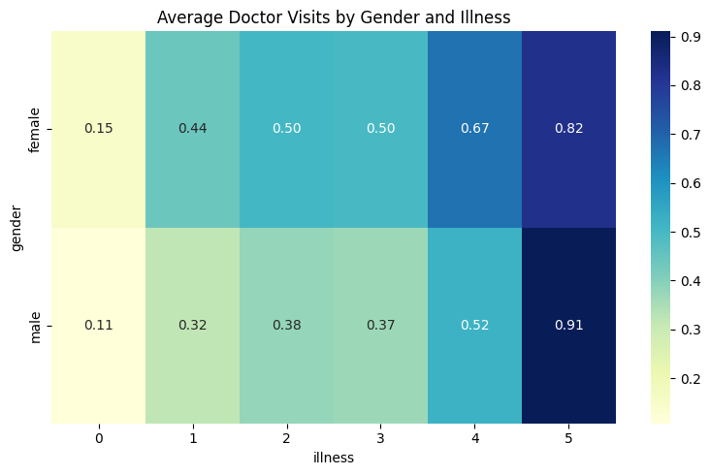
RESULTS
https://github.com/deepikae1504/Healthcare_analysis.git

Slide 11
Thank you
.
.

