Slide 1
TwinHealth
AI
A Digital Twin that warns of glucose spikes 2 hours ahead in type 2 diabetes (India)

Slide 2

Our Team: cosmic bloom
DEEPIKA E
JAYASRI D
DHATCHAYANI S
J BHAGYALAKSHMI
College : GRT Institute of Engineering and Technology

Slide 3
Problem statement and use case
Type 2 diabetes is very common in India, but doctors see patients only in short, infrequent visits.
Glucose spikes after meals happen between visits and go unnoticed.
Health records and wearable data sit in different places and are never combined.
Our use case
Warn 2 hours ahead when glucose is likely to rise above 180 mg/dL, show why, and let the doctor test what-if changes.
The decision it supports
Which patient should I look at today, and should I review meals, sleep or activity?

Slide 4
Our solution: a virtual patient
01.
02.
03.
Virtual patient
Fused prediction
Safe alerts
Keeps 24 hours of state.
Updates with every new 5-minute reading.
Cleans bad or missing input.
Health record (old data) + wearable and glucose sensor (live data).
Output: spike risk and a 2-hour glucose curve.
Alerts only when risk stays high and data is trustworthy.
Otherwise the twin says “cannot judge” instead of guessing.

Slide 5
Technology stack
Layer | Technology | Purpose
Programming language | Python | Core application and ML logic
Data processing | Pandas, NumPy | Data cleaning, time-series processing, EHR/sensor fusion
Machine learning | Scikit-learn | Classification, preprocessing, model evaluation
Model storage | Joblib | Save and load trained model bundles
Dashboard | Streamlit | Interactive doctor-facing interface
Visualizations | Matplotlib | Glucose curves, forecast comparisons, explanation charts
Data storage | CSV files | Synthetic EHR and sensor datasets for the prototype
Security utilities | Python security module, Streamlit session state | Model integrity checks and demo access control
Version control | Git and GitHub | Source code, documentation and submission
Testing | Pytest | Data handling, predictions and Digital Twin behavior
Security utilities are not, by themselves, evidence of full healthcare regulatory compliance.

Slide 6
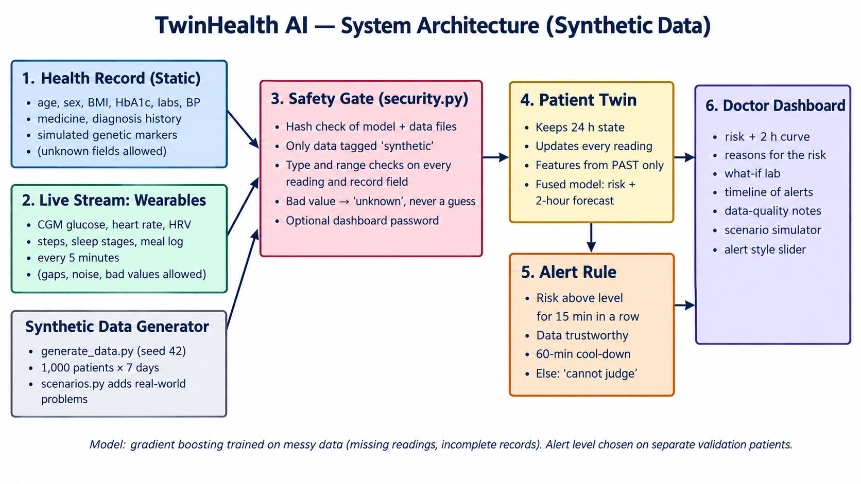
System architecture

Slide 7
Data: two synthetic streams
Static stream: health record
Live stream: wearable and sensor
Age, sex, BMI, diagnosis, family history
HbA1c, fasting glucose, cholesterol, blood pressure
Medicine, BP and cholesterol history
Simulated genetic risk score and TCF7L2-style alleles
Glucose (CGM), heart rate, HRV, steps
Sleep stages and last night’s sleep
Meal log with Indian dishes (carbs, GI class)
Every 5 minutes; gaps and noise added
1,000 patients × 7 days × 288 readings a day | spike rate 10.5% | 800 train, 200 unseen | every row tagged synthetic

Slide 8
AI/ML models and frameworks
Component | Suggested model or method | Framework
Two-hour spike-risk prediction | Logistic Regression or Random Forest classifier | Scikit-learn
Glucose forecasting | Persistence baseline plus a regression model for future glucose values | NumPy / Scikit-learn
EHR and sensor fusion | Feature-level fusion of historical and recent sensor features | Pandas / Scikit-learn
Model explanations | Feature-group perturbation or ablation analysis | Python / Scikit-learn
Digital Twin state | Stateful Python class updated by incoming readings | Python
Model evaluation | PR-AUC, precision, recall, false-alert rate and forecast MAE | Scikit-learn / NumPy
Framework = the software used to build a model. Algorithm = the model itself.

Slide 9
Model and proof that fusion helps
Gradient boosting, trained on messy data (gaps, incomplete records).
Features use only past readings; a test proves no future leakage.
Tested on unseen patients; alert level chosen on separate patients.
Removing the health record lowers accuracy: both streams matter.

Slide 10
The twin and its alert rule
Keeps 24 h of memory and updates per reading
Rejects absurd values (glucose 8 or 650) and bad timestamps
Handles late, duplicate and missing readings
Explains risk by hiding one input group at a time
What-if runs on a copy, never on the real twin
An alert fires only if ALL hold
1
Risk at or above the alert level
2
High for 3 readings in a row (15 min)
3
Glucose not already above 180
4
Data is trustworthy
5
No alert in the last 60 minutes

Slide 11
Doctor dashboard
Risk and 2-hour curve
Reasons
Live glucose, forecast, danger line at 180, and a clear High / Moderate / Low badge.
Which inputs raise or lower the risk: glucose trend, last meal, steps, sleep, health record.
What-if lab
Problem simulator
Try more sleep, a short walk or a lighter meal. Shows how the model reacts, not proof of treatment.
Break sensors or hide parts of the record live. Alert-style slider trades false alarms for missed spikes.

Slide 12
What if the data is messy?
With much missing glucose the twin says “cannot judge” (60% of the time at 30% missing, 94% at 50%) instead of guessing.
No lab results: warning time falls from 35 to 20 minutes.
23 scenarios and 19 patient groups tested; 43 automatic tests pass.

Slide 13
Results at the low-false-alarm setting
69%
65%
0.69
35 min
of spikes caught
of alerts were right
false alerts per patient-day
median warning time
100 unseen synthetic patients, clean data. No setting gives zero false alarms and every spike: fewer false alarms means more missed spikes.
On separate validation patients the same level gave 0.40 false alerts a day, so results vary with the patient sample.
The doctor chooses: Low false alarms, Balanced, or Catch more spikes.

Slide 14
Security and privacy by design
Synthetic data only
Hash-checked files
Input cleaning
Loaders refuse anything not tagged synthetic.
A swapped model or data file is refused.
Every reading and record is type- and range-checked.
Private dashboard
Pinned, scanned libraries
Honest limits
Local only, optional password, XSRF on, no tracking.
pip-audit clean; bandit no medium or high issues.
No software promises zero breaches. See SECURITY.md.

Slide 15
Limits and real-data plan
Limits and weak spots
Real-data test (ShanghaiT2DM)
All data is simulated by rules we wrote: scores show the pipeline works, not clinical accuracy.
Prediabetes: only 50% of spikes caught.
Sensor reading 20 mg/dL too high: score falls from 0.64 to 0.43.
Not simulated: kidney disease, insulin use, pregnancy.
109 recordings, 112,462 readings. Chinese patients, many on insulin (not simulated).
PR-AUC: twin 0.35, glucose stays same 0.33, straight-line trend 0.41, chance 0.15.
Honest finding: the twin does NOT beat a simple trend rule on real data.
Next: tune on real patients, fairly split.

Slide 16
Conclusion
01.
A working digital twin that fuses a health record with live sensor data and warns 2 hours ahead.
02.
Built to cope with missing data and to say “cannot judge” instead of guessing.
03.
Honest results: false alarms and weak spots are measured and shown.
04.
Next: test on real open data, extend to more conditions, validate with Indian cohorts and clinicians.
Link: https://github.com/deepikae1504/twinhealthai.git

Slide 17
Thank
You

