Slide 1



Water Quality Prediction

Slide 2

Learning Objectives
Understand Machine Learning in Environmental Monitoring Learn how ML models can be used to assess and forecast pollution levels in water bodies, enabling smarter environmental decisions.
Work with Real-World Datasets Explore historical water quality data collected across various years and locations, featuring parameters like O₂, NO₃, PO₄, and more.
Build a Multi-Output Regression Model Develop a predictive model using Random Forest that estimates multiple pollutant levels simultaneously.
Evaluate Model Performance Apply regression metrics like R² Score and Mean Squared Error to ensure prediction accuracy and reliability.
Create an Interactive Web Application Use Streamlit to design a user-friendly app that accepts inputs (Year, Station ID) and outputs predicted pollutant levels.
GOAL
Source :
www.freepik.com/

Slide 3
Tools and Technology used
Python 3.12 – Core programming language used for model development
Pandas & NumPy – Data manipulation, preprocessing, and analysis
Scikit-learn – Building and evaluating the machine learning model
Streamlit – Creating an interactive web application for predictions
Jupyter Notebook – Used for exploratory data analysis and model training
Joblib – Saving and loading trained models efficiently

Slide 4
Methodology
Step 1: Data Collection Used the PB_All_2000_2021.csv dataset, which includes yearly water quality data across multiple stations.
Step 2: Feature Selection Selected year and station ID as input features to predict multiple pollutant parameters.
Step 3: Data Preprocessing Applied one-hot encoding to station IDs to convert categorical data into numerical format.
Step 4: Model Development Built a multi-output regression model using RandomForestRegressor wrapped in MultiOutputRegressor.
Step 5: Model Evaluation Evaluated the model using R² Score and Mean Squared Error (MSE) to measure prediction performance.
Step 6: Web App Deployment Created a Streamlit app to input year and station ID and display predicted pollutant levels interactively.

Slide 5
Problem Statement:
Monitoring water quality is essential for public health and environmental sustainability.
Traditional methods rely on manual sampling and laboratory analysis, which are time-consuming, resource-intensive, and lack real-time insights.
Increasing industrial and agricultural activities have led to rising levels of pollutants such as nitrates, phosphates, and chloride in water bodies.
There is an urgent need for a predictive tool that can estimate pollutant concentrations quickly and accurately based on historical trends.
Such a tool can assist authorities in making data-driven decisions and initiating timely actions to prevent water contamination.

Slide 6
Solution:
A machine learning model was developed using RandomForestRegressor wrapped in a MultiOutputRegressor to predict multiple water pollutants simultaneously.
The model uses historical data such as Year and Station ID to forecast pollutant concentrations like O₂, NO₃, NO₂, SO₄, PO₄, and CL.
A Streamlit web application was created to make predictions accessible and interactive, enabling users to enter inputs and instantly view predicted values.
The system offers a faster and cost-effective alternative to lab-based testing and allows real-time monitoring for better water management.
This solution supports environmental authorities and researchers in making informed decisions and responding proactively to pollution trends.

Slide 7
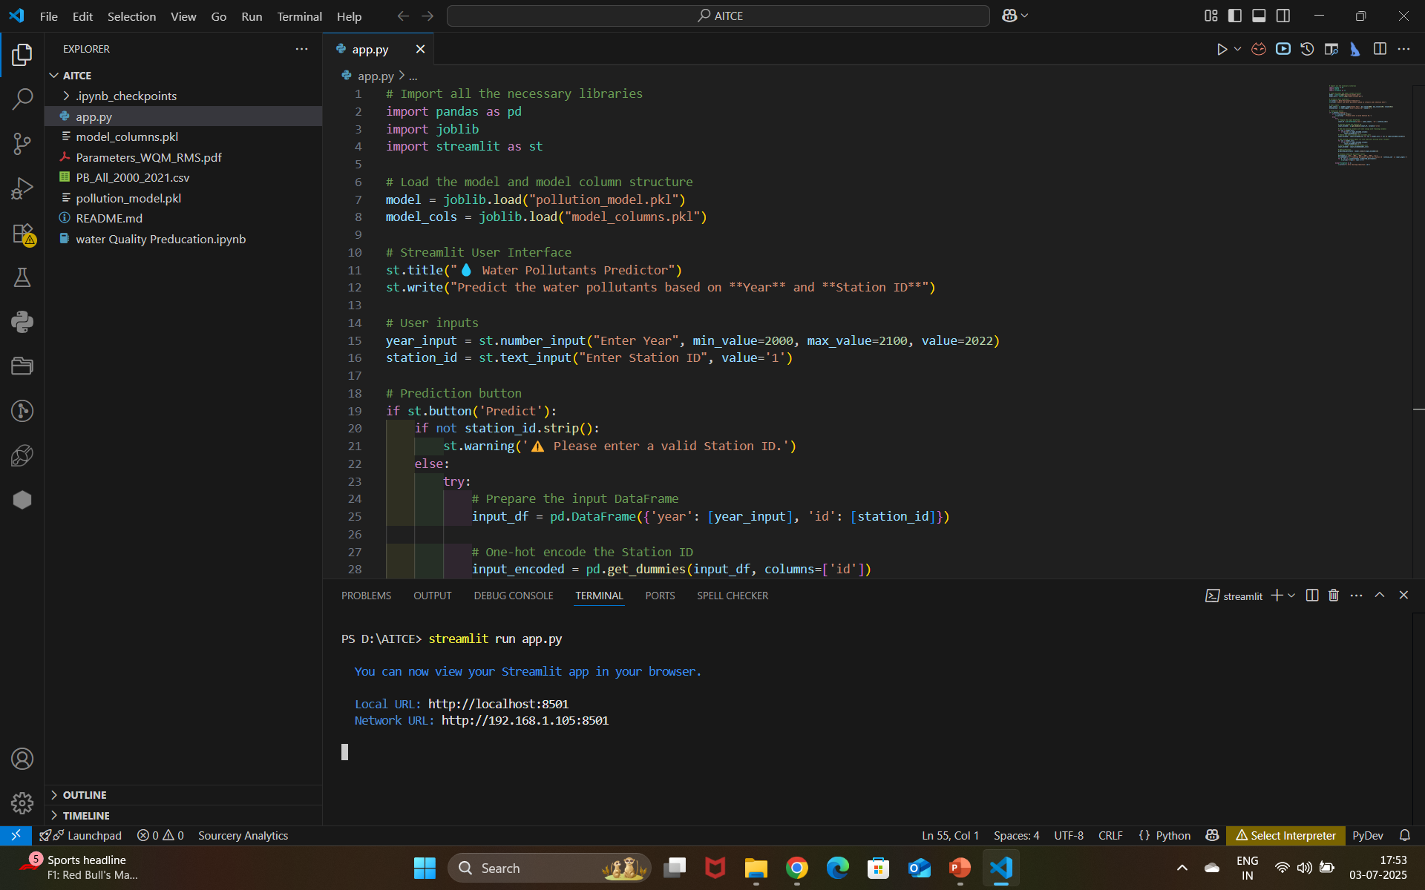
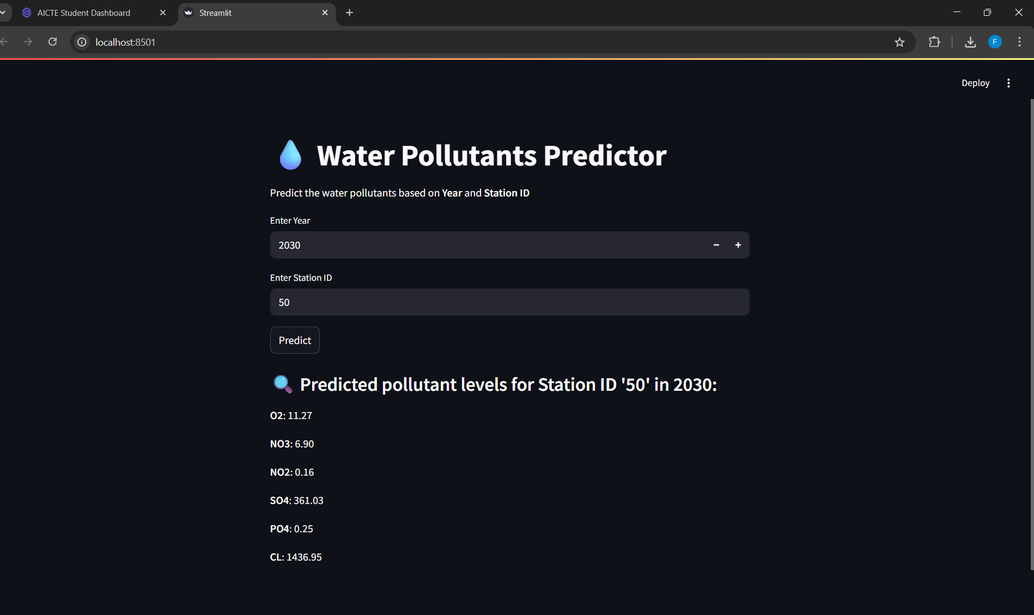
Screenshot of Output:

Slide 8
Conclusion:
The project successfully demonstrates the use of machine learning to predict multiple water pollutants with good accuracy.
It offers a cost-effective, fast, and accessible alternative to traditional lab-based testing.
The Streamlit web app enables real-time predictions, making the tool practical for decision-makers and environmental agencies.
This approach empowers early detection of pollution trends, supporting data-driven water resource management.
The solution is scalable and can be extended to other regions, parameters, or pollutants in the future.

Slide 9
Github link:
https://github.com/deepikakatreddy/WaterPrediction_AICTE/tree/main

