Slide 1
Digital portfolio
Name :DEEPIKA
REGISTER NO AND NMID : 222403801 AND asunm293222403801
Department : BSC ( COMPUTER SCIENCE)
COLLEGE : VIDHYA SAGAR WOMEN’S COLLEGE

Slide 2
My portfolio
Tips for Naming Projects: Use action words or describe the goal of the project. Include the tech stack or domain, if relevant. Make it short but descriptive.

Slide 3
Agenda
Problem statement
Project overview
End users
Tools and Technologies
Portfolio design and layout
Features and functionality
Result and screenshot
Conclusion
GitHub link

Slide 4
Problem statement
💡 Problem Statement for Portfolio Website In today’s competitive digital era, showcasing one’s skills, projects, and professional identity online is essential for personal branding and career growth. However, many individuals struggle to present their work and achievements in a structured and visually appealing way. Traditional resumes lack interactivity and fail to fully capture the personality and creativity of a professional. To address this gap, a personal portfolio website is needed — a centralized, accessible platform where individuals can highlight their skills, projects, experience, certifications, and contact details in a dynamic and user-friendly manner. The goal is to create a responsive, modern, and interactive website that reflects the developer’s capabilities and serves as a digital resume to attract potential employers, clients, or collaborators.

Slide 5
Project overview
Structure of a Project Overview: 1. Project Title 2. Objective / Problem Statement – What issue are you solving? 3. Description – A short explanation of the project. 4. Technologies Used – Tools, languages, frameworks. 5. Outcome / Results – What did you achieve?

Slide 6
Who are the end users
End Users for a Portfolio Website: 1. Recruiters / Hiring Managers – To view your skills, projects, and experience. 2. Clients – To explore your previous work before offering freelance or project opportunities. 3. Teachers / Mentors – For academic evaluation and project review.

Slide 7
Tools and techniques
Tools and Techniques for Portfolio Website Tools Used: HTML5 – For creating the structure of the website. CSS3 – For styling, layout, and responsive design. JavaScript – For interactivity and dynamic elements. VS Code / Sublime Text – Code editor used for development. Git & GitHub – For version control and project hosting. Browser DevTools (Chrome/Edge) – For testing and debugging.

Slide 8
Portfolio design and layout
Portfolio Design and Layout The portfolio is designed with a clean, modern, and user-friendly layout to highlight skills, projects, and achievements in a professional way. The design follows a section-based structure for easy navigation: 1. Header / Navigation Bar – Contains links to all sections (Home, About, Projects, Contact). 2. Home Section – A short introduction with name, title, and a call-to-action (e.g., “Hire Me” or “View Projects”). 3. About Me Section – Personal details, background, education, and career goals.

Slide 9
Features and functionality
Features and Functionality Features: 1. Responsive Design – Works smoothly on mobile, tablet, and desktop devices. 2. Navigation Bar – Easy access to different sections like Home, About, Projects, Skills, and Contact. 3. About Section – Highlights personal details, education, and career goals.

Slide 10
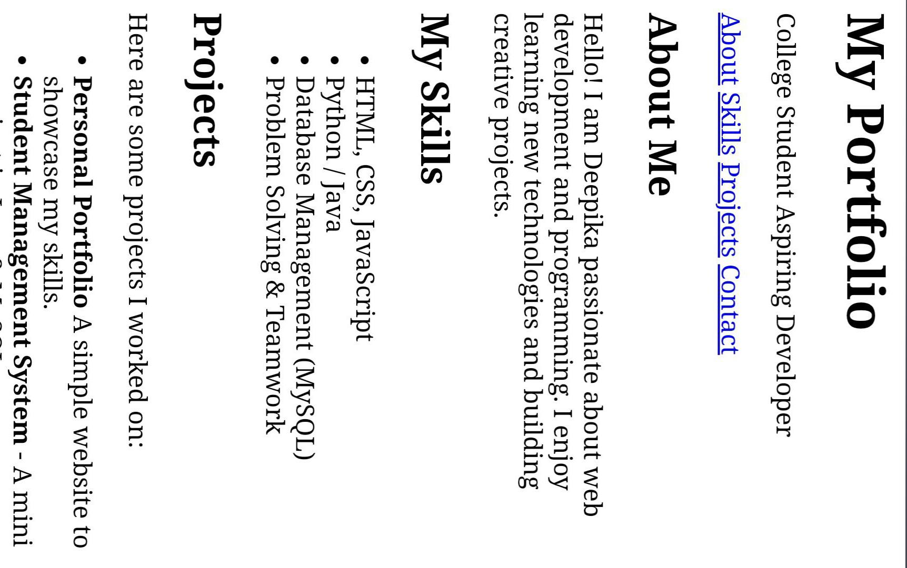
Result and screenshot

Slide 11
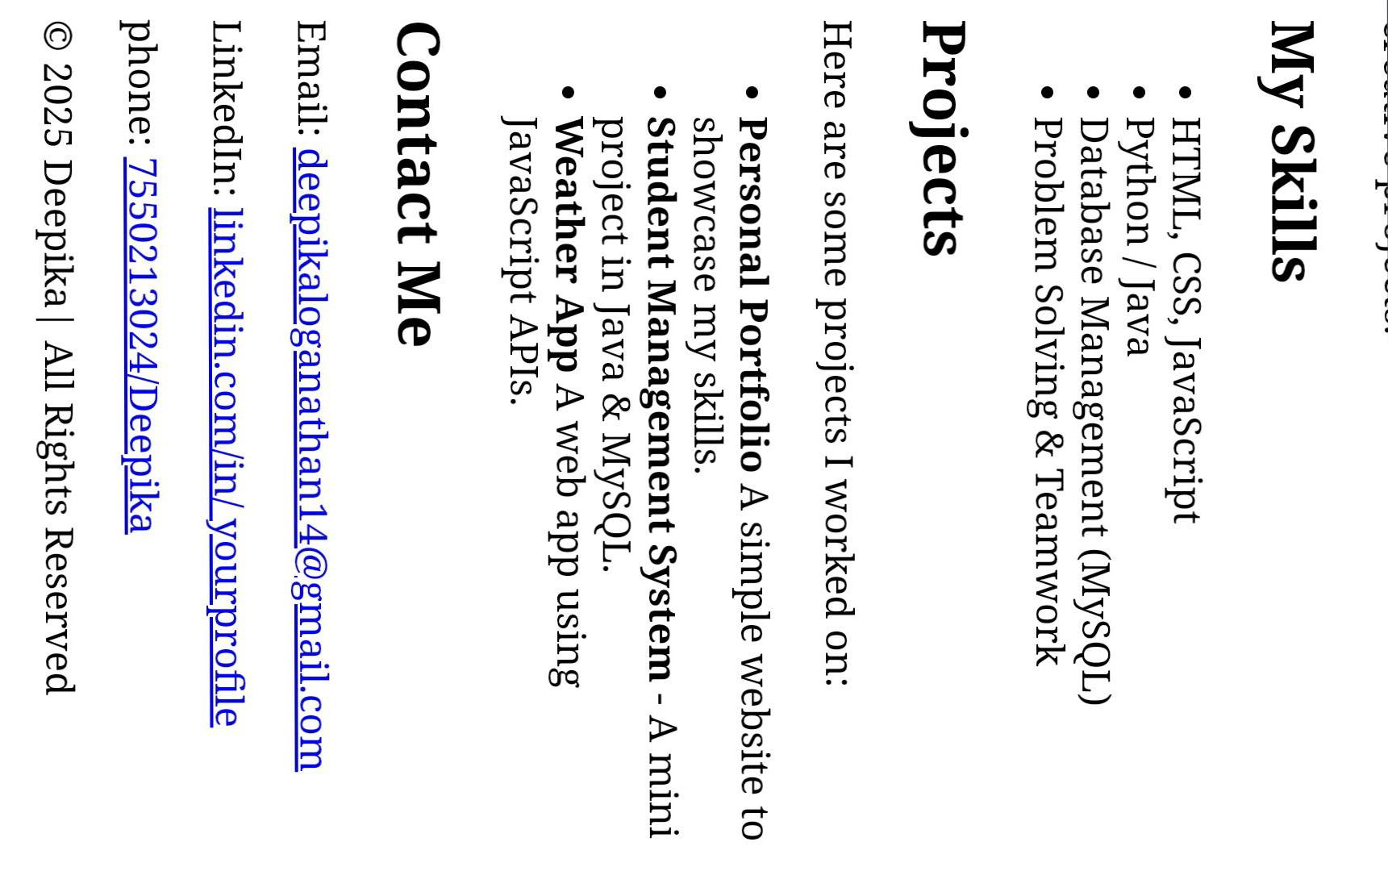

Slide 12
Conclusion
Conclusion My portfolio reflects my journey of learning, creativity, and growth in the field of technology. Through these projects, I have demonstrated my skills in problem-solving, design, and development. Each work represents my dedication and ability to apply knowledge to real-world challenges. Moving forward, I aim to continuously improve, explore new tools, and take on opportunities that will enhance my skills.

