Slide 1

Customer Purchase Intention Prediction System
A machine learning–powered platform that analyzes behavioral and demographic data to predict purchase likelihood in real time — enabling smarter targeting, higher conversions, and data-driven marketing decisions.
MACHINE LEARNING
BEHAVIORAL ANALYTICS
E-COMMERCE INTELLIGENCE
NAME: MAMIDI DEEPIKA
REGISTER NO: 323129510034

Slide 2

The Problem: Lost Conversions at Scale
E-commerce businesses lose significant revenue to untargeted marketing and cart abandonment. Without predictive intelligence, teams rely on guesswork — wasting budget on low-intent customers while missing high-value opportunities.
💸 Wasted Ad Spend
🛒 High Abandonment
Campaigns reach uninterested audiences, inflating cost-per-acquisition.
Over 70% of online shoppers abandon carts without completing purchases.
📉 Low Conversion
Generic messaging fails to resonate with individual customer intent signals.

Slide 3
Project Objectives
This system bridges raw customer data and actionable marketing intelligence through five core goals.
1
Collect & Analyze
Aggregate behavioral and demographic data — age, income, browsing history, and purchase patterns.
2
Preprocess & Engineer
Transform raw data into high-quality features for improved model accuracy.
3
Train & Evaluate
Build and benchmark multiple ML classification models for optimal performance.
4
Predict in Real Time
Deliver instant purchase intention scores via API for live decision-making.
5
Segment & Report
Generate customer segments and interactive dashboards for marketing teams.

Slide 4
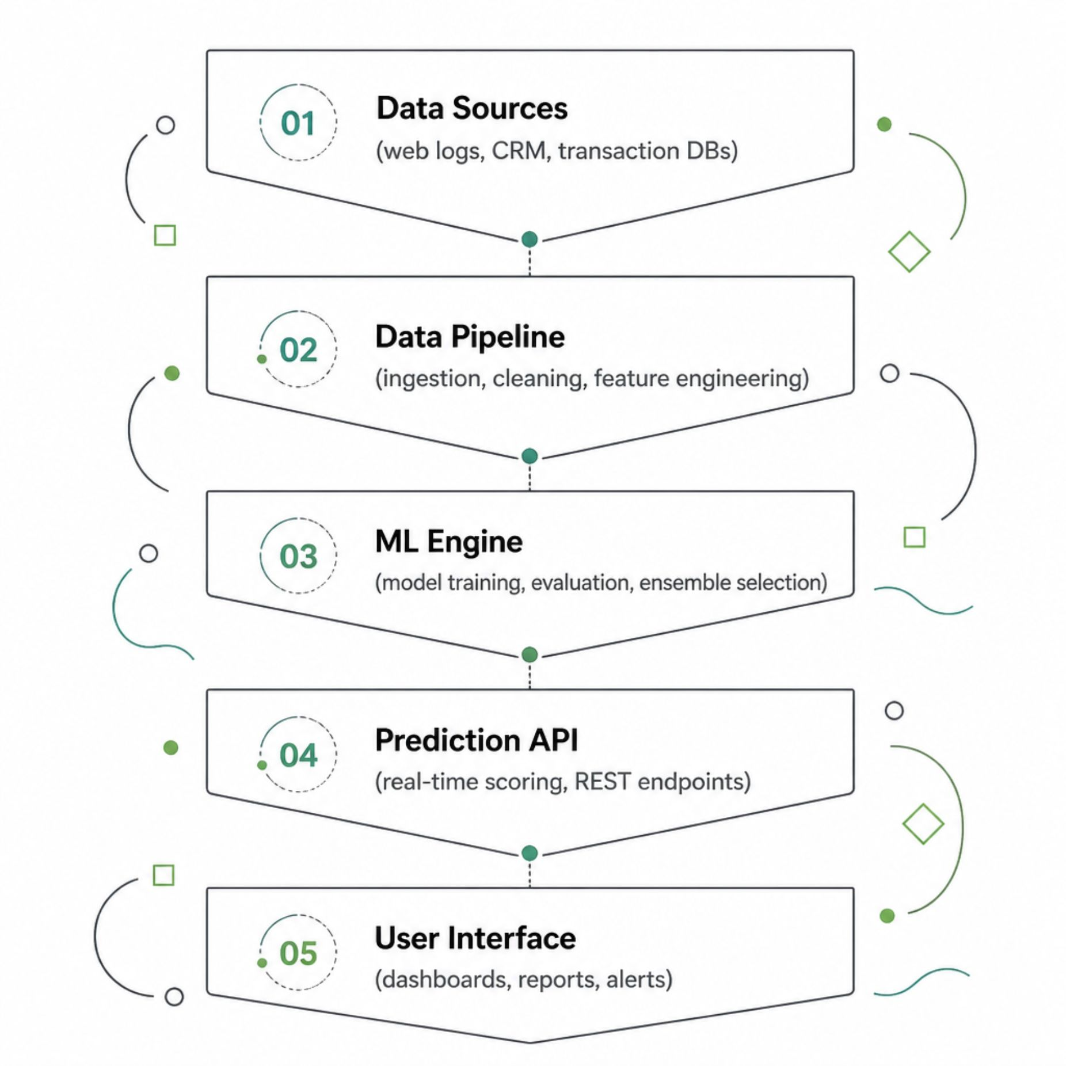
System Architecture Overview
End-to-End Intelligence Pipeline
The system ingests raw customer data from multiple sources, processes it through a robust ETL pipeline, applies trained ML models, and surfaces predictions through a secure API and interactive dashboards — all in near real time.
The modular architecture allows individual components to be upgraded or replaced without disrupting the full system.

Slide 5
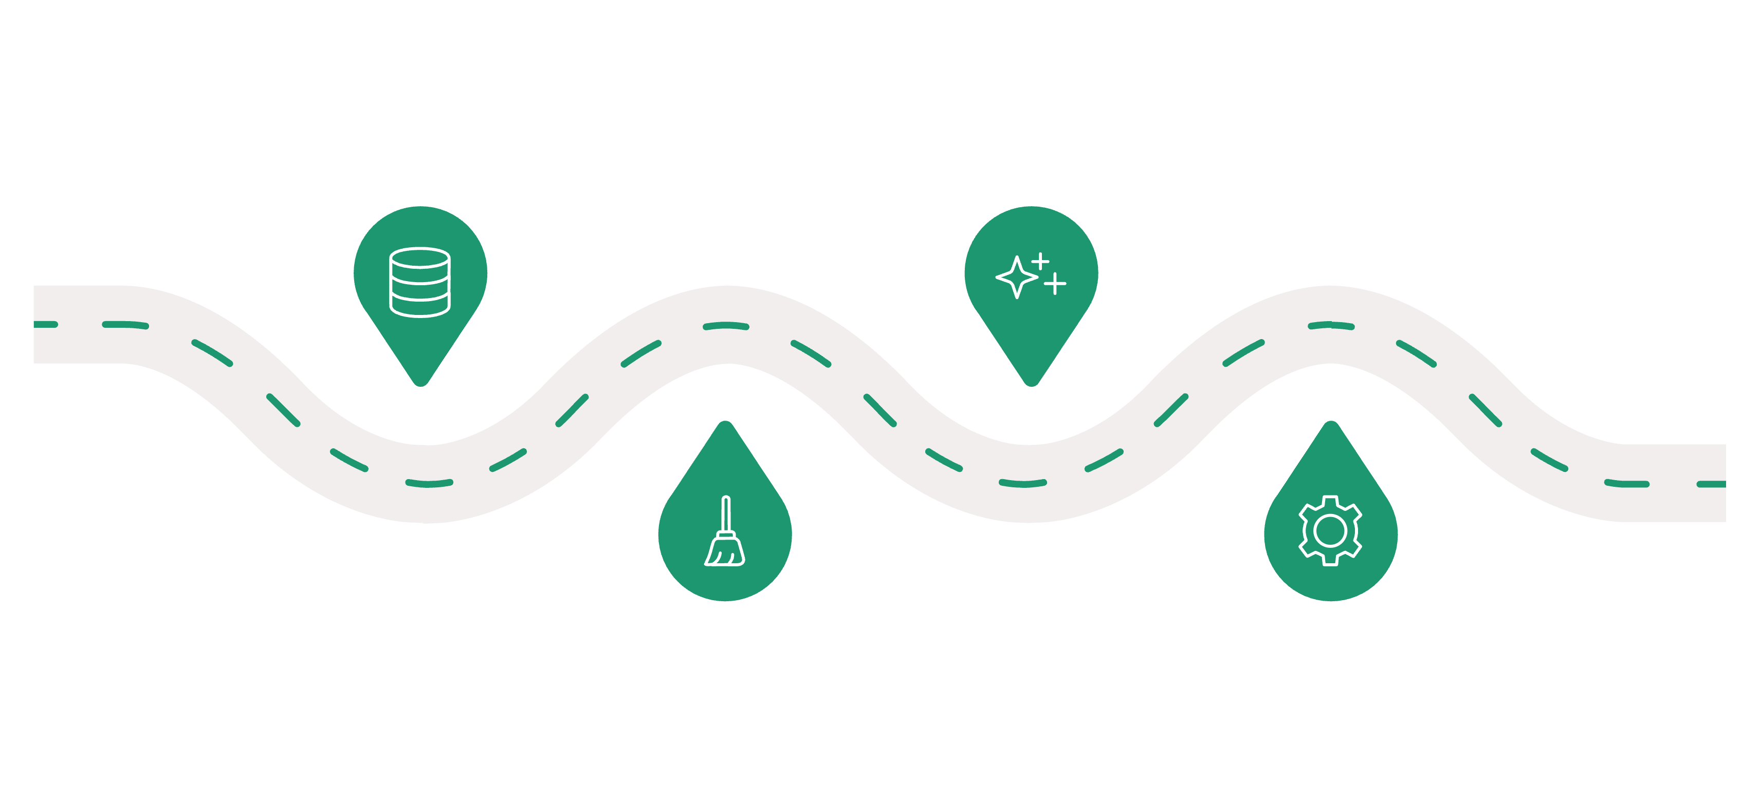
ML Workflow: From Data to Prediction
Feature Engineering
Data Collection
Behavioral and demographic sources
RFM, session metrics, intent signals
Preprocessing
Model Training
Cleaning, normalization, encoding
Logistic, RF, XGBoost ensembles
Each stage is optimized for accuracy and latency. Feature engineering transforms raw signals into predictive variables, while ensemble models balance interpretability with performance.

Slide 6

Data Sources & Feature Engineering
Input Data Dimensions
Engineered Features
Demographic
RFM Score
Engagement Index
Age, income, location, gender, occupation
Recency, Frequency, Monetary composite
Normalized browsing intensity metric
Behavioral
Page views, session duration, click patterns, time on product pages
Intent Signal
Cart additions, wishlist activity, repeat visits
Transactional
Purchase history, average order value, frequency, recency
Contextual
Device type, referral source, campaign attribution

Slide 7
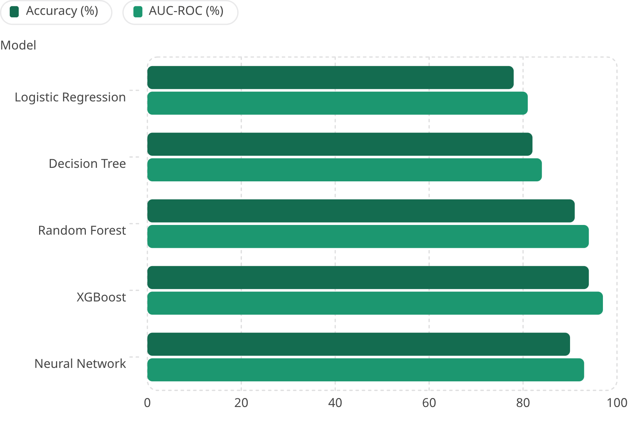

Model Training & Evaluation
Why XGBoost Leads
XGBoost achieves the highest accuracy (94%) and AUC-ROC (97%) by combining gradient boosting with regularization, handling class imbalance, and capturing non-linear patterns in customer behavior.
Confusion Matrix
Cross-Validation
Validates true positive and negative rates on held-out test data.
5-fold CV ensures robust, generalizable performance estimates.

Slide 8
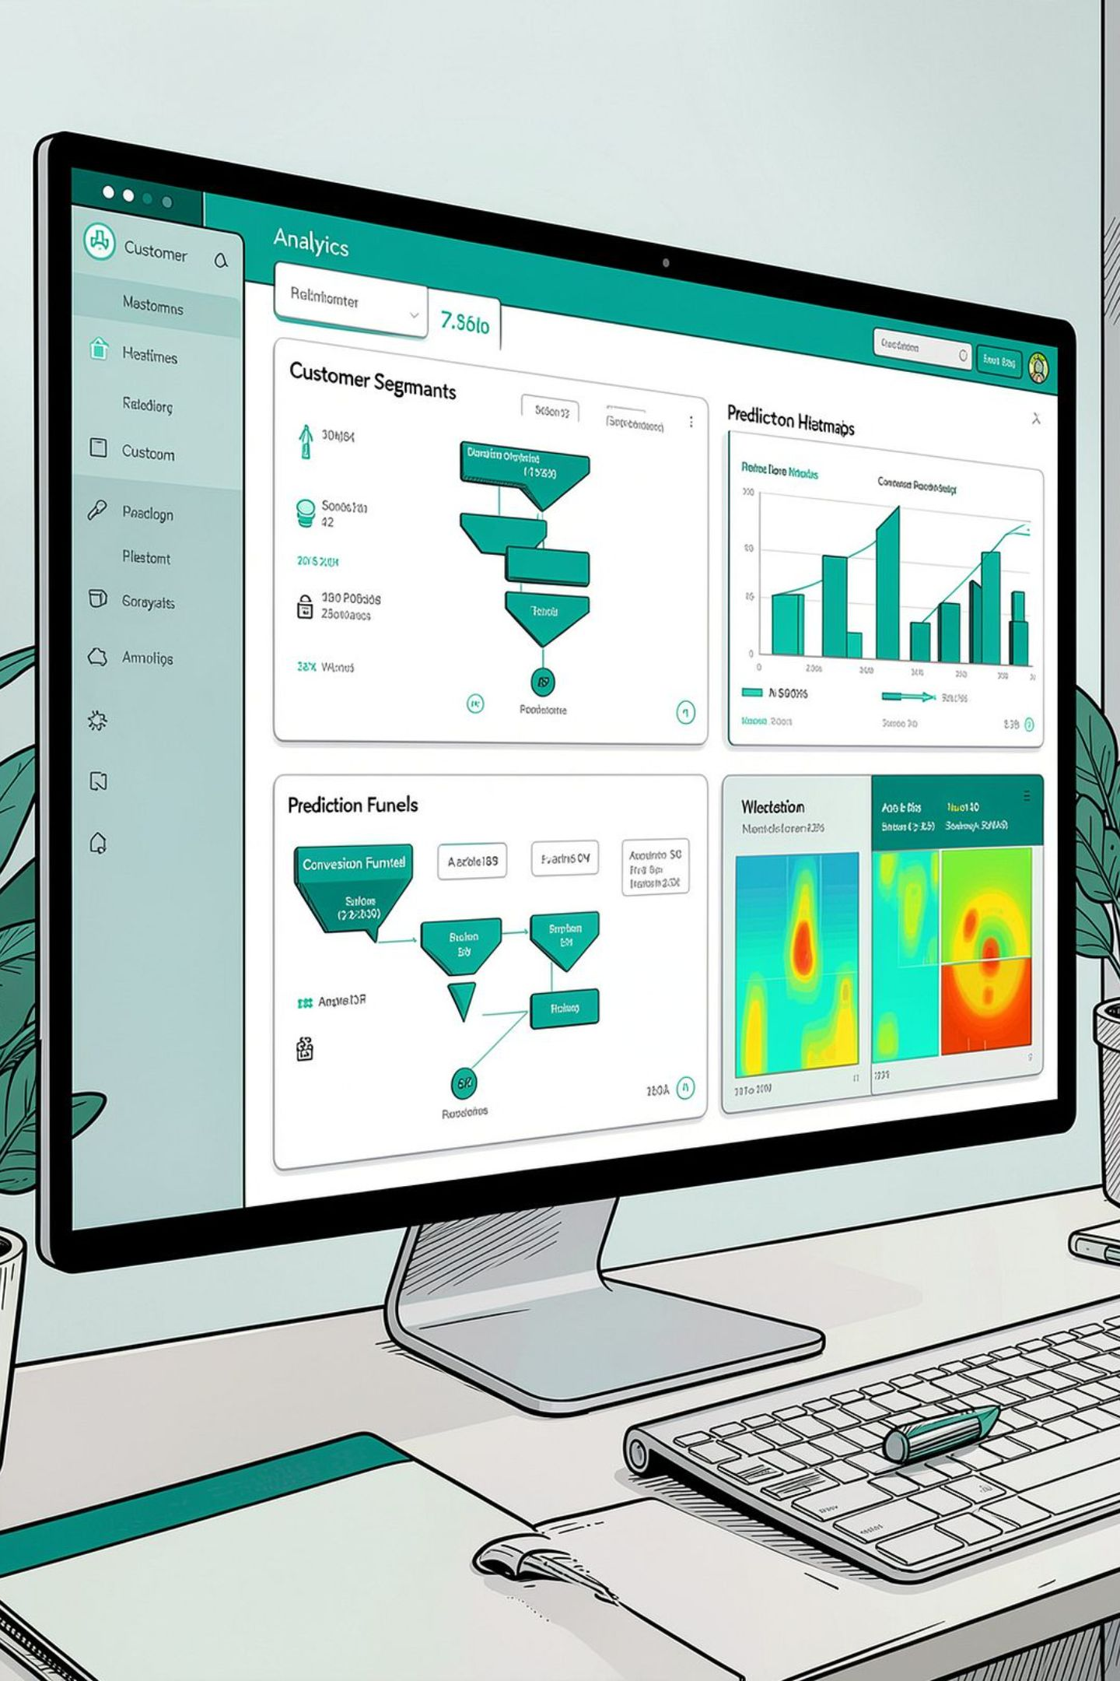




Analytical Dashboards & Insights
The platform provides interactive dashboards that translate model outputs into actionable business intelligence for marketing and sales teams.
Conversion Funnel
Visualize drop-off points and identify high-intent segments for retargeting.
Customer Segments
Auto-generated clusters by purchase propensity, value, and behavior profile.
Live Intent Scores
Real-time purchase probability scores updated with every user interaction.
Prediction Reports
Exportable reports with model confidence, feature attribution, and recommendations.

Slide 9
Real-World Applications & Advantages
Where It Applies
Competitive Advantages
Higher Conversion Rates — Target high-intent customers precisely.
Reduced CAC — Eliminate wasteful ad spend on low-propensity audiences.
Scalable Architecture — Handles millions of events with cloud-native deployment.
Secure by Design — Role-based access, encryption, and GDPR-compliant data handling.
🛍️ E-Commerce
🏪 Retail
Personalized product recommendations and cart recovery emails.
In-store and omnichannel campaign targeting.
📣 Digital Marketing
Ad spend optimization based on predicted intent scores.

Slide 10



Limitations, Future Roadmap & Conclusion
Current Limitations
Future Enhancements
01
Cold Start
Deep Learning Models
New users with no history reduce prediction confidence.
LSTM and transformer architectures for sequential behavior modeling.
Data Quality
02
Model accuracy depends on clean, consistent input data.
Real-Time Streaming
Apache Kafka integration for sub-second intent scoring.
Concept Drift
03
Customer behavior shifts over time, requiring periodic retraining.
Explainable AI
SHAP and LIME dashboards for transparent, auditable predictions.
This system transforms raw customer data into a competitive advantage — driving smarter decisions, higher conversions, and measurable ROI for modern businesses.

