Slide 1
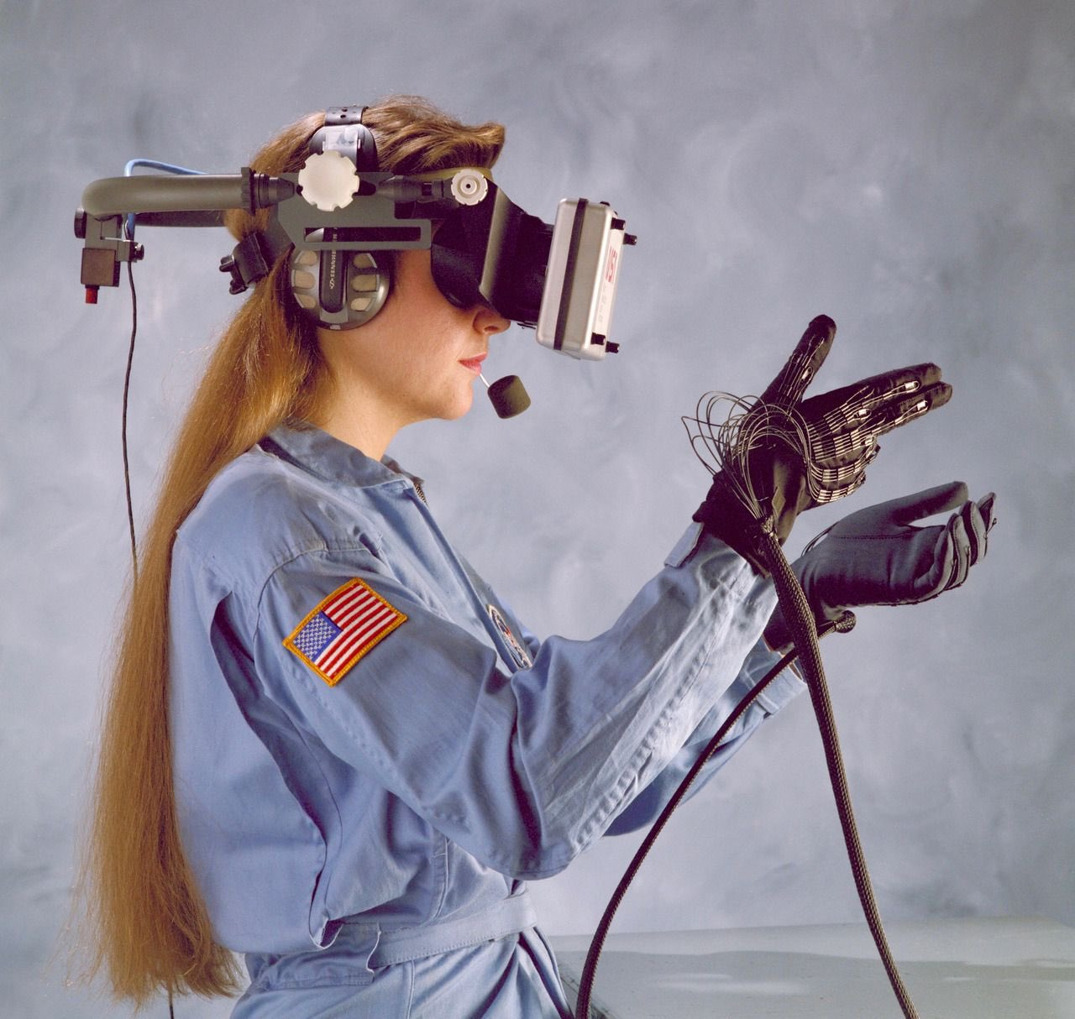
Design of Haptic Sleeve for AR/VR experience
Design Credit Project
Oppangi Poojita (B21CS055)

Slide 2

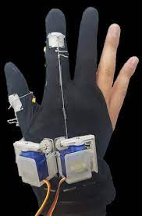
PROBLEM STATEMENT & MOTIVATION
Current AR/VR experiences lack the sense of touch, which limits their ability to fully immerse users in a virtual environment.
Haptic sleeve enables feel tactile sensations, making the virtual environment more realistic and enhancing the overall experience. This can be particularly useful for training simulations, entertainment, and therapeutic applications.

Slide 3
PERCEPTUAL ILLUSIONS OF MOTION
Cutaneous Rabbit illusion
Apparent Motion
Phantom Saltation
01
02
03
It’s an illusion of hopping sensations on skin when touched on different areas of the forearm.
It’s an illusion of movement between stationary tactile stimuli delivered to three different sites on the forearm.
It’s an illusion of touch between non-stimulated skin points on the forearm, creating a hopping sensation.

Slide 4
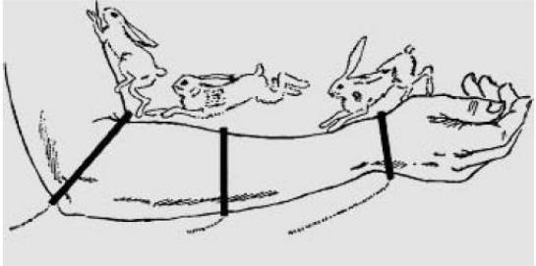
CUTANEOUS RABBIT ILLUSION
The cutaneous rabbit illusion is a tactile illusion where taps or touches delivered at different locations on the skin create a perceptual sequence of bouncing or hopping sensations. The sequence of taps may not correspond to the actual physical stimulation, and the brain integrates sensory information to create a coherent perceptual experience. This illusion highlights how the brain processes tactile information and creates a perception that may not reflect the physical reality of the stimulus.

Slide 5
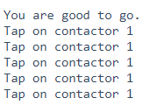
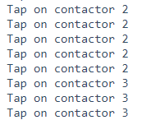
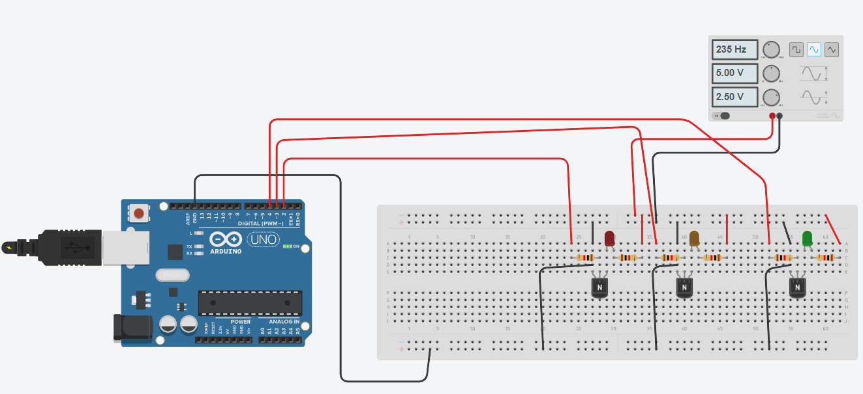
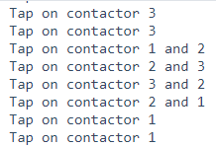
CUTANEOUS RABBIT ILLUSION
Serial Monitor Output
The software output of the cutaneous rabbit illusion involves the delivery of five taps at each actuator located on the wrist, middle of the forearm, and elbow, resulting in three different sequences. The tapping interval for each sequence is 500 ms, and there is a pause interval of 1000 ms between each sequence. The tapping sequences create a hopping sensation that moves up the arm (between actuators 1 and 2, and 2 and 3) and then back down (between actuators 3 and 2, and 2 and 1), replicating the perceptual experience of the cutaneous rabbit illusion.

Slide 6
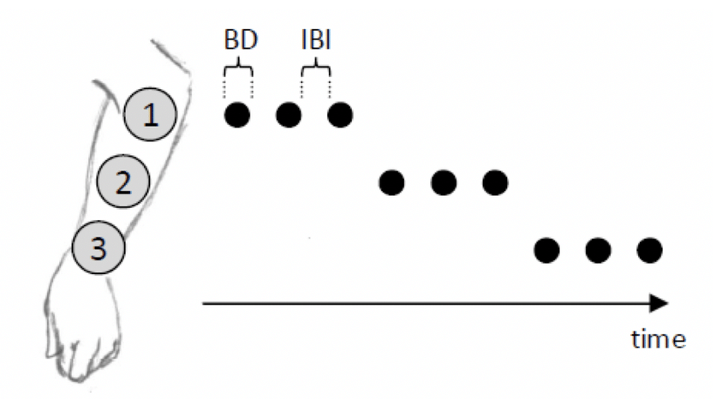
APPARENT MOTION
Apparent motion is a tactile perceptual illusion where the delivery of three tactile stimuli at different sites on the forearm creates the illusion of movement between the contact sites. The illusion occurs when the interval between the stimulus onset falls within a certain range, typically periodic in nature such as 150 Hz. Apparent motion is a well-known example of how the brain processes tactile information and creates a perception of motion in the absence of actual movement.

Slide 7
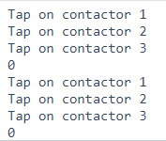
APPARENT MOTION
Serial Monitor Output
The software output of the apparent motion involves the delivery of three tactile stimuli at a frequency of 1000 ms and a duration of 800 ms, with a delay interval of 1000 ms between each stimulus. The delivery of each stimulus is completed with a void loop, and the participant's response is stored in a variable initialized to 0. This technology enables the creation of a perceptual experience of apparent motion by delivering tactile stimuli at different locations on the forearm, which could have implications for enhancing the immersion of users in augmented or virtual reality environments.

Slide 8
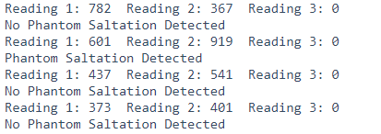
PHANTOM SALTATION
Phantom saltation is a phenomenon where the perception of touch occurs at a non-stimulated location, caused by the integration of sensory signals from different skin regions. This tactile illusion creates the sensation of a hopping movement between two or more contact points on the skin, even in the absence of any physical stimulus. It is thought to be a result of the brain's sensory integration processes and may have implications for the development of haptic technology.
Serial Monitor Output
In the software, the Phantom saltation is detected by comparing two readings to a preset threshold of 500. Specifically, if first two readings are greater than the threshold or both are less than the threshold, the saltation is detected. Otherwise the phantom saltation is not detected.

Slide 9
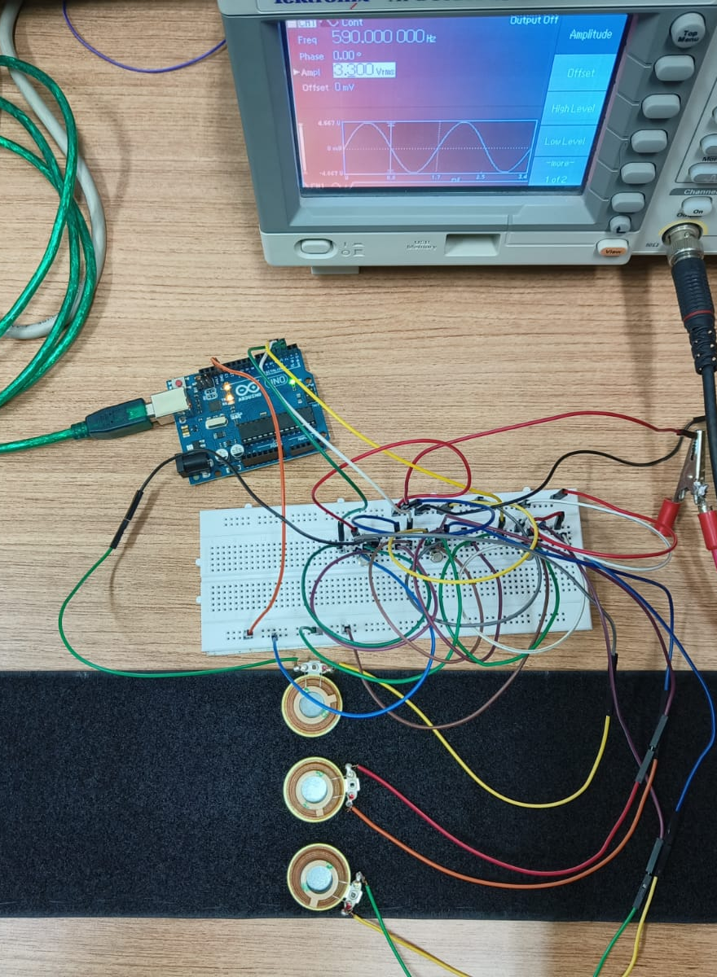
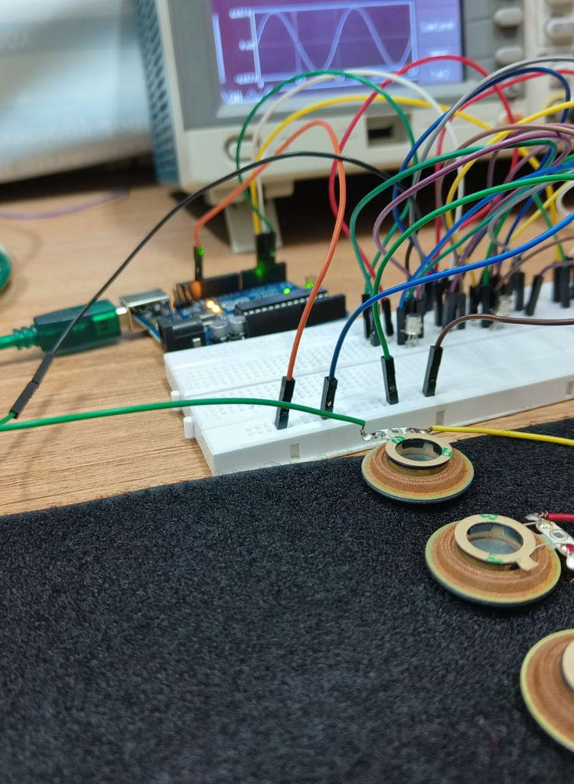
Used Tectonic actuators(Model TEAX13C02-8/RH), transistors, Arduino mega 2560 as a major component.
Transistors are acting like a switch .
The actuators are operating in frequency range of 590Hz at an amplitude range of 3.300 Vrms

Slide 10
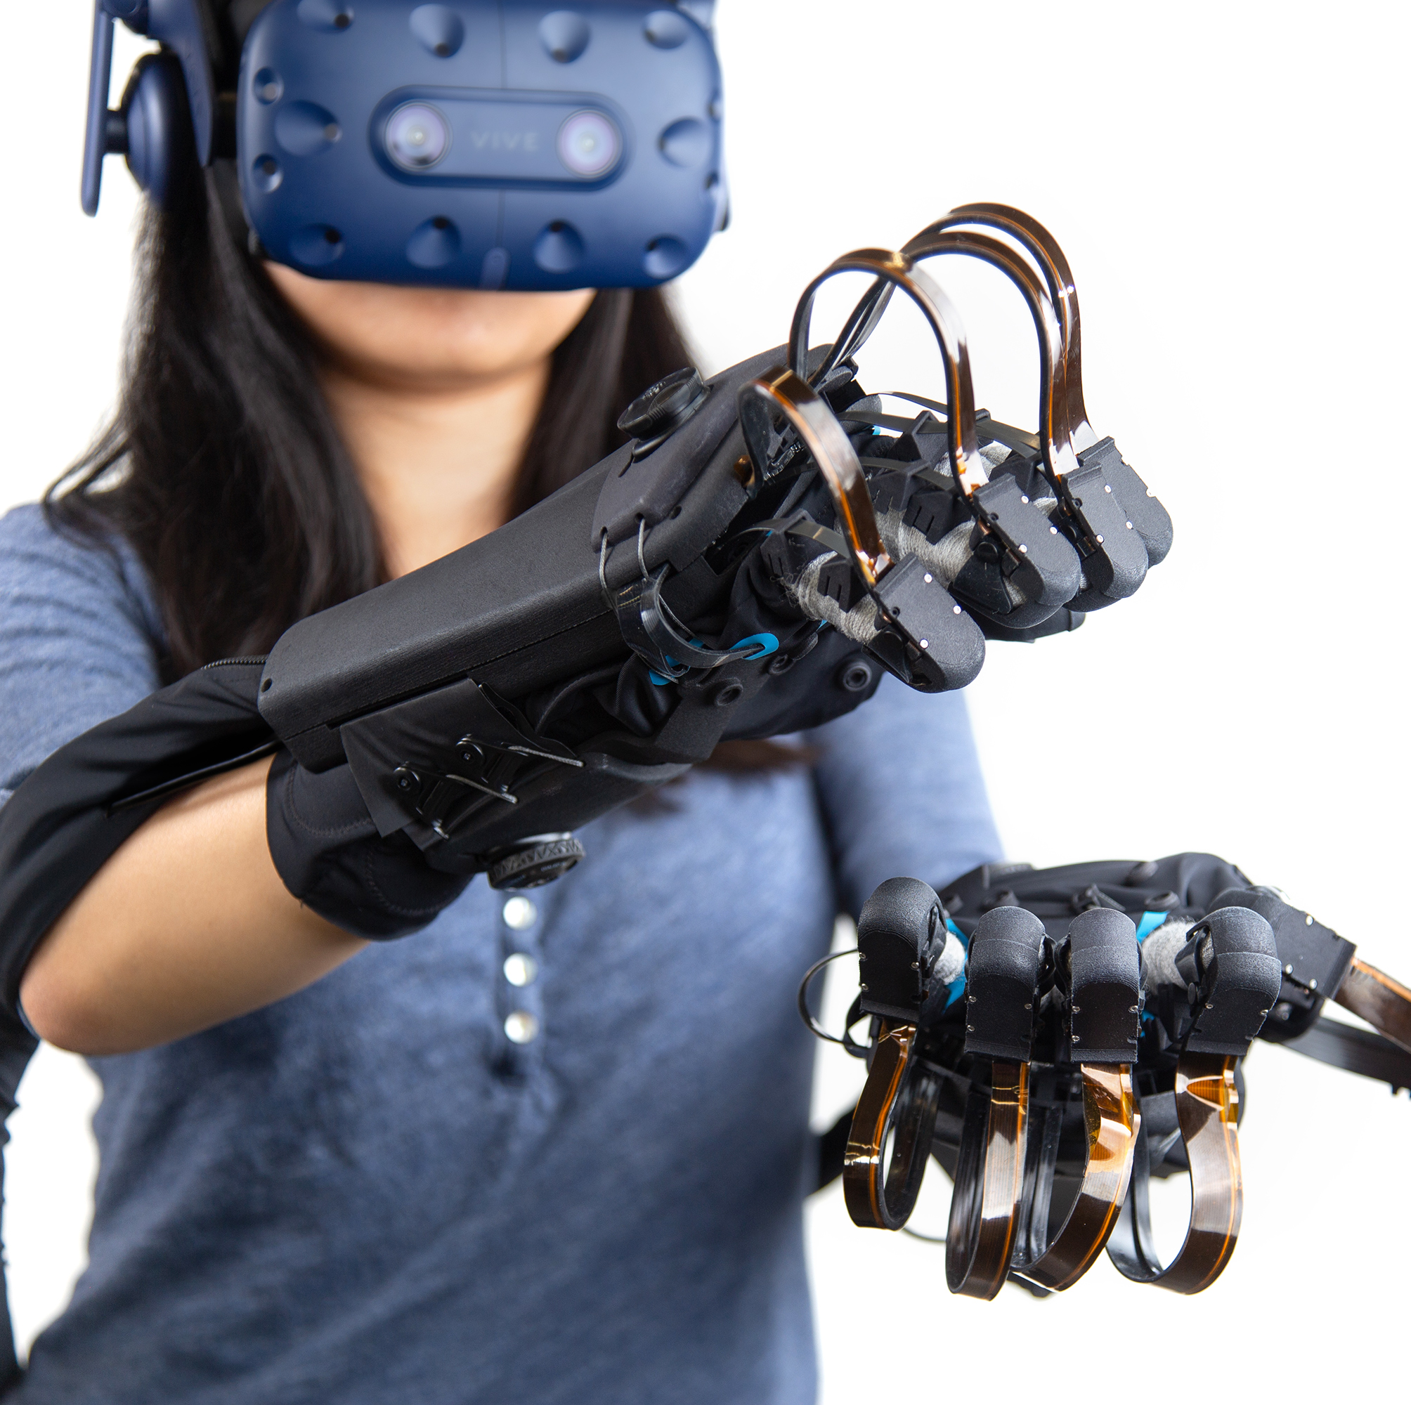
THANKS !
Does anyone have any questions?
Follow the project updates
Poojita.1@iitj.ac.in +91 8309203027
Oppangi Poojita(B21CS055)
INSTRUCTOR- Dr. Amit Bharadwaj

