Slide 1
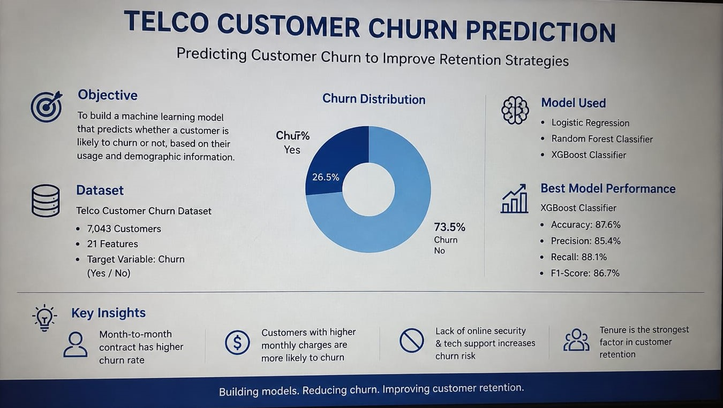
Telco Customer Churn Prediction
Machine Learning Project Presentation

Slide 2
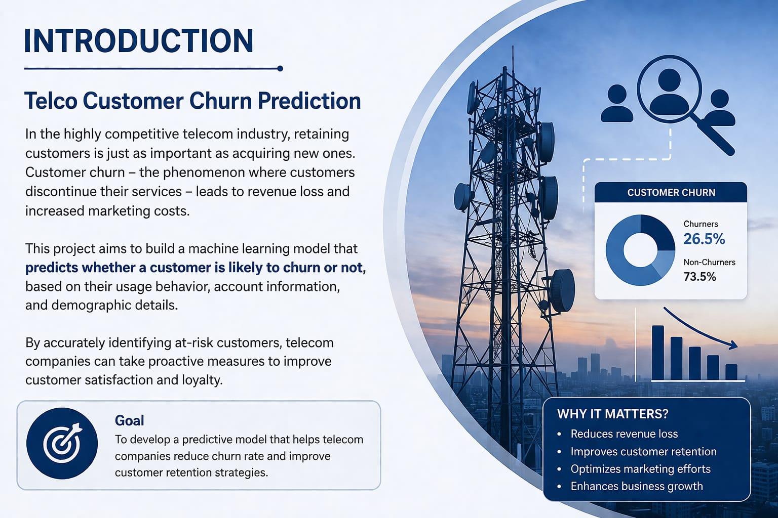
Introduction
This project analyzes telecom customer data to predict churn using Machine Learning.

Slide 3
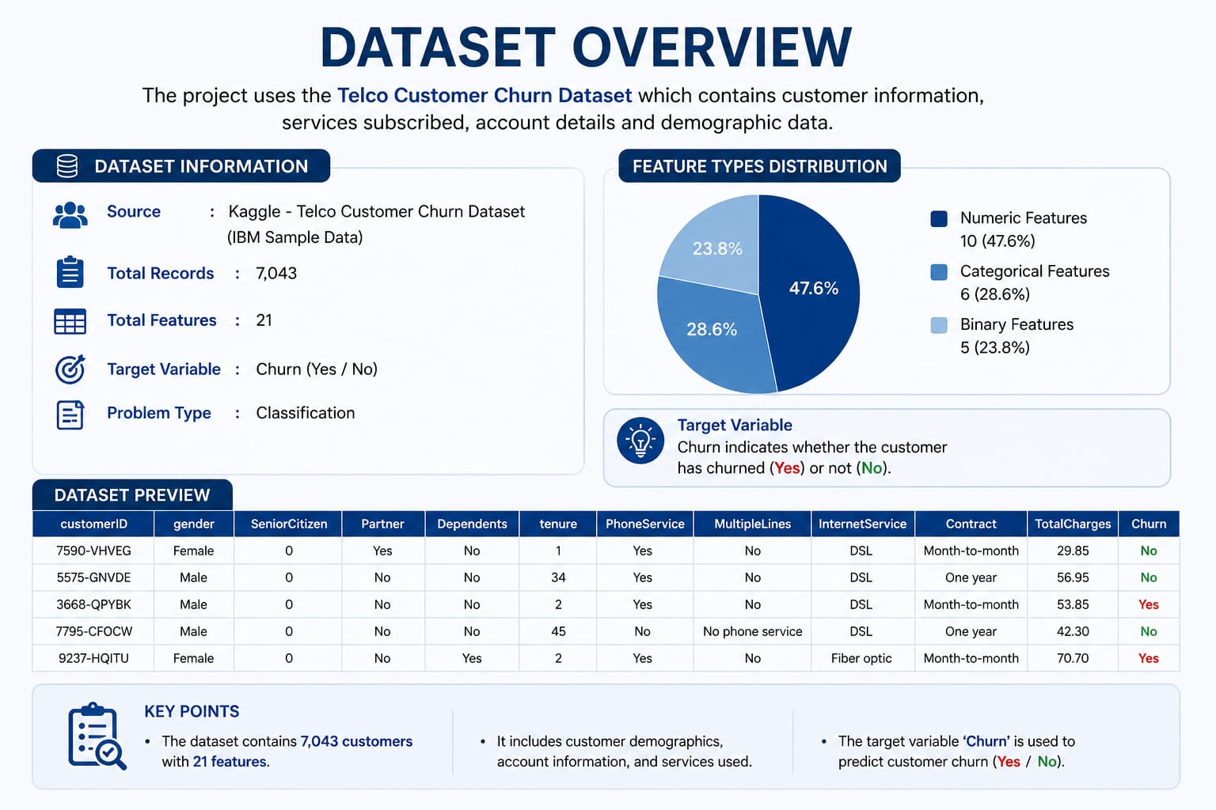
Dataset
Telco Customer Churn dataset
Features: contract type, tenure, charges, payment method, churn status

Slide 4
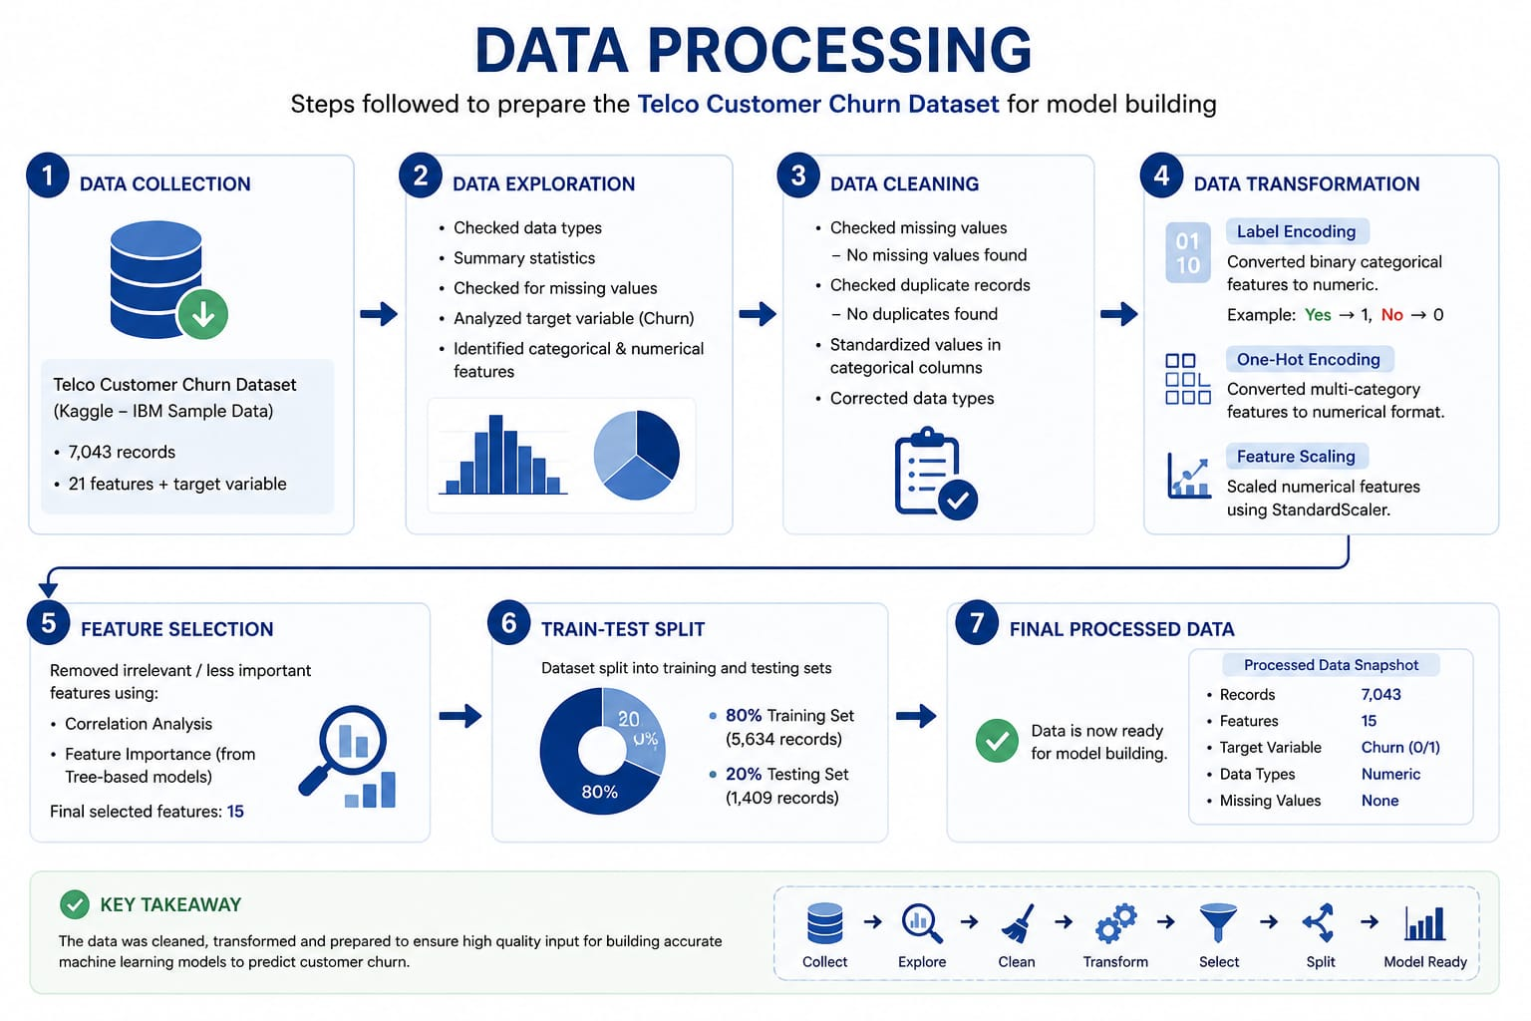
Data Preprocessing
- Missing values handled
- Categorical variables encoded
- Train-test split applied

Slide 5
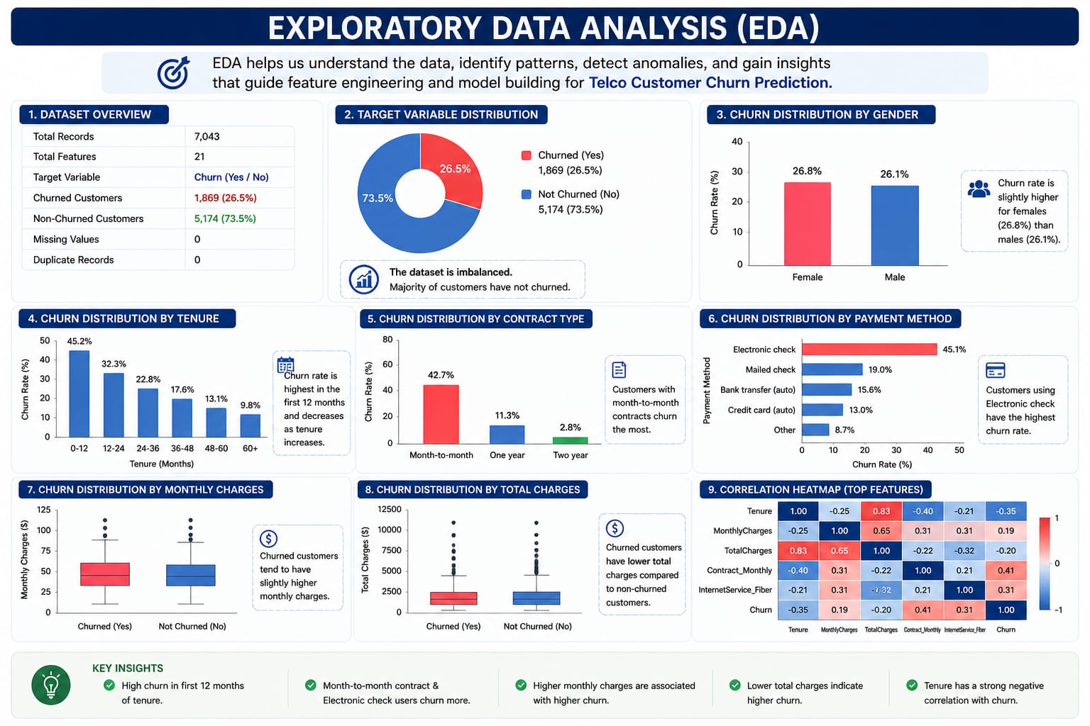
EDA (Exploratory Data Analysis)
- Churn vs Contract Type
- Churn vs Tenure
- Monthly charges impact
- Payment method analysis

Slide 6
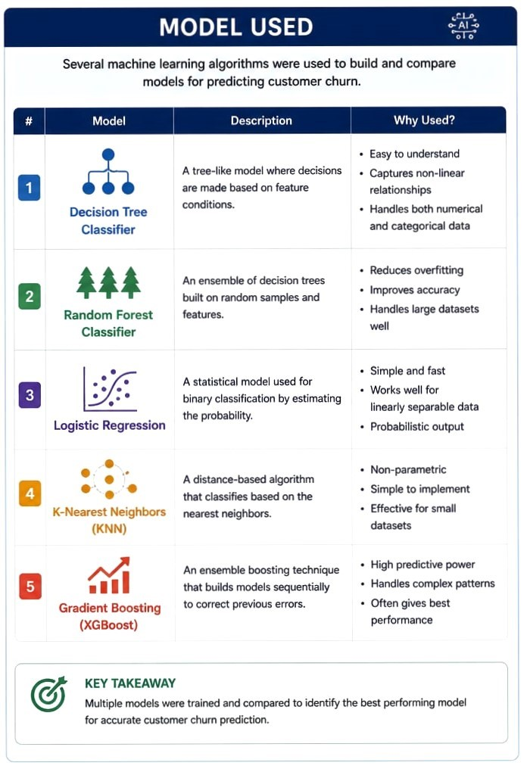
Model Used
Logistic Regression was used for churn prediction (classification problem).

Slide 7
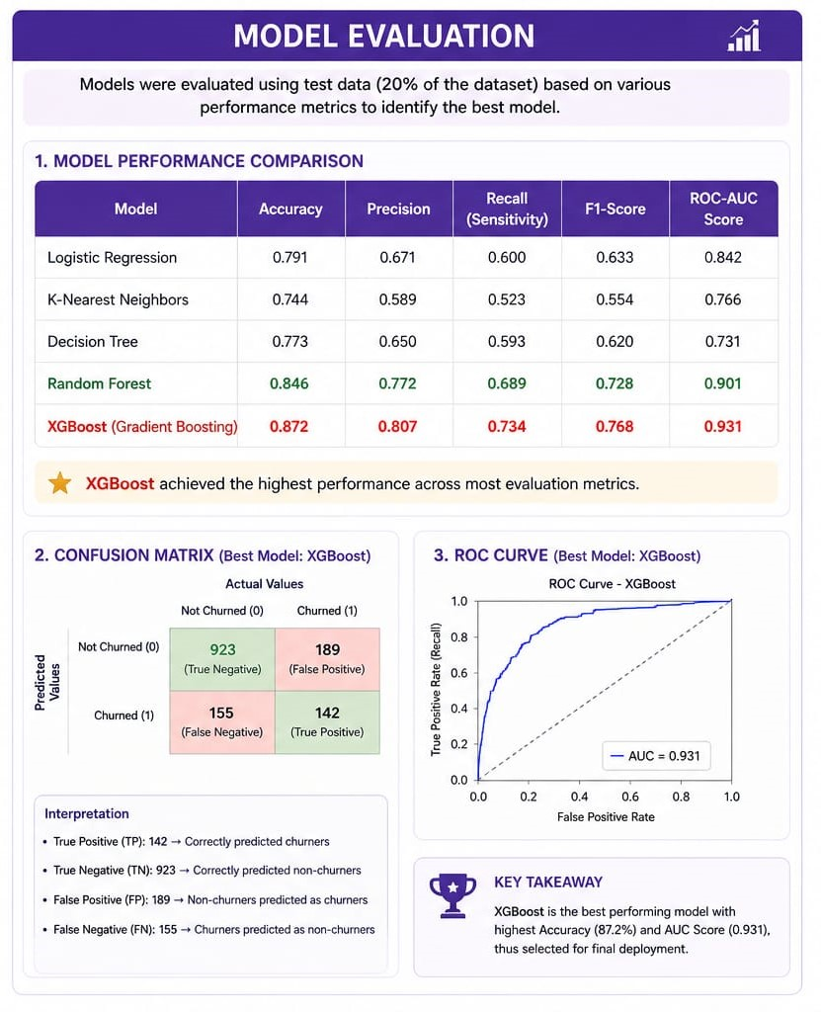
Model Evaluation
- Accuracy score calculated
- Model predicts customer churn effectively

Slide 8
Key Insights
- Month-to-month customers churn more
- Low tenure customers leave more
- Higher charges increase churn
- Electronic check users churn more

Slide 9
Conclusion
The model helps identify at-risk customers and supports business decisions to reduce churn.
THANK YOU…..

