Slide 1
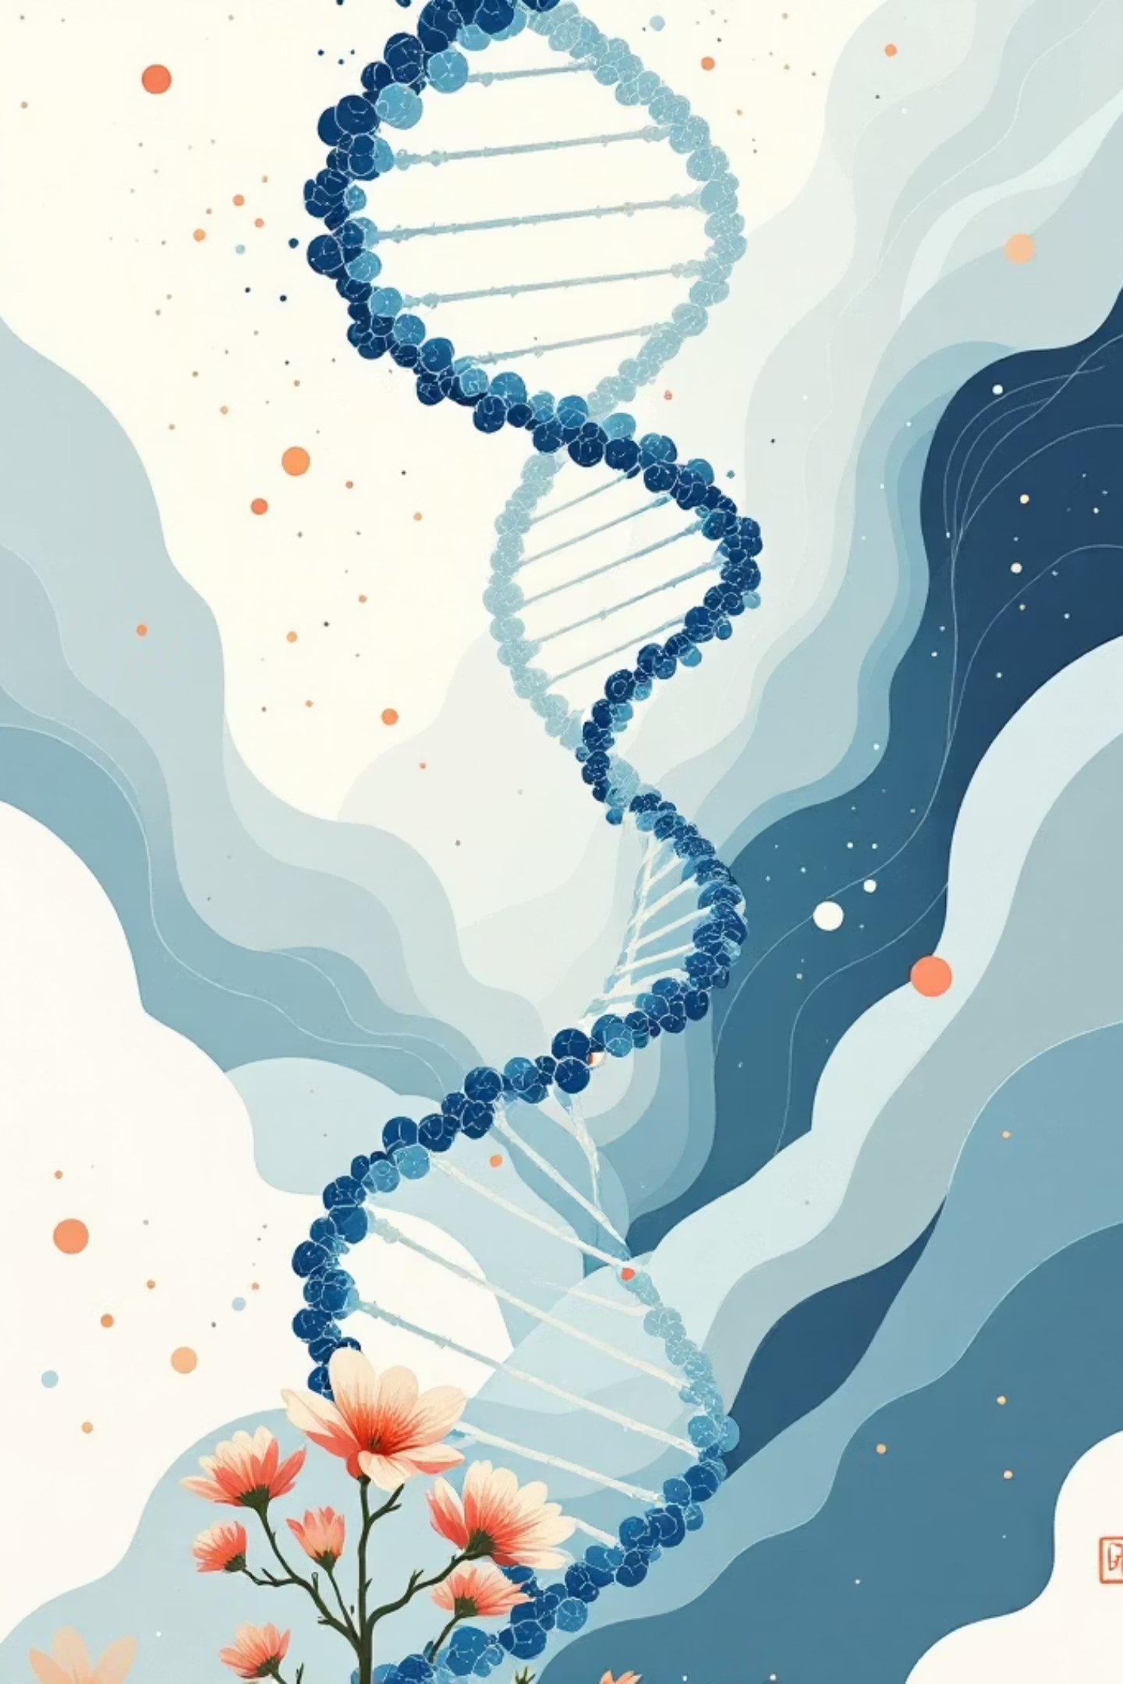
Design and Evaluation of DNA & Protein Language Model Pipelines for Biological Sequence Analysis
🧬
Final Project Presentation
Deepika Sarala Pratapa
Faculty Advisor: Matt Gitzendanner
MS Applied Data Science | University of Florida
Final Project Presentation | Project in Applied Data Science | University of Florida

Slide 2
Problem & Motivation
Why does this project exist?
🔍
📦
❓
🎯
Lack of Evaluation
Black-Box Usage
Unclear Performance
Limited Guidance
Pretrained biological LMs lack systematic task-level comparison against baselines
Often used as feature extractors without validation of when they actually help
No clear guidance on when transformers outperform classical ML approaches
Practitioners lack structured criteria for model selection in bio sequence tasks
Central Question: Do large pretrained biological language models consistently outperform engineered baselines — or is their advantage task-dependent?
Success Criteria
Transformer Advantage
Measurable Improvement
Reproducible Evaluation
Interpretability
Identify when transformers outperform other methods
Demonstrate quantified progress beyond baselines
Ensure methods are statistically sound and repeatable
Provide biologically meaningful model insights

Slide 3
Datasets & Methodology
🧬 DNA — Promoter Classification
🔬 Protein — Pfam Classification
Source
Ensembl GRCh38 (GTF + REST API)
Source
UniProtKB + Pfam database
Sequences
4,000 total (2,000 promoter / 2,000 non-promoter)
Sequences
2,293 total | 10 Pfam family classes
Length
200 bp each | Class balance: 50/50
Families
GPCRs, kinases, GTPases, TFs, zinc fingers + more
Task
Binary classification (promoter vs non-promoter)
Task
10-class multi-label classification
Features
95 engineered: GC content, CpG O/E, k-mer, entropy
Features
176 engineered: CTD, PseAAC, reduced dipeptides
Unified Modeling Pipeline
1
2
3
4
5
Raw
Sequences
Feature
Engineering
Transformer
Embeddings
Downstream
Classifiers
Evaluation
& Comparison
▶
▶
▶
▶
GRCh38 DNA
UniProt Protein
95 DNA features
176 Protein features
DNABERT-2 · NT-500M
ESM-2 · ProtBERT
LR · SVM · RF
XGBoost
ROC-AUC (DNA)
Accuracy (Protein)
Infrastructure: UF HiPerGator HPC | NVIDIA A100 GPUs | SLURM | 5-fold CV | Stratified 80/20 split

Slide 4
Transformer Models Evaluated
🧬 DNA
🔗 DNA
🔬 Protein
⚗️ Protein
DNABERT-2
Nucleotide
Transformer 500M
ESM-2
ProtBERT
Parameters
Parameters
Parameters
Parameters
117M
500M
35M
420M
Pretrained on
Pretrained on
Pretrained on
Pretrained on
135-species
genomes
GRCh38 human
genome
65M UR50D
proteins
217M UniRef100
sequences
Tokenization
Tokenization
Tokenization
Tokenization
BPE tokenizer
6-mer k-mer
Residue tokens
Residue tokens
Evaluation Strategy: All transformer models used as frozen feature extractors — embeddings extracted from [CLS] token (proteins) or mean-pooled hidden states (DNA). Same downstream classifiers (LR, SVM, RF, XGBoost) applied uniformly across all paradigms for a fair apples-to-apples comparison. No fine-tuning to avoid overfitting on small labeled datasets.

Slide 5
🧬 DNA Results — Promoter Classification
Paradigm | Best Model | Accuracy | ROC-AUC
Baseline ML | Random Forest | 0.748 | 0.837
CNN | Seq_CNN | 0.750 | 0.826
Hybrid CNN + Features | Hybrid | 0.698 | 0.832
DNABERT-2 | XGBoost | 0.756 | 0.846
NT-500M ★ | XGBoost | 0.769 | 0.851
0.851
+1.5 pts
Best ROC-AUC
(NT-500M + XGBoost)
Gain over Random
Forest baseline
500M
95
NT-500M
Parameters
Engineered DNA
Features
Key Finding: NT-500M + XGBoost achieves ROC-AUC 0.851 — only +1.5 pts above a Random Forest built on 95 engineered GC/CpG features. Promoter identity is largely defined by local sequence composition, creating a high feature engineering ceiling that limits transformer headroom.

Slide 6
🔬 Protein Results — Pfam Classification
Paradigm | Best Model | Accuracy | F1-Macro
Baseline ML | Random Forest | 0.923 | 0.924
CNN | seq_cnn | 0.924 | 0.925
Hybrid CNN + Features | Hybrid | 0.956 | 0.957
ESM-2 | Linear SVM | 0.987 | 0.989
ProtBERT ★ | Linear SVM | 0.991 | 0.992
99.1%
+7 pts
Best Accuracy
(ProtBERT + Linear SVM)
Gain over
Hybrid baseline
Linear
SVM
420M
Classifier —
linear separability
ProtBERT
Parameters
Key Finding: ProtBERT + Linear SVM achieves 99.1% accuracy — 7 points above the Hybrid model. Linear SVM winning (not XGBoost) reveals that Pfam families are already linearly separable in ProtBERT's embedding space. Pretraining on 217M UniRef100 sequences bakes in the structural organization of protein families.

Slide 7
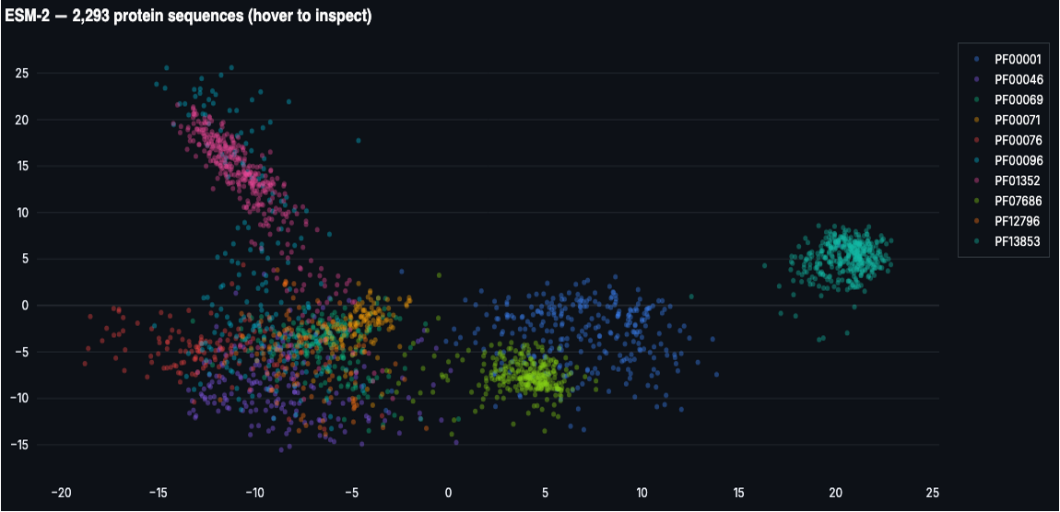
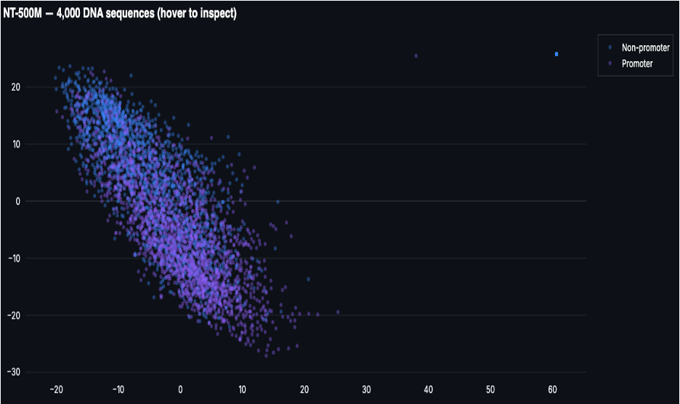
Embedding Space & Interpretability
Protein Embedding Space (ProtBERT UMAP)
In-Silico Mutagenesis (DNA)
2,293 protein sequences projected via UMAP from ProtBERT embeddings. 10 Pfam families form tight, well-separated clusters with minimal overlap — explaining why a Linear SVM achieves 99.1%. The pretraining has organized the manifold along functional axes.
Method: Each of 200 nucleotide positions substituted with 3 alternative bases (600 forward passes per sequence). ΔP(promoter) scored per position. Green positions tolerate substitution. Red positions are functionally critical — likely transcription factor binding sites or TATA box elements.
DNA Embedding Space (NT-500M UMAP)
Alanine Scanning (Protein)
4,000 DNA sequences projected via UMAP from NT-500M embeddings. Promoter and non-promoter classes show significant overlap in the center of the projection — no clean linear boundary is achievable, explaining the marginal +1.5 AUC improvement over classical baselines.
Method: Each residue substituted with alanine (smallest side-chain amino acid). Positions where substitution drops Pfam classification confidence are flagged as functionally critical — likely active sites, binding interfaces, or structural core residues.
Clusters vs Overlap
→ Task-Dependent Result
Feature Importance (XGBoost)
Top DNA features by XGBoost SHAP importance: GRAVY score, CTD descriptors, reduced dipeptide compositions — all biologically grounded measures. Validates that the engineered baseline captures real biological signal, not noise — explaining why the transformer ceiling is so hard to exceed for DNA.

Slide 8
Bio Seq LM Explorer — Interactive Application
Real-time biological sequence analysis without any ML setup
🧬
DNA Classification
🔬
Protein Classification
📊
Embedding Explorer
Paste any 200bp sequence. Predict promoter probability using NT-500M + XGBoost. Instant scoring with confidence intervals.
Predict Pfam family from raw amino acid sequence using ProtBERT + Linear SVM across 10 family classes.
UMAP visualization of your sequence plotted against the training set. See where your sequence lands in the learned embedding space.
⚡
In-Silico Mutagenesis
🔑
Alanine Scanning
🔍
Similarity Search
Per-position sensitivity scan for DNA sequences. Green/red heatmap shows which nucleotides are functionally constrained.
Residue-level functional site detection for proteins. Flags positions critical to Pfam family classification.
Find the nearest neighbors in the training set to your query sequence using embedding-space distance.
Deployment: Streamlit Community Cloud (in progress) | All models load from Hugging Face Hub | No GPU required for demo mode (pre-extracted embeddings)

Slide 9
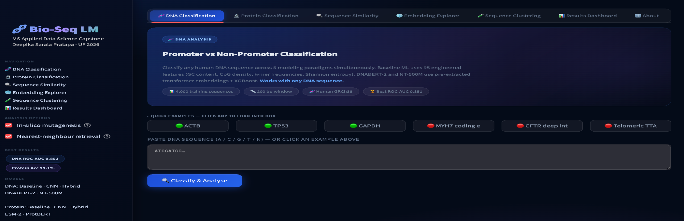

Slide 10
Challenges, Decisions & Lessons Learned
⚙️ HiPerGator Environment
📏 Framing the DNA Result
Challenge:
Challenge:
conda not initialized on compute nodes; protobuf 6.33.5 incompatible with Streamlit 1.9.0; SSH tunnel requires exact compute node hostname.
NT-500M gains only +1.5 AUC over Random Forest. Risk of presenting this as a failure rather than a scientific finding.
Lesson:
Lesson:
Tested deployment incrementally. Upgraded Streamlit to 1.32+ and configured SSH port forwarding. Dependency pinning at environment creation time is essential for reproducibility.
Reframed as evidence of a high feature engineering ceiling — promoters are compositionally defined, and 95 GC/CpG features already capture the core signal. The finding is meaningful, not negative.
💾 Model Inference at Scale
🗂️ Cloud Deployment
Challenge:
Challenge:
Loading 117M–500M parameter models at app startup is impractical without dedicated GPU allocation during demo sessions.
All models loaded from local HiPerGator paths. Migrating to a public deployment requires resolving cluster-specific path dependencies.
Lesson:
Lesson:
Disabled live transformer inference by default. Pre-extracted embeddings used in demo mode with sidebar toggle for GPU-enabled inference. Preserves app responsiveness.
Prototyping Hugging Face Hub loading as a path-agnostic alternative. Streamlit Community Cloud chosen for speed-to-deployment; Hugging Face Spaces for bio-ML community visibility.

Slide 11
Key Takeaways & Impact
1
Transformers win decisively for proteins
ProtBERT + Linear SVM achieves 99.1% accuracy — 7 points above the best hybrid model. Pfam families are linearly separable in the pretrained embedding space.
2
DNA is driven by biological features
GC content and CpG density capture most of the promoter signal. A 500M-parameter model adds only +1.5 AUC points over a Random Forest built on 95 engineered features.
3
Linear separability is a key finding, not a convenience
Linear SVM winning on proteins confirms ProtBERT's embedding space is organized along functional axes — a direct consequence of pretraining scale and diversity.
4
Interpretability reveals real biology
In-silico mutagenesis and alanine scanning results are biologically coherent. XGBoost top features (GRAVY, CTD) match known biochemical signals — the baselines learn real structure.
5
Unified pipeline enables flexible analysis
The app lets biologists analyze unseen sequences — prediction, embedding visualization, mutagenesis — without retraining any model or setting up ML infrastructure.

Slide 12
Future Work & Extensions
🧬 ClinVar Variant Prioritization (NB08)
☁️ Public Cloud Deployment
Extend in-silico mutagenesis framework to score variants of uncertain significance (VUS). Combine DNABERT-2 DNA embeddings with ESM-2 protein structure embeddings for cross-modal fusion. Target dataset: ClinVar + AlphaFold DB.
Deploy Bio Seq LM Explorer to Streamlit Community Cloud with Hugging Face Hub model loading. Cross-post to Hugging Face Spaces for bio-ML research community visibility. Eliminates HiPerGator path dependencies.
Target: Bioinformatics (Oxford), NAR, PLOS Comp Bio
Timeline: May 2025
🔀 End-to-End Fine-Tuning
Explore fine-tuning transformer models on larger curated datasets where data scale justifies the computational cost. Test whether closing the DNA gap requires fine-tuning or whether the ceiling is truly biological, not architectural.
Requires larger labeled dataset or data augmentation

Slide 13
99.1%
0.851
Thank You
Protein accuracy
ProtBERT + Linear SVM
DNA ROC-AUC
NT-500M + XGBoost
Deepika Sarala Pratapa
MS Applied Data Science
University of Florida
dpratapa@ufl.edu
+7 pts
6
Advisor: Dr. Matt Gitzendanner
UF Research Computing
Protein gain
over Hybrid baseline
App modules
Bio Seq LM Explorer
Questions?
Slides | GitHub | Poster | App Demo

