Slide 1
BOSS - BLOCKCHAIN OMR SECURITY SYSTEM

Slide 2
Problem statement
OMR marks are stored into secure databases . But, No matter how secure a database is , it is always prone to viruses , data corruptions, malwares .
In a rare case , even hacker attack might happen or similar to the Vyapam scam , Madhya Pradesh - 2013 marks are manipulated such that there is improper seat allotment in medical seats.

Slide 3
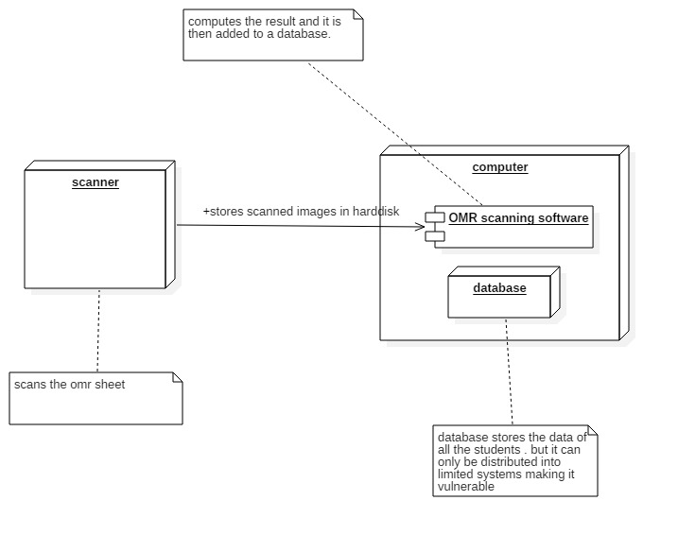
Existing solution
At present the evaluated
marks are stored in
databases

Slide 4
Our solution
To store the marks into blockchain for more security.

Slide 5
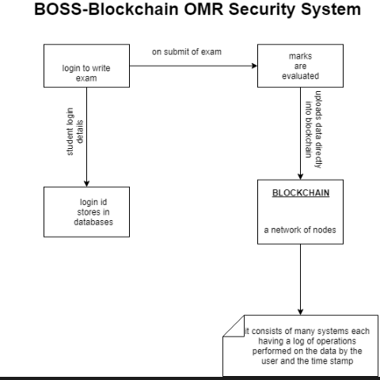

Slide 6
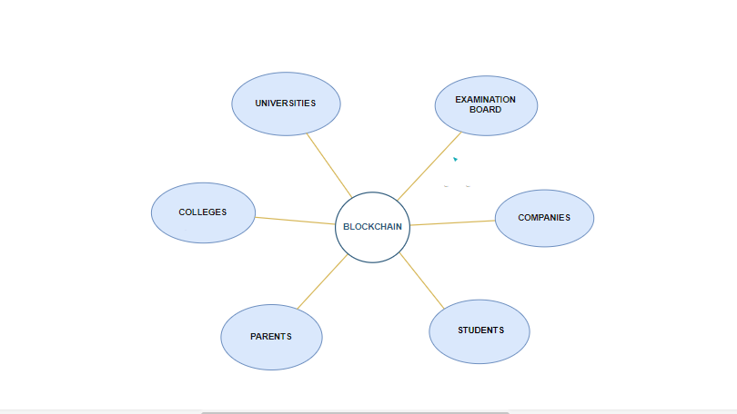
0UR NODES

