Slide 1

Logistic Regression
A Powerful Tool for Binary Classification
Predicting 10-Year Coronary Heart Disease Risk
Using the Framingham Heart Study
Medical Data Science | Predictive Analytics | Healthcare AI

Slide 2

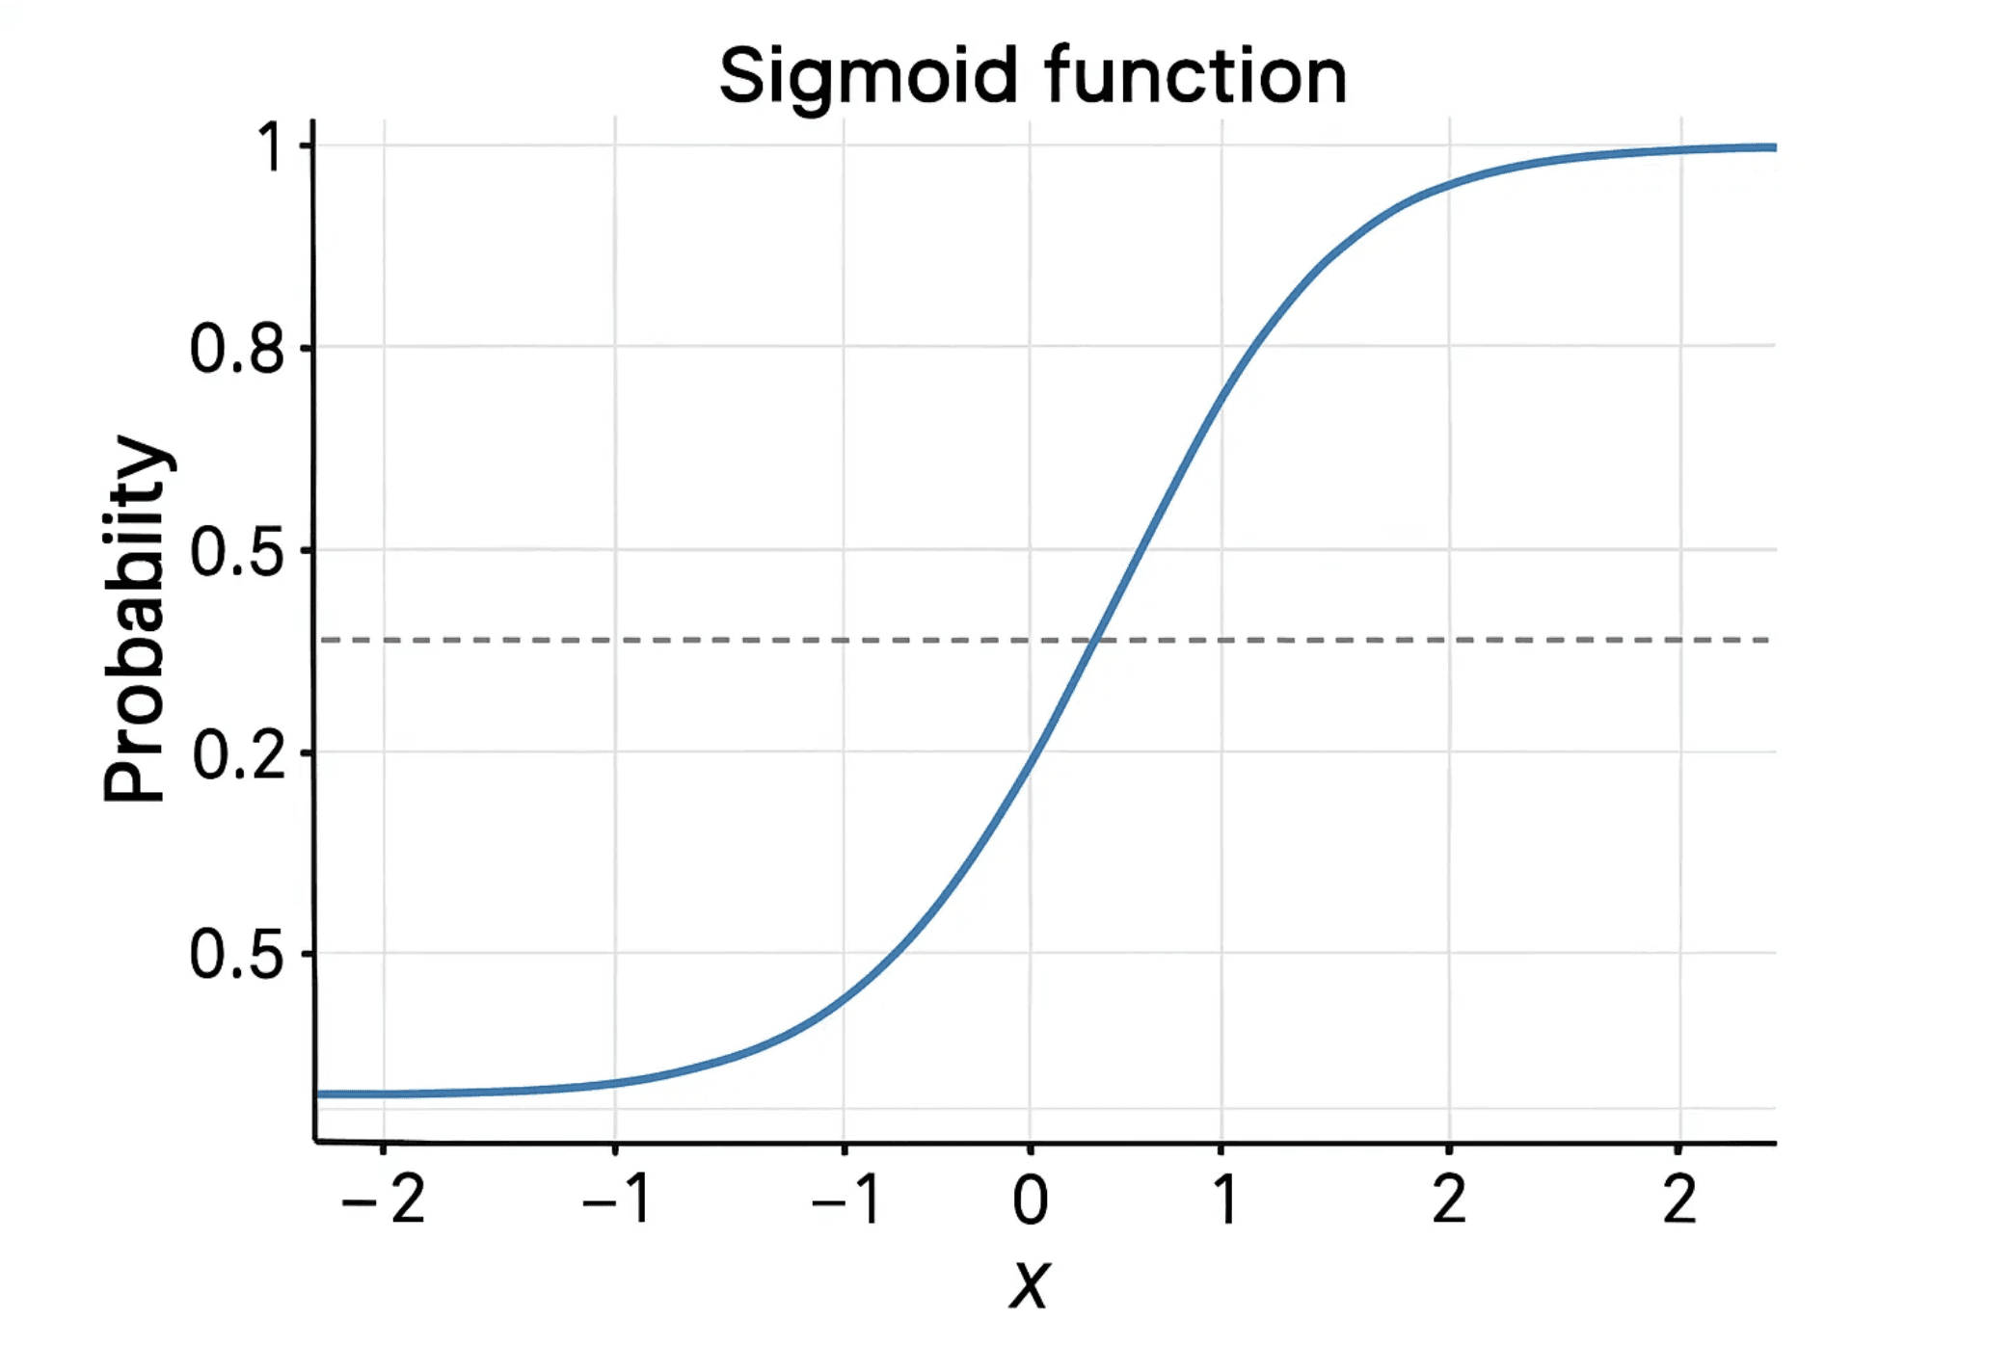
Logistic Regression: Modeling Probability, Not Value
Classification Algorithm
Unlike Linear Regression (which predicts a continuous value), Logistic Regression is used for binary classification (predicting one of two outcomes, e.g., Yes/No, 0/1).
The Sigmoid Function
It uses the Sigmoid (or Logit) function to map any real-valued number into a probability between 0 and 1.
P(Y=1) = 1 / (1 + e^(-z))
Decision Boundary
A threshold (usually 0.5) is applied to the probability to classify the outcome. If P ≥ 0.5, classify as 1; otherwise, classify as 0.
Real-World Example
Predicting if a customer will click an ad (Click/No Click), or if an email is spam (Spam/Not Spam).

Slide 3

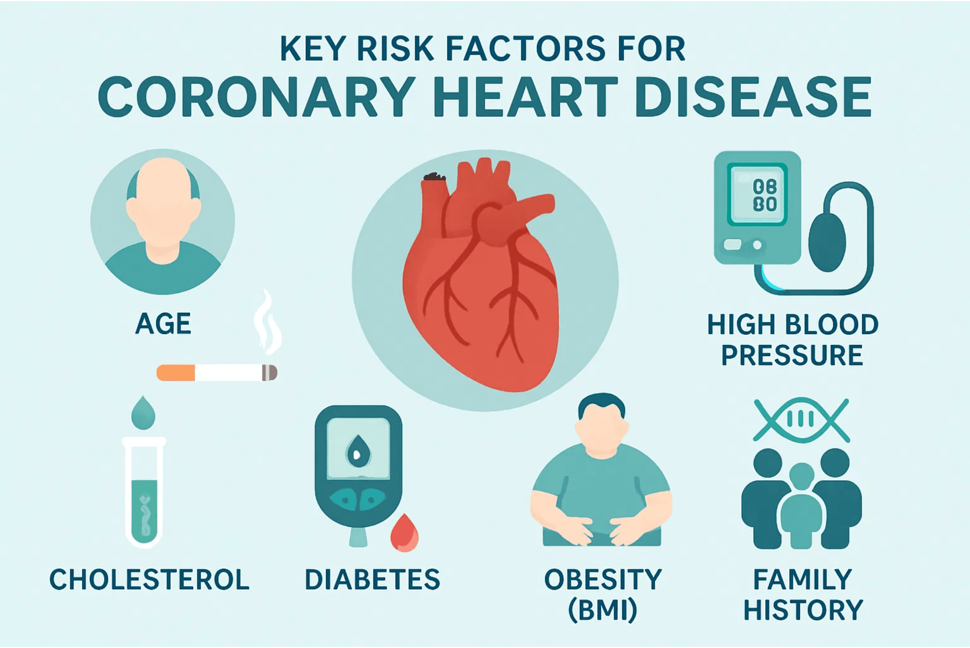
Case Study: Predicting 10-Year Coronary Heart Disease (CHD) Risk
The Framingham Heart Study (FHS)
A long-running, landmark cardiovascular study that provides a rich dataset of patient health metrics and outcomes spanning decades.
The Goal
To build a model that can predict a patient's risk of developing Coronary Heart Disease (CHD) within the next 10 years. This is a critical binary classification problem (CHD: Yes/No).
Key Predictor Variables (Features)
The model uses a combination of demographic, behavioral, and medical
factors:
Age, Gender (male), Smoking Status
Blood Pressure (systolic, diastolic)
Cholesterol, Glucose, BMI
History of Diabetes and Hypertension

Slide 4

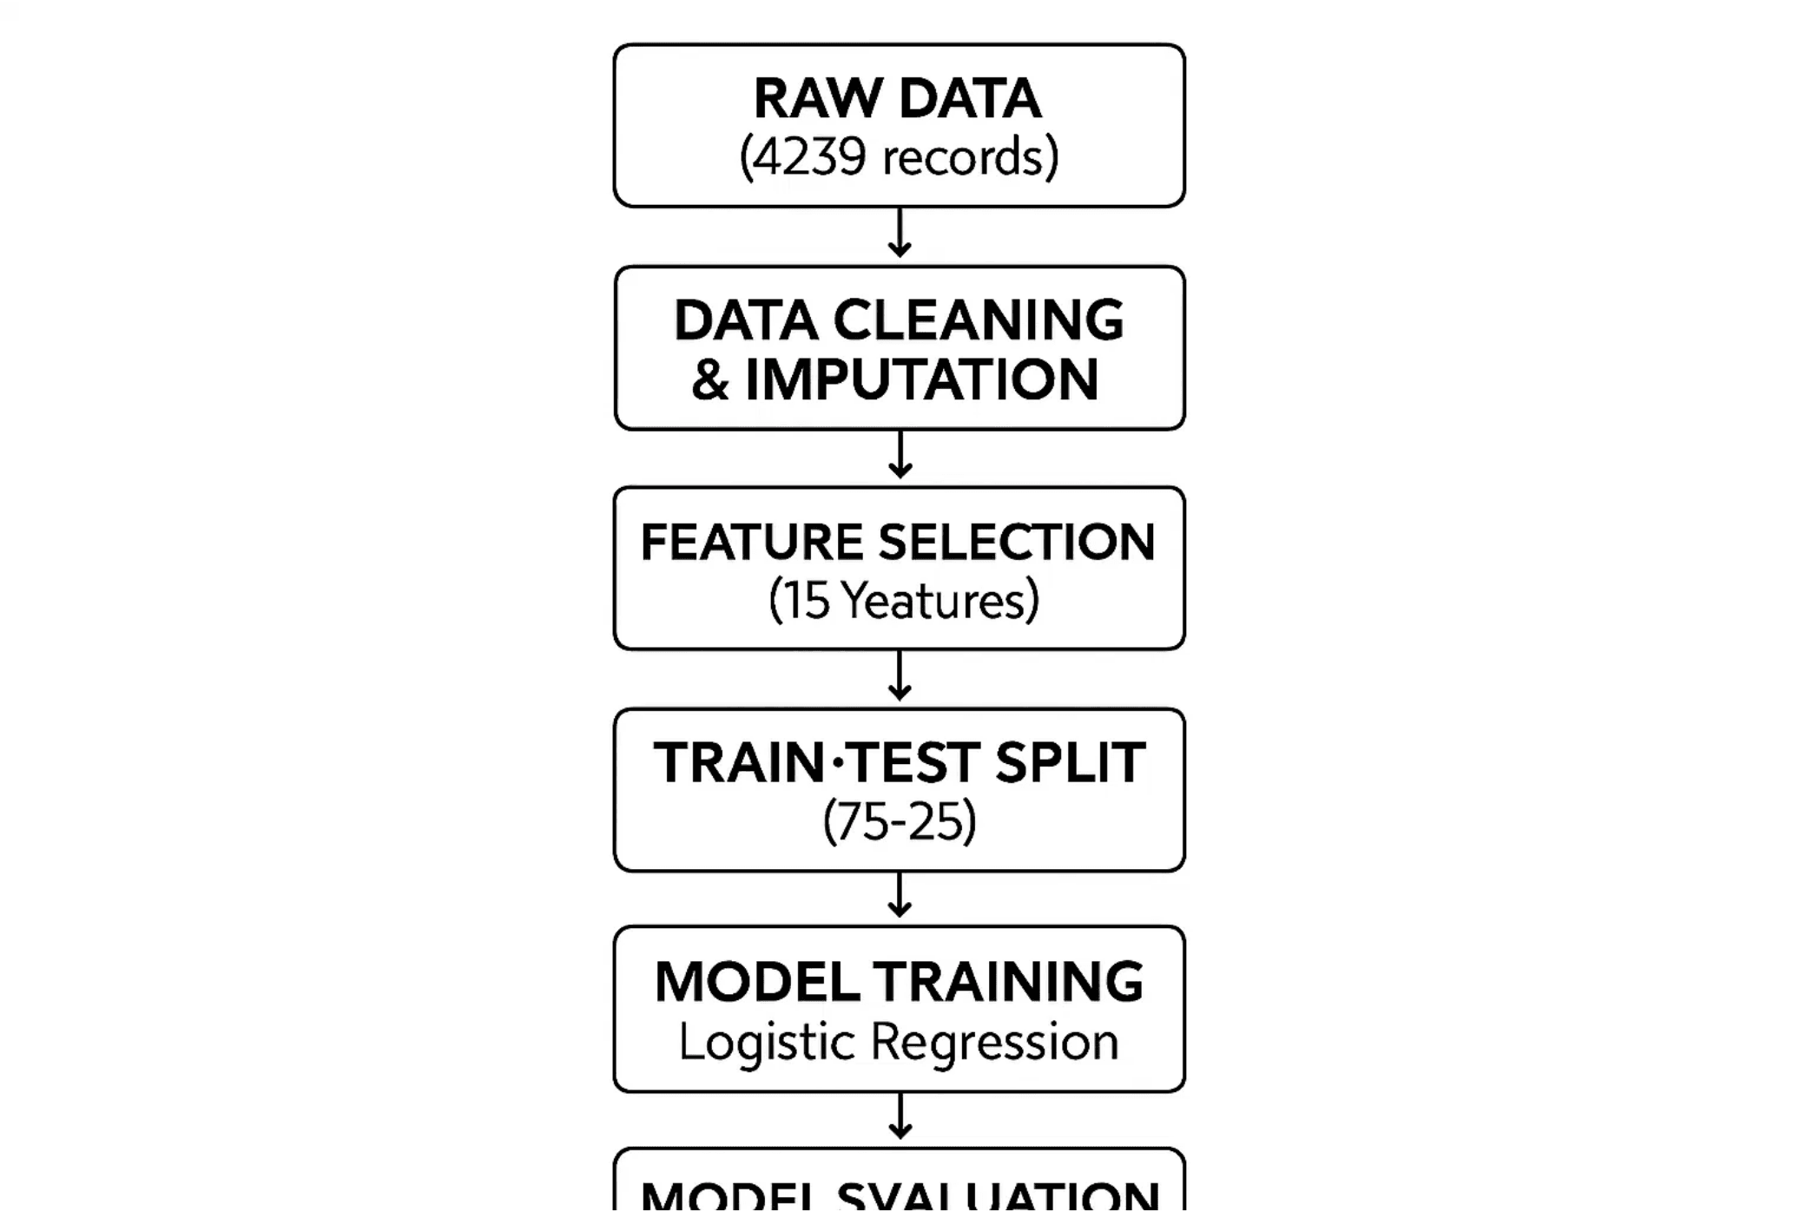
Robust Data Cleaning Ensures Reliable Predictions
Initial Data State
The dataset contained 4,238 records with 16 features representing patient demographics, lifestyle, and medical information.
Handling Missing Data (Imputation)
Missing values in features like cigsPerDay, totChol, BMI, and glucose were imputed using the mean of the respective column.
Why Imputation? To retain valuable data points and prevent model bias from dropping too many rows.
Feature Selection
The final model was trained on 15 features, focusing on the most relevant risk factors for heart disease prediction.
Train-Test Split
The data was split into Training (75%) and Testing (25%) sets to evaluate the model's performance on unseen data.
Training: 3,178 records | Testing: 1,060 records

Slide 5

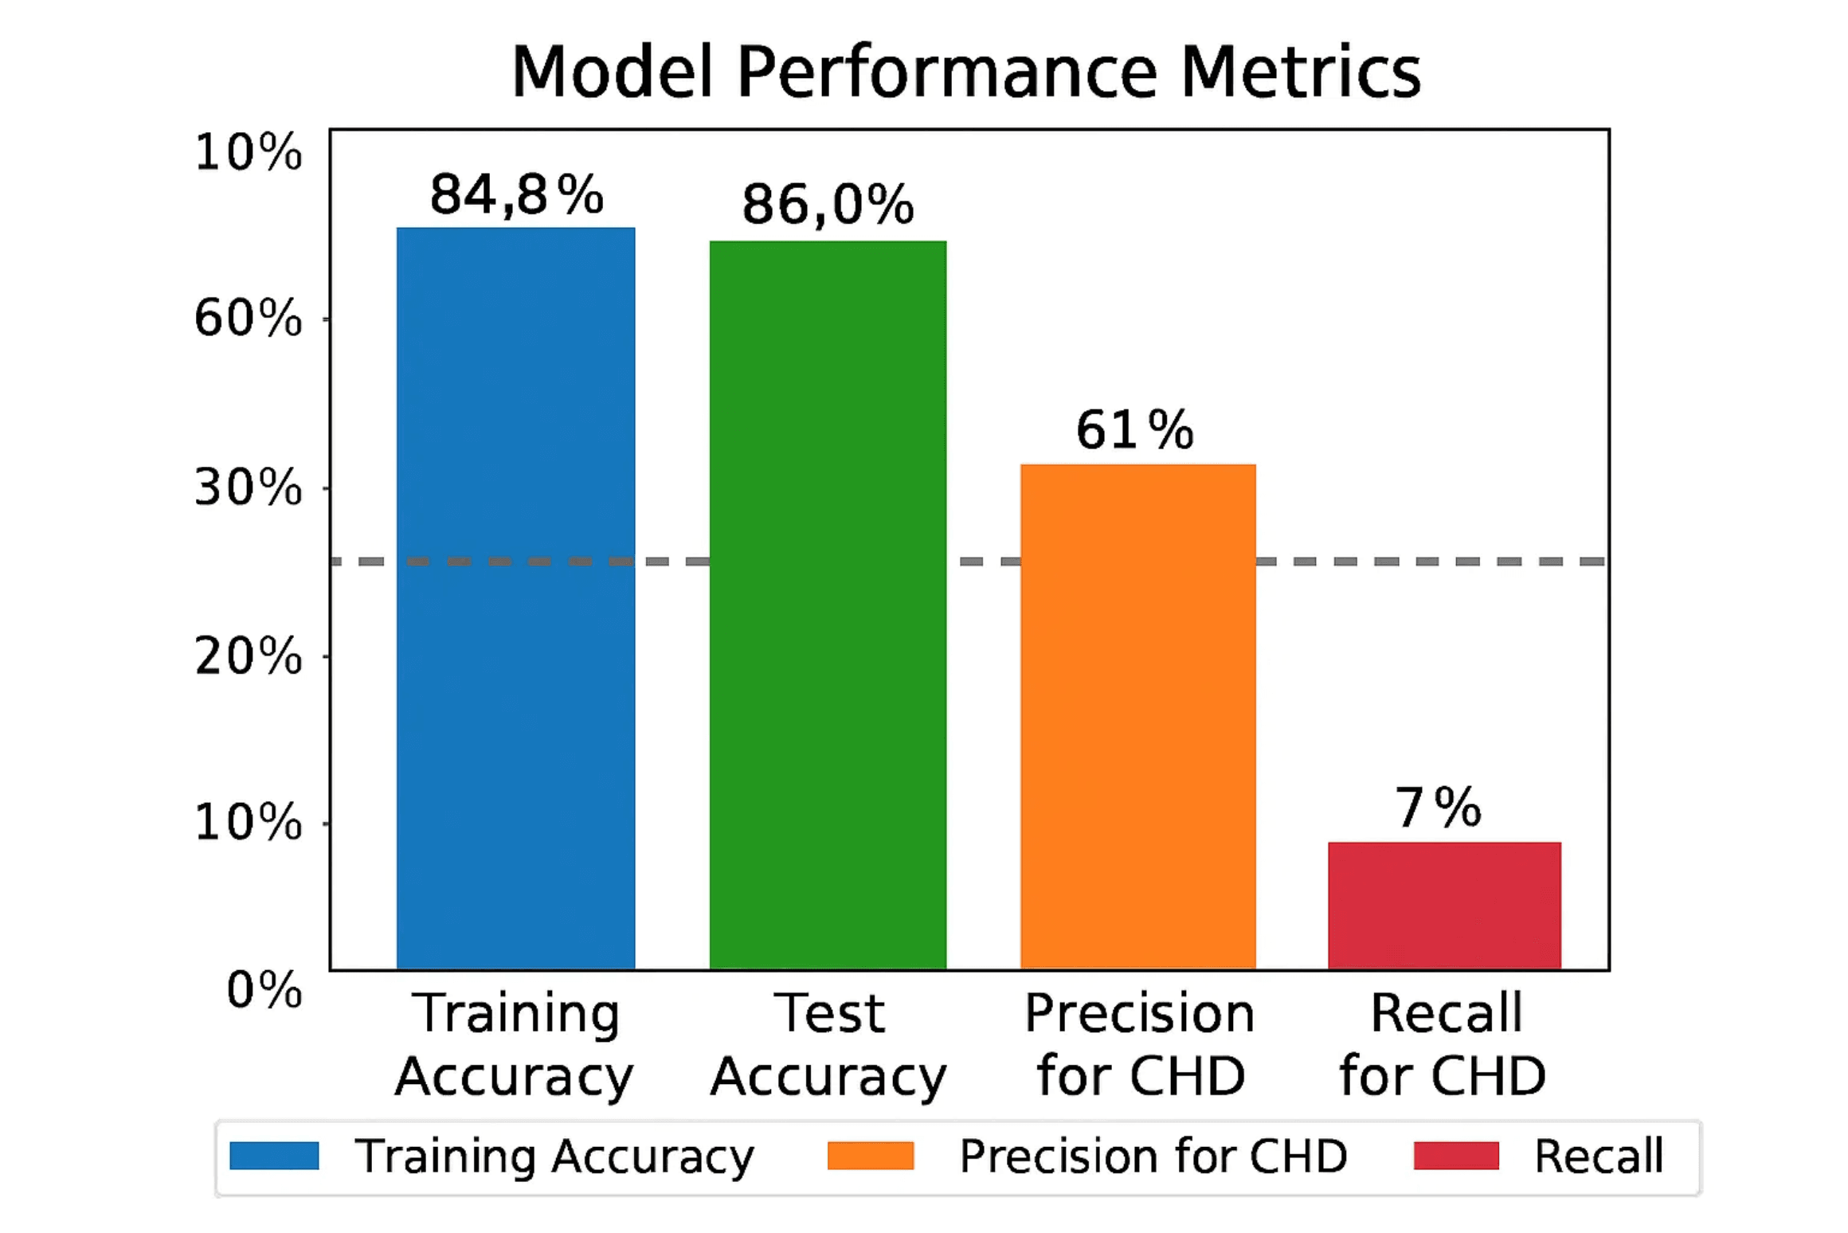
Model Training and Evaluation: Beyond Simple Accuracy
Model Training
A Logistic Regression model was trained on the 75% training data (3,178 records) using 15 features to learn the relationship between patient characteristics and heart disease risk.
Accuracy Score
The model's performance on both training and test data:
Training Data Accuracy: ~84.8%
Test Data Accuracy: ~86.0%
The model correctly predicts the outcome approximately 86% of the time on new, unseen data.
The Challenge of Imbalanced Data
The dataset is highly imbalanced: far more "No CHD" cases than "CHD" cases. High accuracy can be misleading if the model is poor at predicting the minority class (CHD).
Advanced Metrics Required
We must examine Precision, Recall, and F1-Score for a complete picture, especially for the critical minority class (CHD, label 1).

Slide 6

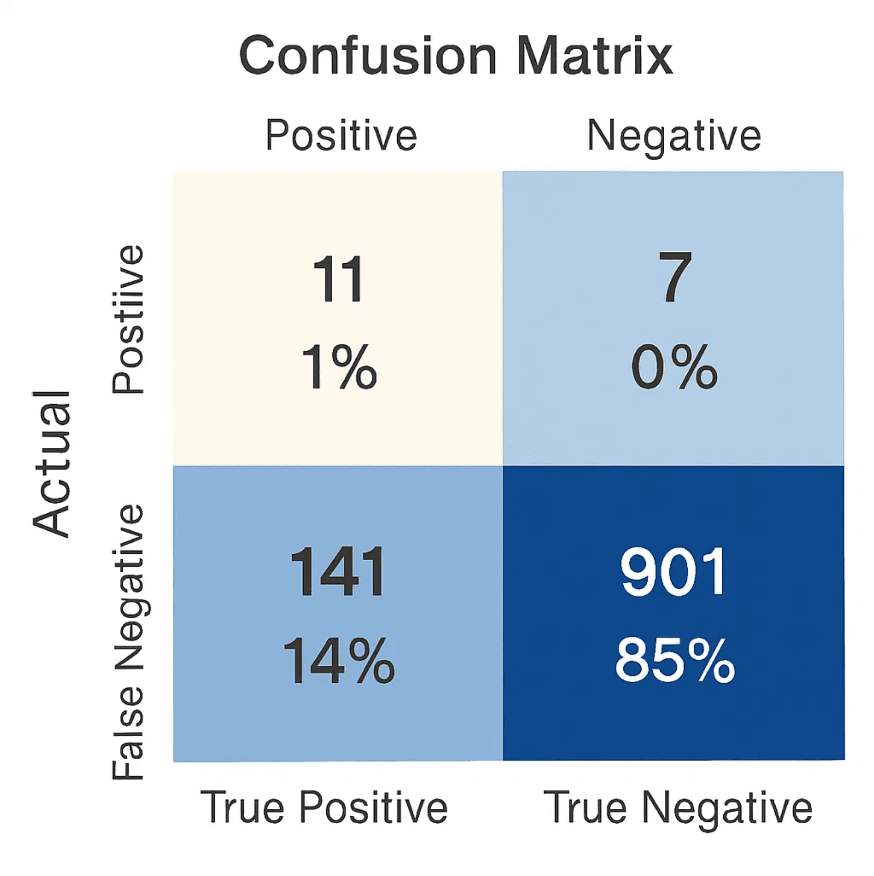
The True Cost of Misclassification: Precision and Recall
Confusion Matrix Results (Test Data)
Recall for CHD (Label 1)
True Negatives: 901 (No CHD, Predicted No CHD)
False Positives: 7 (No CHD, Predicted CHD)
False Negatives: 141 (CHD, Predicted No CHD)
True Positives: 11 (CHD, Predicted CHD)
~7%
11 / (141 + 11) = 0.07
CRITICAL WEAKNESS: The model only correctly identifies 7% of actual heart disease cases. This is dangerously low for a medical application, as missing a positive case (False Negative) can have severe health consequences.
Precision for CHD (Label 1)
Key Finding
~61%
The model is highly biased towards the majority class ("No CHD"), leading to a high overall accuracy (86%) but a dangerously low recall for the critical "CHD" class. In medical prediction, Recall is more important than Accuracy.
11 / (7 + 11) = 0.61
When the model predicts heart disease, it is correct approximately 61% of the time. This moderate precision indicates a reasonable positive predictive value, but the low recall remains problematic.

Slide 7

Strategies for Building a More Robust Predictive Model
Strategy 1
Strategy 2
Address Data Imbalance
Feature Scaling
Techniques like SMOTE (Synthetic Minority Over-sampling Technique) or undersampling the majority class are crucial to give the model more examples of the rare "CHD" event.
Standardizing or normalizing the numerical features (e.g., age, cholesterol, blood pressure) will prevent features with larger scales from dominating the model's coefficients.
SMOTE creates synthetic samples
StandardScaler for normalization
Balances class distribution
MinMaxScaler for range scaling
Improves minority class detection
Improves convergence speed
Strategy 3
Strategy 4
Hyperparameter Tuning
Explore Alternative Models
Optimize the LogisticRegression solver and regularization parameters (e.g., C value) to improve generalization and model performance.
For imbalanced data, tree-based models like Random Forest or Gradient Boosting often perform better and should be tested.
Grid search or random search
Random Forest for ensemble learning
Adjust regularization strength (C)
XGBoost for advanced boosting
Cross-validation for validation
Compare performance metrics

Slide 8

Logistic Regression: A Powerful Start, But Context is Key
1
2
Foundation Algorithm
Accuracy is Not Enough
Logistic Regression is the go-to algorithm for initial binary classification problems, providing a simple, interpretable baseline that's easy to understand and deploy.
The model achieved 86% accuracy but highlighted the danger of relying solely on accuracy in imbalanced datasets. High accuracy can mask poor performance on minority classes.
3
4
Recall Matters Most
Path Forward
In critical applications like medicine, Recall (minimizing False Negatives) for the positive class is often more important than overall accuracy. Missing a disease case is clinically dangerous.
Future work must focus on data balancing and feature engineering to create a clinically useful model with high recall for heart disease prediction.

