Slide 1

Logistic Regression
Understanding Classification and Key Evaluation Metrics
Why We Need a Better Tool

Slide 2

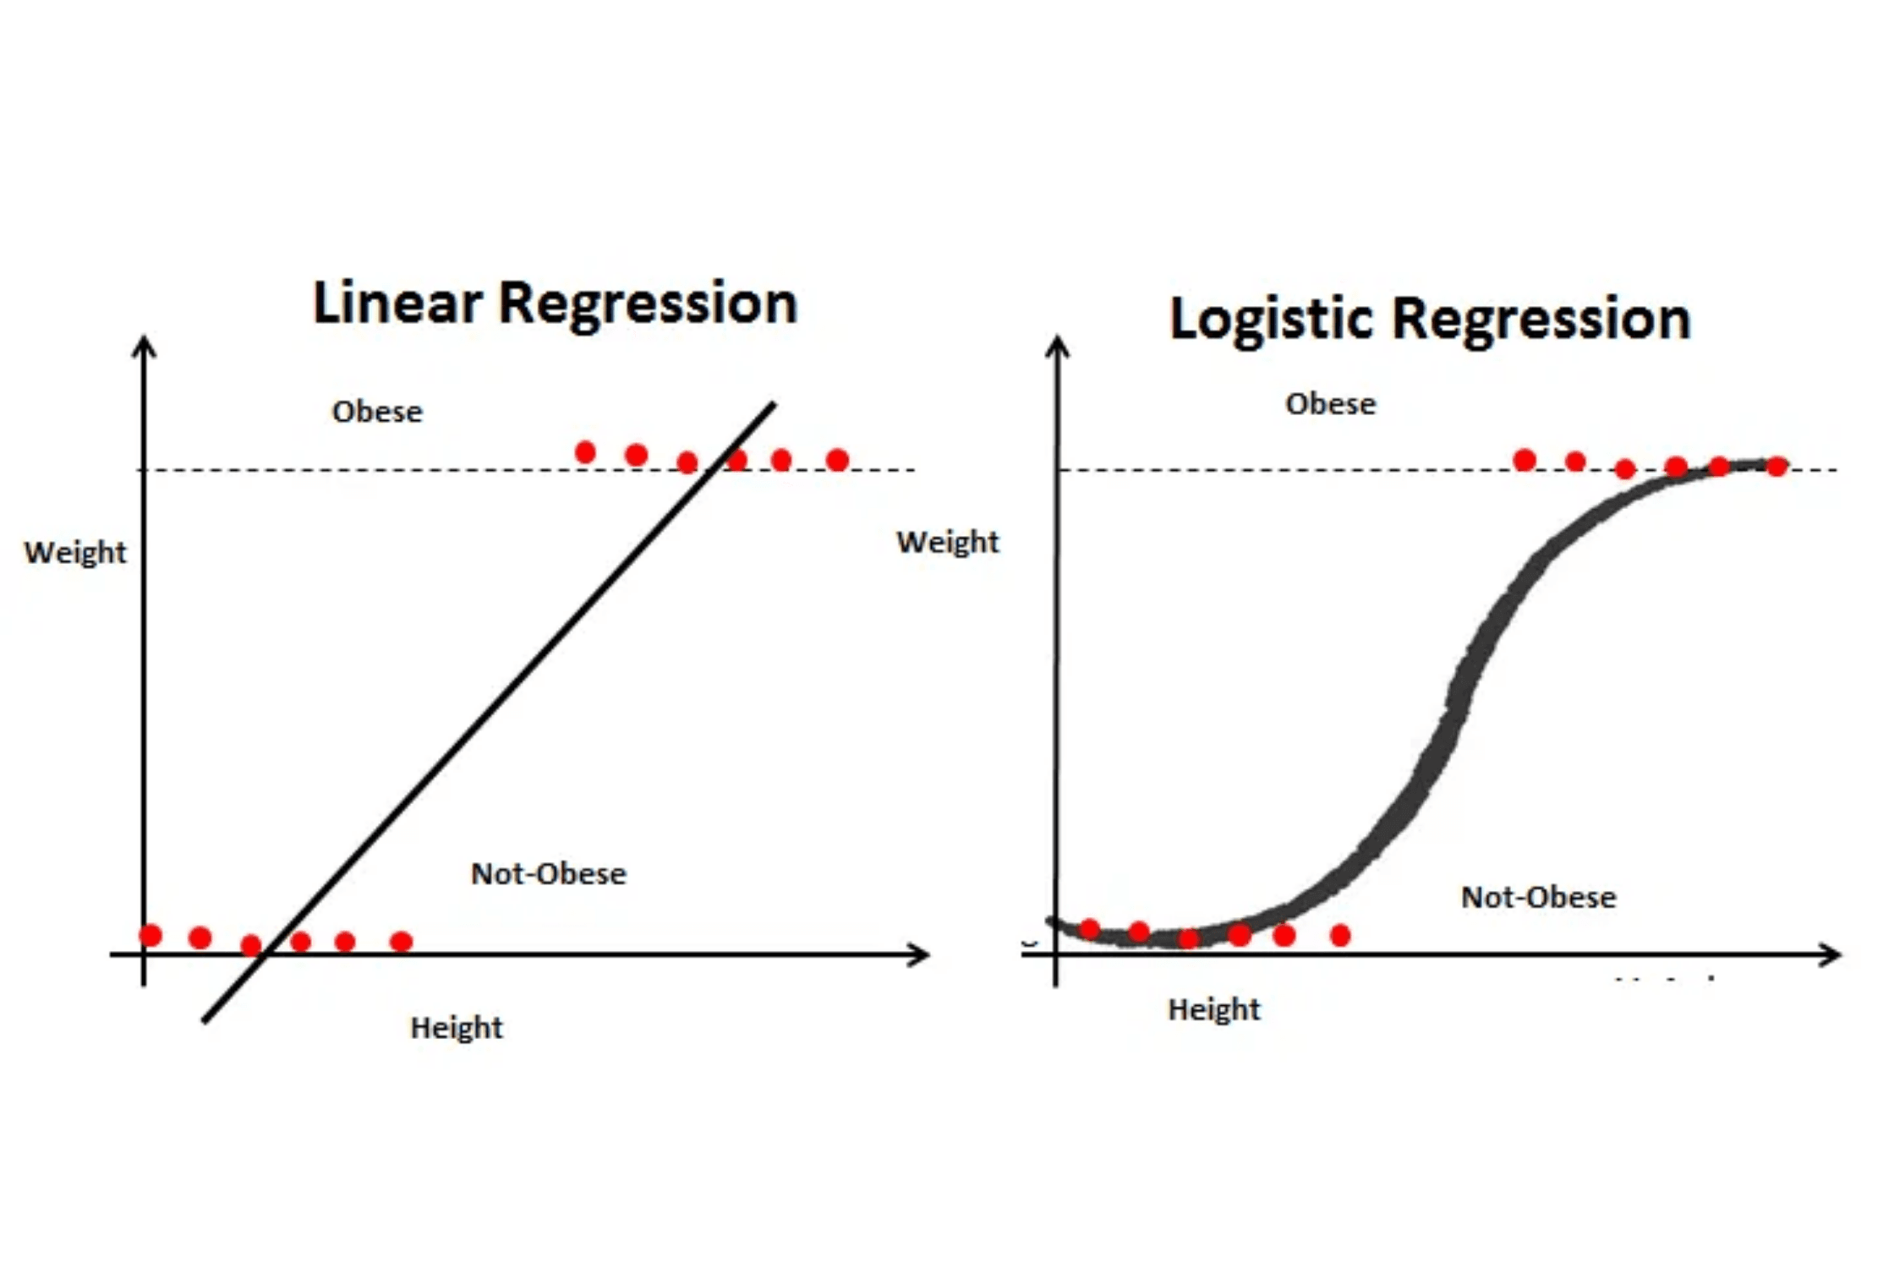
When the Answer Isn't a Number
Linear Regression (Recap)
Used when output is continuous (house price, temperature, age)
The New Challenge
What if output is categorical? (Yes/No, Spam/Not Spam, Pass/Fail)
The Critical Problem
Linear Regression outputs values like -0.5, 0.3, 1.2 for binary predictions (0 or 1). These values are meaningless for classification.
Outlier Vulnerability
A single outlier (e.g., student with 100 study hours who failed) distorts the decision boundary, making predictions unreliable.

Slide 3

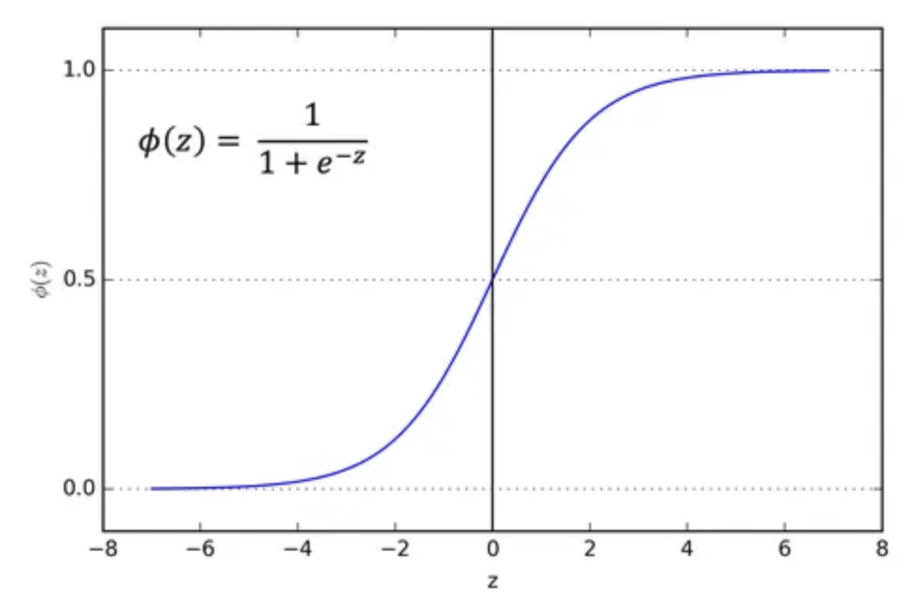
Turning a Straight Line into an "S" Curve
The Goal
Map any input value to output strictly between 0 and 1. This output is interpreted as a probability.
The Sigmoid Function
P(Y=1) = 1 / (1 + e^(-z))
Where z = b₀ + b₁X₁ + b₂X₂ + ...
What It Does
Takes the linear output (z) and squashes it into a beautiful S-shaped curve. No more impossible values!
The Result
Model predicts probability of the event (e.g., P(Passing) = 0.85)
Decision Boundary
Threshold at 0.5: If P ≥ 0.5 → Classify as 1 (Pass). If P < 0.5 → Classify as 0 (Fail).

Slide 4

Real-World Application: Predicting Customer Churn
The Scenario
What the Model Reveals
Organization
Telecom company with thousands of customers
P(Churn) = 0.90
Prediction Target
Customers with low usage + short contract
Will a customer churn (1) or stay (0)?
Key Insight
Input Variables
Logistic Regression doesn't just say "this customer will churn." It quantifies the probability and certainty of that prediction.
Monthly usage (minutes) and contract length (months)
Business Action
Target high-probability churners with retention offers and personalized engagement.
Key Takeaway
Logistic Regression provides not just a classification (Yes/No), but the certainty (probability) behind that classification. This probability is crucial for making data-driven business decisions, prioritizing resources, and maximizing ROI on customer retention campaigns.

Slide 5

Beyond Just "Correct"
The Scenario: Predicting a Rare Disease
Total Patients
Healthy (0)
1,000
990
Disease (1)
Disease Prevalence
10
1%
The Dummy Model
A model that predicts EVERYONE as healthy (0) would make exactly 990 correct predictions out of 1000.
The Misleading Accuracy
Accuracy = Correct Predictions / Total Predictions
Accuracy = 990 / 1000 = 99%
This model appears excellent, yet it is completely useless.
The Critical Flaw
The model misses all 10 true disease cases. In healthcare, this is a catastrophic failure. Patients with the disease go undiagnosed and untreated.
Conclusion: For classification, especially with real-world imbalanced data, we need more sophisticated metrics that reveal where the model actually fails.

Slide 6

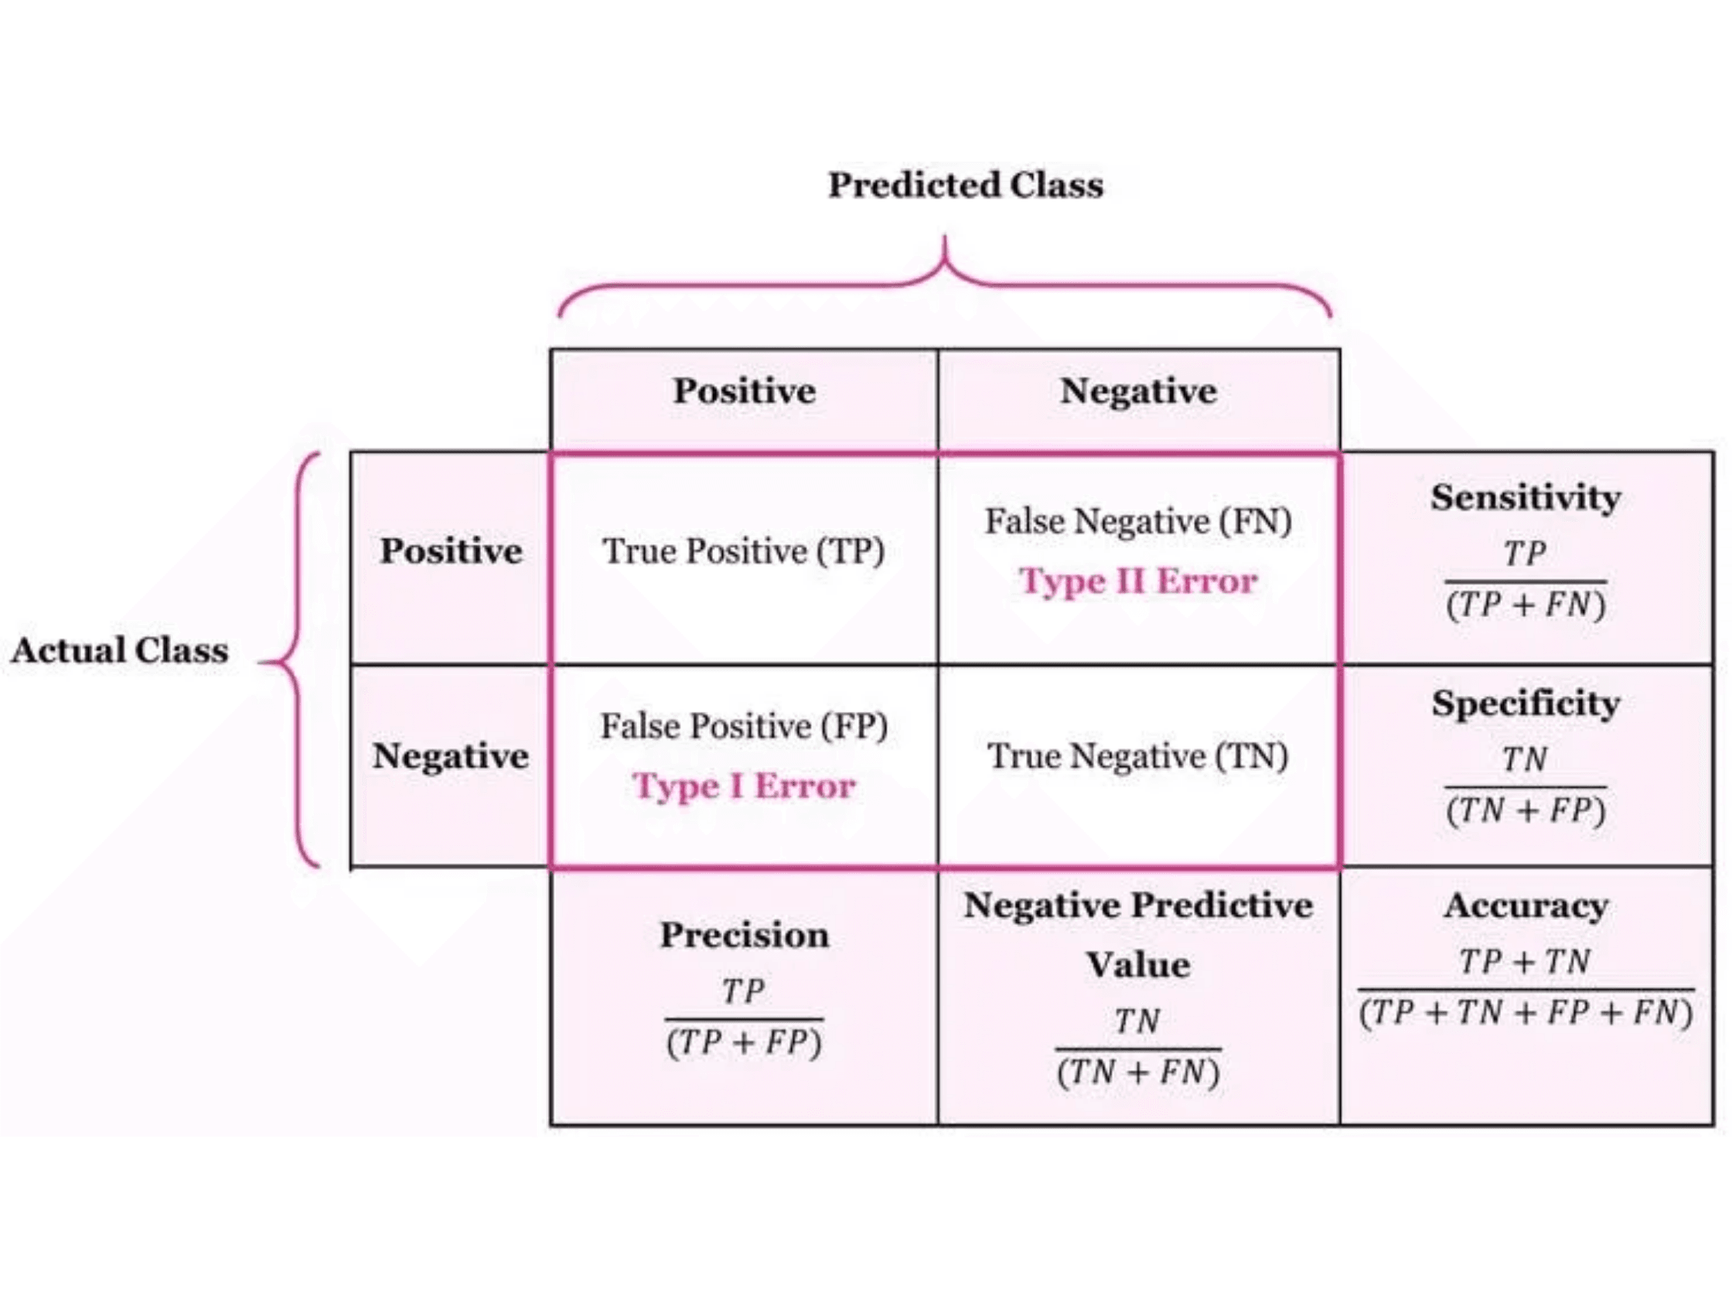
Breaking Down Prediction Outcomes
TP
TN
True Positive
True Negative
Correctly predicted 1 (e.g., Predicted Spam, it was Spam)
Correctly predicted 0 (e.g., Predicted Not Spam, it was Not Spam)
FP
FN
False Positive (Type I Error)
False Negative (Type II Error)
The Alarm: Incorrectly predicted 1 (e.g., Predicted Spam, it was NOT Spam)
The Miss: Incorrectly predicted 0 (e.g., Predicted Not Spam, it was Spam)

Slide 7

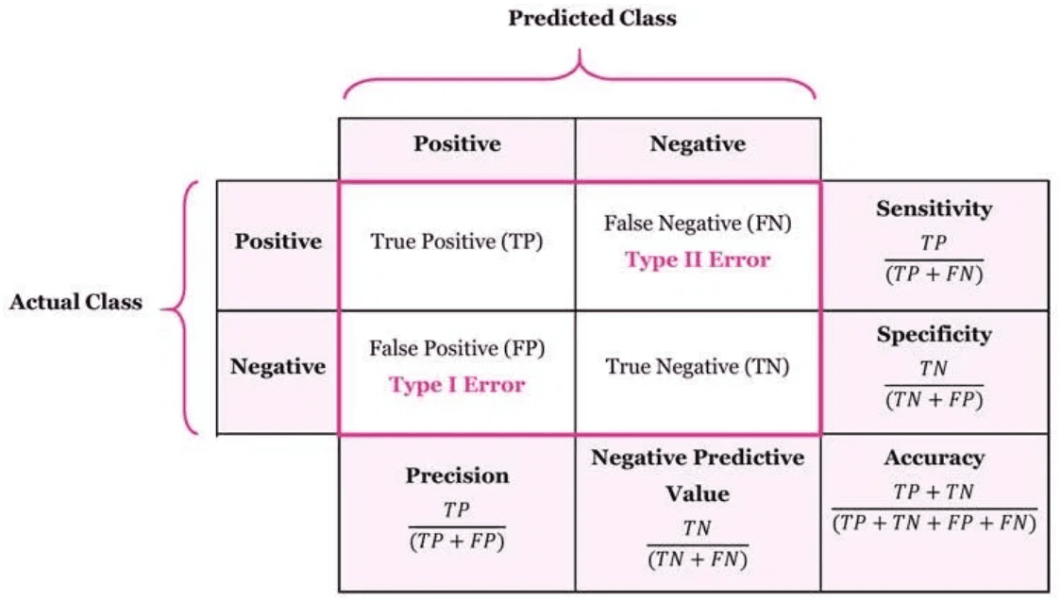
Precision, Recall, and F1-Score Guide Metric Selection
Recall (Sensitivity)
Precision
F1-Score
Recall = TP / (TP + FN)
Precision = TP / (TP + FP)
F1 = 2 × (P × R) / (P + R)
Out of all actual positives, how many did we correctly identify?
Out of all predicted positives, how many were actually correct?
Harmonic mean of Precision and Recall
When It Matters
When It Matters
When missing a positive is costly. Minimize False Negatives (The Miss)
When It Matters
Need balance between precision and recall. Ideal for imbalanced data
When a false positive is costly. Minimize False Positives (The Alarm)
Examples
Advantage
Disease detection, Fraud detection
Examples
Single metric for overall performance
Spam filtering, Expensive offers

Slide 8

Key Takeaways
1
Linear Regression is for continuous output
2
Logistic Regression is for categorical (classification) output using the Sigmoid Function
3
Simple Accuracy is misleading with imbalanced data
4
The Confusion Matrix is essential for deep model evaluation
5
Choose metrics (Precision, Recall, F1) based on the cost of error in your scenario
Questions?

