Slide 1
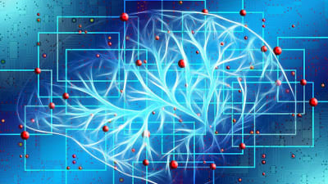
BIOCHIPS
PRESENTED BY,
DEVAKI M (23EIR018)

Slide 2
INDEX
WHAT IS IT?
COMPONENTS
PROS AND CONS
APPLICATIONS
MEDICAL IMPORTANCE

Slide 3
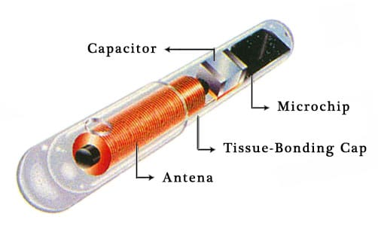
WHAT IS A BIOCHIP?
A Biochip Is A Set Of Diminished Microarrays That Are Placed On A Strong Substrate That Allows Many Experiments To Be Executed At The Same Time. This Device Contains Millions Of Sensor Elements Or Biosensors. Each And Every Biochip Can Be Considered As A Microreactor That Can Detect A Particular Analyte Like An Enzyme, Protein, DNA, Biological Molecule Or Antibody.

Slide 4

COMPONENTS OF BIOCHIPS
The Biochip comprises mainly two components namely the
transponder and reader.

Slide 5
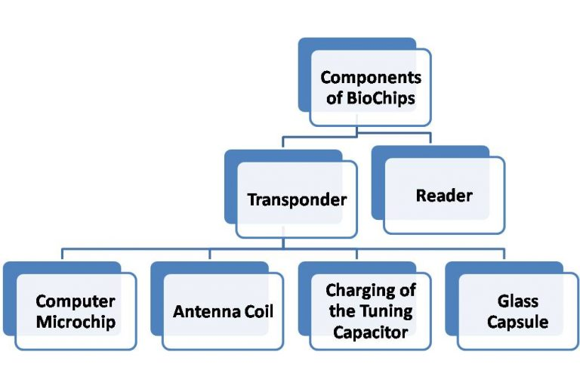

Slide 6
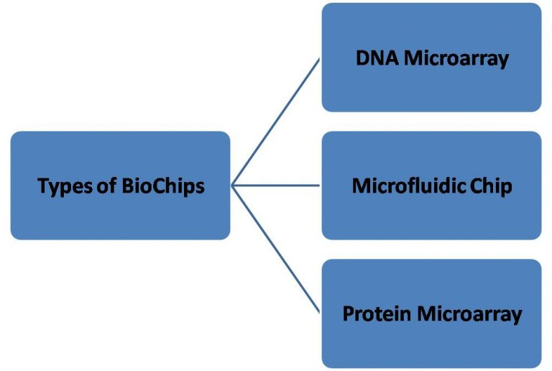

Slide 7
PROS AND CONS OF BIOCHIPS
ADVANTAGES
DISADVANTAGES
The biochip is used to rescue the sick.
Very small in size, powerful and faster.
Biochips are useful in finding the lost people.
Biochip raises dangerous problems of individual privacy.
There will be a chance of turning every person into a controlled person.
Biochips can be fixed into the human’s body without their interference.

Slide 8
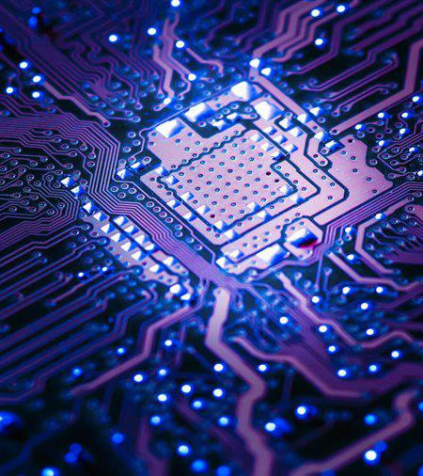
APPLICATIONS ON BIOCHIPS
By Using This Chip We Can Trace A Person Anywhere In The World.
This Chip Is Used To Store And Update The Information Of A Person Like Medical , Financial And Demographics.
A Biochip Leads To Safe E-commerce Systems

Slide 9
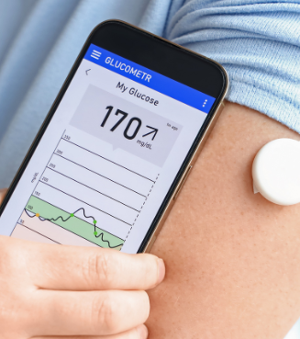
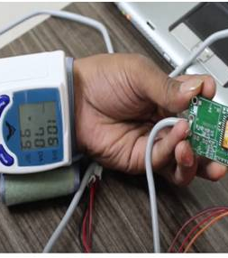
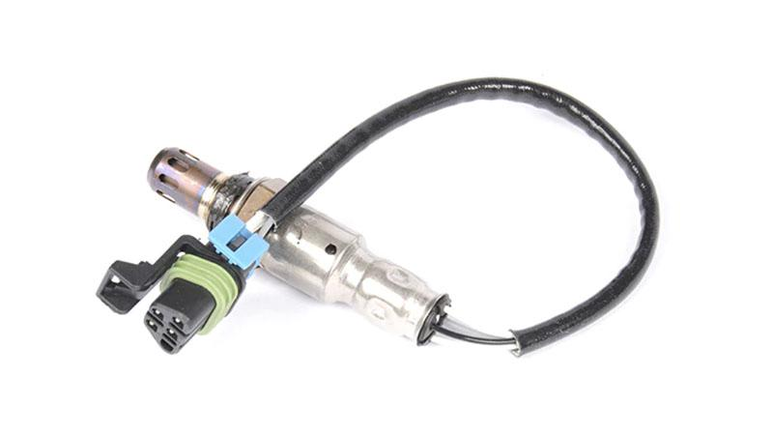
MEDICAL APPLICATIONS ON BIOCHIPS
BP Sensor
Oxygen Sensor
Glucose Detector

Slide 10


