Slide 1
Selenium
~Ganesh Jadhav

Slide 2
Selenium
Selenium is a free (open-source) automated testing framework used to validate web applications across different browsers and platforms.
You can use multiple programming languages like Java, C#, Python, Ruby, JavaScript to create Selenium Test Scripts.
Selenium Software is not just a single tool, but it is a suite of software.
Selenium Integrated Development Environment (IDE)
WebDriver
Selenium Grid
Initially We are having 4 parts in selenium but later Selenium RC & WebDriver both are merge & they introduced Selenium 2 version in the market.

Slide 3
Who developed Selenium?
Since Selenium is a collection of different tools, it had different developers as well.
Primarily, Selenium was created by Jason Huggins in 2004.
An engineer at ThoughtWork's, he was working on a web application that required frequent testing.
Having realized that the repetitious Manual Testing of their application was becoming more and more inefficient, he created a JavaScript program that would automatically control the browser’s actions.
He named this program as the “JavaScriptTestRunner.”
Seeing potential in this idea to help automate other web applications, he made JavaScriptRunner open-source which was later re-named as Selenium Core.

Slide 4
Birth of Selenium Remote Control (Selenium RC)
Unfortunately, testers using Selenium Core had to install the whole application under test and the web server on their own local computers because of the restrictions imposed by the same origin policy.
So, another ThoughtWork’s engineer, Paul Hammant, decided to create a server that will act as an HTTP proxy to “trick” the browser into believing that Selenium Core and the web application being tested come from the same domain.
This system became known as the Selenium Remote Control or Selenium 1.
Birth of Selenium Grid
Selenium Grid was developed by Patrick Lightbody to address the need of minimizing test execution times as much as possible.
He initially called the system “Hosted QA.” It was capable of capturing browser screenshots during significant stages, and of sending out Selenium commands to different machines simultaneously.

Slide 5
Birth of Selenium IDE
Shinya Kasatani of Japan created Selenium IDE, a Firefox extension that can automate the browser through a record-and-playback feature.
He produced this idea to further increase the speed in creating test cases.
He donated Selenium IDE to the Selenium Project in 2006.
Birth of WebDriver
Simon Stewart created WebDriver circa 2006 when browsers and web applications were becoming more powerful and more restrictive with JavaScript programs like Selenium Core.
It was the first cross-platform testing framework that could control the browser from the OS level

Slide 6
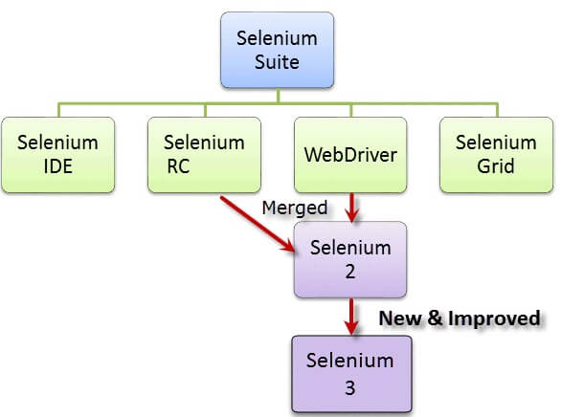
Birth of Selenium 2
In 2008, the whole Selenium Team decided to merge WebDriver and Selenium RC to form a more powerful tool called Selenium 2, with WebDriver being the core.
Most of the Selenium Project’s efforts are now focused on Selenium 4.

Slide 7
What is Selenium Webdriver?
Selenium Webdriver is an open-source collection of APIs which is used for testing web applications.
The Selenium Webdriver tool is used for automating web application testing to verify that it works as expected or not.
It mainly supports browsers like Firefox, Chrome, Safari and Internet Explorer.
It also permits you to execute cross-browser testing.
WebDriver also enables you to use a programming language in creating your test scripts (not possible in Selenium IDE).
programming languages are supported by WebDriver is Java, .Net, PHP, Python, Perl, Ruby.

Slide 8
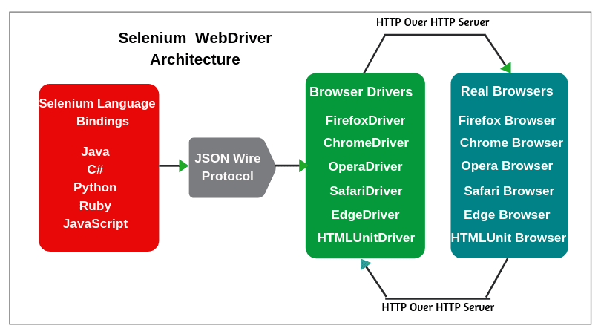
Selenium WebDriver Architecture

Slide 9
Find Element and FindElements
Find Element command is used to uniquely identify a (one) web element within the web page.
Find Elements command is used to uniquely identify the list of web elements within the web page.
There are multiple ways to uniquely identify a web element within the web page such as ID, Name, Class Name, Link Text, Partial Link Text, Tag Name and XPATH

Slide 10
Find Element | FindElements
Returns the first most web element if there are multiple web elements found with the same locator | Returns a list of web elements
Throws exception NoSuchElementException if there are no elements matching the locator strategy | Returns an empty list if there are no web elements matching the locator strategy
Find element by XPath will only find one web element | It will find a collection of elements whose match the locator strategy.
Not Applicable | Each Web element is indexed with a number starting from 0 just like an array

Slide 11
Find locators in selenium
Id – we can also identify elements by using the ‘id’ attribute.
ClassName – A ClassName operator uses a class attribute to identify an object.
name – Name attribute can also identify an element
linkText – partial link text can also recognize the element by using part of the hyperlink text
partialLinkText – partial link text can also recognize the element by using part of the hyperlink text
tagName – This locator type uses tag names to identify elements in a web page. The tag name is the HTML tag, such as ***input, div, anchor tag, button.
cssSelector – CSS is used to create style rules for webpages and can be used to identify any web element.
xpath – Xpath is the language used to query the XML document. The same can uniquely identify the web element on any page.

Slide 12
CssSelector
CSS Selector syntax is quite like the XPath syntax.
It can be represented syntactically as
node[attribute_name = ‘attribute_value’]
node is the tag name of the HTML element, which needs to locate.
attribute_name is the name of the attribute which can locate the element.
attribute_value is the value of the attribute, which can locate the element.
By the Id
input[id='firstName’]
Use another different syntax using #. The ‘# ’ sign symbolizes the ‘ID ’ in CSS Selector.
input#firstName

Slide 13
By the Attribute
textarea[class='form-control’]
Another way of writing the CSS expression for a class attribute is by using the dot (.) symbol to represent the class.
It will help in simplifying the CSS Selector, as shown below:
Textarea.form-control

Slide 14
Xpath
XPath stands for XML Path Language
XPath is a Selenium technique that is used to navigate through the HTML structure of a webpage.
It is a syntax or language that makes finding elements on a webpage possible using XML path expression.
In Selenium automation, there may be times when elements cannot be found with general locators like ID, name, class, etc. And this is when XPath is used to locate those elements on the webpage.
XPath in Selenium may be used on both XML and HTML documents.
Types of X-path
1) Absolute XPath
2) Relative XPath

Slide 15
Absolute XPath
It is the direct way to find the element
But the disadvantage of the absolute XPath is that if there are any changes made in the path of the element then that XPath gets failed.
The key characteristic of XPath is that it begins with the single forward slash(/) which means you can select the element from the root node.
Absolute Xpath Example
/html/body/div[2]/div[1]/div/h4[1]/b/html[1]/body[1]/div[2]/div[1]/div[1]/h4[1]/b[1]

Slide 16
Relative Xpath
Relative Xpath starts from the middle of HTML DOM structure.
It starts with double forward slash (//).
It can search elements anywhere on the webpage, means no need to write a long xpath and you can start from the middle of HTML DOM structure.
Relative Xpath is always preferred as it is not a complete path from the root element.
Relative Xpath Example
//[@id=‘block-perfecto-main-menu’]

Slide 17
1) Basic XPath
XPath expression select nodes or list of nodes based on attributes like ID , Name, Classname.
Xpath=//input[@name='uid’]
2) XPath Text() Function
The XPath text() function is a built-in function of selenium webdriver which is used to locate elements based on text of a web element.
It helps to find the exact text elements and it locates the elements within the set of text nodes. The elements to be located should be in string form.
Xpath=//td[text()='UserID’]

Slide 18
3) Using OR & AND
In OR expression, two conditions are used, whether 1st condition OR 2nd condition should be true. It is also applicable if any one condition is true or maybe both. Means any one condition should be true to find the element.
it identifies the elements who's single or both conditions are true.
Xpath=//input[@name='email' and @id='email’]
Xpath=//input[@name='email' or @id='email’]
4) Xpath Starts-with
XPath starts-with() is a function used for finding the web element whose attribute value gets changed on refresh or by other dynamic operations on the webpage.
In this method, the starting text of the attribute is matched to find the element whose attribute value changes dynamically. You can also find elements whose attribute value is static (not changes).
Xpath=//input[starts-with(@id,'email')]

Slide 19
5) Contains()
Contains() is a method used in XPath expression.
It is used when the value of any attribute changes dynamically.
The contain feature has an ability to find the element with partial text as shown in below XPath example.
//input[contains(@name ,'email’)] //a[contains(text(), 'Forgotten password?')]
6) XPath axes methods
These XPath axes methods are used to find the complex or dynamic elements. Below we will see some of these methods.
Following:
Selects all elements in the document of the current node( ) [ UserID input box is the current node]
Xpath=//*[@type='text']//following::input[1]

Slide 20
b) Ancestor
The ancestor axis selects all ancestor's element (grandparent, parent, etc.) of the current node.
Xpath=//*[text()='Enterprise Testing']//ancestor::div
c) Child
Selects all children elements of the current node (Java)
Xpath=//*[@id='java_technologies']//child::li
d) Following-sibling
Select the following siblings of the context node. Siblings are at the same level of the current node.
It will find the element after the current node.
xpath=//*[@type='submit']//following-sibling::input

Slide 21
f) Parent
Selects the parent of the current node.
Xpath=//*[@id='rt-feature']//parent::div
h) Descendant
Selects the descendants of the current node.
In the below expression, it identifies all the element descendants to current element ( ‘Main body surround’ frame element) which means down under the node (child node , grandchild node, etc.).
Xpath=//*[@id='rt-feature']//descendant::a

Slide 22
Dropdown in Selenium
A web page consists of various web elements ranging from text fields, buttons, checkboxes, drop-downs, etc.
With the wide use of forms on the websites these days, we come across Dropdown now and then.
There are various types of dropdowns available these days, majorly of which are categorized as a single-select (which allows selecting only one value) or multi-select (which allows selecting multiple values).
What is Select Class in Selenium?
In HTML, the dropdowns are generally implemented either using the <select> tag or the <input> tag.
To perform certain operations on the dropdowns, which are declared using the <select> HTML tag, Selenium Webdriver provides a class called "Select " class.
Select select = new Select(WebElement webelement);

Slide 23
How to select a value from a dropdown in Selenium?
The Select class of Selenium WebDriver provides the following methods to select an option/value from a drop-down
selectByIndex
selectByValue
selectByVisibleText
How to deselect a value from a dropdown in Selenium?
deselectAll()
deselectByIndex()
deselectByValue()
deselectByVisibleText()

Slide 24
Actions Class in Selenium
Most user interactions like clicking on a button, entering text in textbox can be done using the WebDriver Element Commands.
For e.g., Commands like WebElement.click() and WebElement.sendKeys() are used to click on buttons and enter text in text boxes.
There are complex interactions like Drag-n-Drop and Double-click which cannot be done by simple WebElement commands.
To handle those types of advance actions we have the Actions class in Selenium.
What is Actions class in Selenium?
Actions class is a collection of individual Action that you want to perform.
For e.g., we may want to perform a mouse click on an element.

Slide 25
Actions class provides various methods that return an actions object unless specified explicitly.
Basically, all the methods of actions class can be divided into two categories:
Mouse based actions methods
Keyboard-based actions methods
What is Action in selenium?
It is not a class but an Interface.
It is only used to represent the single user interaction to perform the series of action items build by Actions class.
Action in Selenium is an interface that provides us two methods perform() and build().

Slide 26
build() Method
The build() method of action interface generates a composite action that contains all the actions gathered which are ready to be performed.
All actions to be performed are specified by method calls.
perform() Method
This method is used to perform a sequence of actions without calling build() first.

Slide 27
Actions class method
click()
clickAndHold()
contextClick()
doubleClick()
dragAndDrop
moveToElement
release()

Slide 28
Keyboard based Actions Commands
keyDown(): The keyDown() method is used to perform the action of pressing and holding a key.
The keys can be Shift, Ctrl, and Alt keys.
It accepts an input parameter as either Keys.SHIFT, Keys.ALT or Keys.CONTROL.
keyUp():
The keyUp() method is used to release a key that has been already pressed using keyDown() method.
You will get undefined behavior if you try to use this method on an unpressed key.
There are also two overloaded methods of keyDown() and keyUp().
sendKeys(CharSequence): The sendKeys() method is used to type in alphanumeric and special character keys into the WebElement such as textarea, textbox, and so on.
The preceding method is different from sendKeys(CharSequence…) method of WebElement.
If the passed keys is null, IllegalArgumentException is thrown.

Slide 29
Difference between Action and Actions class in Selenium
1. Action in selenium is an interface whereas, actions in selenium is a class.
2. Action provides two methods such as build() and perform() whereas, actions class provides various methods to perform complex mouse actions and keyboard shortcuts.
Difference between build() and perform() in Selenium
The build() command of action interface generates a composite action that contains all the actions gathered which are ready to be performed.
The perform() command is used to perform a sequence of actions without calling build() first.

Slide 30
Alert in selenium
Many a time a test fails when we click on an element or enter text in a field.
This is because the element is displayed or exists in DOM, but it does not exist on the web page.
The result would be that there was an error and the test failed.
We can handle these kinds of problems by checking the visibility of web elements on webpage.
There are three types of Alerts in selenium
Simple Alert : The simple alert class in Selenium displays some information or warning on the screen.
Prompt Alert : This Prompt Alert asks some input from the user and Selenium webdriver can enter the text using sendKeys().
Confirmation Alert : This confirmation alert asks permission to do some type of operation.

Slide 31
Alert Handling in Selenium
Handling alerts manually is a tedious task.
To reduce human intervention and ease this task, Selenium provides a wide range of functionalities and methods to handle alerts.
driver.switchTo().alert().dismiss();
driver.switchTo().alert().accept();
driver.switchTo().alert().getText();
driver.switchTo().alert().sendKeys(“");

Slide 32
isEnabled(), isDisplayed() & isSelected()
isEnabled()
To verify if an element is enabled or disabled on web-page.
Returns "true" if element is enabled and returns "false" if an element is disabled.
Examples: Mostly used with button elements, locked/disabled text input elements.
Website Example : https://us.megabus.com/account-management/login

Slide 33
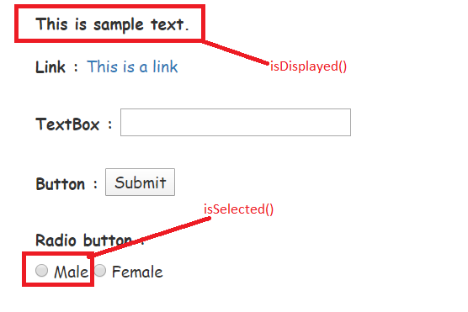
isDisplayed()
To verify presence of a web-element within the web page.
This method returns either true or false boolean values.
If the element is present it returns "true" otherwise it returns "false".
This method can be applicable for almost all the elements on web-page.
isSelected()

Slide 34
isSelected()
Returns whether an element say check box or radio button is selected or not.
If selected returns "true", if not selected returns "false".
Examples: Check boxes, drop downs , radio buttons

Slide 35
Handling Multiple Windows in Selenium
When automating any website or a web application in Selenium, you might have come across a scenario where multiple windows open within an application when a button is clicked, and appropriate action needs to be performed on the opened windows.
What is a window handle?
We can handle multiple windows in selenium webdriver using Switch To methods which will allow us to switch control from one window to another window.
Selenium 4 has a new feature where you can switch between tabs as well.

Slide 36
Method use for window Handle in Selenium?
getWindowHandle(): With this method, we get a unique ID of the current window which will identify it within this driver instance. This method will return the value of the String type.
getWindowHandles( ): With this method, we get the IDs of all the windows opened by the web driver. Its return type is Set.
switchTo(): Using this method, we can perform switch operations within windows.

Slide 37
How to Scroll Down or UP a Page in Selenium Webdriver
A Scrollbar is a lets you move around screen in horizontal or vertical direction if the current page scroll does not fit the visible area of the screen.
It is used to move the window up and down.
Selenium Webdriver does not require scroll to perform actions as it manipulates DOM. But in certain web pages, elements only become visible once the user have scrolled to them. In such cases scrolling may be necessary.
Scroll bar is of two type : Horizontal & vertical
JavascriptExecutor js = (JavascriptExecutor) driver;
js.executeScript(Script, Arguments);
Script – This is the JavaScript that needs to execute.

Slide 38
To scroll down the web page by pixel.
executeScript("window.scrollBy(x-pixels, y-pixels)");
x-pixels is the number at x-axis, it moves to the left if number is positive.
It move to the right if number is negative.
y-pixels is the number at y-axis, it moves to the down if number is positive and it move to the up if number is in negative.
2. To scroll down the web page by the visibility of the element.
js.executeScript("arguments[0].scrollIntoView();",Element );
js.executeScript("window.scrollTo(0, document.body.scrollHeight);");

Slide 39
Scroll up
js.executeScript("window.scrollTo(0, -document.body.scrollHeight);");
js.executeScript("window.scrollBy(0,-250)");
js.executeScript("scroll(0, -250);");

Slide 40
Find All/Broken links using Selenium Webdriver
Broken links are links or URLs that are not reachable.
They may be down or not functioning due to some server error.
An URL will always have a status with 2xx which is valid.
There are different HTTP status codes which are having different purposes.
For an invalid request, HTTP status is 4xx and 5xx.
4xx class of status code is mainly for client-side error, and 5xx class of status codes is mainly for the server response error.
We will most likely be unable to confirm if that link is working or not until we click and confirm it.

Slide 41
Why should you check Broken links?
You should always make sure that there are no broken links on the site because the user should not land into an error page.
The error happens if the rules are not updated correctly, or the requested resources are not existing at the server.
Manual checking of links is a tedious task, because each webpage may have many links & manual process has to be repeated for all pages

Slide 42
Waits
Waits in Selenium is one of the important pieces of code that executes a test case.
It runs on certain commands called scripts that make a page load through it.
Selenium Waits makes the pages reliable.
Why Do We Need Waits In Selenium?
Most of the web applications are developed using Ajax and JavaScript.
When a page is loaded by the browser the elements which we want to interact with may load at different time intervals.
Not only it makes this difficult to identify the element but also if the element is not located it will throw an “ElementNotVisibleException” exception.

Slide 43
Two type of waits
Static wait
Dynamic wait
Static wait
Sleep is a static method that belongs to the thread class.
This method can be called using the reference of the class name i.e Thread.
If you use Thread.sleep while performing automation testing with Selenium, then this method will stop the execution of the script for the specified duration of time, irrespective of whether the element is found or not on the web page.
It accepts the time duration in milliseconds.
Ex. Thread.sleep(3000);

Slide 44
Dynamic wait
Implicit Wait
Explicit Wait
Implicit Wait in Selenium
The Implicit Wait in Selenium is used to tell the web driver to wait for a certain amount of time before it throws a “No Such Element Exception”.
The default setting is 0.
Once we set the time, the web driver will wait for the element for that time before throwing an exception.
If we declared an implicit wait with the time frame of 10 seconds.
It means that if the element is not located on the web page within that time frame, it will throw an exception.
driver.manage().timeouts().implicitlyWait(Duration.ofSeconds(10));

Slide 45
Explicit Wait in Selenium
The Explicit Wait in Selenium is used to tell the Web Driver to wait for certain conditions (Expected Conditions) or maximum time exceeded before throwing “ElementNotVisibleException” exception.
It is an intelligent kind of wait, but it can be applied only for specified elements.
It gives better options than implicit wait as it waits for dynamically loaded Ajax elements.
Once we declare explicit wait, we must use “ExpectedConditions”, or we can configure how frequently we want to check the condition using Fluent Wait.
WebDriverWait wait = new WebDriverWait(WebDriverRefrence,TimeOut);

Slide 46
Let’s consider a scenario where we must use both implicit and explicit waits in our test. Assume that implicit wait time is set to 20 seconds and explicit wait time is set to 10 seconds.
Suppose we are trying to find an element which has some “ExpectedConditions “(Explicit Wait), If the element is not located within the time frame defined by the Explicit wait(10 Seconds), It will use the time frame defined by implicit wait(20 seconds) before throwing an “ElementNotVisibleException“.

Slide 47
Implicit Wait | Explicit Wait
Implicit Wait time is applied to all the elements in the script | Explicit Wait time is applied only to those elements which are intended by us
In Implicit Wait, we need not specify “ExpectedConditions” on the element to be located | In Explicit Wait, we need to specify “ExpectedConditions” on the element to be located
It is recommended to use when the elements are located with the time frame specified in Selenium implicit wait | It is recommended to use when the elements are taking long time to load and for verifying the property of the element like(visibilityOfElementLocated, elementToBeClickable,elementToBeSelected)

Slide 48
iFrame in Selenium Webdriver
iFrame in Selenium Webdriver is a web page or an inline frame which is embedded in another web page, or an HTML document embedded inside another HTML document.
The iFrame is often used to add content from other sources like an advertisement into a web page.
The iFrame is defined with the <iframe> tag.

Slide 49
How to identify the iframe
We cannot detect the frames by just seeing the page or by inspecting.
you need to do Right click on the element, If you find the option like ‘This Frame’ then it is an iframe.
Right click on the page and click ‘View Page Source’ and Search with the ‘iframe’, if you can find any tag name with the ‘iframe’ then it is meaning to say the page consisting an iframe.
We can even identify total number of iFrame by using below snippet.
Int size = driver.findElements(By.tagName("iframe")).size();

Slide 50
How to switch over the elements in iFrame
By Index
driver.switchTo().frame(0);
By Name or Id
driver.switchTo().frame(“”);
By Web Element
driver.switchTo().frame(WebElement);
driver.switchTo().frame(1);
driver.switchTo().frame("google_ads_iframe_/218491546/Ad.Plus-Anchor_0");
driver.switchTo().frame(driver.findElement(By.xpath("//iframe”)

Slide 51
Upload a File
File upload is performed when there is a need of uploading any file or a document on a specific website such as forms, registration pages, document uploaders, etc.
Selenium Upload File
Handing file upload in Selenium can ease human work and can be done simply by using the sendKeys() method.
A message is displayed after uploading a file that confirms if the file is being uploaded successfully.
There are many more such automation methods for file upload.

Slide 52
Cookies Handling in Selenium WebDriver
A HTTP cookie is comprised of information about the user and their preferences.
It stores information using a key-value pair.
It is a small piece of data sent from Web Application and stored in Web Browser, while the user is browsing that website.
Why Handle Cookies in Selenium?
Each cookie is associated with a name, value, domain, path, expiry, and the status of whether it is secure or not. In order to validate a client, a server parses all these values in a cookie.
When Testing a web application using selenium web driver, you may need to create, update or delete a cookie.
For example, when automating Online Shopping Application, you many need to automate test scenarios like place order, View Cart, Payment Information, order confirmation, etc.
If cookies are not stored, you will need to perform login action every time before you execute above listed test scenarios. This will increase your coding effort and execution time.

Slide 53
Selenium Query Commands for cookies
driver.manage().getCookies(); // Return The List of all Cookies
driver.manage().getCookieNamed(arg0); //Return specific cookie according to name
driver.manage().addCookie(arg0); //Create and add the cookie
driver.manage().deleteCookie(arg0); // Delete specific cookie
driver.manage().deleteCookieNamed(arg0); // Delete specific cookie according Name
driver.manage().deleteAllCookies(); // Delete all cookies

Slide 54
Date from DatePicker with Selenium
Here we are using different methods to select the date from the DatePicker using selenium java.
Sendkeys method: In this method, a particular date is filled in the date/ calendar field with the sendKeys method.
sendate.sendKeys("12-january-2021");
2. Selecting a particular date from DatePicker: In this method, choose a particular date using locators and perform a click action to select.
driver.findElement(By.xpath("//a[normalize-space()='20']")).click();
3. Getting a list of dates from the Calendar: In this method, get the list of the dates from the calendar, and iterate dates one by one.

Slide 55
Handle SSL Certificate in Selenium
You might have come across a case when manually opening a website works fine, but the same action through Selenium WebDriver throws an error that says- "This Connection is Untrusted".
Have you ever wondered why this happens? The answer is simple, on manually opening a URL, the browser automatically imports the required certificates, and no error occurs.
Simultaneously, in Selenium WebDriver, each run occurs on a new profile that doesn't have the SSL Certificates, hence the error.

Slide 56
What is an SSL certificate?
SSL(Secure Sockets Layer) is a standard security protocol that establishes a secure connection between the server and the client(browser).
The information sent using an SSL certificate is encrypted and ensures that it delivers to the right server.
It is a validator to the website's identity and helps to keep hackers at bay.
What is an untrusted SSL certificate?
Whenever you try to access a website, the SSL certificate helps determine if the website is what it claims to be.
If there is any issue with the certificate, you will see an error on your browser window saying: "This connection is untrusted". or "Your connection is not private“.

Slide 57
How To Take Screenshot In Selenium
Selenium provides built-in functionality for capturing screenshots.
As per the requirement, TakesScreenshot interface is used to take screenshots, while executing the Selenium scripts.
Thus, Selenium Webdriver helps in capturing screenshots while code is being executed.
Syntax
File f = ((TakesScreenshot) driver).getScreenshotAs(OutputType.FILE);
FileHandler.copy(f, new File("C:/Users/Chait/Desktop/Screenshots/screenshot01.png"));

