Slide 1
Predicting the survival of Titanic Passengers
Deepika Sridhar

Slide 2
Presentation Overview
Project Flow
Data Wrangling
Exploratory Data Analysis
Survived
Pclass
Sex
Age
Relatives
Correlation Map
Machine Learning Analysis
Data Prep
Models
Hyper parameter tuning
Evaluation

Slide 3
Project Flow

Slide 4
Data Wrangling
Data Transformation
Missing Values Treatment
Outlier values treatment

Slide 5
Exploratory Data Analysis
Survived
Pclass
Sex
Age
Relatives
Correlation map

Slide 6
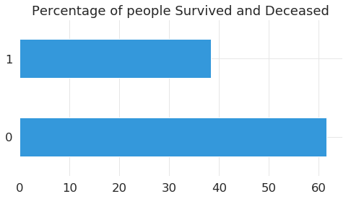
Survived

Slide 7
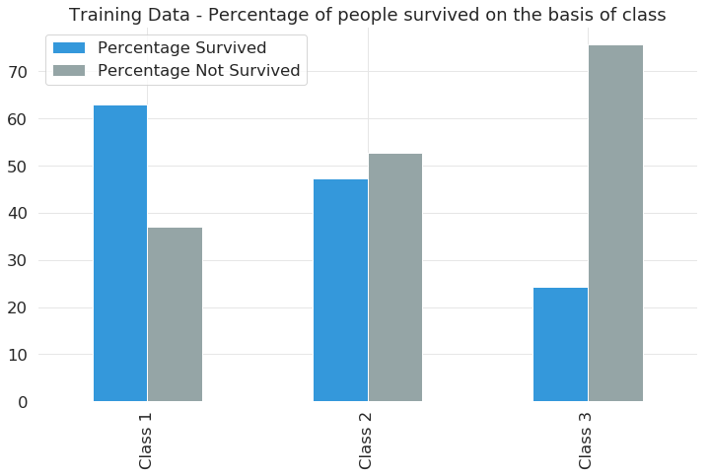
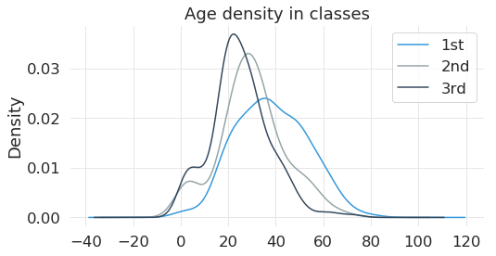
Pclass

Slide 8
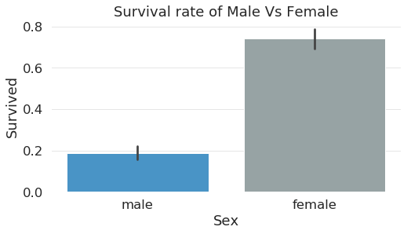
Sex

Slide 9
Age

Slide 10
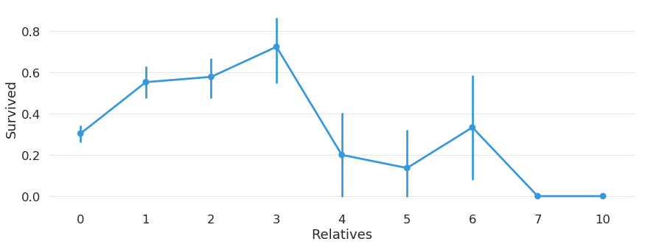
Relatives

Slide 11
Correlation Map

Slide 12
Machine Learning Analysis
Data Prep
Models
Logistic Regression
Random Forest
XGBoost
Evaluation

Slide 13
Data Prep
Change the Pclass hierarchy
Continuous attributes must be binned, and Dummy variables created
Remove categorical variables
Train Test split
Variance Inflation Factor

Slide 14
Models
Logistic Regression

Slide 15
Models
Random Forest Classifier

Slide 16
Models
XGBOOst

Slide 17
Hyper parameter tuning

Slide 18
Evaluation
Confusion Matrix

Slide 19
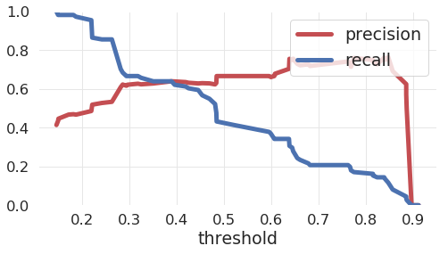
Evaluation
Precision Recall Curve

Slide 20
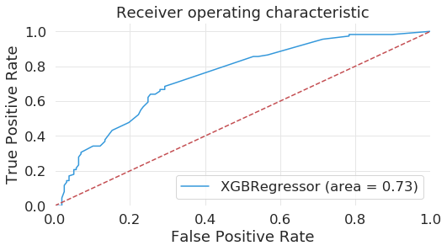
Evaluation
ROC AUC curve

Slide 21
Evaluation
F-Score
0.5111111111111111
ROC Score
0.7431284787972686 .

