Slide 1
Building a Movie Rating Recommendation System
Deepika Sridhar

Slide 2
Presentation Overview
Project Flow
Data Wrangling
Exploratory Data Analysis
Machine Learning Analysis
Data Prep
Models
Hyper parameter tuning
Evaluation

Slide 3
Project Flow

Slide 4
Data Wrangling
Missing Values Treatment

Slide 5
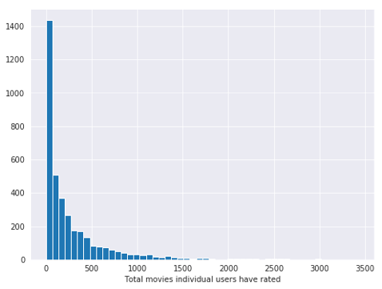
Exploratory Data Analysis
Total movies the individual users have rated

Slide 6
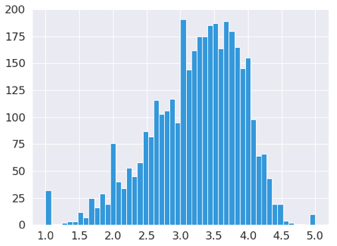
Mean Ratings Distribution

Slide 7
Machine Learning Analysis
Steps
Data Prep
Train Test split
Removing unnecessary features
Model
SVD
Cross Validation
Hype Parameter Tuning
Model Accuracy Analysis
Fraction of Concordant Pair
Mean Absolute Error
Mean Squared Error
Root Mean Squared Error

Slide 8
Data Preparation
Splitting the Data into training and test set
Removing unnecessary features

Slide 9
Machine Learning Model
SVD – Singular Value Decomposition
Evaluation

Slide 10
Cross Validation

Slide 11
Hyper Parameter Tuning

Slide 12
Model Accuracy Analysis
Metrics Families:
Fraction of Concordant Pair
Mean Absolute Error
Mean Squared Error
Root Mean Squared Error

Slide 13
Accuracy Scores

Slide 14
Conclusion
Increases User Engagement
Increases User Retention

