Slide 1
RoadAccident Analysis
Deepika

Slide 2
Problem Statement
Analyze accident patterns to identify key risk factors.
Reduce accident rates through data-driven insights.
Support decision-making for road safety improvements.

Slide 3
Dataset Overview
Source: Provided accident dataset.
Includes attributes: Date, Time, Location, Severity, Cause.
Total Records: ~2200 (approx. from analysis).
Covers multiple regions and accident categories.

Slide 4
Methodology
Data Cleaning & Preprocessing.
Exploratory Data Analysis (EDA).
Visualization of patterns and trends.
Key insights & recommendations.

Slide 5
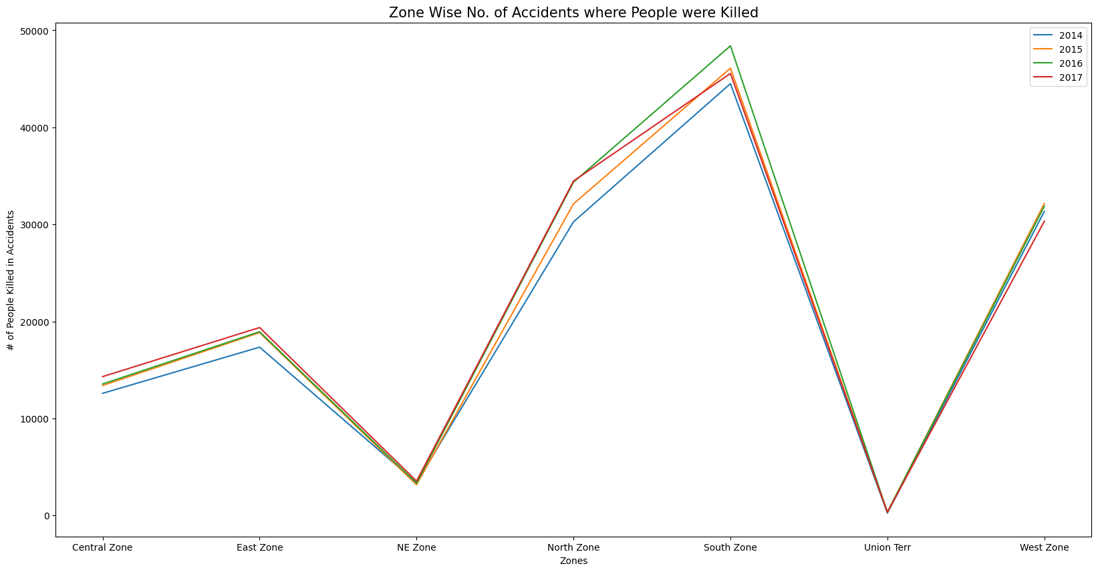
People Died

Slide 6
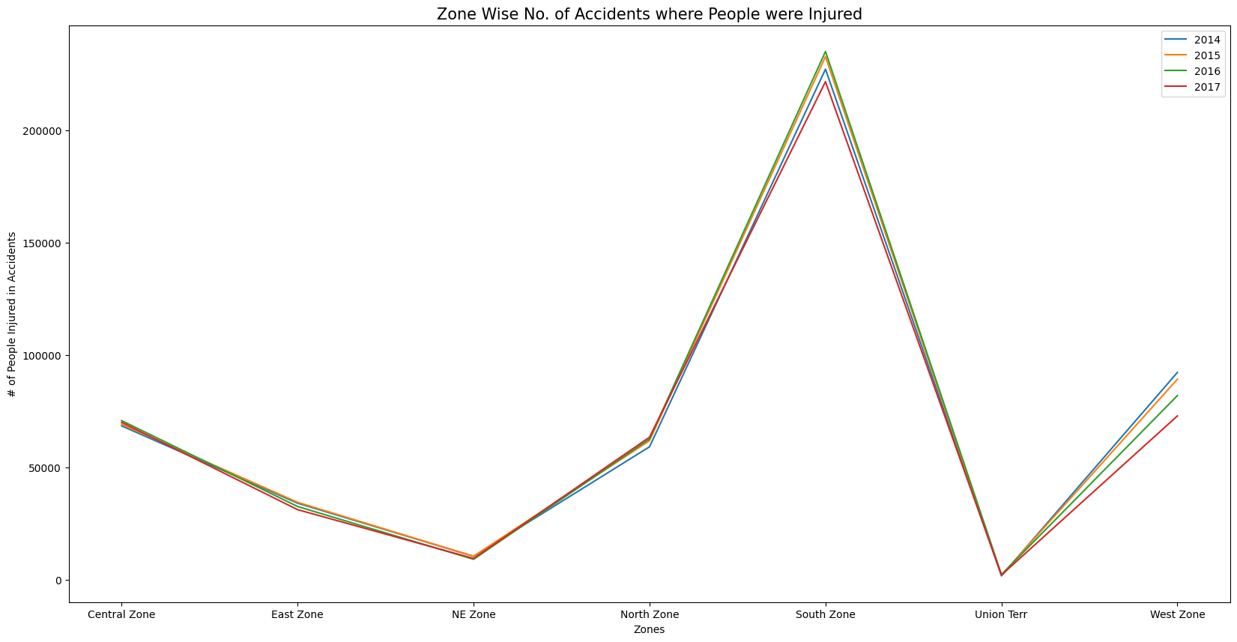
People injured

Slide 7
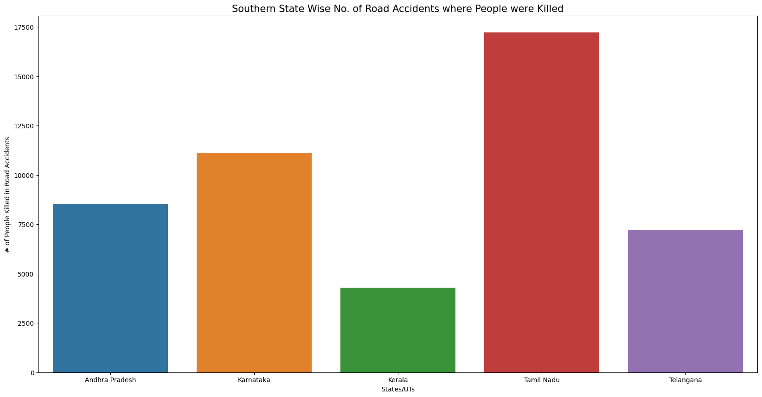
Top states people injured

Slide 8
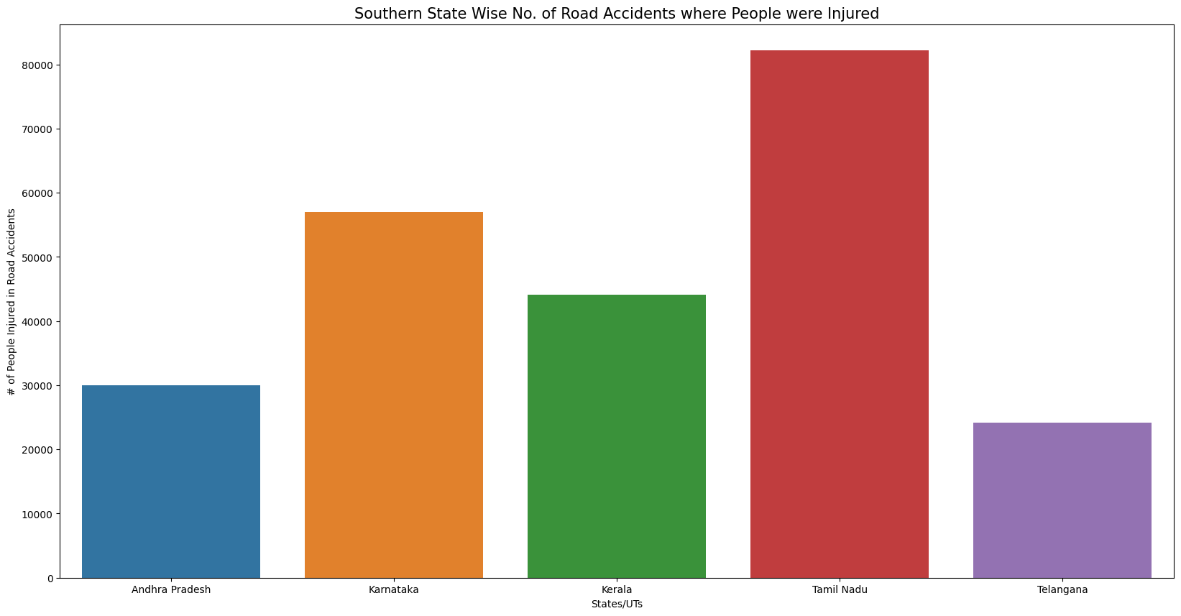
Top states people injured

Slide 9
Recommendations
Focus on high-risk regions and accident hotspots.
Improve road lighting and signage in identified zones.
Enhance driver awareness programs.
Increase enforcement during high-risk times.

Slide 10
Conclusion
Accident analysis revealed clear spatial and temporal patterns.
Findings can guide targeted safety measures.

