Slide 1
Reconstructing Undersampled OCT Data Using Machine Learning
BME 548: Machine Learning and Imaging
Xiao Tang, Holly Wen, Wade Wei

Slide 2
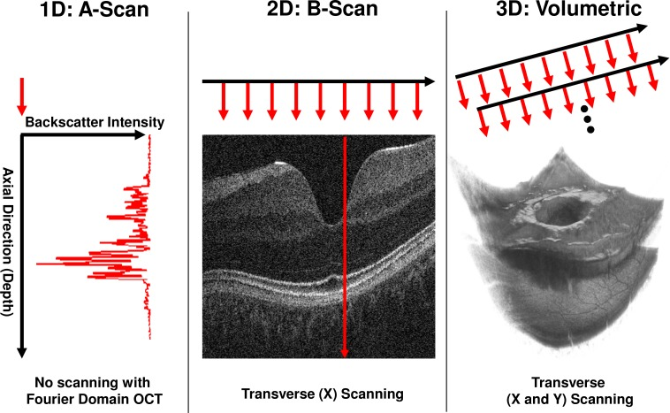
Background
OCT Volume Scan:
The pixel density for each B-scan represents the fast-axis resolution
The number of B-scans represents the low-axis resolution

Slide 3
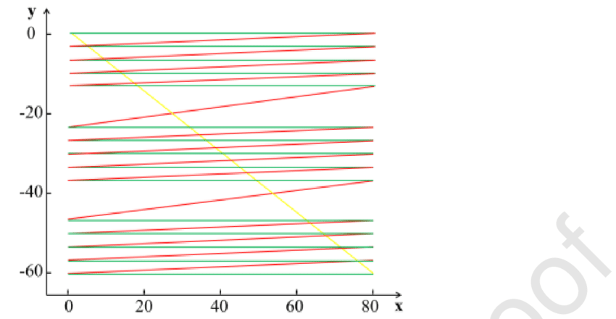
Background
Imaging Tradeoff: Image Resolution and Pixel Density.
Red and Yellow: flayback time and inactive scans
Green: number of lines represents the low-axis resolution
In order to increase the scanning efficiency, the number of green lines decreases as well as the low-axis resolution (380*80).
We want to reconstruct B-scans with fewer pixel density and thus, have more B-scans and increase the low-axis resolution.

Slide 4
Methods: General
In reality, higher speed scanning often leads to low image quality (image undersampled). Data we have are fully sampled, so we will downsample our data to recover the realistic scenario.
Tried cropping raw images into 128 by 128 matrix to fit into our model. Each image was randomly cropped five times. We also train our raw data with its initial dimensions
FD-UNet was chosen as our neural network. ELU replaces RELU to improve learning speed.

Slide 5
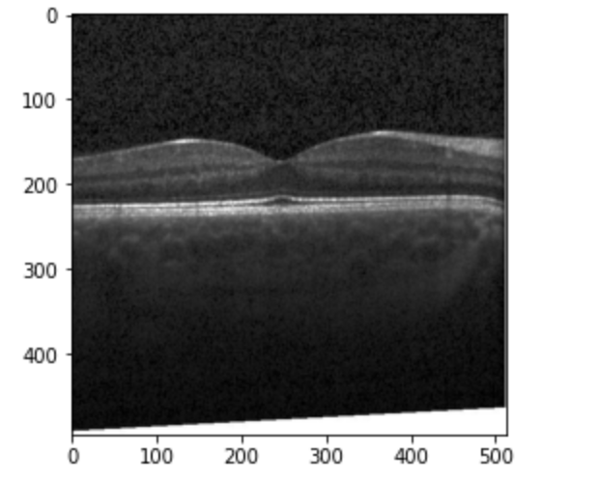
Methods - Dataset
Retinal OCT Images(optical coherence tomography) from Paul Mooney.
https://www.kaggle.com/paultimothymooney/kermany2018
300 scans for train
40 scans for test

Slide 6
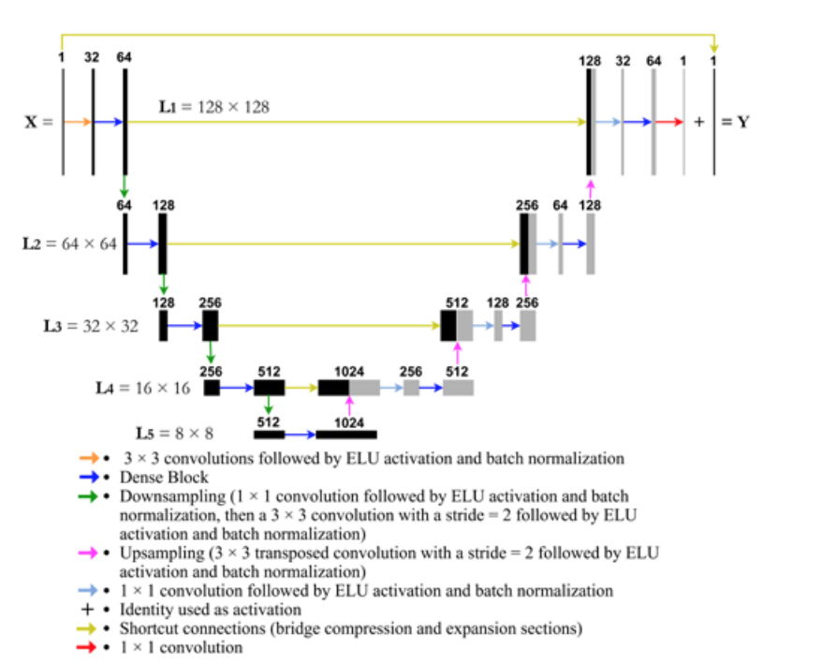
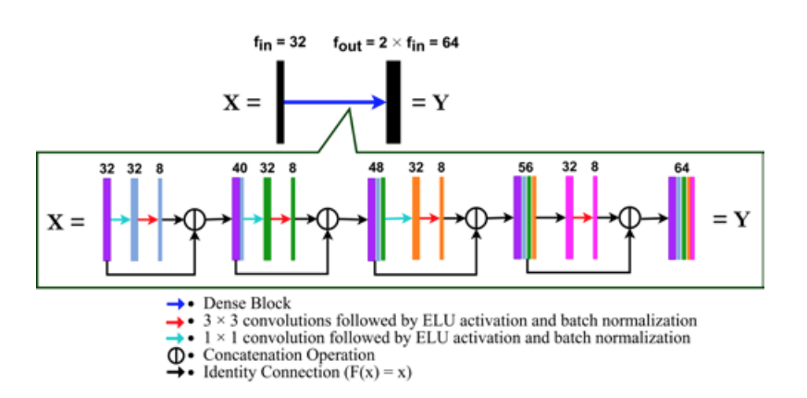
Method: FD-UNet
RELU was replaced by ELU activation
Learning speed
Max pooling was replaced by 2 coonvolution blocks: 1*1 and 3*3
Learned downsampling operation

Slide 7
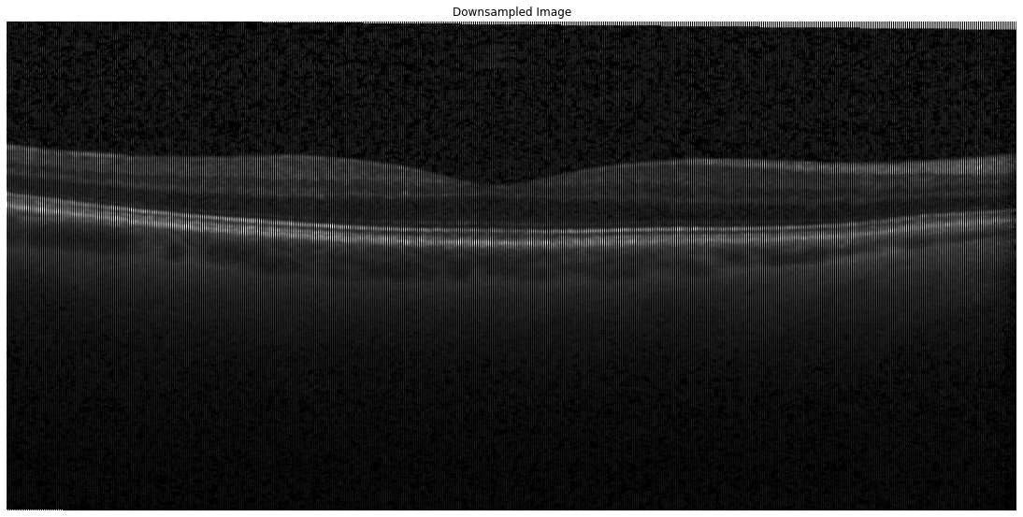
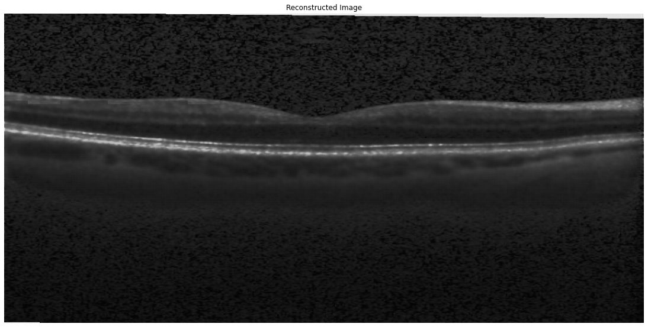
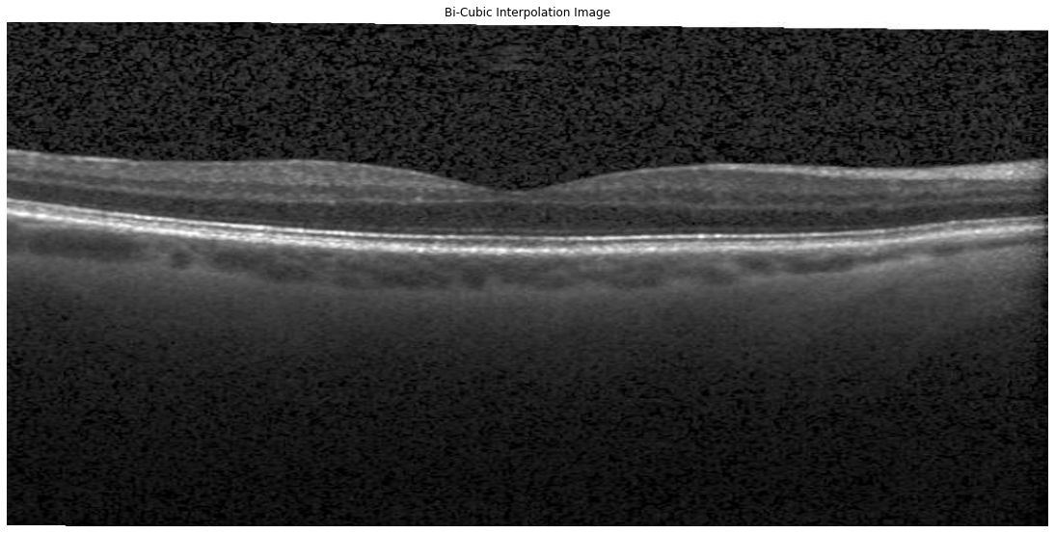
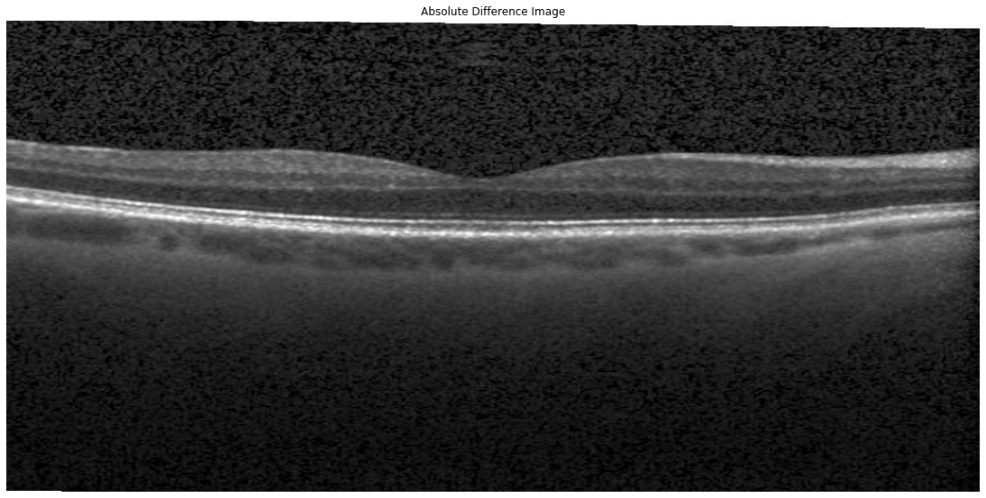
Result
Downsampled Image
Reconstructed Image
Bi-cubic interpolated Image
Absolute Difference Image

Slide 8
Discussion
Model works great for train dataset; not very good for test dataset
Reconstructed image seems good. Comparing with bicubic interpolation image and absolute difference image, our reconstructed image does not have the best reconstructing ability, but the denoising effect is much more effective.
50% downsampled images were able to fully reconstructed to an ideal state

Slide 9
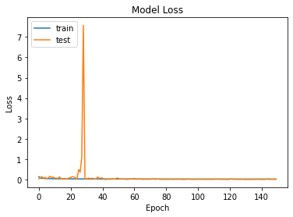
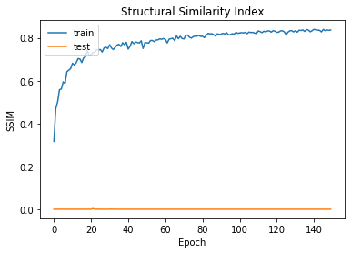
Limitations
Weird training result on test dataset:
Slow training speed
Random cropping includes too much background noise (black pixels)that messes with model training.
Batch size sometimes gives out error when we run the code

Slide 10
Reference
https://arxiv.org/abs/2006.00251

