Slide 1

Workshop #2 Conventions & Basic Queries
Introduction to Graph Database Programming, T1 2021

Slide 2
Graph DB Query Language - Cypher
In Neo4j it is known as Cypher
Cypher is part of the Graph Query Language ISO Standard: https://www.gqlstandards.org/
Cypher is based on patterns

Slide 3
Rules & Conventions
Names should begin with an alphabetic character.
This includes "non-English" characters, such as å, ä, ö, ü etc.
Numbers:
Names should not begin with a number. Example: 1first is not allowed, whereas first1 is allowed.
Symbols:
Except for underscore, as in my_variable, names should not contain symbols, $ as the first character to denote a parameter, e.g. $myParam.
Case-sensitive:
Names are case-sensitive and thus, :PERSON, :Person and :person are three different labels, and n and N are two different variables.
Whitespace characters:
Leading and trailing whitespace characters will be removed automatically. For example, MATCH ( a ) RETURN a is equivalent to MATCH (a) RETURN a.

Slide 4
Cypher Reserved Keywords: Clauses
CALL
CREATE
DELETE
DETACH
EXISTS
FOREACH
LOAD
MATCH
MERGE
OPTIONAL
REMOVE
RETURN
SET
START
UNION
UNWIND
WITH

Slide 5
Subclauses
LIMIT
ORDER
SKIP
WHERE
YIELD

Slide 6
Modifiers
ASC
ASCENDING
ASSERT
BY
CSV
DESC
DESCENDING
ON

Slide 7
Expressions
ALL
CASE
ELSE
END
THEN
WHEN

Slide 8
Operators
AND
AS
CONTAINS
DISTINCT
ENDS
IN
IS
NOT
OR
STARTS
XOR

Slide 9
Schema
CONSTRAINT
CREATE
DROP
EXISTS
INDEX
NODE
KEY
UNIQUE

Slide 10
Hints
INDEX
JOIN
PERIODIC
COMMIT
SCAN
USING

Slide 11
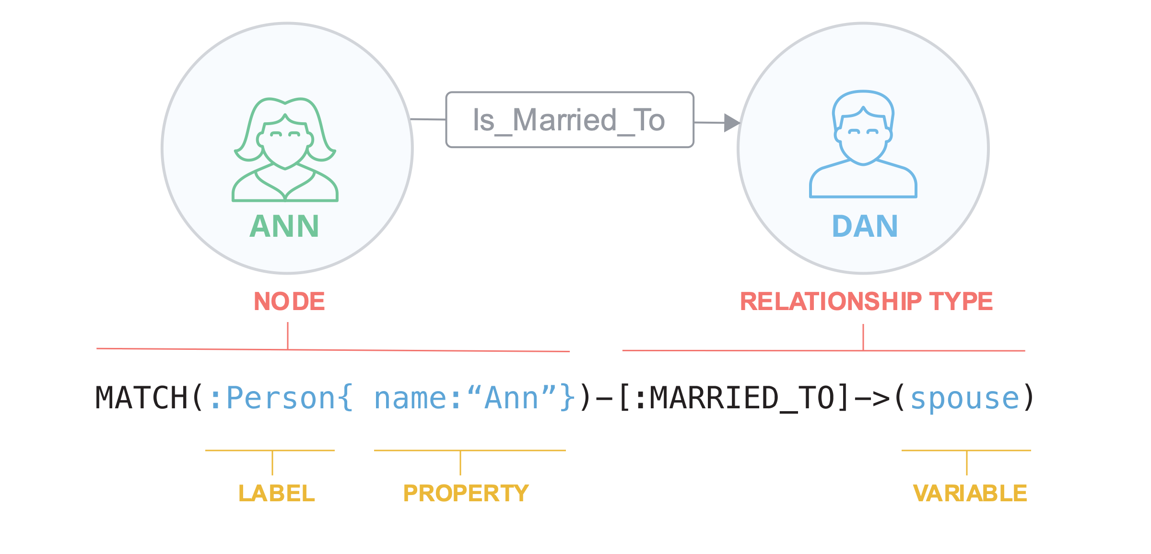

Slide 12
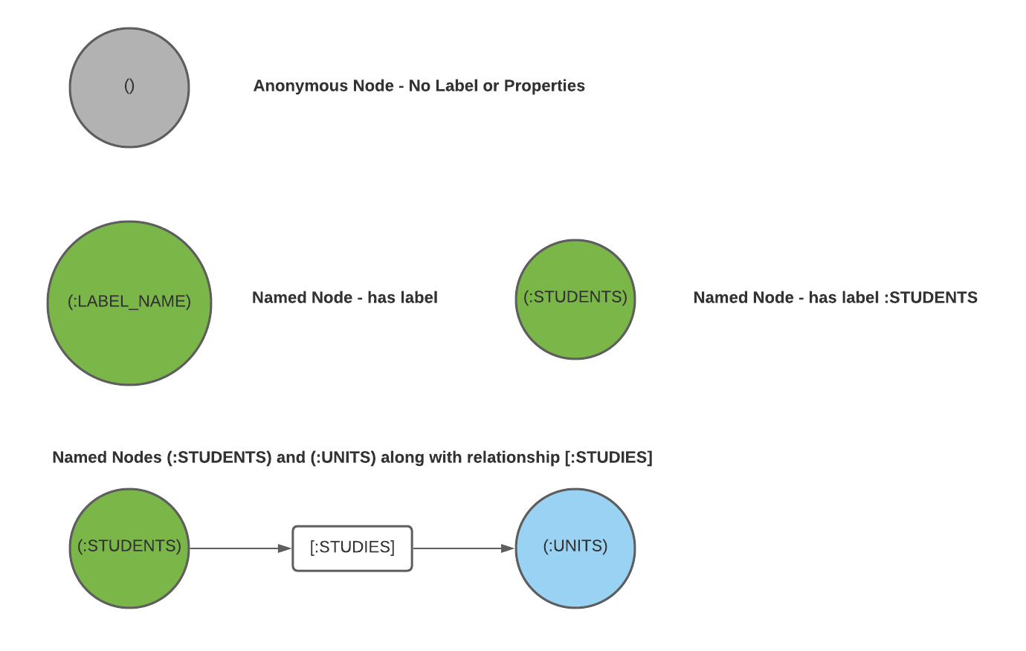
Node & Node Syntax
Contains a LABEL & PROPERTY
Example: :Person {Name: ‘Keanu Reeves’} where :Person is the LABEL & {Name: ‘Keanu Reeves’} is the PROPERTY
An anonymous node ()
Variables & Labels: (p: Person)
Label only: (:Person)
Named variable & label: (actor: Person)

Slide 13
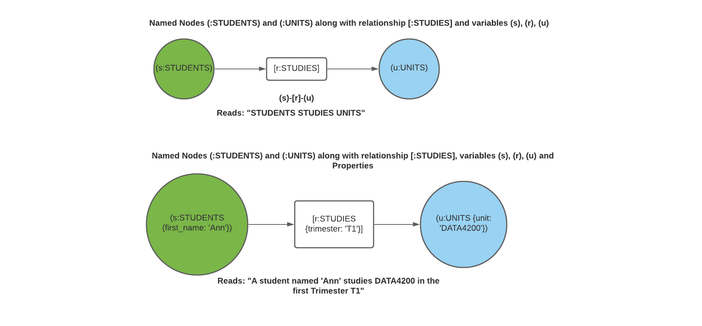
Node & Node Syntax

Slide 14
Nodes & Patterns
Nodes and relationships are what is know as Property Graphs
The power or strength of property graphs are in its ability to encode patterns of connected nodes and relationships
Complex ideas are encoded by a pattern of connected nodes and relationships
Simple case:
a Person LIVES_IN a City, a City is PART_OF a Country
(:Person) –[:LIVES_IN]-> (:City) –[:PART_OF] -> (:Country)
An Actor ACTS_IN a Movie, a Movie is DIRECTED_BY a Director
(:Actor) –[:ACTS_IN]-> (:Movie) –[:DIRECTED_BY] – (:Director)

Slide 15
Relationships
In Cypher, relationships are represented using an arrow --> or <-- between two nodes
Important: if data is stored with one relationship direction, and a query specifies the wrong direction, Cypher will not return any results.
Where the direction of the relationship is unknown, use an undirected relationship to retrieve some results.
Examples:
//data stored with this direction
CREATE (p:Person) - [:LIKES]-> (m:Movies)
//will not return results if the backwards relationship do not exist
MATCH (p:Person) <-[:LIKES]- (m:Movies)
//use an undirected relationship if unless sure of direction
MATCH (p:Person) -[:LIKES]- (m:Movies)

Slide 16
Relationship Types
Relationship types add meaning (or context) and categorise the nature of the connection(s), and are usually described with an action word (a verb)
Examples: [:LIKES], [:IS_FRIENDS_WITH], [:ACTS_IN]
Important: leaving out the semicolon will treat the name as a variable
Example: -[LIKES]-> represents a variable, not a relationship
Any relationship type between nodes can be specified, however the recommendation is to use regular English action words which are meaningful

Slide 17
Relationship Variables
Variables are placeholder names or (named descriptions) of the types of relationships to be used in queries
Can use [r], [rel]
Prefer expressive English words: [likes], [knows], [works] etc.
Anonymous relationship identified using two dashes: --+, +→+, +,--

Slide 18
Cypher Basic Queries
MATCH: looks for patterns in the database on existing nodes, relationships, labels, and properties
RETURN: specifies results to be returned i.e. nodes, relationships, nodes & relationship properties, and patterns
LIMIT: specifies the number of results to return
CREATE: adding data
MERGE: want to add data but checks for existing data (acts like combination of MATCH & CREATE)

