Slide 1

Python Programming Workshop #3
Every Wednesday, 7:00PM Melbourne/Sydney Time, T1, 2021

Slide 2
Python Iterables (enumerable)
An iterable is a collection of objects (data). For example, lists. Iterables can be enumerated (counted)
An iteration is the process of looping through the iterables
An iterator is the variable that produces successive values from the iterable

Slide 3
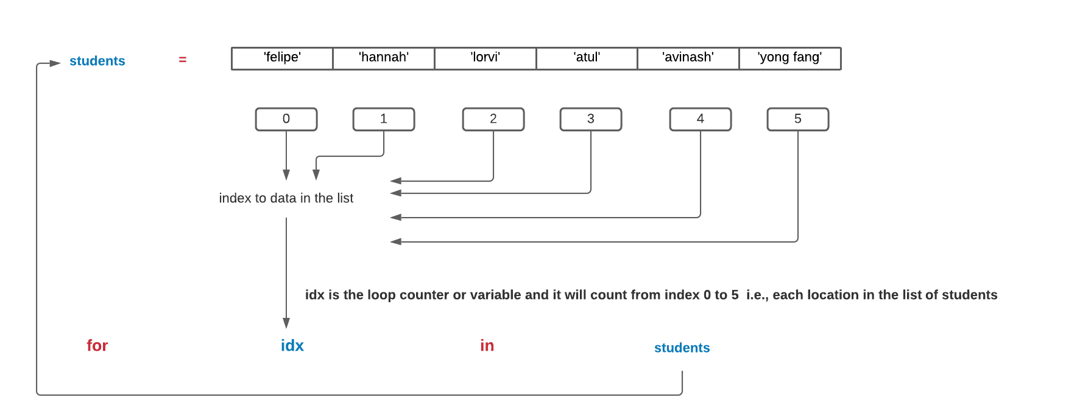
Python Iteration: For Loops
For loops is an example of a definite iteration – there is a starting point (e.g., at index 0) and and ending or terminating point (the location of the last element)

Slide 4
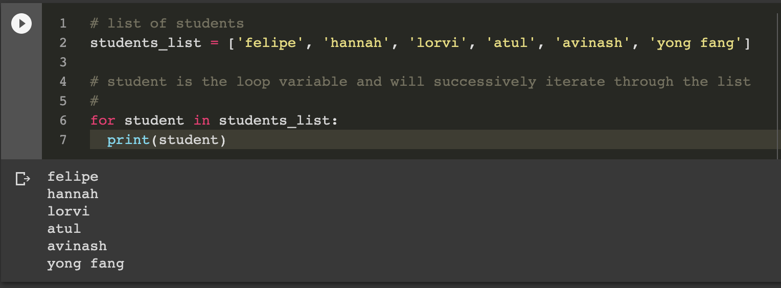
Example: iterating through a list of students

Slide 5
WHILE Loops
A while loop is an example of an indefinite type of iteration. That is, the iteration will continue until some condition is satisfied
The number of the times that the loop will run or execute is not specified in advance but will continue for as long as the condition is met

Slide 6
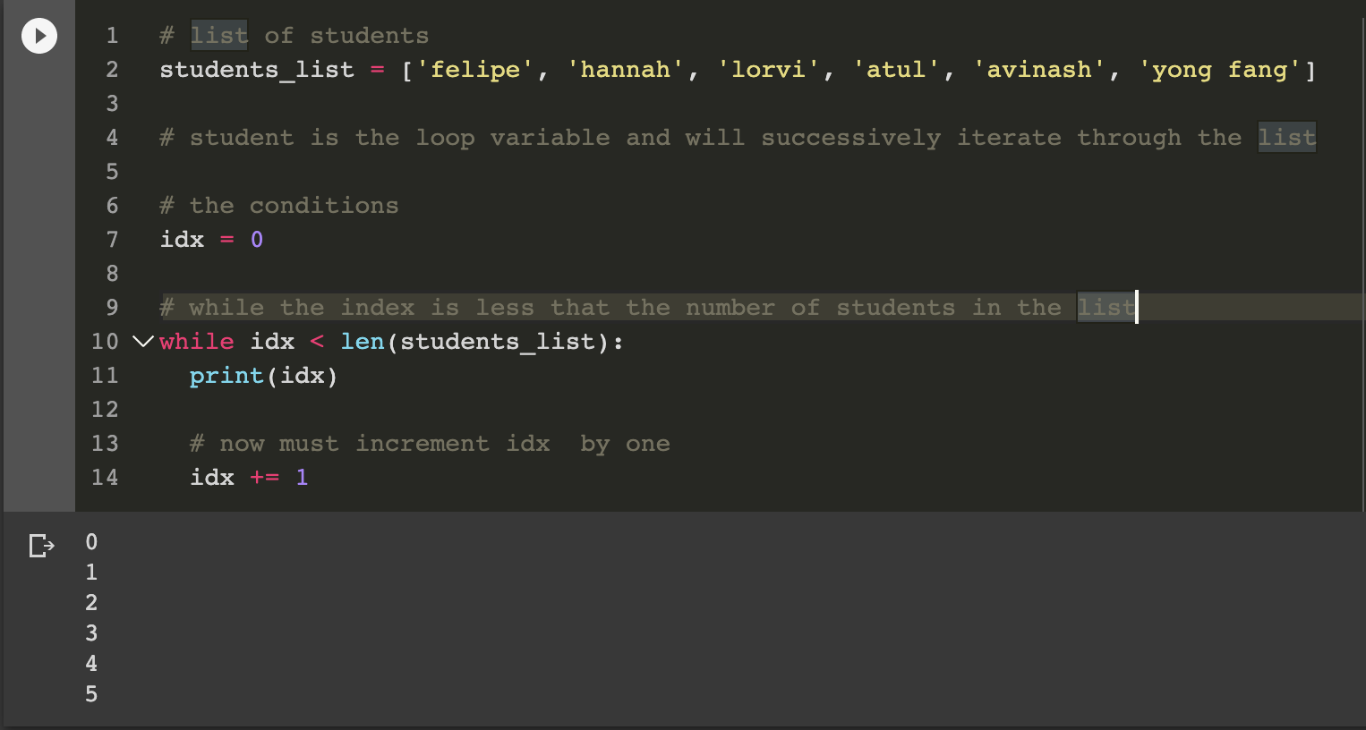
Python WHILE Loops

Slide 7
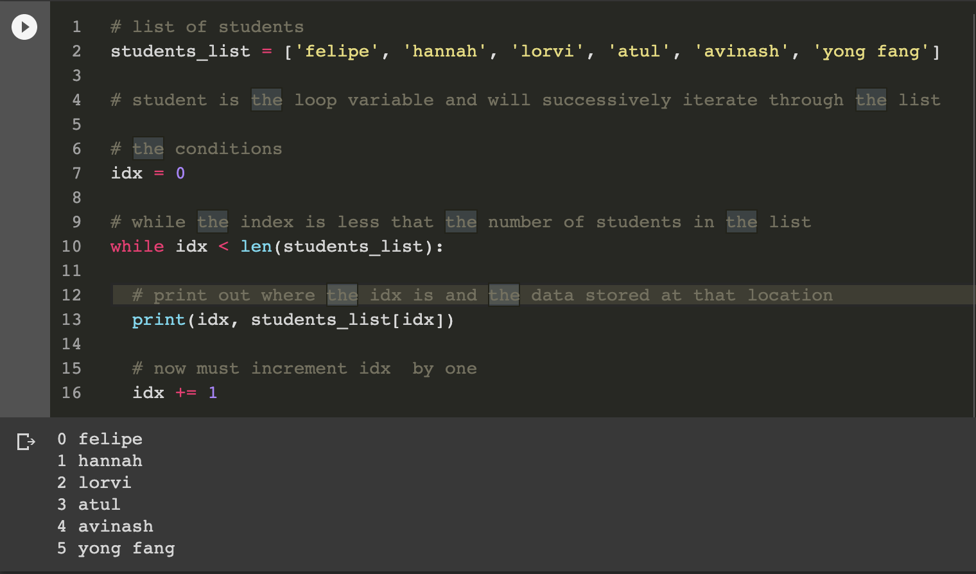
Python WHILE Loops

Slide 8
Python Pandas Library
Python Data Analysis Library: https://pandas.pydata.org/

