Slide 1

Python Programming Workshop #2
Every Wednesday, 7:00PM Melbourne/Sydney Time, T1, 2021

Slide 2
Python Assignment Operators
Assign means to attach data to a variable

Slide 3
Python Data Types
Integers: INT, are numbers. Example, 1,2,3,4 etc…
Floats (short for Floating Point): FLOAT, are decimal numbers. Examples: 3.143, 1.618, etc…
Strings: STR, are sequences of characters.
Examples: ‘abcdefg’ , ‘name’, ‘customer123XYZ’, ‘hello, world’.
Note that strings are enclosed in inverted commas.
More information:
https://realpython.com/python-data-types/
https://www.w3schools.com/python/python_datatypes.asp

Slide 4
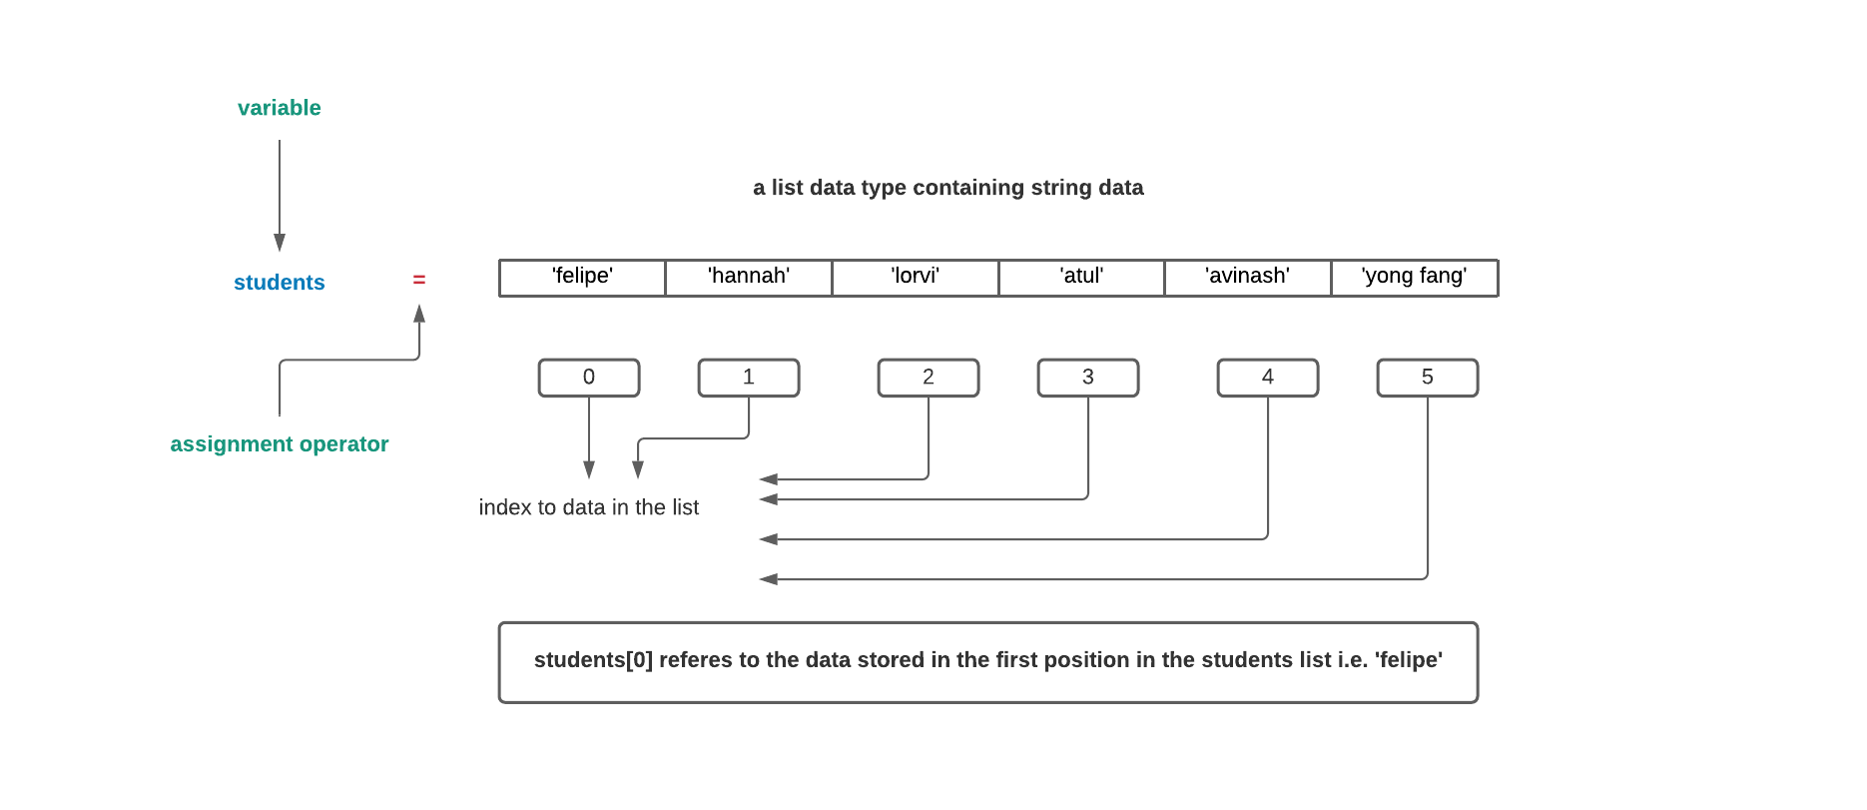
Python Lists

Slide 5
Python Lists
List items are enclosed in square brackets, like this [item1, item2, item3].
Lists are ordered i.e. the items in the list appear in a specific order, meaning if you add new items to a list, the new items will be placed at the end of the list.
Lists are mutable, which means we can add or remove items.
List elements do not need to be unique. Item duplication is possible, as each element has its own distinct indexed location in the list.
Elements can be of different data types, which means that you can combine strings, integers, and objects in the same list.

Slide 6
Python Arrays
Like lists, an array is also a data structure that stores a collection of items. And like lists, arrays are:
ordered
Mutable i.e. can add or remove elements in the array
enclosed in square brackets
store non-unique items
Need to use the NumPy library to create arrays: https://numpy.org/
To use we use the ‘import’ keyword: import numpy as np
That is: use the numpy library and alias its name as np (so that the full label numpy is not typed out every time)

Slide 7
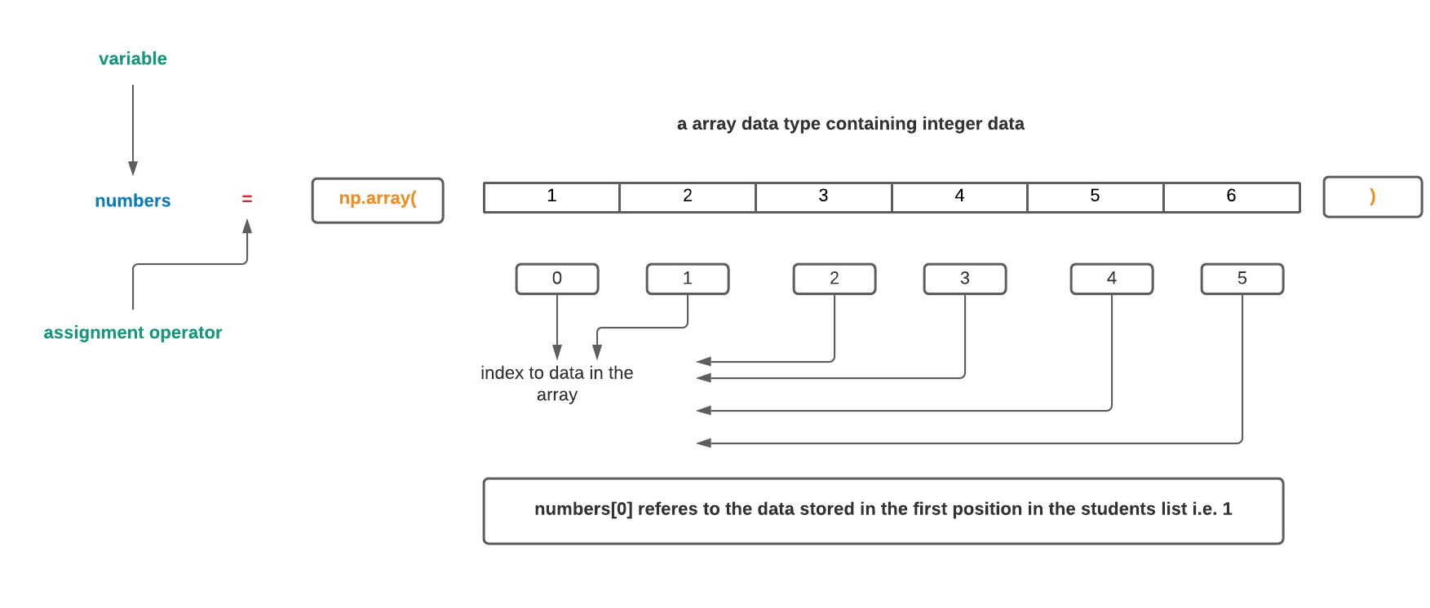
Python Arrays

Slide 8
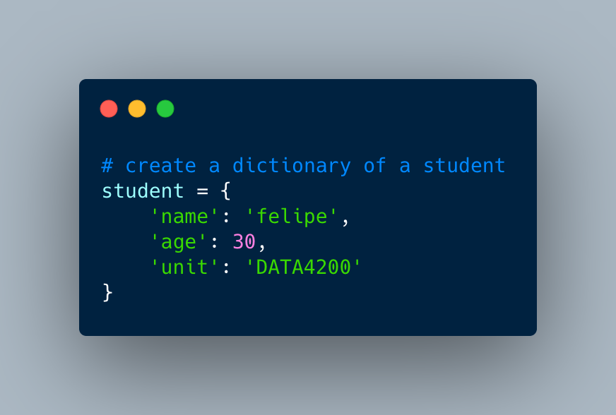
Python Dictionary Data Type
Variable: student
Keys: ‘name’, ‘age’, ‘unit’
Values: ‘felipe’, 30, ‘DATA4200’

