Slide 1
Music Analytics with Spotify - Introduction
Intermediate Graph Database Programming for Business Analytics 2021

Slide 2

Storing Data in Graph DBMS (Neo4j)
Part A: The Music Dataset

Slide 3

Spotify: Music For Generations 1920 - 2021
It is said that “Music defines the generations.”
We know intimately that, through music, we can:
Identify cultures. For example, we can say “Spanish Music”, “Indian Music”, “Chinese Music”, “Greek Music”, “Thai Music”, and so on
Identify an era: the 70s music, the 80s music (☺), 90s…and in doing so we can determine the artists, genres, hair styles, clothing etc…
Musical scores (symphony) is a significant part of bringing movies to life. For example, there is the infamous Jedi Theme:

Slide 4
Our Objectives
Perform Analytics:
Descriptive e.g. 50% of artists…
Predictive Analytics e.g. predict the mood (valence) of songs, predict the popularity of songs
Prescriptive Analytics: what song should be recommended?
Create recommendation engines:
Content-based filtering
Collaborative filtering
Recommend songs
Create a playlist recommendation

Slide 5
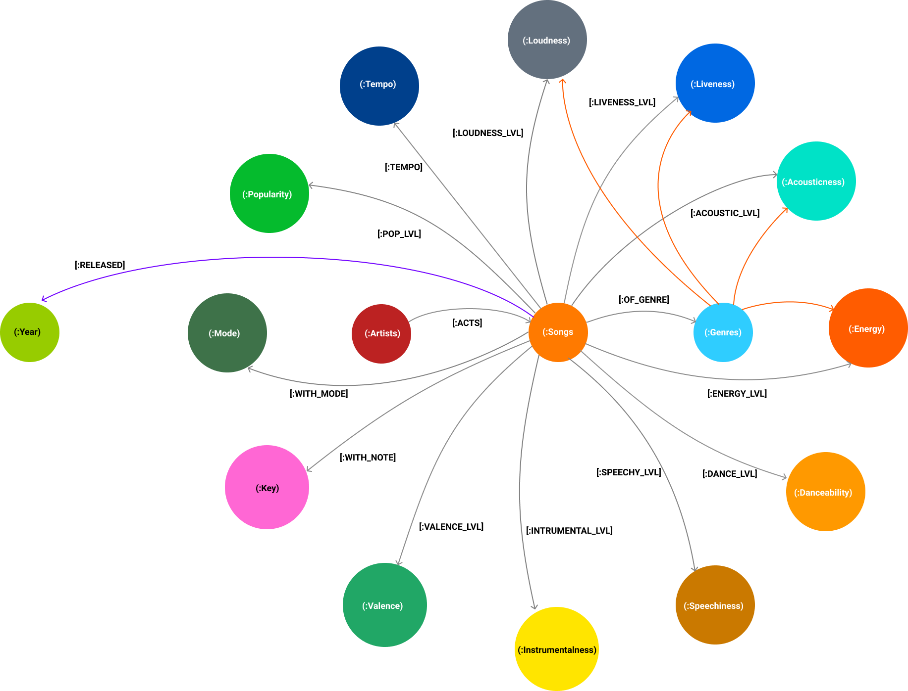

Slide 6
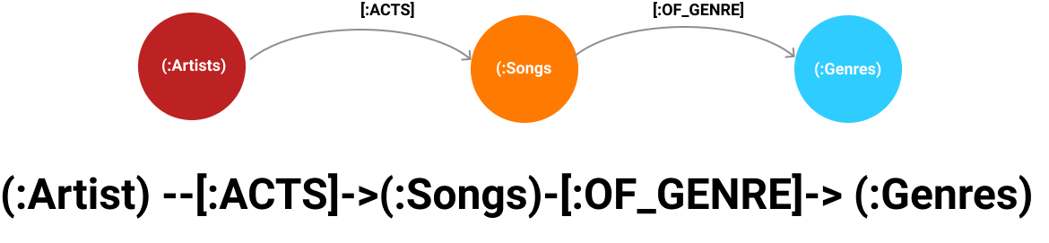
Graph Symbols & Languages

Slide 7

Model Assumptions
Songs and artists can be identified by their musical characteristics
These musical characteristics also identify the genres
Therefor, the year and decades must also be identifiable by these musical characteristics - by implication
These assumptions leads to diverse business questions

Slide 8
Business Questions
Identify an era (decade) through artists, songs and genres – what are the musical characteristics of that decade?
Create recommendations:
of songs based on certain musical characteristics e.g., moods (valence)
What determines popularity?
Are there specific combinations of the KEY Types?
KEY Types: Energy, Valence, Tempo, Acousticness, Liveness, Danceability, Loudness, Speechiness, Instrumentalness, Key, Mode?

Slide 9

Commercialization
Identify new talent
01
Predict if an budding artist will be the next superstar and the song the next hit song
Match the KEY characteristics for popularity – can it be done?
Predict if the song is “a fresh sound” that would become popular and that will “define” the artists
02
Recommend playlists, artists and songs to users based on:
03
Moods and other KEY Types
Related and “serendipitous” genres
Use musical behaviour and moods to recommend parallel products and services
04

Slide 10
Commercialization
Organise
Organise playlists based on moods and genres
Find
Find social communities with similar musical interests – what are the general moods?
Promote up and coming
Promote up and coming artists – ranked recommendations
Find
Find key trends in listening behaviour
Create
Create effective digital marketing campaigns for social communities for artists and record labels

Slide 11
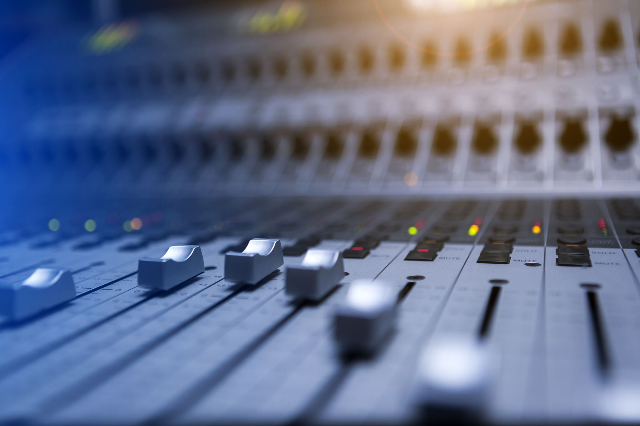
Descriptive Analytics
How many: songs, genres, artists?
The number of artists and songs for each genre?
What is the average number of genre per each artist?
The number of genres per decade?
The most popular artists, songs and genres of each year;
the overall for each decade
Calculate average values for each KEY Types

Slide 12
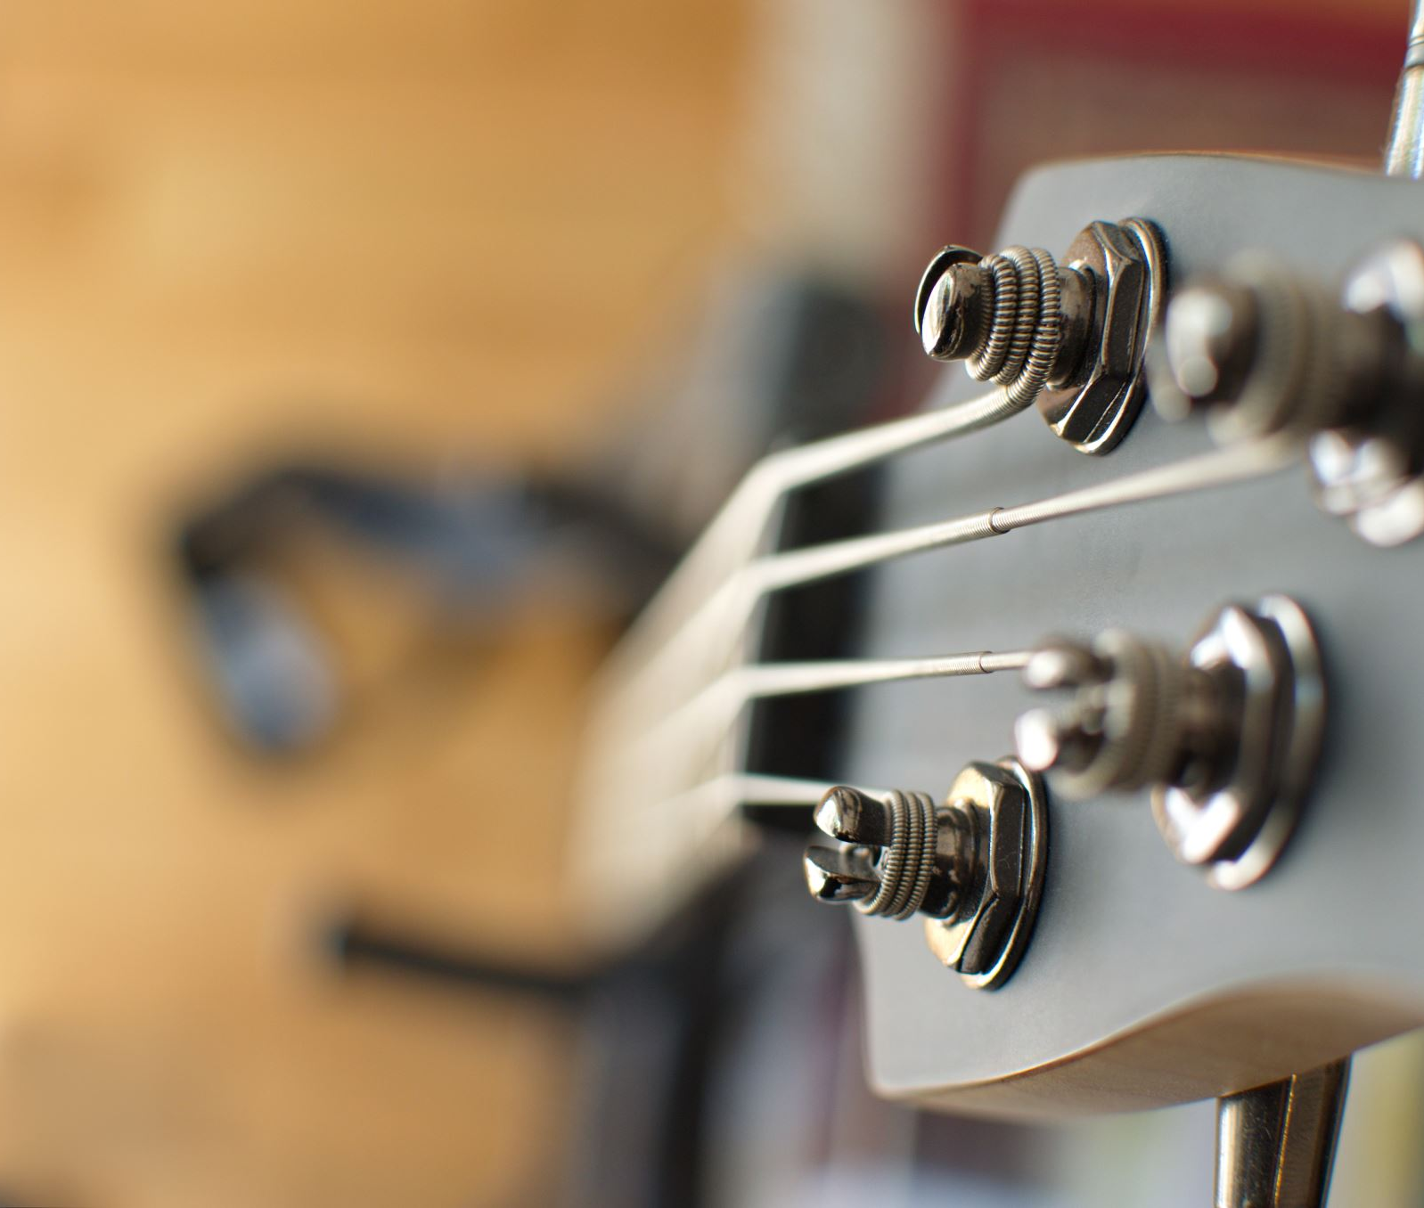
Descriptive Analytics
Identify artists with genres; count
How many songs for each artists?
Are there one-hit wonders?
Do artists belong to more that one genre?
Are they more popular?
How many KEY Types do genres have? Average?
What are the most popular genre per year? Decade?
What are the similarities and differences?

Slide 13
Predict if a song will be popular based on combinations of KEY Types (e.g., energy, valence, loudness and so on…)
What label should be given to the 2020s?
What kind of genres will be popular?
Who will be the successful artists?
What are the key trends?
Predictive Analytics

Slide 14
What are the artists, songs and genre recommendations given user listening behaviours and moods?
Recommend playlists based on:
Moods
Past listening behaviours
Predict the mood given the songs listened
Prescriptive Analytics

Slide 15
What are the artists, songs and genre recommendations given user listening behaviours and moods?
Recommend playlists based on:
Moods
Past listening behaviours
Predict the mood given the songs listened
Prescriptive Analytics

Slide 16
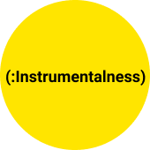

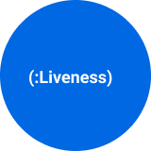
MUSICAL METRICS
instrumentalness
Predicts whether a track contains no vocals. “Ooh” and “aah” sounds are treated as instrumental in this context. Rap or spoken word tracks are clearly “vocal”.
The closer the instrumentalness value is to 1.0, the greater likelihood the track contains no vocal content.
Values above 0.5 are intended to represent instrumental tracks, but confidence is higher as the value approaches 1.0. Float data type.
key
The key the track is in. Integers map to pitches using standard Pitch Class notation . E.g. 0 = C, 1 = C♯/D♭, 2 = D, and so on. Integer data type but will be mapped to musical notes (string data type).
liveness
Detects the presence of an audience in the recording.
Higher liveness values represent an increased probability that the track was performed live.
A value above 0.8 provides strong likelihood that the track is live. Float data type.

Slide 17
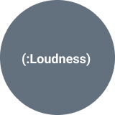
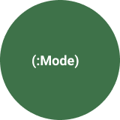
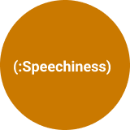
MUSICAL METRICS
loudness
The overall loudness of a track in decibels (dB). Loudness values are averaged across the entire track and are useful for comparing relative loudness of tracks. Loudness is the quality of a sound that is the primary psychological correlate of physical strength (amplitude). Values typical range between -60 and 0 db. Float data type.
mode
Mode indicates the modality (major or minor) of a track, the type of scale from which its melodic content is derived. Major is represented by 1 and minor is 0. Integer data type.
speechiness
Speechiness detects the presence of spoken words in a track.
The more exclusively speech-like the recording (e.g. talk show, audio book, poetry),
the closer to 1.0 the attribute value. Values above 0.66 describe tracks that are probably made entirely of spoken words.
Values between 0.33 and 0.66 describe tracks that may contain both music and speech, either in sections or layered, including such cases as rap music.
Values below 0.33 most likely represent music and other non-speech-like tracks. Float data type.

Slide 18
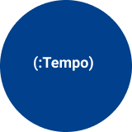

MUSICAL METRICS
tempo
The overall estimated tempo of a track in beats per minute (BPM). In musical terminology, tempo is the speed or pace of a given piece and derives directly from the average beat duration. Float data type.
valence
A measure from 0.0 to 1.0 describing the musical positiveness conveyed by a track.
Tracks with high valence sound more positive (e.g., happy, cheerful, euphoric),
while tracks with low valence sound more negative (e.g., sad, depressed, angry).

Slide 19

MUSICAL METRICS
time_signature
An estimated overall time signature of a track. The time signature (meter) is a notational convention to specify how many beats are in each bar (or measure). Integer data type.
track_href
A link to the Web API endpoint providing full details of the track. String
type
The object type: “audio_features” String
uri
The Spotify URI for the track. String

Slide 20
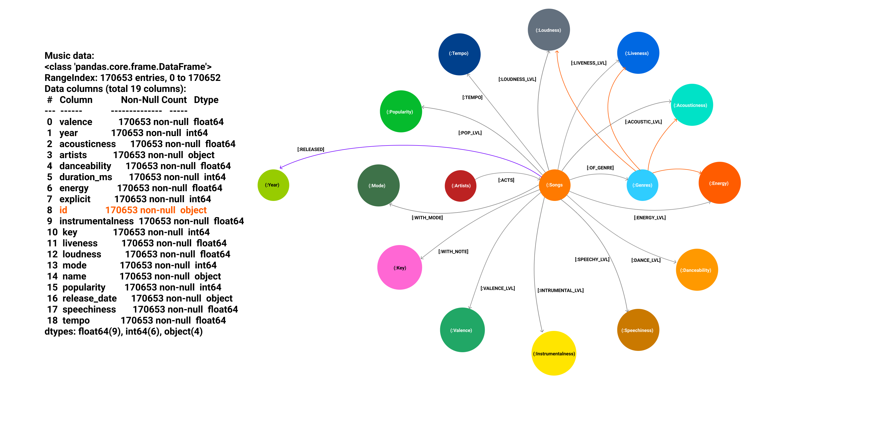
Data Modelling

Slide 21
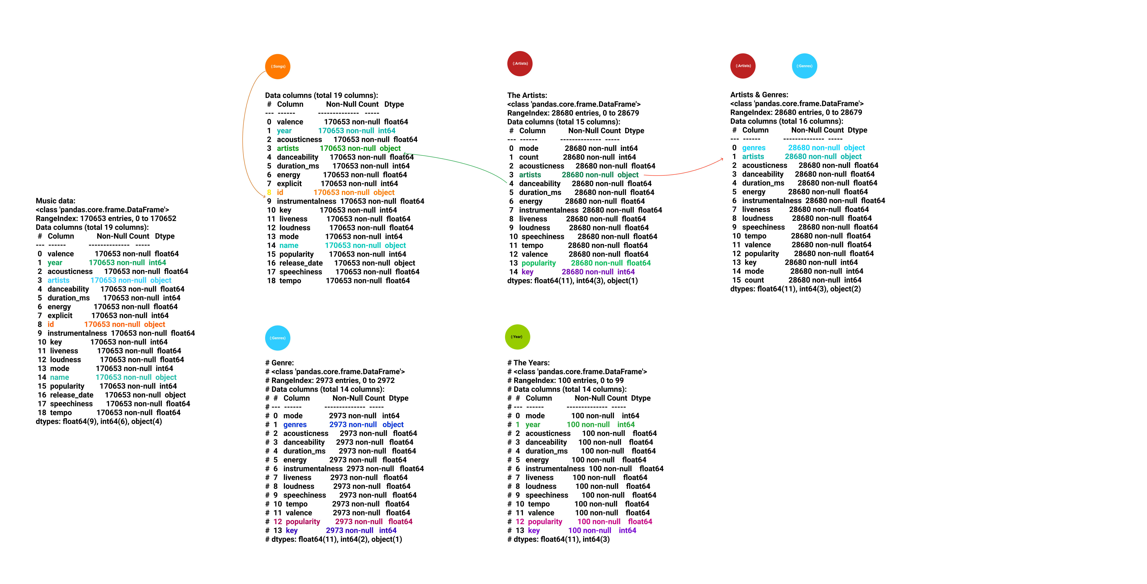

Slide 22
Storing Data in Graph DBMS (Neo4j)
Next: Part B - Data Storage

