Slide 1
[Confidential - Distribution with NDA]
AMD CSP & Tier-1 FAE · Customer brief · 2026-05-24
Ruby on Rails on AWS EPYC Turin
How m8a.metal-24xl, m8a.2xlarge, and c8a.2xlarge compare
when running production Puma — what to buy and why
22,992
4.5 %
70%+
EPYC 9R45
Peak RPS / 1-CCD
C8A price-perf win
Frontend bound — Zen5 wide fetch wins
Turin · same silicon, all 3 shapes
1 / 13 | 8TH GEN AMD EC2 | Rails Puma benchmark | Released under NDA
AMD

Slide 2
[Confidential - Distribution with NDA]
PART 1 · THE INSTANCES
What VMs are we comparing?
Three AWS shapes, one silicon — AMD EPYC 9R45 Zen5 Turin.
m8a.metal-24xl
m8a.2xlarge
• 96 vCPU / 384 GiB DDR5 / full P0 socket
• 8 vCPU / 32 GiB / 1 CCD slice (4 GiB per vCPU)
• $4.661 / hr on-demand (us-west-2)
• $0.4334 / hr on-demand
• Bare-metal — no hypervisor, no shared tenants
• General-purpose — Rails default tier
• Reference ceiling for all cloud shapes
• Headroom for AR caches, JSON buffers, sessions
c8a.2xlarge
Why this matrix?
• 8 vCPU / 16 GiB / 1 CCD slice (2 GiB per vCPU)
• Quantify silicon vs cloud overhead (bare vs cloud)
• $0.3888 / hr on-demand (10.3% cheaper)
• Compare general-purpose vs compute-opt at fixed core count
• Compute-optimized — same cores, half memory
• Show the memory-ratio trade-off (1:4 vs 1:2 GiB/core)
• Best for lightweight microservices, ingress
• Build a defensible price-performance story
2 / 13 | 8TH GEN AMD EC2 | Rails Puma benchmark | Released under NDA
AMD

Slide 3
[Confidential - Distribution with NDA]
[Confidential - Distribution with NDA]
__m8a.metal-24xl
96 vCPUs / 96 cores / Full P0 socket — 12 CCDs / 96 cores / 384 GiB DDR5
P0
INSTANCE
MEMORY
Name
m8a.metal-24xl
Total
384 GiB
Z5
L 3
Z5
Z5
L 3
Z5
Z5
L 3
Z5
Z5
L 3
Z5
Z5
L 3
Z5
Z5
L 3
Z5
CSP gen
AWS 8th gen
Per vCPU
4 GiB
Z5
Z5
Z5
Z5
Z5
Z5
Z5
Z5
Z5
Z5
Z5
Z5
AMD gen
Zen 5 / Turin
Type
DDR5-6000
Z5
Z5
Z5
Z5
Z5
Z5
Z5
Z5
Z5
Z5
Z5
Z5
Sockets
1 (P0)
NETWORK
Z5
Z5
Z5
Z5
Z5
Z5
Z5
Z5
Z5
Z5
Z5
Z5
CPU
Perf
50 Gbps
GMI 4
GMI 4
GMI 4
GMI 4
GMI 4
GMI 4
Processor
AMD EPYC 9R45
ENIs
15 (50 IPs)
MEMORY / IO DIE
Boost
up to 4.5 GHz
STORAGE
vCPUs
96
SMT
off
Local
EBS-only (gp3/io2)
EBS BW
40 Gbps
EBS Tput
5,000 MB/s
EBS IOPS
120,000
GMI 4
GMI 4
GMI 4
GMI 4
GMI 4
GMI 4
Z5
L 3
Z5
Z5
L 3
Z5
Z5
L 3
Z5
Z5
L 3
Z5
Z5
L 3
Z5
Z5
L 3
Z5
Z5
Z5
Z5
Z5
Z5
Z5
Z5
Z5
Z5
Z5
Z5
Z5
Z5
Z5
Z5
Z5
Z5
Z5
Z5
Z5
Z5
Z5
Z5
Z5
Z5
Z5
Z5
Z5
Z5
Z5
Z5
Z5
Z5
Z5
Z5
Z5
AMD
1 | 8TH GEN AMD EC2 | RELEASED TO AWS UNDER NDA
AMD
3 / 13 | 8TH GEN AMD EC2 | Rails Puma benchmark | Released under NDA

Slide 4
[Confidential - Distribution with NDA]
[Confidential - Distribution with NDA]
__m8a.2xlarge
8 vCPUs / 8 cores / 1 CCD on P0 (1 of 24 on host) — 4 GiB/vCPU general-purpose
P0
INSTANCE
MEMORY
Name
m8a.2xlarge
Total
32 GiB
Z5
L 3
Z5
Z5
L 3
Z5
Z5
L 3
Z5
Z5
L 3
Z5
Z5
L 3
Z5
Z5
L 3
Z5
CSP gen
AWS 8th gen
Per vCPU
4 GiB
Z5
Z5
Z5
Z5
Z5
Z5
Z5
Z5
Z5
Z5
Z5
Z5
AMD gen
Zen 5 / Turin
Type
DDR5-6000
Z5
Z5
Z5
Z5
Z5
Z5
Z5
Z5
Z5
Z5
Z5
Z5
Sockets
1 (P0)
NETWORK
Z5
Z5
Z5
Z5
Z5
Z5
Z5
Z5
Z5
Z5
Z5
Z5
CPU
Perf
up to 15 Gbps
GMI 4
GMI 4
GMI 4
GMI 4
GMI 4
GMI 4
Processor
AMD EPYC 9R45
ENIs
4 (15 IPs)
MEMORY / IO DIE
Boost
up to 4.5 GHz
STORAGE
vCPUs
8
SMT
off
Local
EBS-only (SSD)
EBS BW
10 Gbps
EBS Tput
1,250 MB/s
EBS IOPS
40,000
GMI 4
GMI 4
GMI 4
GMI 4
GMI 4
GMI 4
Z5
L 3
Z5
Z5
L 3
Z5
Z5
L 3
Z5
Z5
L 3
Z5
Z5
L 3
Z5
Z5
L 3
Z5
Z5
Z5
Z5
Z5
Z5
Z5
Z5
Z5
Z5
Z5
Z5
Z5
Z5
Z5
Z5
Z5
Z5
Z5
Z5
Z5
Z5
Z5
Z5
Z5
Z5
Z5
Z5
Z5
Z5
Z5
Z5
Z5
Z5
Z5
Z5
Z5
AMD
1 | 8TH GEN AMD EC2 | RELEASED TO AWS UNDER NDA
AMD
4 / 13 | 8TH GEN AMD EC2 | Rails Puma benchmark | Released under NDA

Slide 5
[Confidential - Distribution with NDA]
[Confidential - Distribution with NDA]
__c8a.2xlarge
8 vCPUs / 8 cores / 1 CCD on P0 (1 of 24 on host) — 2 GiB/vCPU compute-optimized
P0
INSTANCE
MEMORY
Name
c8a.2xlarge
Total
16 GiB
Z5
L 3
Z5
Z5
L 3
Z5
Z5
L 3
Z5
Z5
L 3
Z5
Z5
L 3
Z5
Z5
L 3
Z5
CSP gen
AWS 8th gen
Per vCPU
2 GiB
Z5
Z5
Z5
Z5
Z5
Z5
Z5
Z5
Z5
Z5
Z5
Z5
AMD gen
Zen 5 / Turin
Type
DDR5-6000
Z5
Z5
Z5
Z5
Z5
Z5
Z5
Z5
Z5
Z5
Z5
Z5
Sockets
1 (P0)
NETWORK
Z5
Z5
Z5
Z5
Z5
Z5
Z5
Z5
Z5
Z5
Z5
Z5
CPU
Perf
up to 15 Gbps
GMI 4
GMI 4
GMI 4
GMI 4
GMI 4
GMI 4
Processor
AMD EPYC 9R45
ENIs
4 (15 IPs)
MEMORY / IO DIE
Boost
up to 4.5 GHz
STORAGE
vCPUs
8
SMT
off
Local
EBS-only (SSD)
EBS BW
10 Gbps
EBS Tput
1,250 MB/s
EBS IOPS
40,000
GMI 4
GMI 4
GMI 4
GMI 4
GMI 4
GMI 4
Z5
L 3
Z5
Z5
L 3
Z5
Z5
L 3
Z5
Z5
L 3
Z5
Z5
L 3
Z5
Z5
L 3
Z5
Z5
Z5
Z5
Z5
Z5
Z5
Z5
Z5
Z5
Z5
Z5
Z5
Z5
Z5
Z5
Z5
Z5
Z5
Z5
Z5
Z5
Z5
Z5
Z5
Z5
Z5
Z5
Z5
Z5
Z5
Z5
Z5
Z5
Z5
Z5
Z5
AMD
1 | 8TH GEN AMD EC2 | RELEASED TO AWS UNDER NDA
AMD
5 / 13 | 8TH GEN AMD EC2 | Rails Puma benchmark | Released under NDA

Slide 6
[Confidential - Distribution with NDA]
PART 2 · THE METHODOLOGY
What test did we run?
Identical recipe across all three shapes — only the cloud topology varies.
Workload
Geometry (same on all 3)
• Rails 8.1.3 Hello World controller — plain text response
• Puma pinned to cores 0-6 via taskset
• Puma 8 cluster: 7 workers × 1 thread (no GVL stall)
• wrk client pinned to core 7 — same CCD, loopback
• Ruby 3.3.11 + YJIT (just-in-time native code)
• 30 s steady-state at c = 50 / 100 / 200 / 400
• jemalloc preloaded, MALLOC_ARENA_MAX = 2
• 5 s warmup discarded before each step
Measurement
Reproducibility
• RPS + p50 / p99 latency via wrk --latency
• One self-contained setup_rails_bench.sh — apt deps,
• PMC matrix via perf stat -j on cores 0-6, 30 s window
• rbenv + Ruby compile, Bundler, Rails, wrk, sanity check
• AMD Zen5 TopDown events (6-slot dispatch model)
• Idempotent: re-runs detect existing installs
• Effective freq, IPC, FE/BE bound %, branch misp rate
• Tested on fresh Ubuntu 24.04 AMI on all 3 shapes
6 / 13 | 8TH GEN AMD EC2 | Rails Puma benchmark | Released under NDA
AMD

Slide 7
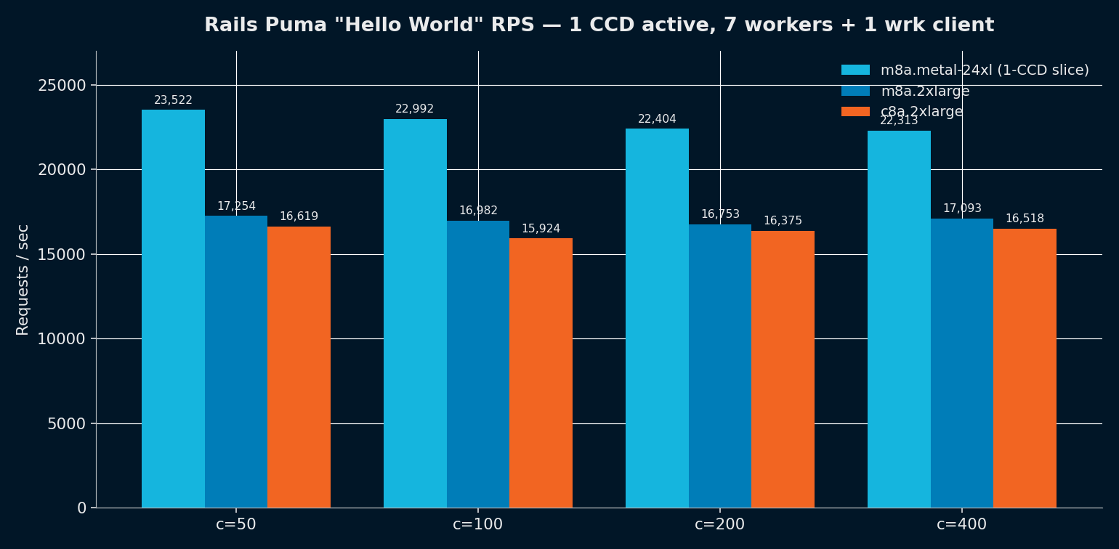
[Confidential - Distribution with NDA]
PART 3 · THE RESULTS
Throughput — bare metal beats cloud by ~30 %
Same 7 Puma workers + 1 wrk client on every shape. 1 CCD active.
KEY TAKEAWAYS
• Bare-metal 24xl 1-CCD peaks at 23,522 RPS
• M8A.2xl and C8A.2xl land at 17k and 16.6k
• 30% gap = Nitro shared-tenant tax, not silicon
• C8A is only 6 % below M8A despite half the RAM
• Latency knee clearly at c=100 — production sizing point
7 / 13 | 8TH GEN AMD EC2 | Rails Puma benchmark | Released under NDA
AMD

Slide 8
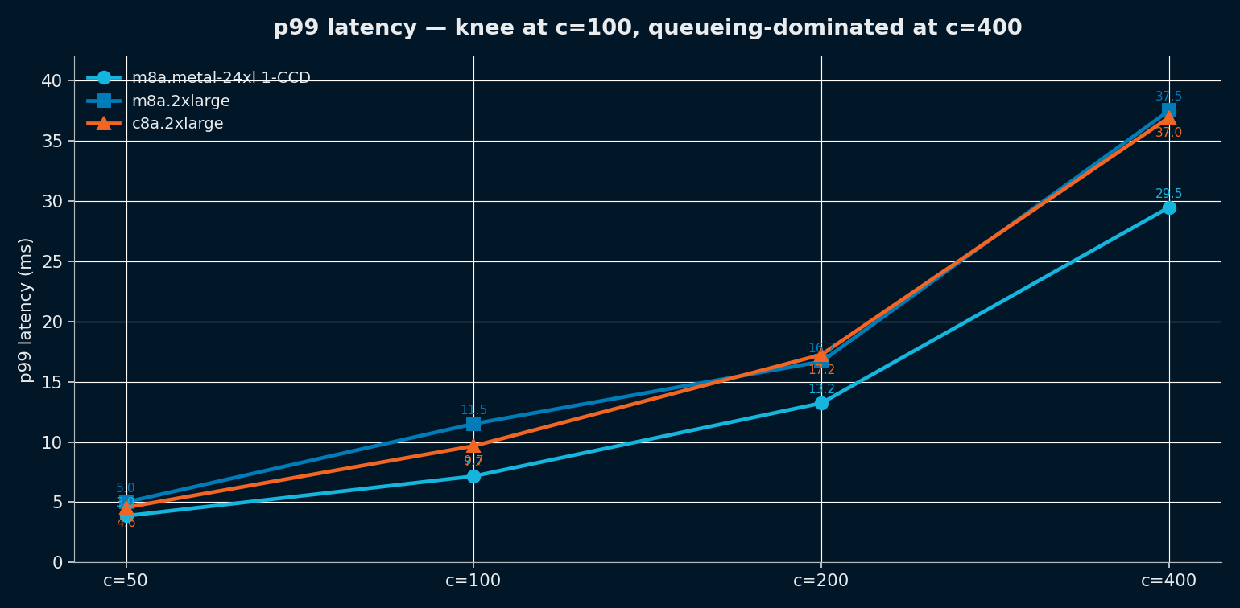
[Confidential - Distribution with NDA]
PART 3 · THE RESULTS
Tail latency — same shape across all three
p99 ms as concurrency climbs. Queueing dominates at c=400.
KEY TAKEAWAYS
• Bare-metal is fastest at every load level
• Cloud shapes are within 1.5 ms of each other
• Size for c=100 to stay under 12 ms p99
• Beyond c=200 queueing eats the gain
• Use 60-65 % steady-state utilization headroom
8 / 13 | 8TH GEN AMD EC2 | Rails Puma benchmark | Released under NDA
AMD

Slide 9
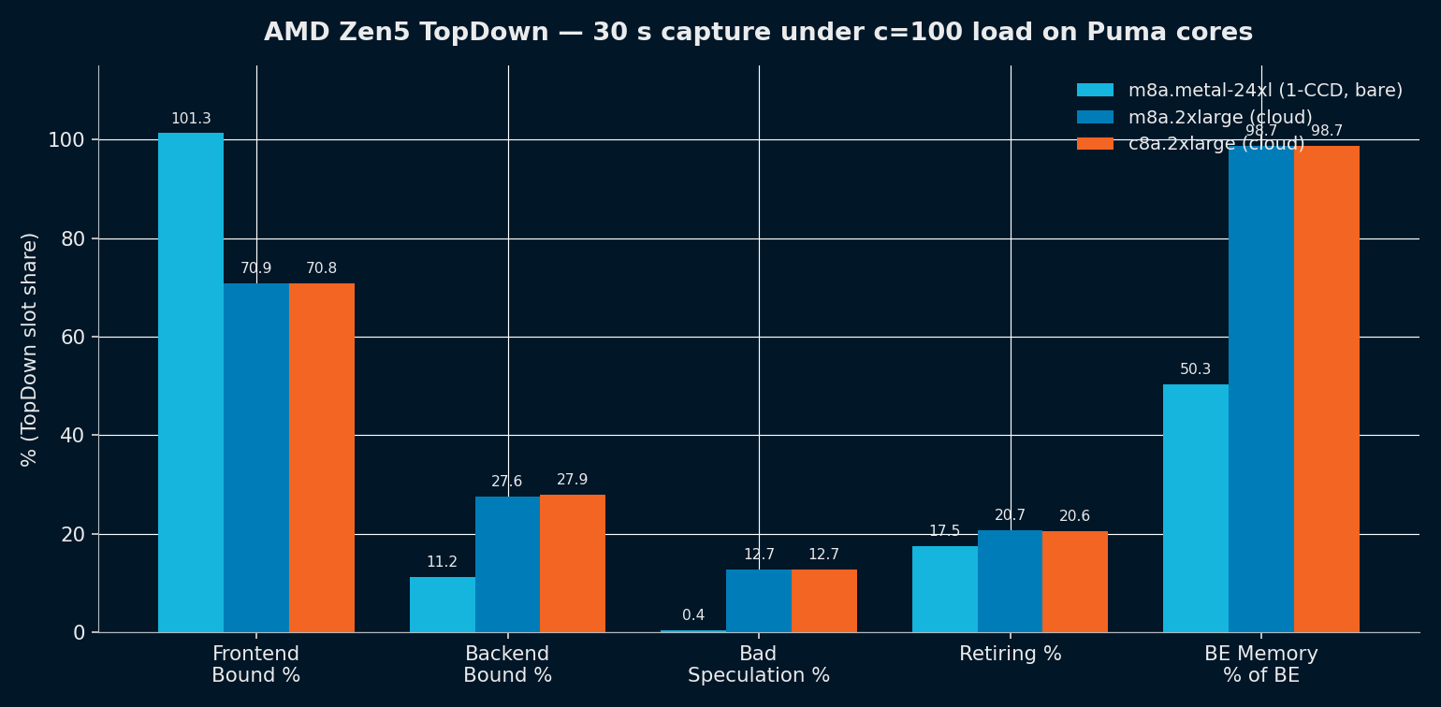
[Confidential - Distribution with NDA]
PART 4 · WHAT THE PMCs TELL US
M8A and C8A are microarchitecturally identical
AMD Zen5 TopDown — every category within 1 %. Only freq differs.
KEY TAKEAWAYS
• Cloud shapes show 70%+ Frontend Bound
• Same Backend, same Bad Spec, same BE-Memory %
• L2 hit rate matches within 0.6 pts
• Hardware is the same EPYC 9R45 die
• Performance delta = freq + neighbor contention
9 / 13 | 8TH GEN AMD EC2 | Rails Puma benchmark | Released under NDA
AMD

Slide 10
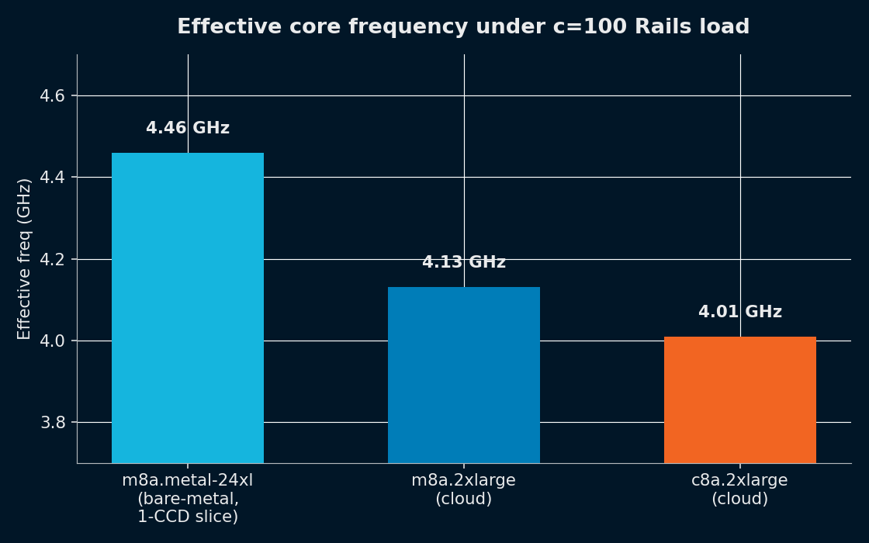
[Confidential - Distribution with NDA]
PART 4 · WHAT THE PMCs TELL US
Frequency — the only material microarch difference
Bare-metal holds 4.46 GHz; cloud shapes settle around 4.0-4.13 GHz.
KEY TAKEAWAYS
• Bare metal: 4.46 GHz under sustained Rails load
• M8A.2xl: 4.13 GHz (-7 %) — Nitro interrupt overhead
• C8A.2xl: 4.01 GHz (-10 %) — same silicon, different SKU profile
• Freq accounts for ~half of the cloud throughput loss
• The other half is DRAM contention from neighbors
10 / 13 | 8TH GEN AMD EC2 | Rails Puma benchmark | Released under NDA
AMD

Slide 11
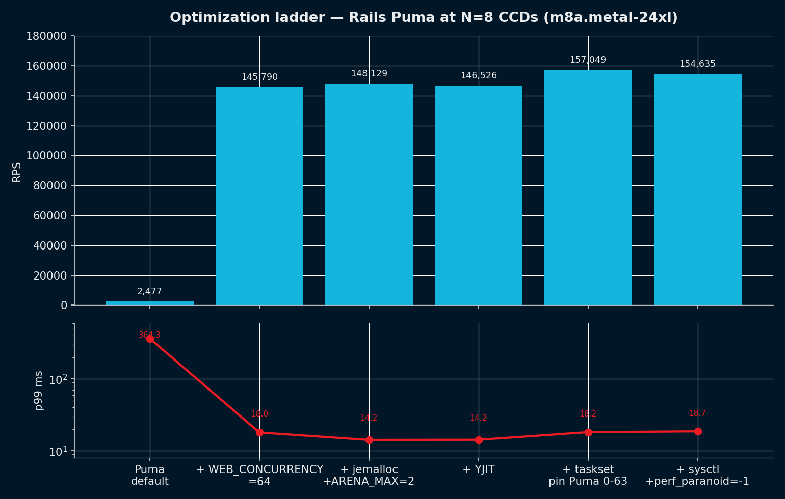
[Confidential - Distribution with NDA]
PART 5 · WHAT OPTIMIZATIONS HELPED
One knob dominated — match workers to cores
WEB_CONCURRENCY=N (cores) gave us 58.9× over Puma defaults.
KEY TAKEAWAYS
• Puma default = 5 workers — catastrophic at 96 cores
• Right WEB_CONCURRENCY: 2.5k → 145k RPS (58.9x)
• jemalloc + ARENA_MAX=2: +1.6 % (memory steady-state)
• YJIT: noise on Hello World — material on real apps
• taskset pinning: +7.2 % — keeps wrk off Puma cores
• sysctl tweaks: noise at this scale
11 / 13 | 8TH GEN AMD EC2 | Rails Puma benchmark | Released under NDA
AMD

Slide 12
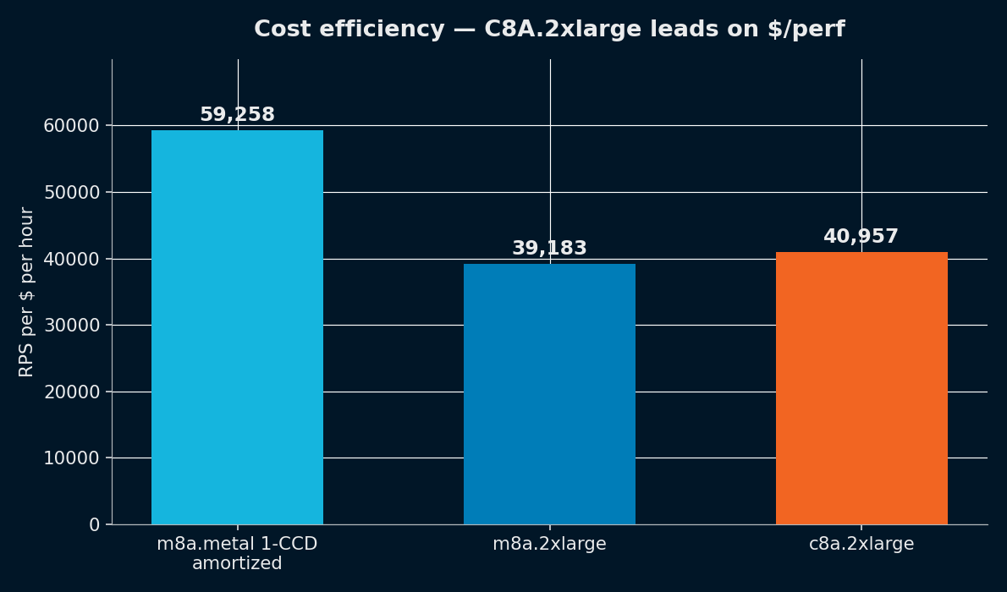
[Confidential - Distribution with NDA]
PART 6 · WHAT TO BUY
Price / performance — C8A.2xl wins on $/RPS
C8A gives up 6 % RPS for 10 % cheaper hourly — net +4.5 % $/perf.
KEY TAKEAWAYS
• M8A.2xl: 39,180 RPS per $/hr (4 GiB/vCPU)
• C8A.2xl: 40,957 RPS per $/hr (2 GiB/vCPU)
• Bare-metal amortized 1-CCD: 59,194 RPS per $/hr
• Choose C8A only when working set fits in 2 GiB/core
• Choose M8A for heavy Rails (AR cache, JSON buffers)
12 / 13 | 8TH GEN AMD EC2 | Rails Puma benchmark | Released under NDA
AMD

Slide 13
[Confidential - Distribution with NDA]
RECOMMENDATION
What to deploy and why
Match the shape to the workload memory profile and SLO.
Default tier — Rails APIs, web services
Cost-optimized tier — light microservices, proxies
• m8a.2xlarge (4 GiB/vCPU)
• c8a.2xlarge (2 GiB/vCPU)
• Plenty of headroom for AR caches, JSON, sessions
• +4.5 % price-perf vs M8A on this workload
• Within 6 % of C8A on $/perf, lower OOM risk
• Validate with production memory profile first
Reference for sizing
Next experiments
• m8a.metal-24xl bare-metal sets the ceiling
• Re-bench with real Rails app (AR + JSON workload)
• Cloud 2xl shapes lose ~30 % to Nitro tax
• Quantify V-Cache benefit on AR-heavy traffic
• Plan capacity at c=100, 60-65 % steady-state util
• Validate memory ceiling on C8A under prod load
13 / 13 | 8TH GEN AMD EC2 | Rails Puma benchmark | Released under NDA
AMD

