Slide 1
Transparent Huge Pages
One setting. Measurable savings.
AMD EPYC 9R45 (Turin) · AWS M8a · OpenJDK 21

Slide 2
Your fleet is paying for idle CPU cycles
THE OPPORTUNITY
The symptom — JVM nodes appear CPU-bound, but throughput is flat. Root cause: page-table walk overhead from 4 KB pages exhausting the dTLB.
The fix — Enable Transparent Huge Pages (THP=always). Pages grow from 4 KB to 2 MB. dTLB reach expands 512×. Page-table walker fires 33–107× less often.
The cost — One sysctl command. No code changes. No redeployment. No downtime.
The evidence — Measured on real AMD EPYC hardware with hardware PMC counters (ls_l1_d_tlb_miss.all_l2_miss) under identical workloads.

Slide 3
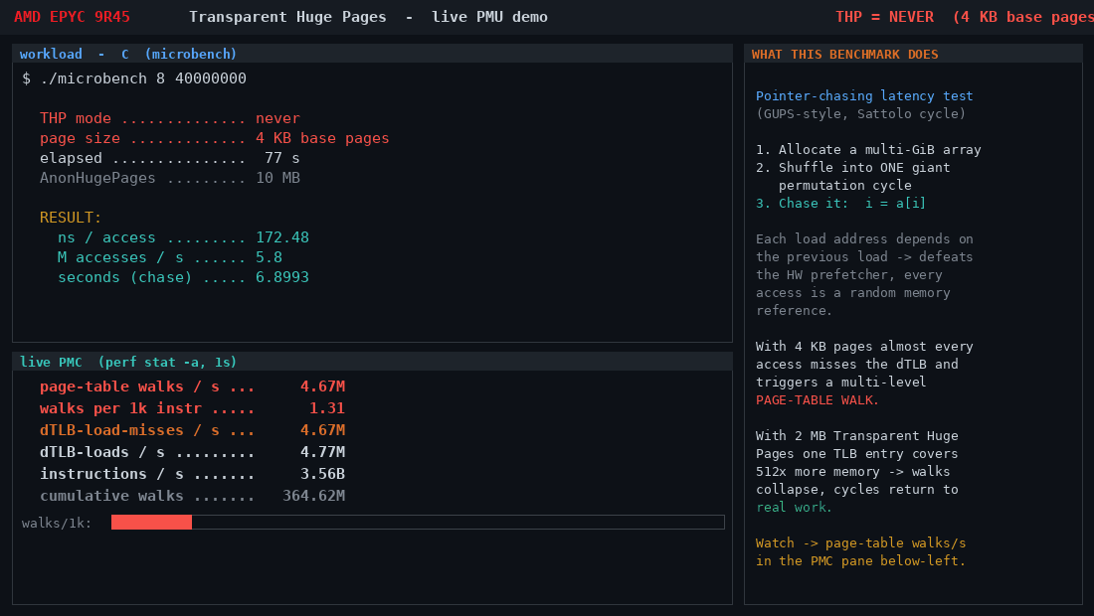
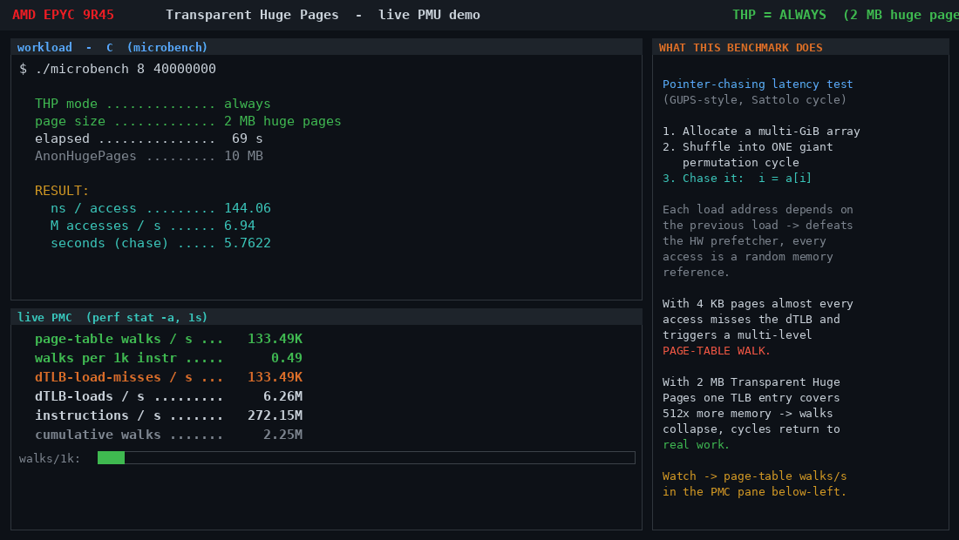
C microbench: before and after
LIVE HARDWARE EVIDENCE · AMD EPYC 9R45
THP = NEVER (4 KB pages) · 172 ns/access · 5.9M walks/s
THP = ALWAYS (2 MB pages) · 144 ns/access · 55K walks/s
▲ 16.5% faster · 107× fewer page-table walks

Slide 4
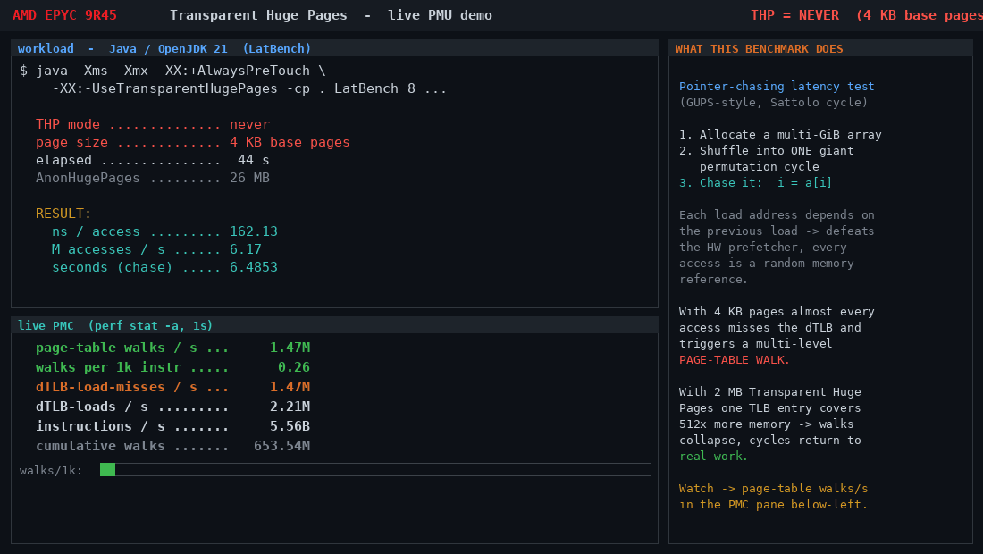
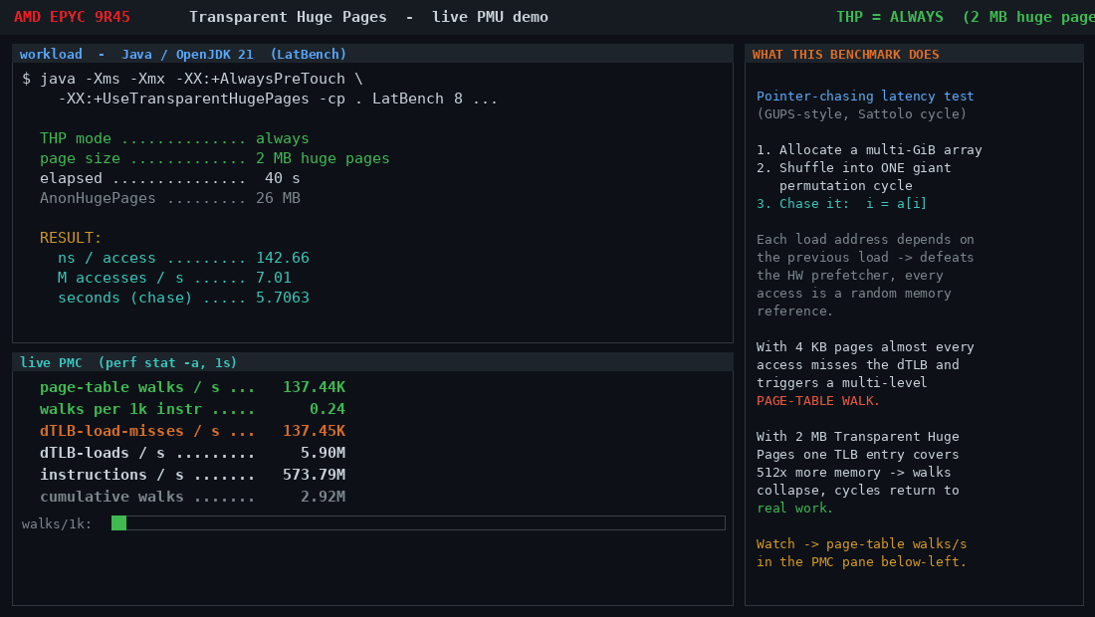
JVM workload: before and after
LIVE HARDWARE EVIDENCE · JAVA / OPENJDK 21
THP = NEVER (4 KB pages) · 162 ns/access · 1.47M walks/s
THP = ALWAYS (2 MB pages) · 143 ns/access · 44K walks/s
▲ 12% faster · 33× fewer walks · -XX:+UseTransparentHugePages optional (THP=always covers all JVM memory)

Slide 5
Measured on production-representative hardware
RESULTS SUMMARY
12%
16%
33×
107×
0
JVM latency reduction
C workload improvement
Fewer walks (Java)
Fewer walks (C)
Code changes required
162 → 143 ns/access
172 → 144 ns/access
1.47M → 44K/s
5.9M → 55K/s
One sysctl only
SAME WORKLOAD · SAME INSTANCE · SAME BINARY
Hardware: AMD EPYC 9R45 (Turin) · PMC: ls_l1_d_tlb_miss.all_l2_miss via perf stat -a

Slide 6
One setting recovers the equivalent of 1,200 instances per year
TCO IMPACT · 10,000-INSTANCE JVM FLEET
Based on 12% measured Java throughput gain. Same work handled by 12% fewer instances at zero additional cost.
Cloud | Instance | $/hr (OD) | Fleet Cost/yr | THP Savings/yr | Freed Instances
AWS | m8a.2xlarge | $0.4869 | $42,650,688 | $5,121,871 | 1,201
GCP | n2d-standard-8 | $0.3397 | $29,757,720 | $3,573,569 | 1,201
Azure | D8as_v5 | $0.3440 | $30,134,400 | $3,618,804 | 1,201
OCI | E5.Flex 8 OCPU | $0.4480 | $39,244,800 | $4,712,862 | 1,201
Prices: AWS Vantage instances.vantage.sh · Azure public API · GCP/OCI published list rates · Jun 2026

Slide 7
Enable THP in your fleet today
ACTION
# Step 1 — Enable now (runtime, takes effect immediately):
echo always | sudo tee /sys/kernel/mm/transparent_hugepage/enabled
echo always | sudo tee /sys/kernel/mm/transparent_hugepage/defrag
# Step 2 — Verify huge pages are being used:
grep AnonHugePages /proc/meminfo
# Should jump from ~26 MB to ~12,000 MB for a JVM workload
# Step 3 — Make persistent (add to /etc/rc.local or systemd unit):
echo 'echo always > /sys/kernel/mm/transparent_hugepage/enabled' >> /etc/rc.local
echo 'echo always > /sys/kernel/mm/transparent_hugepage/defrag' >> /etc/rc.local
# Step 4 — Validate with PMC (AMD Zen, requires sudo perf):
sudo perf stat -a -e ls_l1_d_tlb_miss.all_l2_miss,instructions -- sleep 10
# Expect: walks/s to drop 30–100× vs THP=never baseline
Repo: github.com/deepindeepsea/transparent-hugepages-demo | No code changes · No recompile · No procurement

