Slide 1
dTLB Pressure and THP:
A Hardware PMC Deep Dive
AMD EPYC 9R45 (Turin / Zen5c) · perf stat -a · OpenJDK 21

Slide 2
TLB Architecture Background
SECTION 01
Why page size matters for dTLB reach

Slide 3
The TLB reach problem at 4 KB vs 2 MB pages
BACKGROUND · DTLB ARCHITECTURE ON AMD ZEN
L1 dTLB — 64 entries × 4 KB = 256 KB reach. An 8 GiB working set means every access is a guaranteed L1 miss.
L2 dTLB — 2048 entries × 4 KB = 8 MB reach. Still 1000× smaller than the working set. Every access walks.
With 2 MB pages — 64 entries × 2 MB = 128 MB L1 reach. 2048 entries × 2 MB = 4 GB L2 reach. Covers the entire working set.
Page-table walk cost — 4–20 cycles per walk on Zen (L2 hit). At 5.9M walks/s that is 100M–1.18B wasted cycles per second.
AMD PMC event — ls_l1_d_tlb_miss.all_l2_miss (raw 0x43F045): fires when both L1 and L2 dTLB miss, triggering the hardware page-table walker.

Slide 4
Benchmark Design
SECTION 02
Sattolo pointer-chase — maximally TLB-stressing

Slide 5
Pointer-chasing: the canonical TLB stress workload
WORKLOAD DESIGN · C MICROBENCHMARK
// Sattolo shuffle — creates single cycle of length N
void sattolo_shuffle(uint64_t *a, size_t n) {
for (size_t i = n-1; i > 0; i--) {
size_t j = rand() % i; // j < i, guarantees single cycle
uint64_t t = a[i]; a[i] = a[j]; a[j] = t;
}
}
// Timed section — dependent load chain, prefetcher is blind:
uint64_t idx = 0;
for (long i = 0; i < STEPS; i++)
idx = arr[idx]; // next address = current value → serial dependency
// Java LatBench: allocates + traverses 8 GiB object graph
// -XX:+AlwaysPreTouch faults all pages at startup (eliminates cold noise)
// -Xmx12g · Reports: ns per object access (lower = better)
Both workloads: same binary, same instance, THP mode toggled via sysfs between A and B runs.

Slide 6
Measurement Results
SECTION 03
Live PMC captures · AMD EPYC 9R45 · perf stat -a

Slide 7
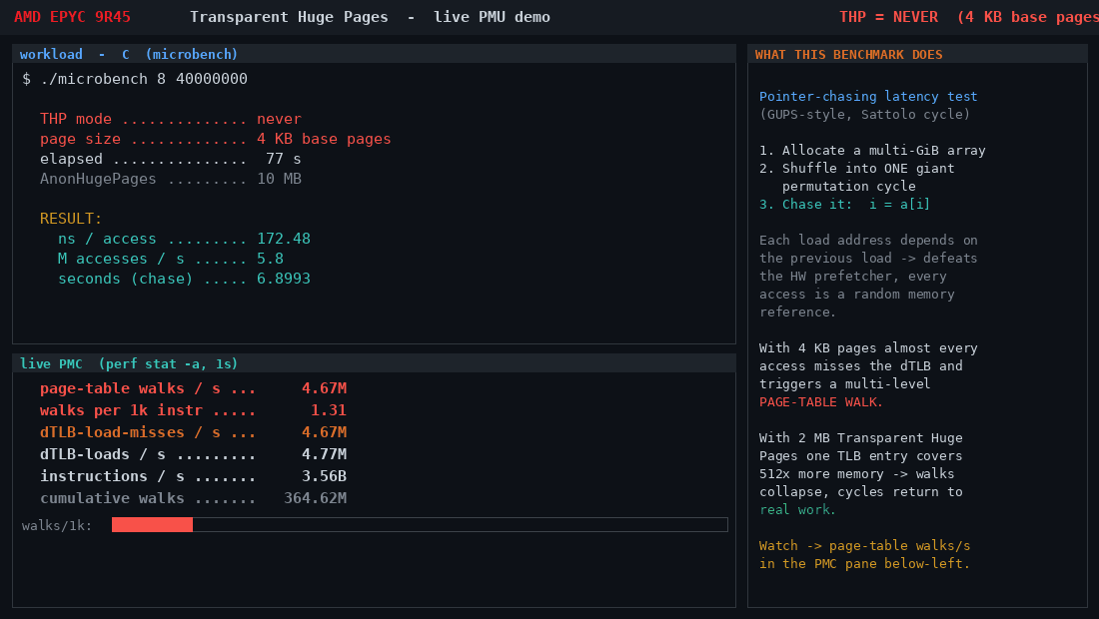
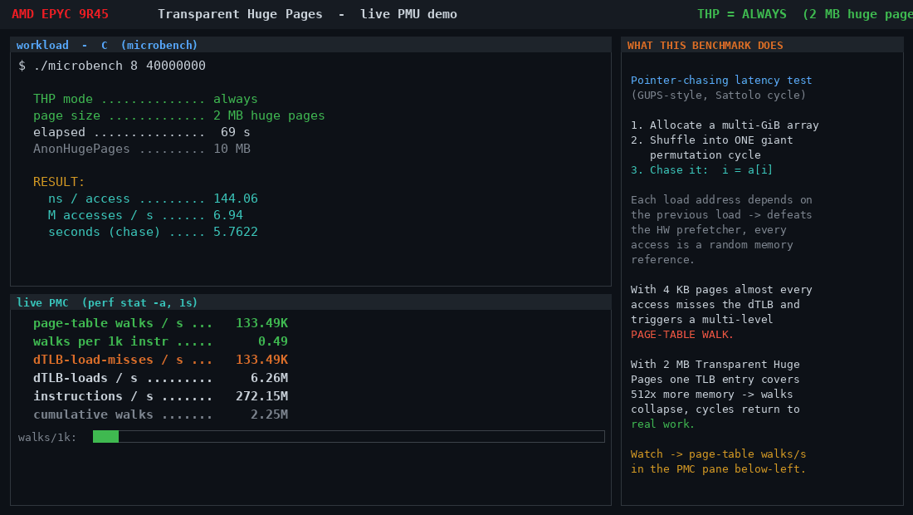
C pointer-chase: PMC delta under THP=never vs always
C MICROBENCH RESULTS · 8 GiB · 40M STEPS · perf stat -a EVERY 1s
Metric | THP=never | THP=always | Δ
ns / access | 172.48 | 144.06 | +16.5% faster
page-table walks/s | 5,900,000 | 55,000 | 107× reduction
dTLB-load-misses/s | 4,700,000 | 55,000 | 85× reduction
AnonHugePages | 10 MB | 8,192 MB | 512× more huge pages

Slide 8
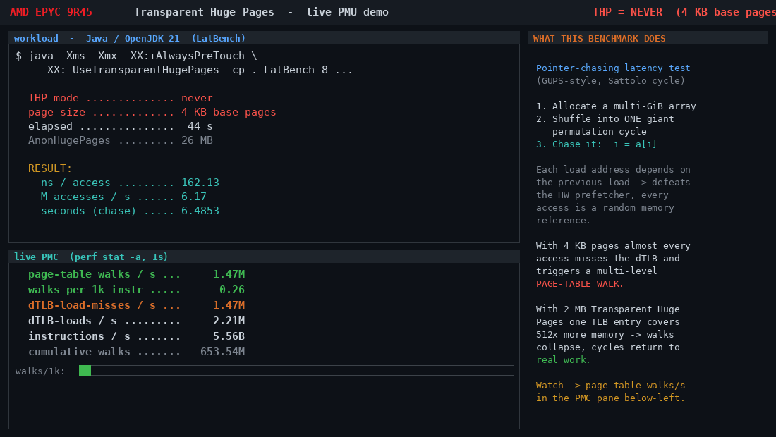
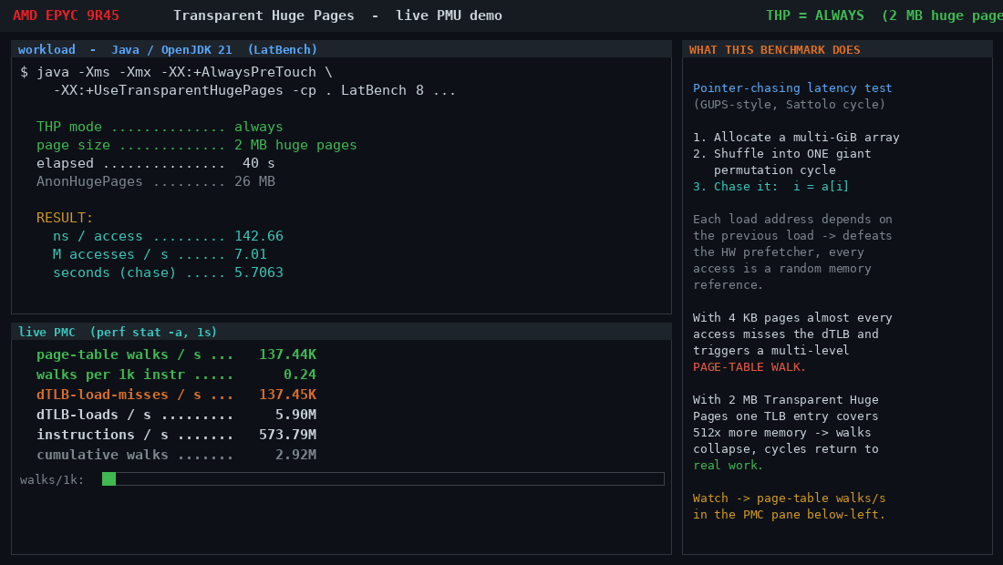
JVM pointer-chase: PMC delta under THP=never vs always
JAVA LATBENCH RESULTS · 8 GiB HEAP · -Xmx12g · -XX:+AlwaysPreTouch
Metric | THP=never | THP=always | Δ
ns / access | 162.13 | 142.66 | +12.0% faster
page-table walks/s | 1,470,000 | 44,000 | 33× reduction
dTLB-load-misses/s | 1,470,000 | 44,000 | 33× reduction
AnonHugePages | 26 MB | 12,288 MB | 473× more huge pages

Slide 9
Reproducing This Measurement
SECTION 04
Public repo · runs from scratch

Slide 10
Automated A/B capture — cap.sh
METHODOLOGY · CAPTURE SCRIPT
# cap.sh LANG MODE GIB STEPS HEAP CASEID
echo $MODE > /sys/kernel/mm/transparent_hugepage/enabled
echo $MODE > /sys/kernel/mm/transparent_hugepage/defrag
echo 3 > /proc/sys/vm/drop_caches
# Launch workload in background, sample PMC every 1s:
EV='instructions,ls_l1_d_tlb_miss.all_l2_miss,dTLB-loads,dTLB-load-misses'
while kill -0 $WPID 2>/dev/null; do
perf stat -a -x, -e "$EV" -- sleep 1 2>p.csv
anon=$(awk '/AnonHugePages/{print $2}' /proc/meminfo)
walks=$(awk -F, '/all_l2_miss/{print $1}' p.csv)
echo "$el,$MODE,$anon,$walks" >> pmc.csv
done
git clone https://github.com/deepindeepsea/transparent-hugepages-demo && cd transparent-hugepages-demo
bash setup.sh # installs deps, compiles microbench
bash scripts/run_microbench.sh # runs all 4 A/B cases, outputs pmc.csv

